Slide 1
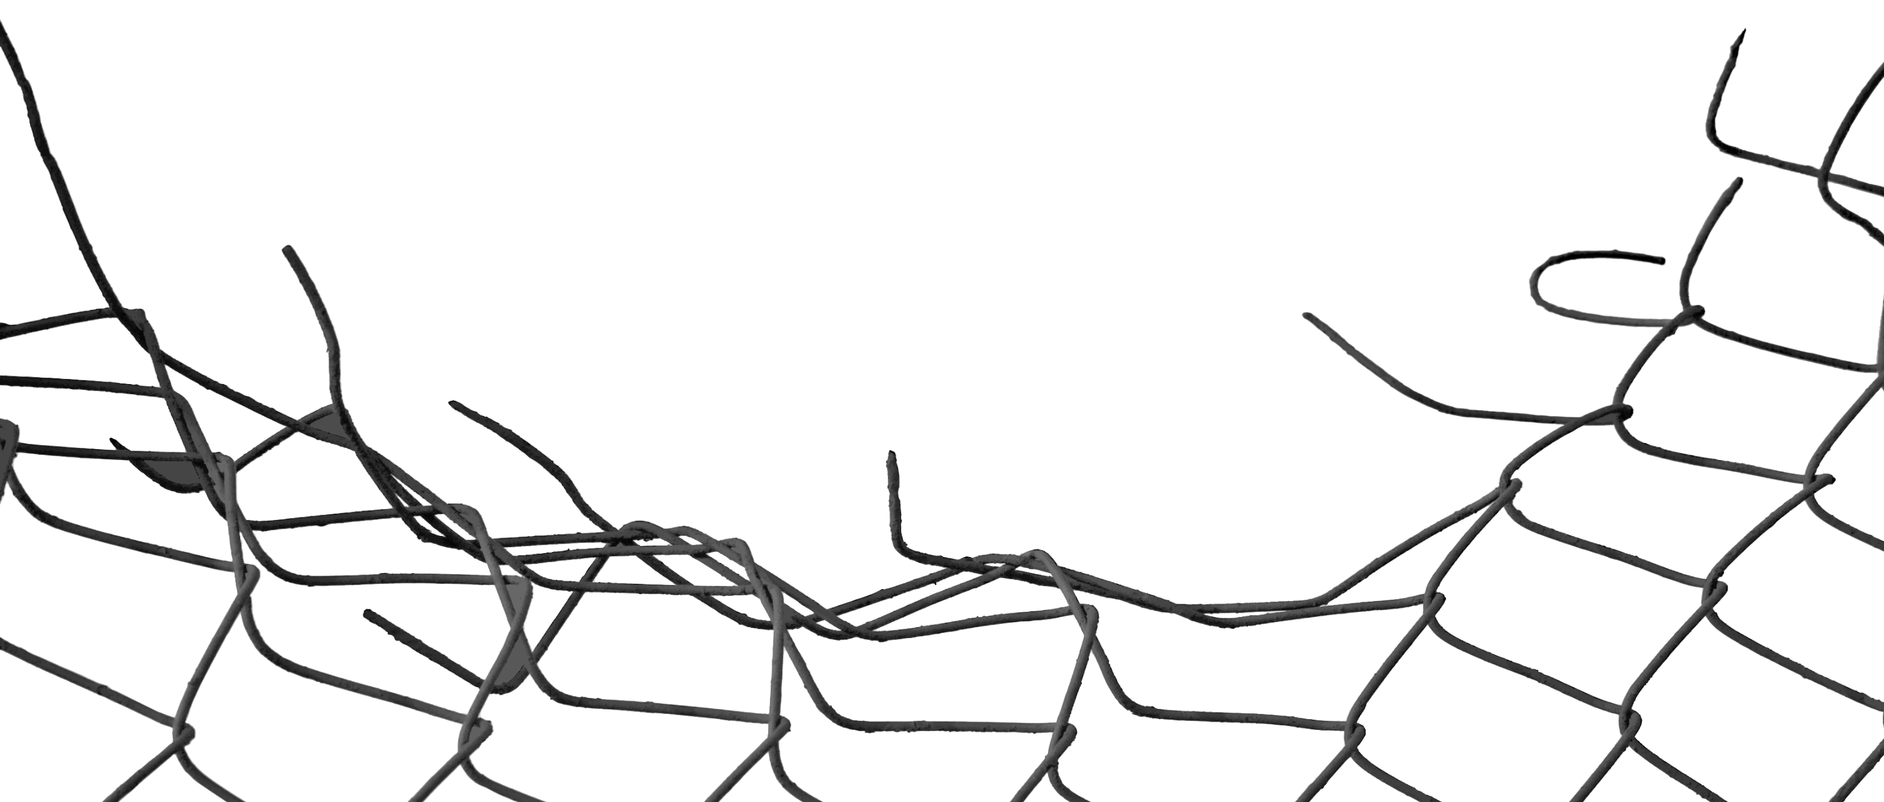

Testing the Fences
New Directions for Genetic Engineering in Food and Farming
PAT THOMAS

Slide 2
New directions
New technologies – CRISPR, TALENs or zinc finger nucleases
New & improved technologies – CRISPR prime editing
Synbio ingredients – food and plant-based cosmetics
Computer generated DNA – novel foods
Non lab-based technologies – Gene drives and RNAi sprays
Novel uses for DNA – tracers/tagging
New application in food – Gene edited farm animals/farmed fish
New applications in nature – Conservation

Slide 3
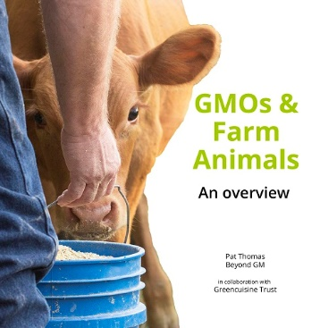
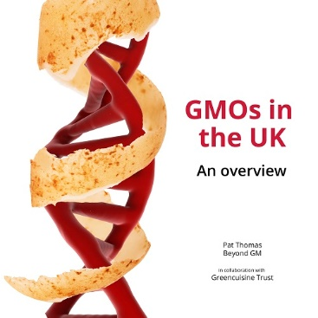

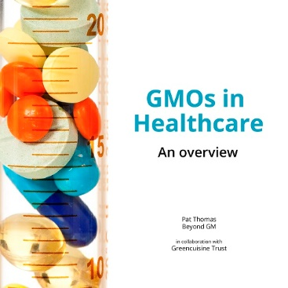


Slide 4
Why is it important?
EU elections and Brexit bring regulatory uncertainty
Strong support for deregulation from Member States & research establishment
Greater emphasis on public benefit
Climate ’chaos’ used as an excuse for promoting biotech solutions
Activist response stuck in the ‘Frankenfoods’ and ‘fuck Monsanto’ past

Slide 5
New directions
New technologies – CRISPR, TALENs or zinc finger nucleases
New & improved technologies – CRISPR prime editing
Synbio ingredients – food and plant-based cosmetics
Computer generated DNA – novel foods
Non lab-based technologies – Gene drives and RNAi sprays
Novel uses for DNA – tracers/tagging
New application in food – Gene edited farm animals/farmed fish
New applications in nature – Conservation

Slide 6



ensser.org
beyond-gm.org
iucn.org

Slide 7

In the US
Non browning white button mushrooms Arctic apples & Innate potatoes
AquAdvantage salmon
Calyno soybean oil (gene-edited) soybean
USDA deregulates new gene-editing techniques – new labelling refers to them as ‘bioengineered’
President Trump Executive Order proposes streamlining GMO regulations and a programme of outreach and education aimed at EU/UK citizens

Slide 8
Globally
Australia SDN-1 (or site-directed nuclease) techniques deregulated
Japan SDN-1 (or site-directed nuclease) techniques deregulated
Europe coalition of 14 EU Member States and EU’s Commission’s Scientific Advice Mechanism (SAM) call for the existing GMO directive to be revised.
UK – new regulations mandate a 5 year review

Slide 9
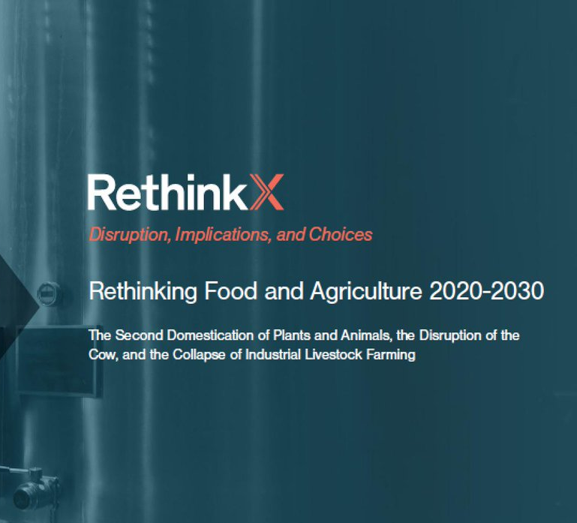
“Modern production, however, has seen and will continue to see job creation for fermentation farmers, bioengineers, protein engineers, metabolic engineers, cell biologists, computer scientists, IT workers, food scientists and designers, nutritionists, and other similar professions...”
Notes:
Rethinking Food and Agriculture 2020-2030: https://www.rethinkx.com/food-and-agriculture

Slide 10
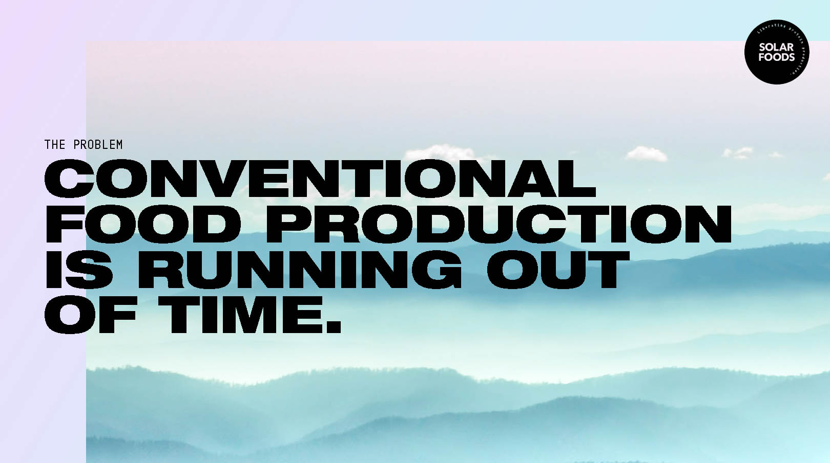


Notes:
Solar Foods: https://solarfoods.fi/ See also: https://www.forbes.com/sites/brianfrank/2019/07/17/making-protein-from-thin-air-yes-startups-are-doing-it/#71d36a1661ee

Slide 11
“Gene editing for disease resistance to improve health and productivity of crops and livestock and reduce emissions.”
Achieving Net Zero Farming’s 2 Goal
NFU Report
Notes:
Achieving Net Zero Farming’s 2040 Goa:l (https://www.nfuonline.com/nfu-online/business/regulation/achieving-net-zero-farmings-2040-goal/

Slide 12
“New technologies such as gene editing or robotics, if handled in ways that do not generate new practical or ethical difficulties, could theoretically help us to overcome some challenges. Lab produced meat, hydro/aquaponics and the use of novel ingredients from algae, fungi and insects may reduce the dependency on land to produce some of our food and other products, freeing more of it for wildlife, recreation and ecosystem services...”
Food, Farming & Countryside Commission
Our Common Ground, 2018
Notes:
Our Common Ground: https://www.thersa.org/globalassets/pdfs/reports/rsa-our-common-ground.pdf

Slide 13
“To address the environmental and health problems caused by our food system, to ensure the security of our food supply, and to maximise the benefits of the coming revolution in agricultural technology.”
UK National Food Strategy
Notes:
National Food Strategy - Call for Evidence: https://consult.defra.gov.uk/agri-food-chain-directorate/national-food-strategy-call-for-evidence/

Slide 14
On the first day of his premiership he proposed:
“Let’s liberate the UK’s extraordinary bioscience sector from anti-genetic modification rules, and let’s develop the blight-resistant crops that will feed the world.”
Two days later he promised:
“…a memorial to the sceptics and the doubters, complete with bioengineered edible paper with which they were forced to eat their words.”
UK Prime Minister, Boris Johnson
Notes:
Beyond GM video: https://www.youtube.com/watch?v=ixjcTGhB4UA

