Slide 1
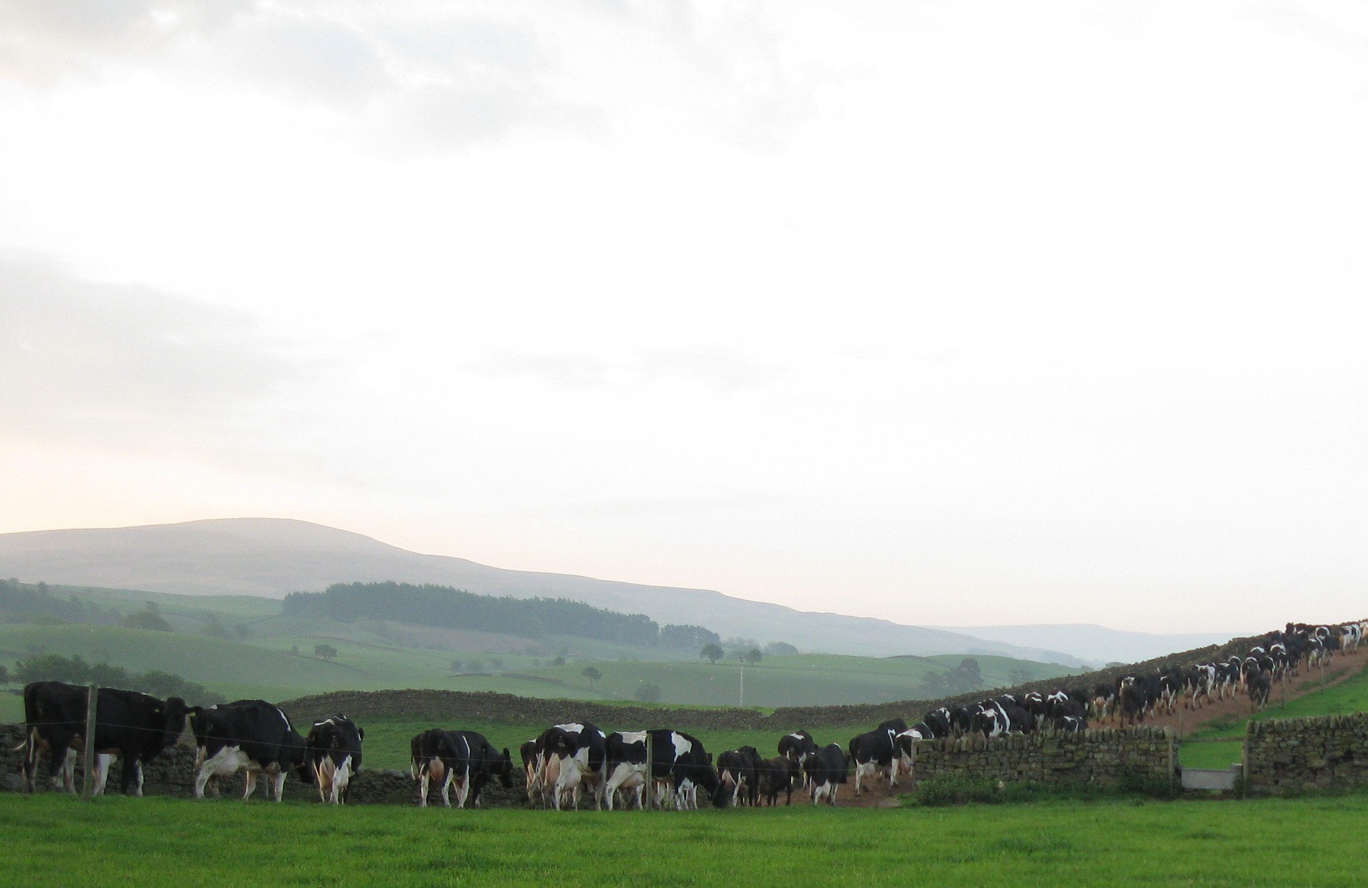
Farming Outside The Box
Milking Your Pastures
Robert Craig
Email: jackierobert@cumrew.freeserve.co.uk
Mob: 0777 6477802
Twitter: @robertcraignfu

Slide 2
30 Years Of EU Milk Quotas
1984 2013
3.27m Dairy cows 1.78m
50,625 Dairy herds 13,265
Average yield/cow 7535
Average herd size 126
15,488m Total milk production 13,680m

Slide 3
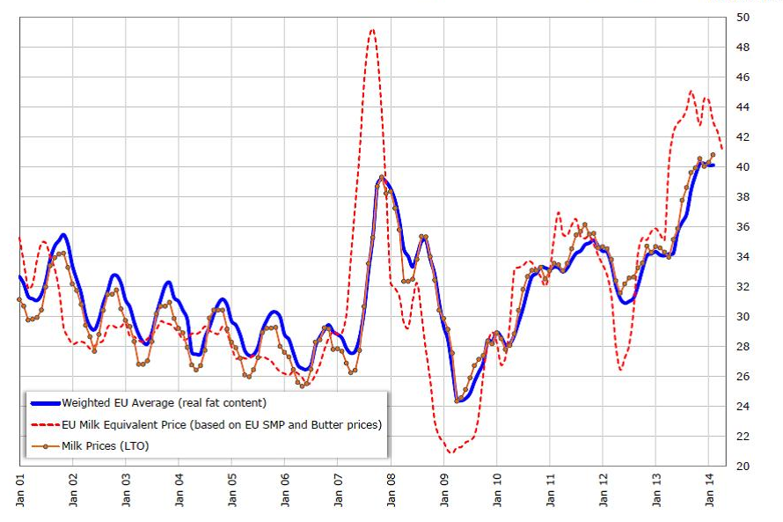
Welcome to a volatile future!
?
Jan-July 17
Jan-July 15

Slide 4
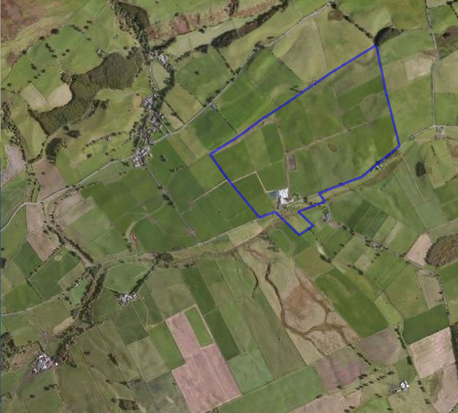

Cairnhead 1986
150 Ac/60 ha
Grass and cereals
40 cows, random calving
200,000 litres milk quota
Dairy young stock
Family labour

Slide 5
Poor work life balance with only family labour
Northern Hemisphere Holstein genetics
High silage dependency
Increasing use of purchased feed
High quota cost for expansion and yield increase
Why Challenge Convention?

Slide 6
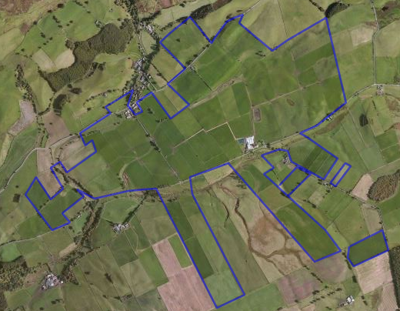
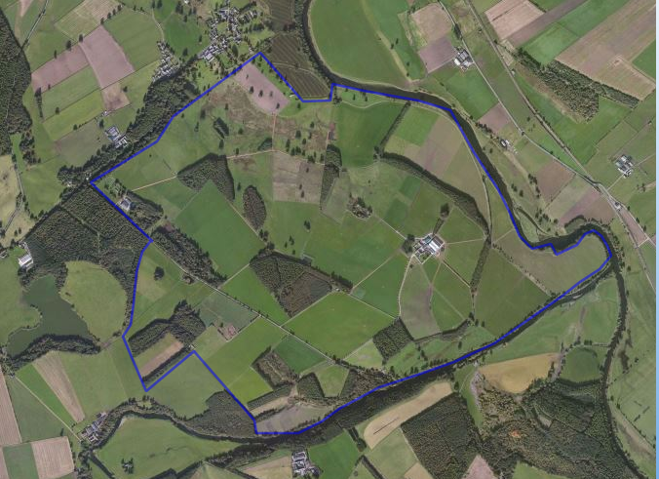
Cairnhead 180 Ha Dolphenby 270 Ha

Slide 7
How have we grown from 40 to 1000 cows?
Changed the way we farm
Focused on cost of production not yield per cow
Maximising profit per hectare
Perennial ryegrass swards producing 13+ tonnes of DM/Ha

Slide 8
The Basics
Grass growth monitoring
Rotational grazing
Block spring calving
NZ Genetics
Infrastructure

Slide 9
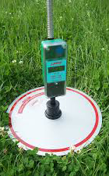
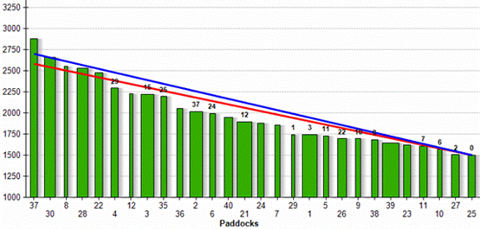
Grass Growth Monitoring

Slide 10
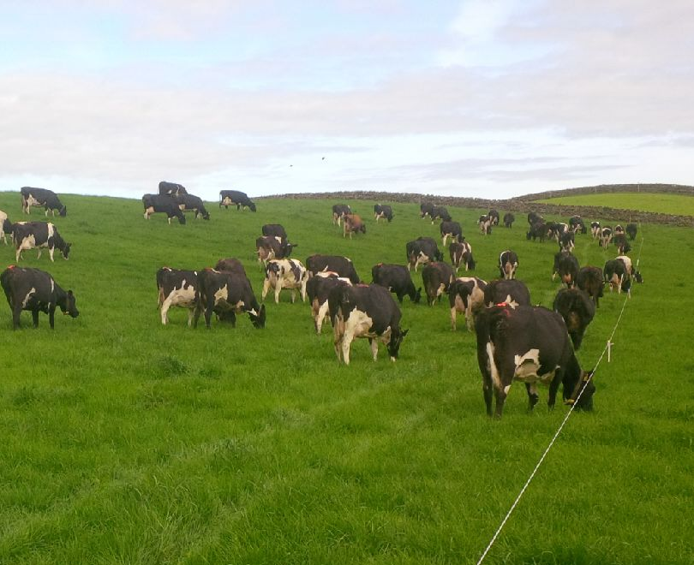
Rotational Grazing
Grazing always first not silage
Back fencing to protect re-growth
12/24/36 hour feed allocation
18-24 day grazing round

Slide 11
Block Spring Calving
12 weeks calving period Feb-March-April (70%+ in 6 wks)
4 Weeks AI with NZ semen for replacements (BW & Kiwi X)
3 Weeks AI with beef semen – Hereford
5 Weeks Hereford stock bulls

Slide 12
Genetics
Aim to breed a herd of cows that will efficiently convert grass dry matter into milk solids
Highly fertile with low non-pregnancy rates
High Breeding Worth New Zealand black and white or Kiwi cross dairy bulls

Slide 13
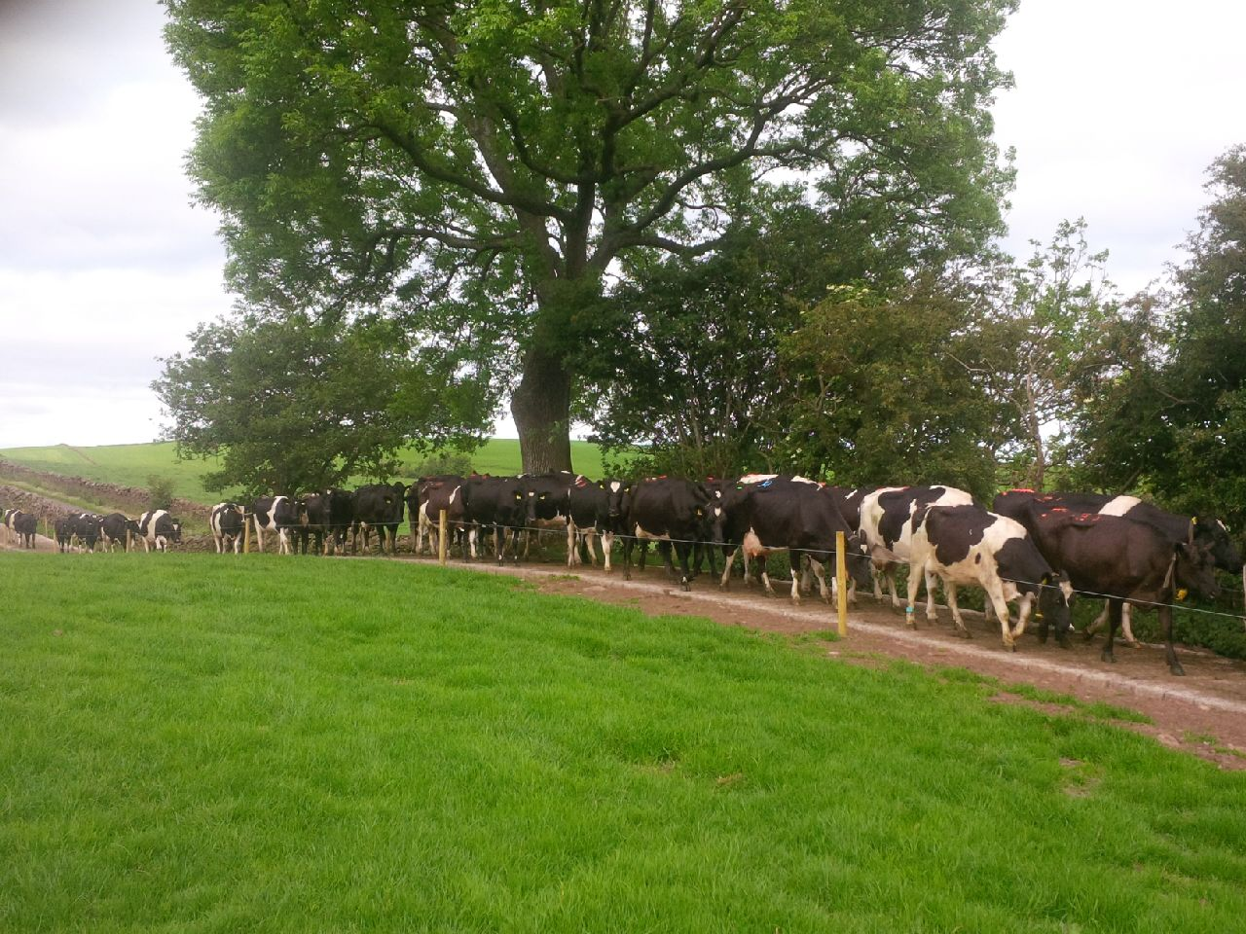
Infrastructure
Access tracks for cows
Water
Mains electric fencing

Slide 14
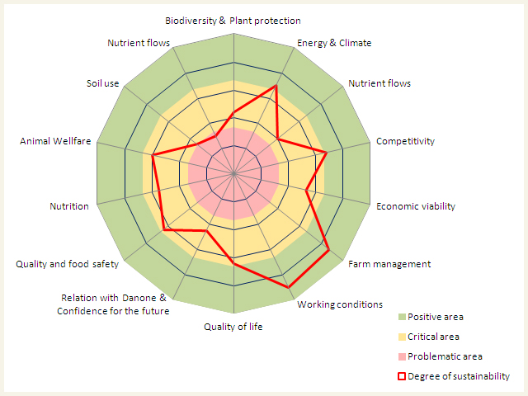

The Future

Slide 15

“True cost accounting in food and farming”

Slide 16
Thank you for listening
Email: jackierobert@cumrew.freeserve.co.uk
Mob: 0777 6477802
Twitter: @robertcraignfu

