Slide 1
Innovation and Transformation in Agricultural Systems
Mike Jones
Swedish Biodiversity Centre
IUCN Resilience Task Force
Resilience Alliance Connector

Slide 2
Introduction
A bit of resilience theory
Key attributes for resilient agricultural systems
Innovation for adaptive capacity and transformational change
Intervening in systems

Slide 3
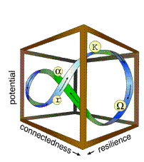
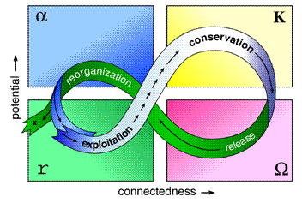
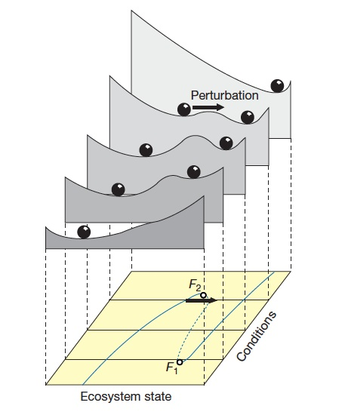
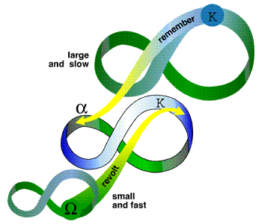
Resilience Models: Tools For Understanding System Dynamics
1. Change within systems: Adaptive Cycle (Holling 2004)
2. Interactions between systems: Panarchy (Holling 2004)
3. Transitions between system states: Ball and Basin (Scheffer et al., 2001)
Notes:
Resilience models are rule-of-thumb guides for understanding change processes in complex adaptive systems.
Adaptive Cycle. Resilience is a function of a system’s potential for change (social, ecological and financial capitals) and the internal connections that regulate the system in relation to environmental variability. Red dots represent system dysfunction: (a) a rigidity trap where a system of high potential is over-connected and unable to change when change is needed; and (b) a poverty trap where potential and connectedness are insufficient to support reorganization and growth.
Panarchy. The interactions between nested systems operating at different levels of scale (e.g., leaf, tree, forest; or farm, landscape, landregion). Small, fast changing sub-systems can create change by introducing innovation and novelty in large scale systems. Large, slow changing systems resist change from below and provide long term stability. This is a model of evolution that addresses the sustainability paradox of how things can change while remaining more or less the same.
Ball and Basin. A metaphor for the way in which a system (the ball) can move between two (or more) alternate stable states (the basins). The lip between adjacent basins represents the tipping point at which a system “flips” from one state to the other. Resilience is the ability of a system to remain within its basin in the face of disturbance.
The purpose of resilience assessment based on these models is to identify thresholds and determine a strategy for maintaining resilience, either by enhancing the adaptability of the existing system (potential and connectedness), or deliberately transforming a system so that it enters a different stable state. Transformational change requires small scale innovation, and windows of opportunity to draw on the potential of larger scale systems.

Slide 4

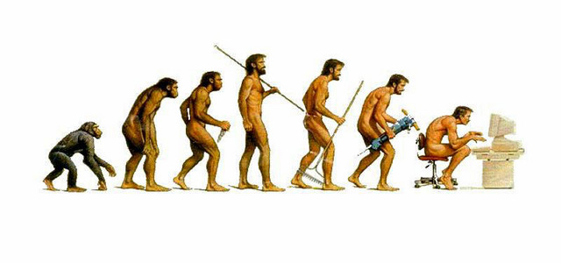
“Bounce Back” or “Bounce Forward”?
Which way do we want to go?

Slide 5
System Resilience
System Environment
Disturbance Events
Famine
Fire
Earthquake
Flood
Peak Oil
Peak P
Financial Collapse
Stabilize
Change
Focal System
Stabilize
Change
Sub-systems
The outcome of a disturbance event is determined by the resilience of the focal system (a farm or a farming landscape), and the interactions with its subsystems, and the larger environment within which it occurs.

Slide 6
Attributes of Resilient Systems
Attributes Related to Potential for Change
Diversity
Ecological variability
Social capital (trust, leadership, networks)
Innovation
Openness
System reserves
Equity
Humility
Slow variables
Attributes Related to Connectedness (Internal Regulation)
Modularity (disconnectedness)
Tight feedbacks
Overlap in governance
Ecosystem services are valued
Equity
Openness

Slide 7
Innovation For Adaptability
Selection for specialization (efficiency)
Systems become more rigid under relatively stable environmental conditions but collapse when conditions change.
Investment in innovation and periodic “creative destruction” maintains adaptive capacity.
Trade Off
Selection for generalization (adaptability)
Implication for management in a climate change world: investment in innovation and creative destruction should be a priority.

Slide 8
Innovation to Respond to Collapse
If large scale systems collapse they are unable to perform the “remember” function:
the “revolt” function prevails by default; OR
systems go into terminal decline
From (Holling 2004)
Implications for agricultural policy: avoid chaos or terminal decline by supporting local innovation, adaptive management and social learning in “sequenced devolution”

Slide 9
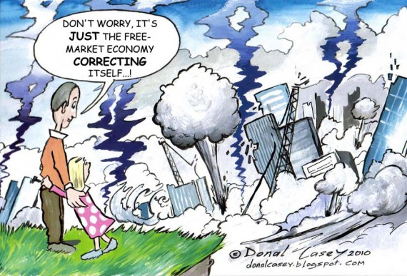
Opportunities For Transformation

Slide 10
Transformational Change (Meadows 1999)
Transcend paradigms
Paradigms: the mind-set out of which the system - its goals, structure, rules, delays, parameters – arises
Goals: The purpose of the system
Self-organization: The power to add, change, or evolve system structure
Rules: incentives, punishments, constraints
Information flows: the structure of who does and does not have access to information
Reinforcing feedback loops: the strength of the gain of driving loops
Balancing feedback loops: the strength of feedbacks relative to the impacts they are trying to correct
Delays: The length of time relative to the rates of system changes
Stock and flow structures: physical systems and their nodes of intersection
Buffers: The sizes of stabilizing stocks relative to their flows
Numbers: Constants and parameters such as subsidies, taxes and standards

