Slide 1

Access to Land - Biodynamics for Local Food and Nature Restoration: Trialling a model with Diocesan Land coordinated by
Notes:
FORMAT and Structure:
Intro: by Chair/Moderator and then 10mins per speaker (45 mins),
Discussion with all with Q&A (20 mins)
Collation of key points & Consensus Poll (show of hands) and 5-10 key conditions at the end after the discussion summarised by the chair/ moderator (20 mins)
By bringing different interests, different parties together to discuss what action can be taken we hope to increase these possibilities.
Do we need research or a feasibility study, or a pilot scheme? Or is this the one?
How can we make this work for as many as land owners and entrant farmers as possible.

Slide 2
What is needed to have a successful Agroecological or Biodynamic tenancy ? What are key components? We explore these questions in this session - The Story of trialling a model with Diocesan Land as a potential winner for all parties concerned - Carbon capture and nature restoration with agro-ecology and biodynamics - Access to land for farming sustainably ……
Notes:
Gabriel

Slide 3
Good land use - What does it take?
Looking at key-elements for nature restoration and agroecological tenancies
Hoping to build some key aspects for a Heads of terms,
Exploring:
A real-time trial of 25 acres, built on the success of conversion of land by the Apricot Centre at Huxhams Cross Farm, Dartngton
Biodynamic / agroecological farming methods return a positive carbon outcome through sequestration and energy efficient, human-scale cultivation methods.

Slide 4
Access to Land – can be difficult and costly so also can be Finding suitably skill farmers to take on land
Finding access to land for growing local food, soil health, nature-restoration, rural jobs and carbon-capture is a real challenge
While land-owners are seeking ways to reduce their properties’ carbon footprint, increase biodiversity gain and reduce risk of flooding, while maintaining choice on their land

Slide 5
The Story –… how we got here
In 2015 the Biodynamic Land Trust acquired 34 acres of Dartington Hall Trust land on a 999 year lease
the Apricot Centre team led by Marina O’Connell took it on as Land Trust tenant
It was a badly depleted bit of land and needed much care
The brief was to farm it and restore soil and nature’s biodiversity and to keep records of the changes using biodynamic methods
This good work and the subsequent 5 year report led to interest from the neighbours – Exeter Diocese
Notes:
Gabriel

Slide 6
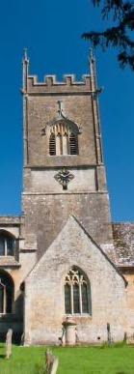

The Mission of the Church
To proclaim the Good News of the Kingdom
To teach, baptise and nurture new believers
To respond to human need by loving service
To transform unjust structures of society, to challenge violence of every kind and pursue peace and reconciliation
To strive to safeguard the integrity of creation, and sustain and renew the life of the earth.
Notes:
Mark B

Slide 7
Key drivers for the Church: General Synod
That this Synod, recognising that the global climate emergency is a crisis for God’s creation, and a fundamental injustice, and following the call of the Anglican Communion in ACC Resolutions A17.05 and A17.06;
call upon all parts of the Church of England, including parishes, BMOs [Bishop Mission Orders], education institutions, dioceses, cathedrals, and the NCIs [National Church Institutions], to work to achieve year-on-year reductions in emissions and urgently examine what would be required to reach net zero emissions by 2030 in order that a plan of action can be drawn up to achieve that target;
request reports on progress from the Environment Working Group and the NCI’s every three years beginning in 2022 and;
call on each Diocesan Synod, and cathedral Chapter, to address progress toward net zero emissions every three years.

Slide 8
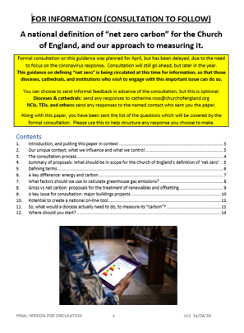
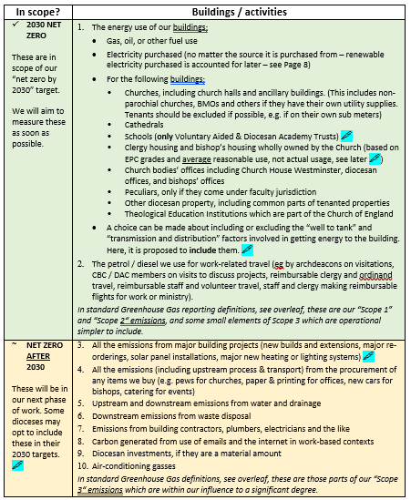
Guidance has been issued defining the scope of Net Zero

Slide 9
What the guidance says about land:
‘It is therefore suggested that land should be included within environmental policies by Church organisations so that where decisions present themselves, such as with a change of tenant or sale/purchase of land, climate and biodiversity (and wider environmental gains such as flood prevention, soil improvement, temperature moderation, air quality improvements) are considered as part of the process. It is not reasonable though to include this land in the net zero target for 2030 because the Church organisations do not have the ability to directly change the management of it.’

Slide 10
The Story – the land agent’s role to facilitate
Willing and open land owner with a broadly messaged objective – creating the conditions and desire to engage, specific site is in very poor condition. Agents and clients keen to make something happen
Expression of interest and proposal received from viable entity – this is vital
Develop concept proposal with landowner to fit objective, review and engage with proposer, push and pull – hard to start from neutral
Develop ‘heads of terms’ (HOTs), series of in-person engagements
Notes:
JEREMY

Slide 11
The Story – concept to delivery
HOT’s focused on trying to align/clearly setting out objectives of parties;
Market rent
Verifiable/measurable GHG sequestration and biodiversity improvements and how benefits are apportioned
Resolve localised flooding issue
Security of use
Freedom to undertake variety of operations and engage other parties in them
Land use design, short and longer term use areas
Shared learning, help for new users introduced by landowner, provision of data
FBT ultimately used, a variety of other arrangements could suit

Slide 12
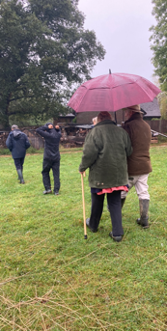
The Story – making things happen - steps
Collaborative design process, do the work to flesh out the HOT’s and understand each parties position
Each party have clear governance structures; vital. This needs to be done first (at proposal stage)
Memorandum of understanding (MoU) useful – set out intentions if very hard to codify
Good and functioning is ok
An evolving process and be prepared to amend legal framework

Slide 13
Ideas on land for communities and good tenancies in this context (Land Agent perspective – pros and cons – challenges)
Certain external schemes (stewardship, BPS) push towards use of FBT when more flexibility may be preferable
Need to balance certain objectives that create tension – alternative development, flexibility for future use and longer term land use requirements (tree planting for example) – memo of understanding and land use design critical to reduce tension
Case study use – how to share learning, create model for use
Think bigger than 20 acres, not perfect here, much scope, scalability is key
Concerns; status quo bias, resource - time and finance and relative skill levels
Notes:
Jeremy’s last

Slide 14
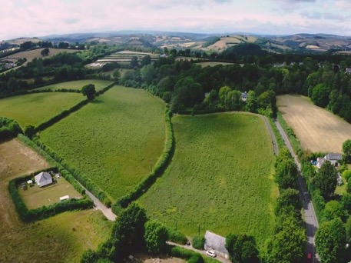
Case Study – what it takes to restore land
Notes:
MARINA

Slide 15
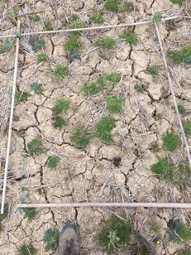
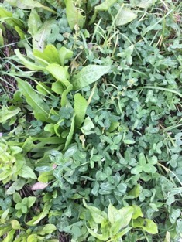
Case Study – what it takes to restore land

Slide 16
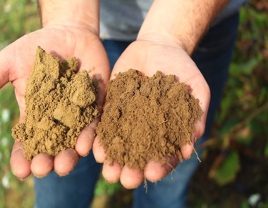
Increases in Soil Carbon
Year One 2021-2022
0.3-0.4% increase in soil carbon

Slide 17
The challenges = pros and cons in this experience
5 year Tenancy
We give 50% of our carbon to the Diocese Of Exeter
We offer 3 x visits to other DOE tenants per year
No tree or perennial planting
Decreases the potential for Carbon sequestration
Decreases the potential for biodiversity lift
Could be more collaborative – in the field together once a year, or at start and after 5 years?
Notes:
Marina

Slide 18
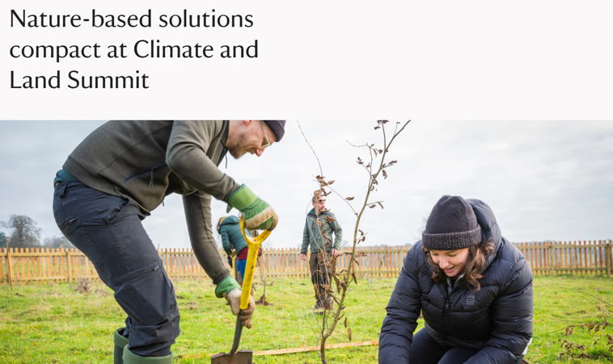
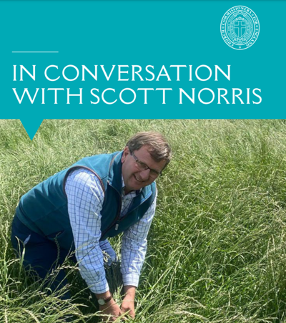
Mission, Community and Influencing
Notes:
MARK

Slide 19
Developing our countryside for food and people
Agri villages: these are planned developments which include housing, land to grow the food for that settlement, work units and retail and social spaces, as a sustainable living space for people.
Horticultural belts: have protected status and agricultural ties, these can be re-instated.
More Rural jobs - More food production (at a sub-industrial level) = more rural jobs and opportunities and also more connection to food.
CSAs and community - a way to connect people to food and farming and having a viable affordable organisation/employment situation
Notes:
Gabriel
Access to land for food and farming – There is land and there are possibilities – but they do not always come together – sometimes the conditions seem impossible to meet as an entrant … talk to us
Agri villages: local food for local people, work spaces and sustainable housing – these are planned developments which include housing, land to grow the food for that settlement, work units and social spaces, as a sustainable living space for people.
Horticultural belts: are designated areas around a village, town or city which the planners reserve for vegetable and fruit growing. You can work with local planners and Council to re-instate such areas. They then have protected status and agricultural ties. Which makes it easier to buy or rent for vegetable and fruit production

Slide 20
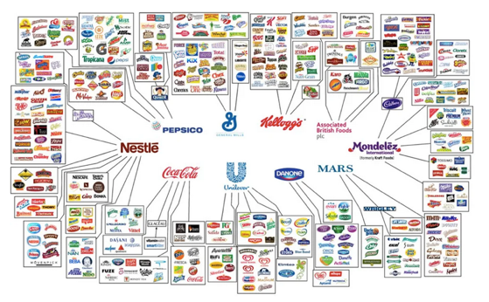
Food sovereignty and UK Food Security - how difficult can it be?
Now only 10 companies own / control our all food sales and distribution systems worldwide.
In Victorian times most towns and
cities had Horticultural Belts
designed to feed the urban population
and there were regular markets in the
towns for fresh food where the farmers and
growers could sell their produce. Currently we import about 50% of our food and buy (mostly) from supermarkets. Local direct sales are pretty much the only way to circumvent the multi-nationals’ systems.
We can change this!
Notes:
GABRIEL

Slide 21
Access to Land – finding what you need
Access to land for food and farming – There is land and there are possibilities – but they do not always come together – sometimes the conditions seem impossible to meet as an entrant … Are you seeking a tenancy
Who do you want to feed? - will you be enhancing the land you take on?
Can you bring a team of growers/farmers together?
5 acres, 10 hectares or a farm?
Is a CSA model going to work for you?
Will you be crowd-funding for start up capital?
What will you offer the land owner? What can you put into a Heads of Terms?
Notes:
Gabriel

Slide 22
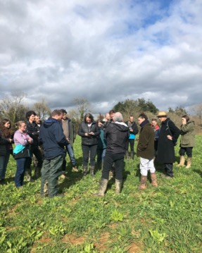
Questions to the panel & - Discussion How can we make this work? - - - Audience views and experiences? - How do we bring different needs and interests together? - Do we need a research team? - What are your Key imperatives? Let’s list what is needed ……
Thank you for joining our session
Notes:
Gabriel

Slide 23
Contact Information
mark.betson@churchofengland.org
jeremy@dixonsmith.uk
gabriel@biodynamiclandtrust.org.uk
info@apricotcentre.co.uk (Marina O’Connell)
philip@theflowpartnership.org

