Slide 1
Biodynamics, and why it matters
“We aren’t seeing the farm as a living system, but as a living organism, and ultimately as a living individuality” – Biodynamic Farmer

Slide 2
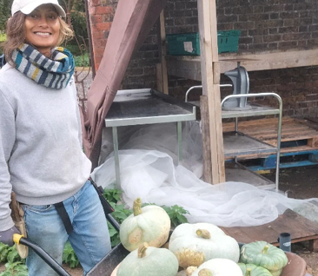
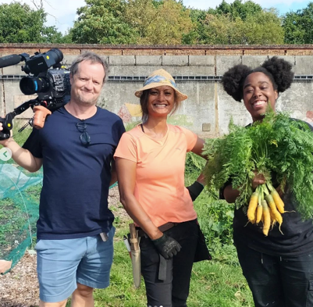
Who Am I?
Instagram: growingsmart.perma
Completing second year of biodynamic diploma with the Biodynamic Agricultura College
Head of Estate at Birch Hotel in Hertfordshire
7 years working in permaculture and biodynamic agriculture in Asia & Europe.

Slide 3
Organic Farming
Biodynamic Farming
Regenerative Farming
Permaculture

Slide 4
Biodynamics
Who was the founder?
When?

Slide 5
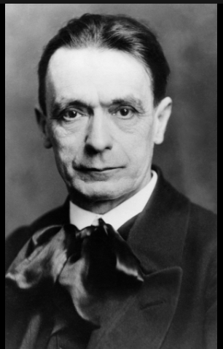
Rudolph Steiner, Austrian
27 or 25 February 1861
to
30 March 1925
What was happening around this time?

Slide 6
(1) Rudolf Steiner only reluctantly agreed to give the famous series of lectures that biodynamics is based on
Biodynamics is based on a series of eight lectures given over 10 days in June 1924 in Koberwitz, Silesia (now Kobierzyce, Poland).
(2) 111 people attended these lectures
The Experimental Circle of Anthroposophical Farmers.
Notes:
Steiner was a busy man, much in demand. He was also in poor health at this time – this was to be the last year of his life – but was persuaded to come to Silesia by Count Carl Keyserlingk, who managed 18 farms in the area and wanted some input from the famous Austrian.
30 female and 81 male. They came from six countries: Germany (61); Poland (30); Austria (9); Switzerland (7); France (2); and Sweden (2). Thirty-eight were agricultural people and 20 of these were farmers. Nine priests attended! One outcome from the course was the founding of

Slide 7
(3) These lectures weren’t meant to be a practical guide for farming; The lectures were confidential.
Attendees had to sign an NDA!
Notes:
Between 1924 and 1938 Steiner’s ideas were tested only by Anthroposophists.
Steiner said test the ideas and then publish what works.’ The term ‘biodynamics’ was also developed during this period.

Slide 8
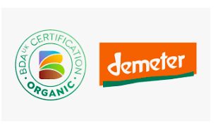
Founded in 1928 - Demeter - the world’s first ecological food and farming trademark.
Notes:
Named after the Greek goddess of the harvest, the orange Demeter label is the international logo used for certified biodynamic products. Founded in 1928, Demeter is the world’s first ecological food and farming trademark. Used in over 60 countries, Demeter certification verifies that biodynamic products meet international standards in the production and processing of sustainable food. Regulated in the UK by the Biodynamic Agriculture Association (BDA), Demeter’s biodynamic standards build on EU organic standards.

Slide 9
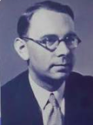
(4) It was Pfeiffer who introduced biodynamics to the world
Bio-Dynamic Farming and Gardening, published in 1938
Notes:
While Steiner is well known as the instigator of biodynamic farming, Dr Ehrenfried Pfeiffer doesn’t get the credit he deserves. After the Steiner lectures there was a gestation period of 14 years while his experimental circle worked on the details.
Biodynamics was released to the world in Pfeiffer’s book. Pfeiffer moved to the USA in the 1940s, and carried on his work there.
Pfeiffer alone took BD public.

Slide 10
(5) Biodynamics prompted the organic movement
Lord Northbourne - Look to the Land – 1940
Eve Balfour - The Living Soil – 1943
Soil Association - 1946.
Notes:
Pfeiffer’s work was noticed by Lord Northbourne in the UK. A landholder with a keen interest in farming, Northbourne had been alarmed by the impact of modern agriculture on the environment. He invited Pfeiffer over to take part in a Summer School and Conference on Bio-Dynamic Farming, held at Northbourne’s property in July 1939.
A year later, Northbourne published his book, Look to the Land, which introduced the term ‘organic’ farming to the world.
Effectively, this work secularized biodynamic farming, taking out some of the more esoteric elements.
In 1943, Eve Balfour, who quoted Northbourne extensively, published The Living Soil, which led to the founding of the Soil Association in 1946.

Slide 11
Biodynamic Farming
Organic Farming
Permaculture
Regenerative Farming

Slide 12
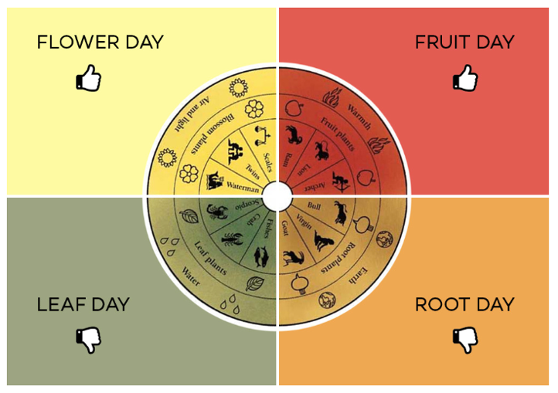
Unique to Biodynamics
Planting by the moon, stars and planets:
Includes constellations and planetary alignments.
Biodynamic calendar, now in its 57th year
Notes:
Whilst traditional farming has long used lunar almanacs, the biodynamic calendar also includes constellations and planetary alignments. Inspired by Steiner, the biodynamic calendar, now in its 57th year, was developed by German farmer, Maria Thun (1922 – 2012) who experimented with planetary effects on planting, sowing and harvesting. Now produced by her son, Matthias Thun, the biodynamic calendar can be adapted for particular hemispheres. Although it is not mandatory for Demeter certification, the biodynamic calendar is used by farmers and gardeners.

Slide 13
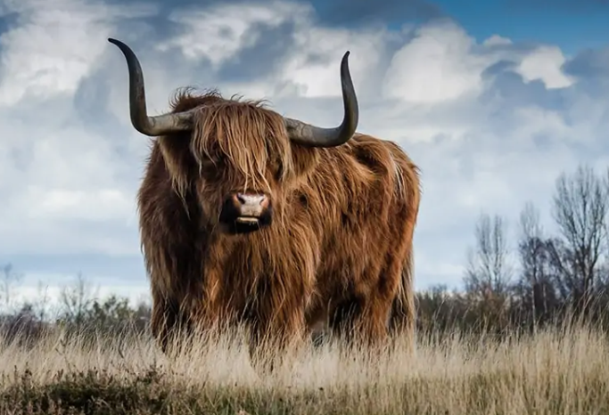
Biodynamic Animals
Horned
Specific numbers & types/hectare
12 cows, 4 horses, 6 pigs, 10 sheep and 120 hens for 60 hectares (150 acres) – Karl Osthaus
Rare breeds
Openess to Homeopathic remedies
Natural food

Slide 14
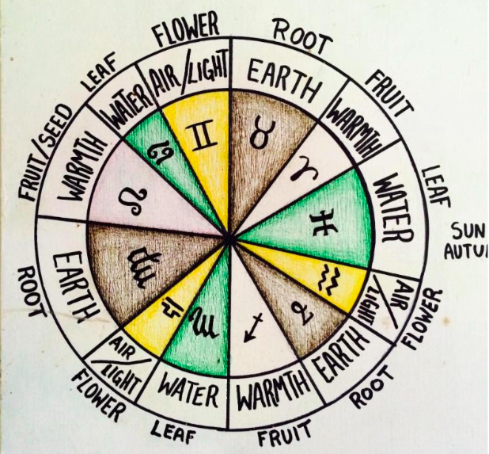
How does the biodynamic calendar work?
the moon moves through all twelve constellations
the twelve zodiac constellations have been associated with the each of the four elements: earth, water, air, and fire
Each element is related to a part of the plant: thus, Earth – root; water – leaf; air – flower; fire – fruit.
Notes:
Each month the moon moves through all twelve constellations of the zodiac in turn. This is referred to as the moon’s sidereal cycle and forms the basis of the biodynamic calendar. Although the waxing and waning (synodic) cycle is the most well known lunar rhythm, it plays a small part in this calendar.
Since ancient times the twelve zodiac constellations have been associated with the each of the four elements: earth, water, air, and fire. Three constellations are connected to each element.
Each element is related to a part of the plant: thus, Earth – root; water – leaf; air – flower; fire – fruit.
For example, for sowing or harvesting carrots an earth – root day should be chosen; for lettuce – a water – leaf day; for beans and apples – a fire – fruit day; and for cut flowers and broccoli – an air – flower day.
The influences have most effect when the soil is disturbed and /or when the biodynamic preparations have been used. Choosing suitable times for cultivation, as well as for sowing and harvesting, is therefore important.

Slide 15
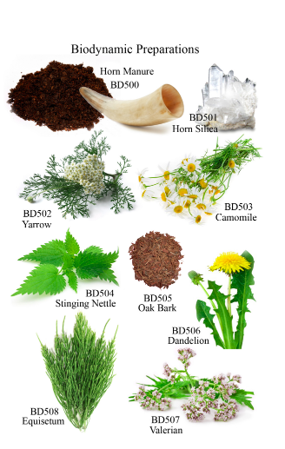
Soil & Plant Preparations
Compost preparations
Soil & Plant Preparation

Slide 16
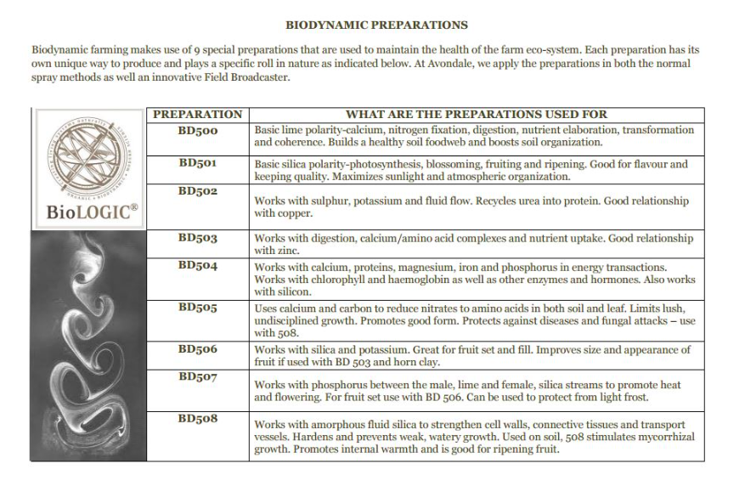

Slide 17
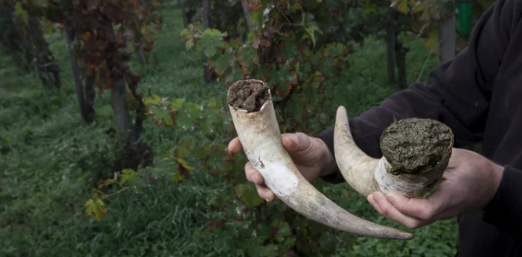
How is BD500 made?
The preparation involves packing cow manure (preferably from a lactating cow) into cow horns; which are buried in Autumn on a Root day with a descending moon, and then lifted in Spring, also on a Root day.

Slide 18
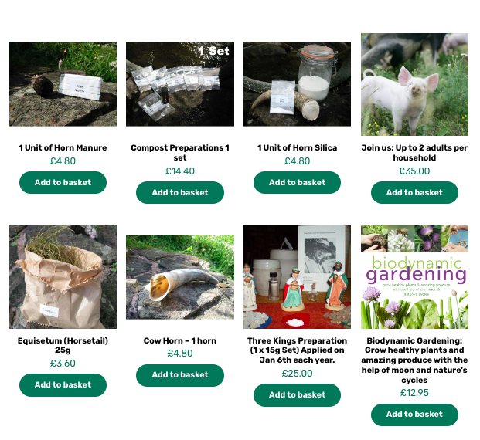
Hacking Biodynamics
https://www.biodynamicsolutions.org/
https://www.biodynamic.org.uk/shop/

Slide 19
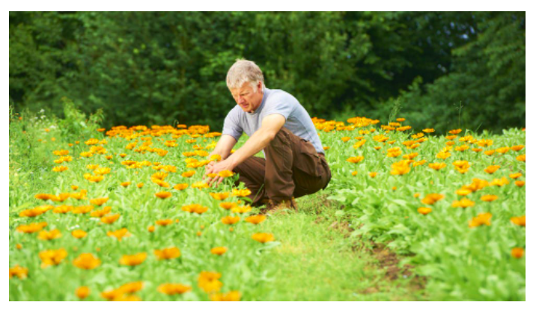
Weleda - Derbyshire

Slide 20
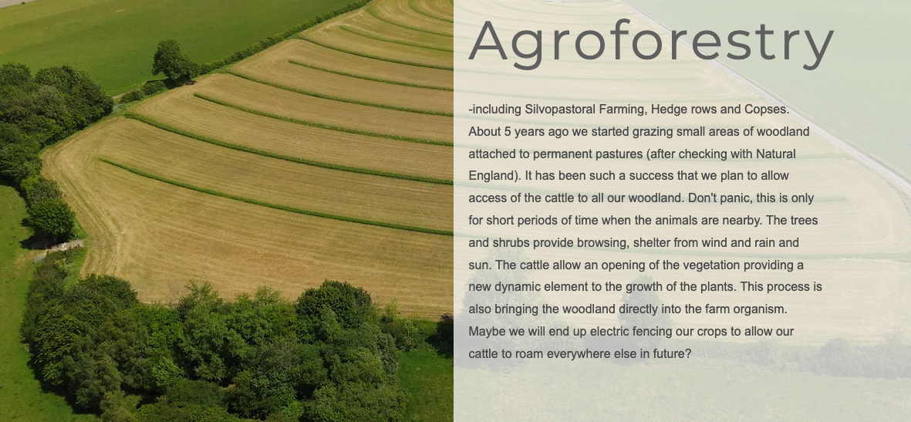
Yatesbury Farm - Avebury

Slide 21
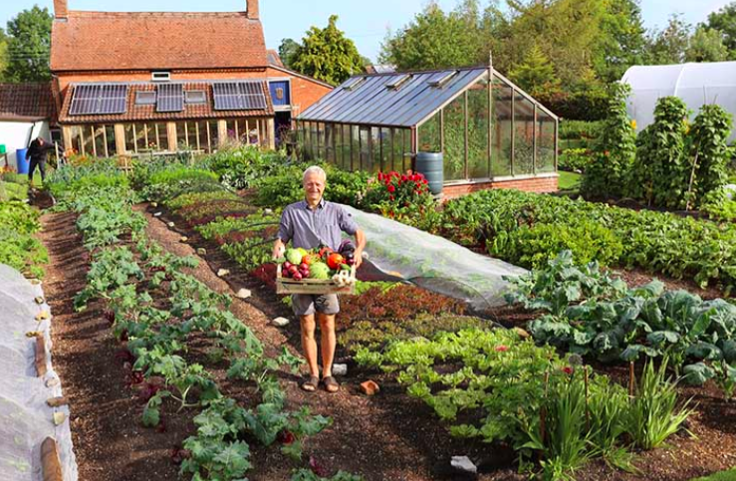
Charles Dowding - Somerset

Slide 22
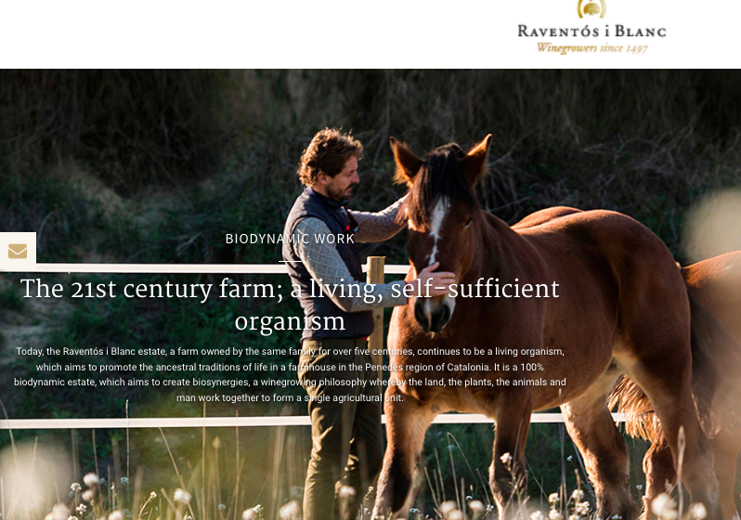
Viticulture
Wine Making

Slide 23
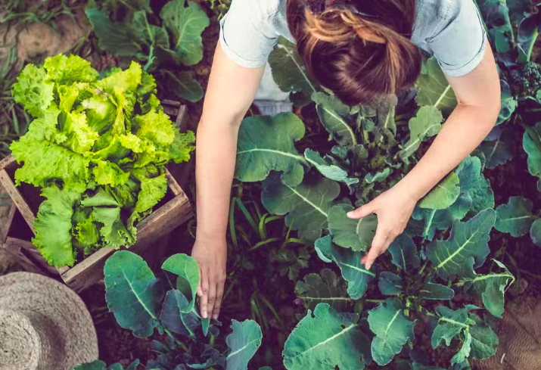
Food Sovereignty & Resilience
Eat & grow locally, Closed Loop Systems, Integrated Systems, Soil Health,Celebrate seasons
Rudolf Steiner developed Anthroposophy (‘anthropo’ meaning human, and ‘sophia’ meaning wisdom), a philosophy based on the premise that:
all beings can develop their inner potential and access a spiritual world

Slide 24
Next Generation Farmers
Biodynamics, and why it matters.

Slide 25
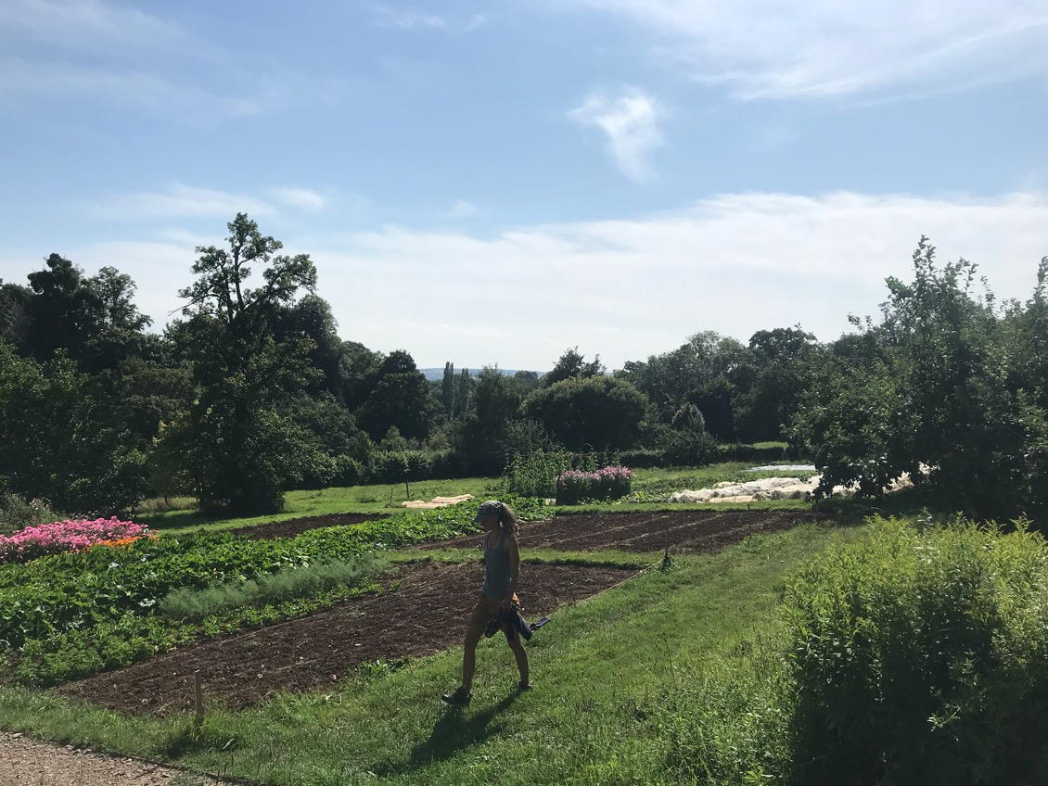
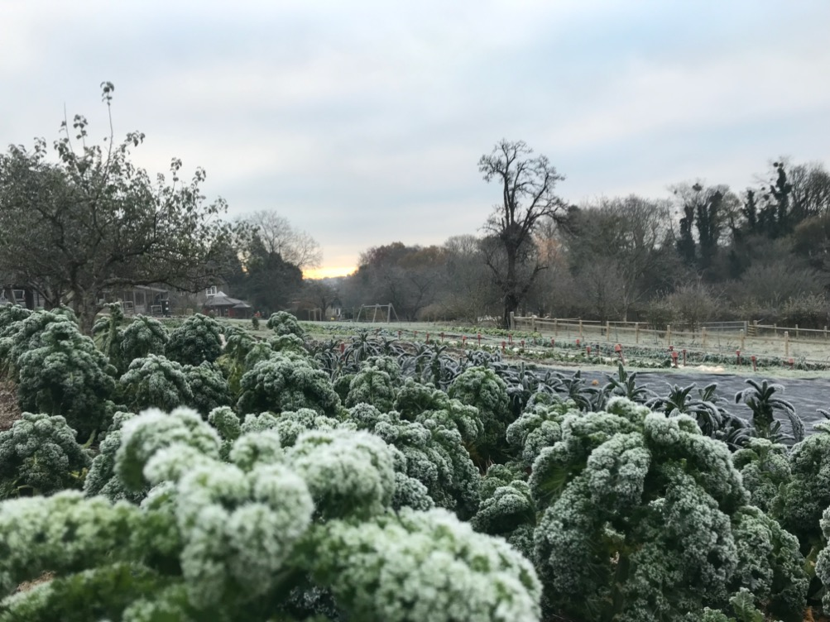
Barney Spooner
barneyspooner97@gmail.com
shahara.khaleque@gmail.com

Slide 26
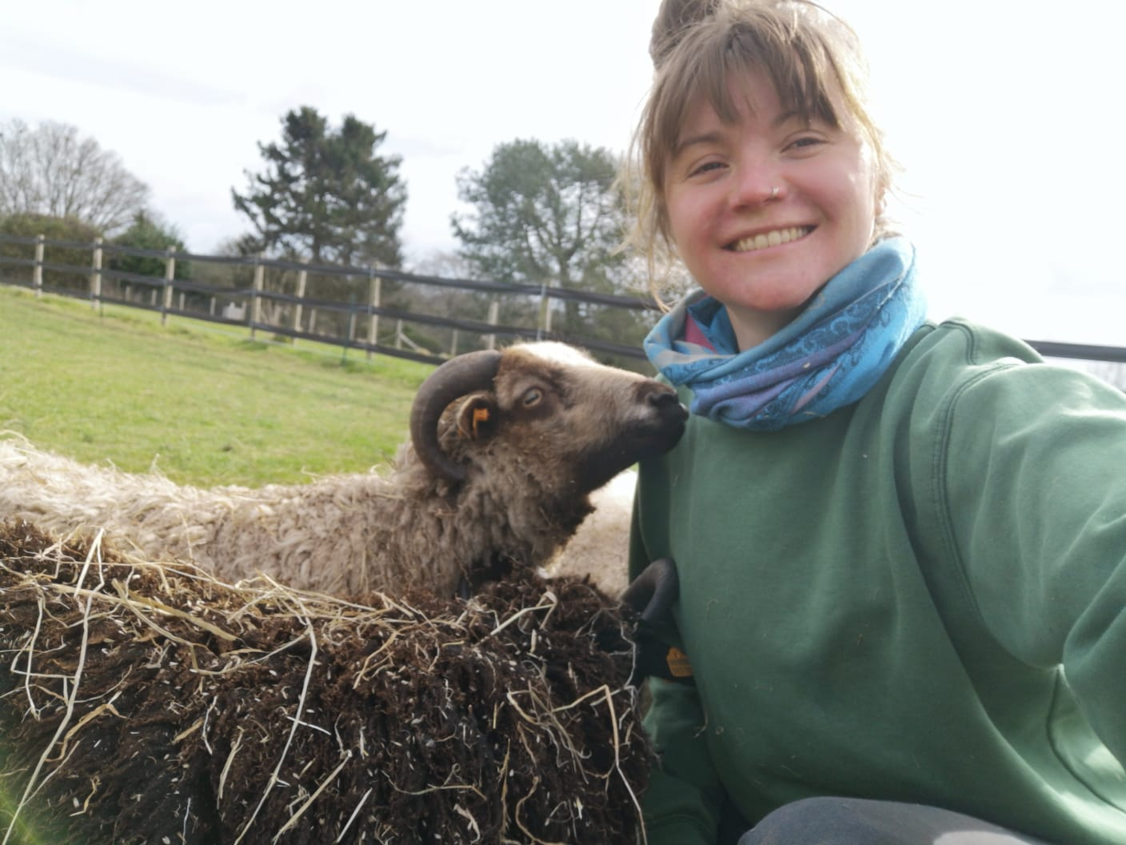
Sophie Clayton
sophie.clayton07@gmail.com

Slide 27
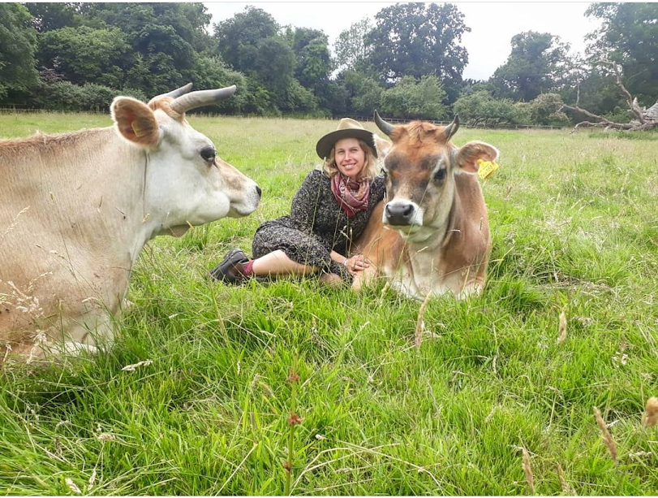
Keziah Suskin
keziahsuskin@gmail.com
Instagram: @becoming_a_farmer

Slide 28
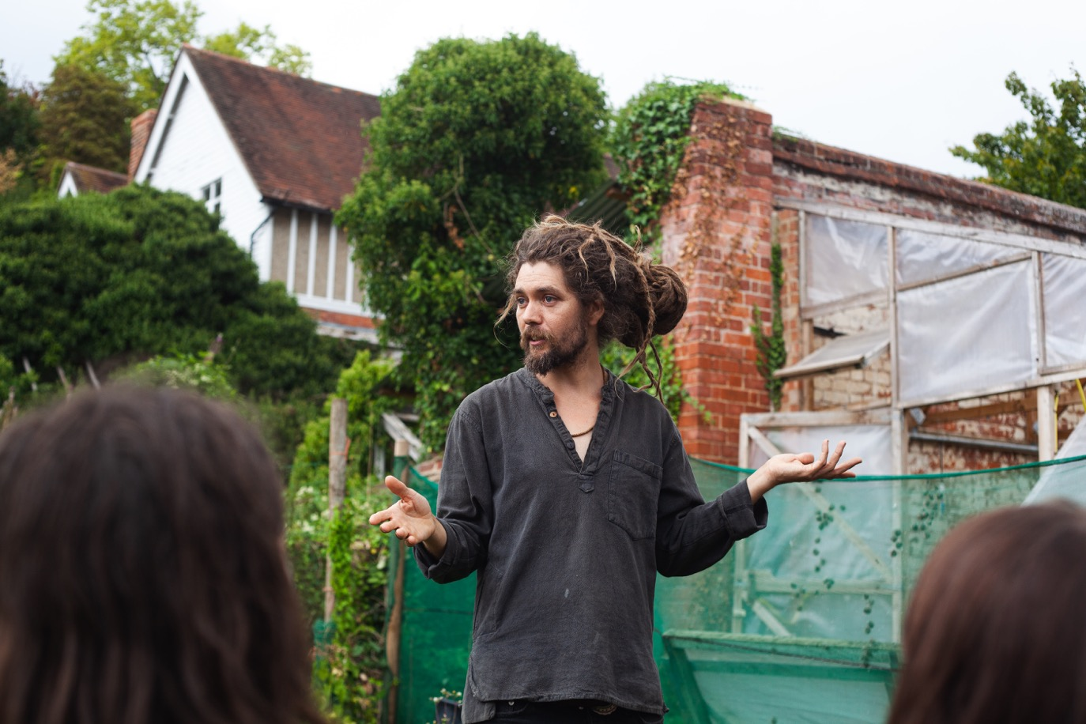
Sparrow Middleton
sparrowsqueezebox@gmail.com

Slide 29
Q&A
Contacts
Biodynamic Agricultural College: kailogo@gmail.com
Biodynamic Association: gkaye@biodynamic.org.uk
Shahara Khaleque: shahara.khaleque@gmail.com
Barney Spooner: barneyspooner97@gmail.com
Sophie Clayton: sophie.clayton07@gmail.com
Keziah Suskin: keziahsuskin@gmail.com
Sparrow Middleton: sparrowsqueezebox@gmail.com

