Slide 1
Trees on your farm, 1850:
Exploring old maps to take stock
and plan for the future
Dr. Ewan McHenry

Slide 2
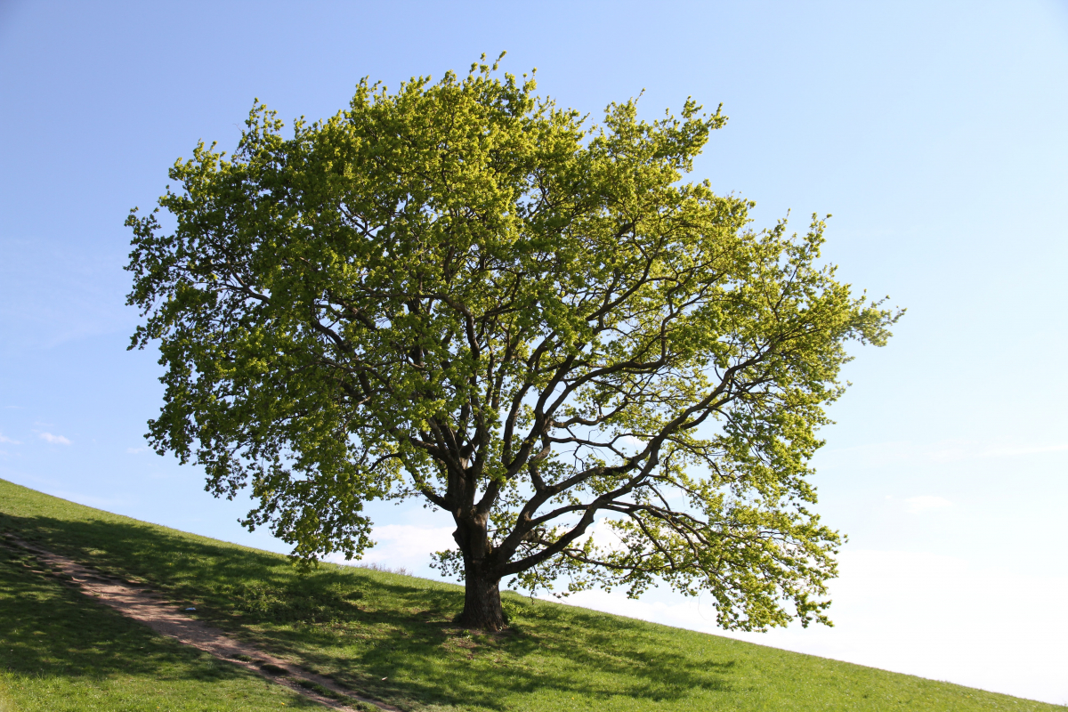
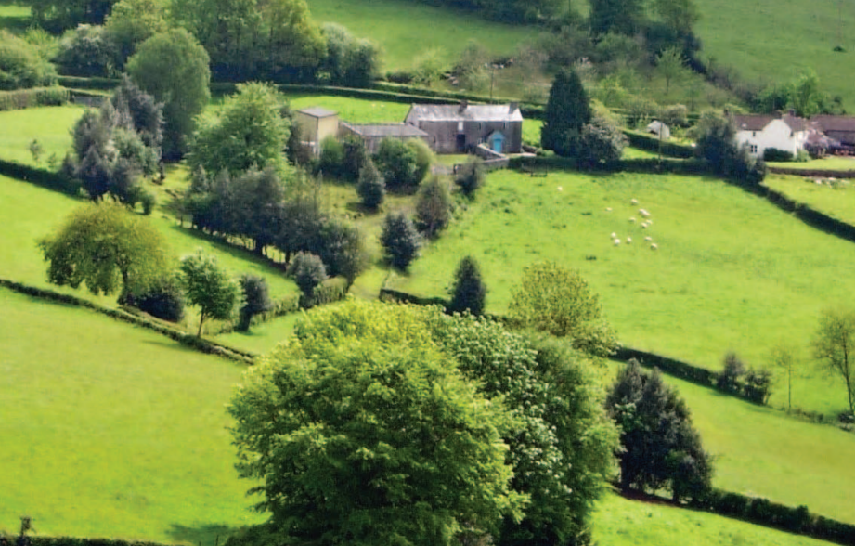
Trees outside woods
Woodland:
>20% canopy cover
> 0.5 ha (1.2 acres)
Trees… that aren’t in woodland
Lone field trees
Hedgerow trees
Groups of trees & small woods

Slide 3
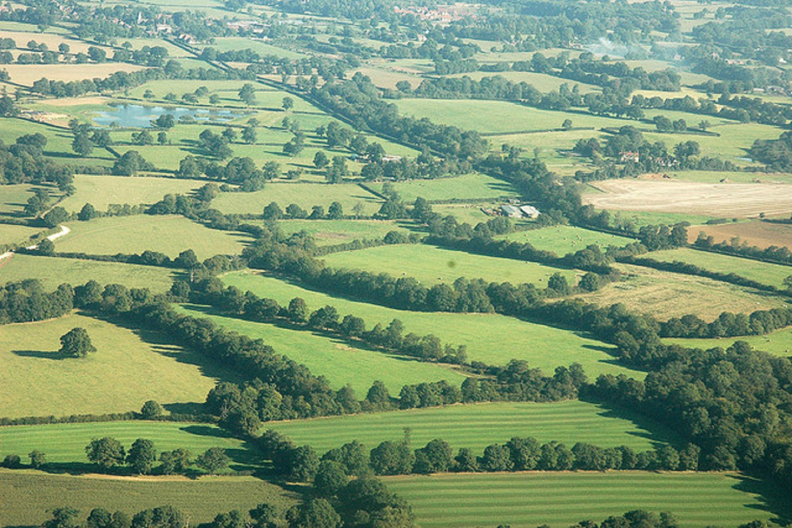
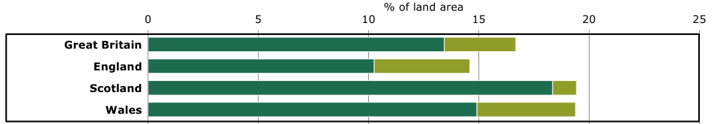
Trees outside woods: a significant resource
3% of GB land area
19% of all GB tree canopy
94% broadleaf
Woodland
Trees outside Woodland

Slide 4
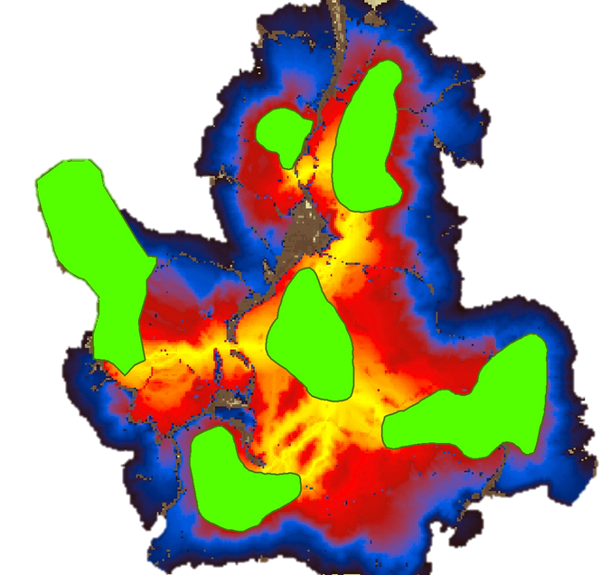
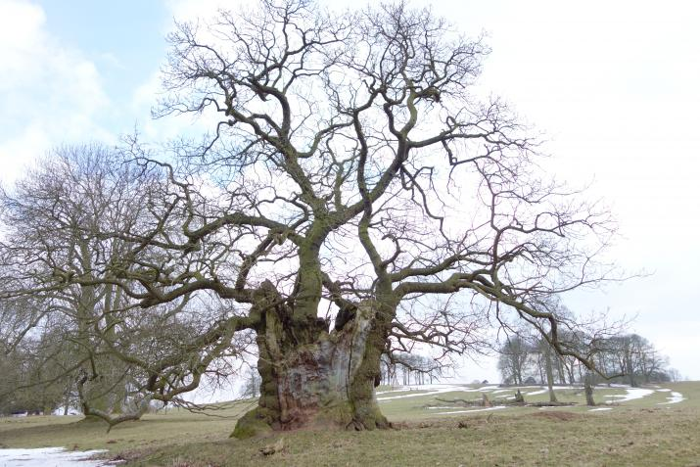
Wildlife value
Can grow to an old age
Complex habitat
Genetic resource
Helps species move between habitat
Climate change response

Slide 5
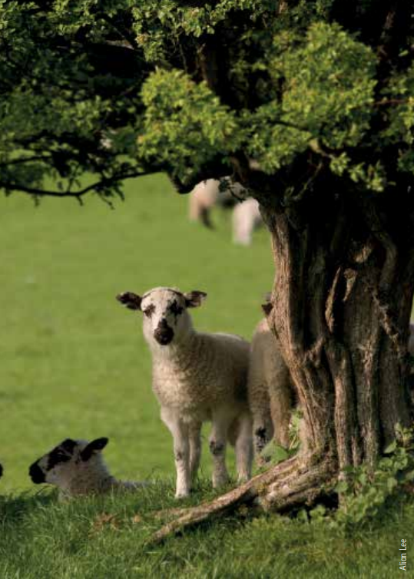
Value to people
Carbon
Crop/livestock shelter
Hosting pollinators/enemies of pests
Soil stability
Pollutant filtration
Landscape character
Etc…

Slide 6
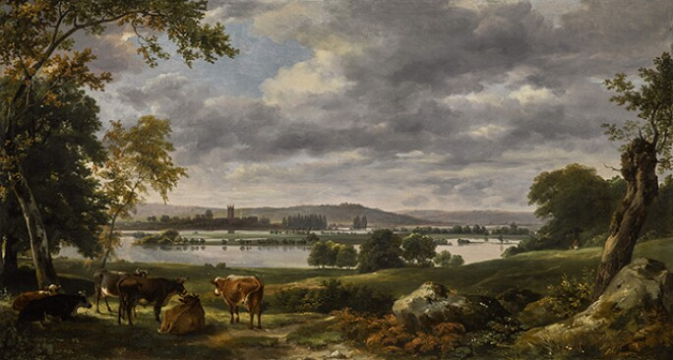

Slide 7
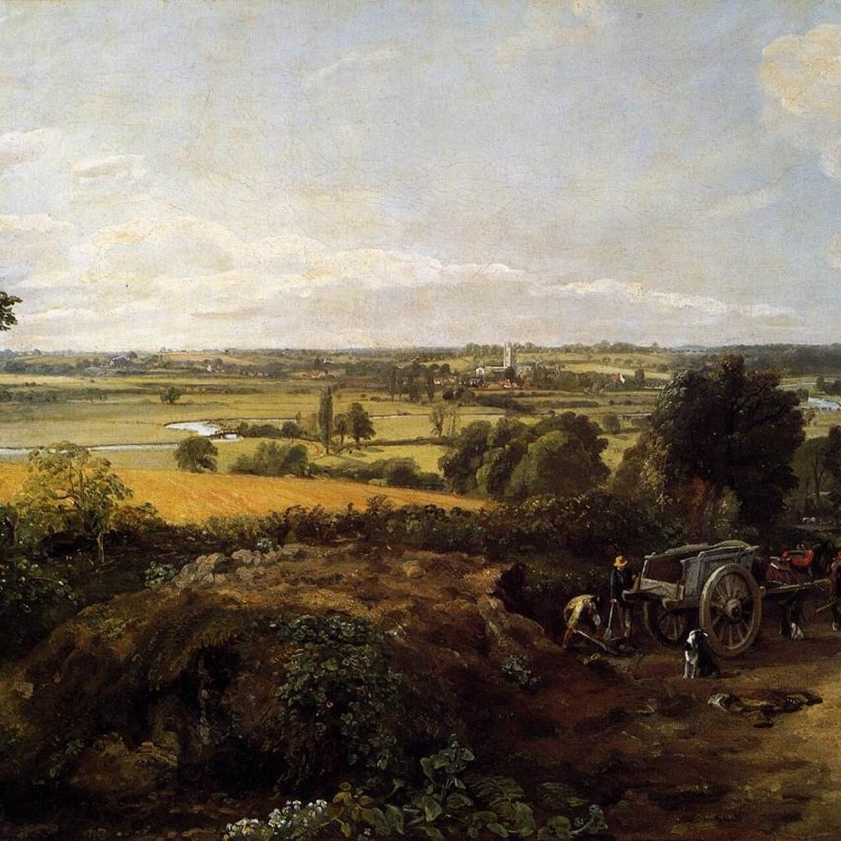

Slide 8
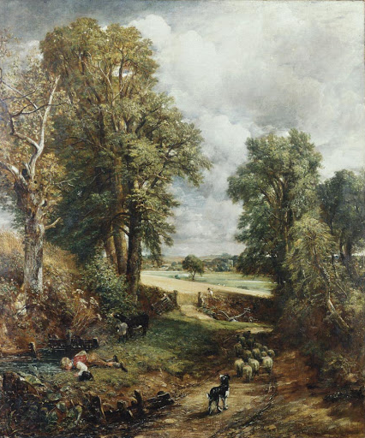

Slide 9
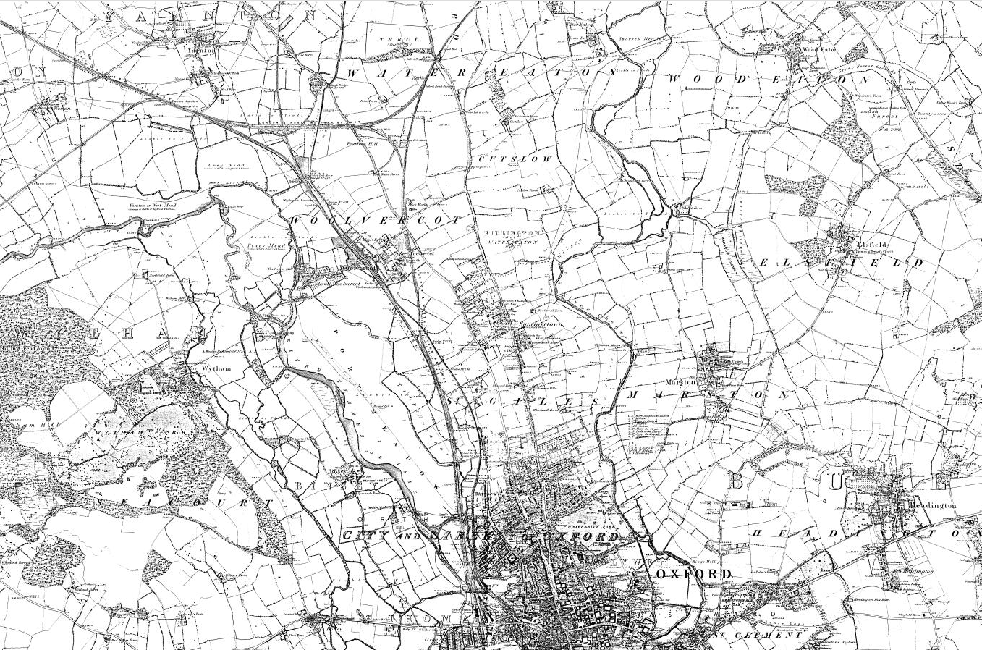

Slide 10
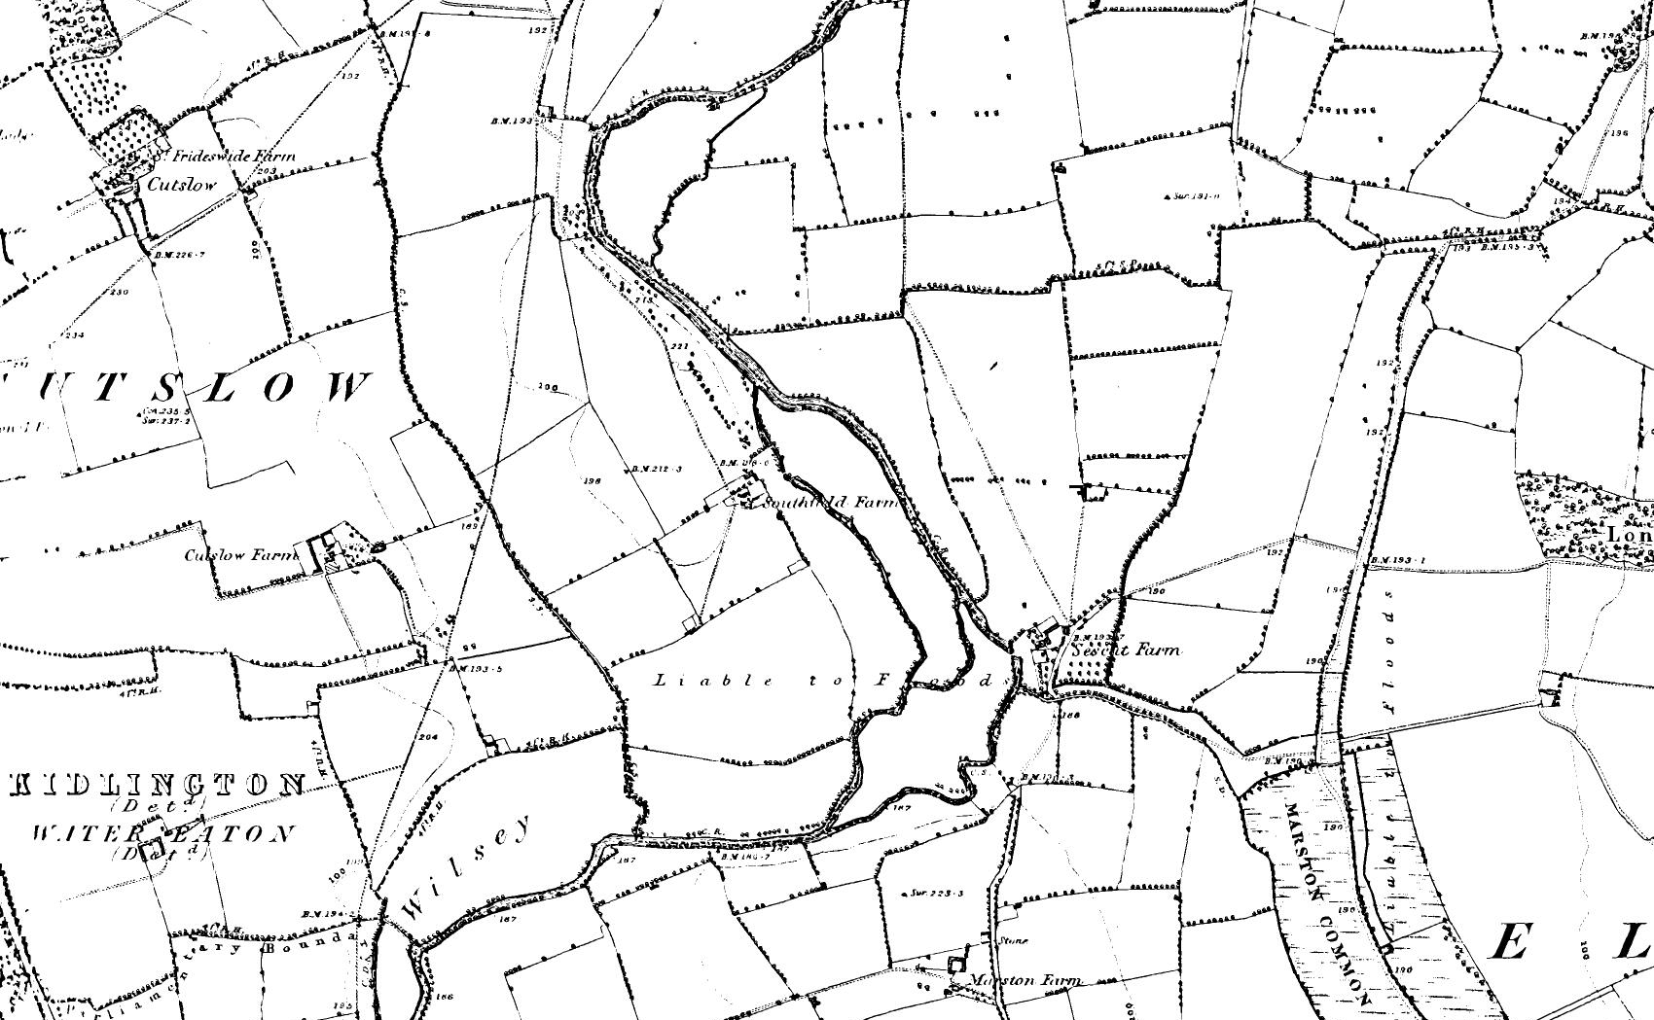

Slide 11
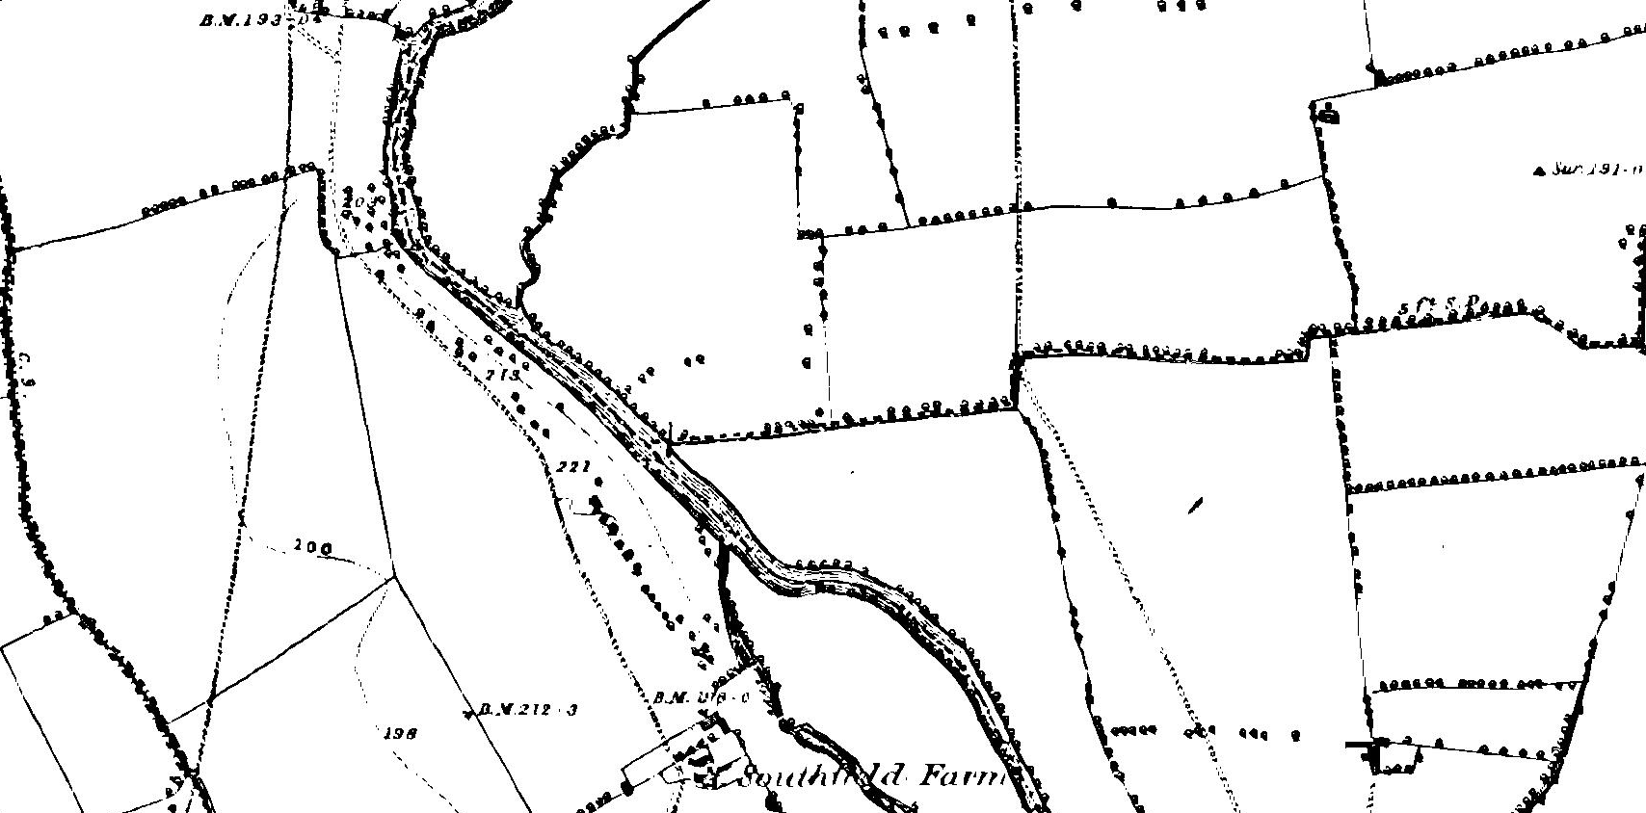

Slide 12
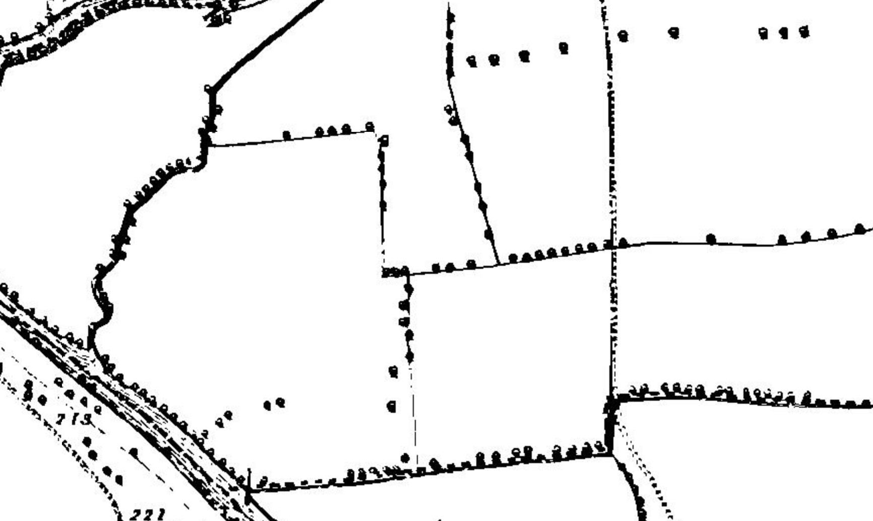

Slide 13
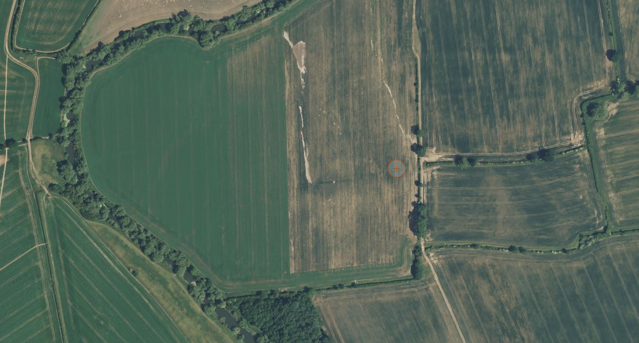

Slide 15
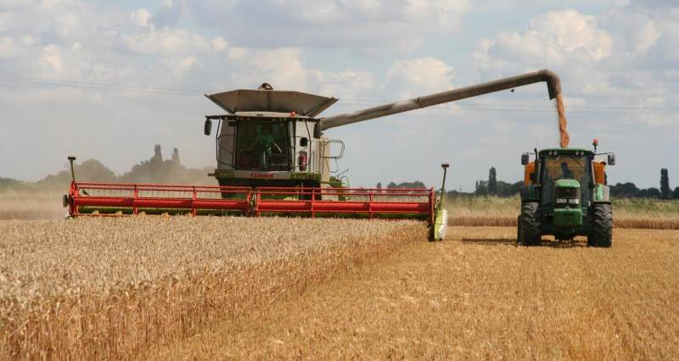
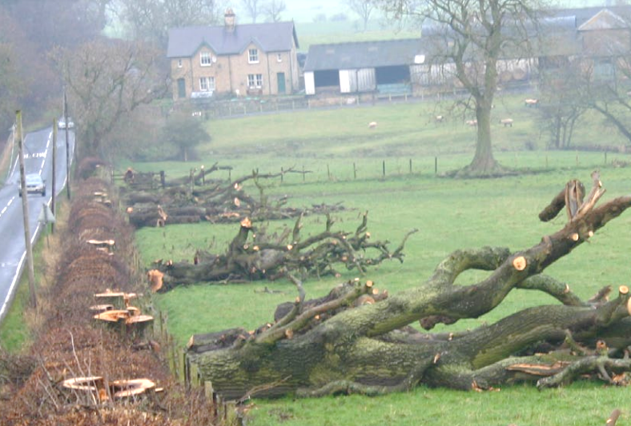
What’s the scale of loss?
Disease
Storms
Suppressed regrowth
particularly within fields
Extensive agriculture with larger equipment
Development & urban expansion

Slide 16
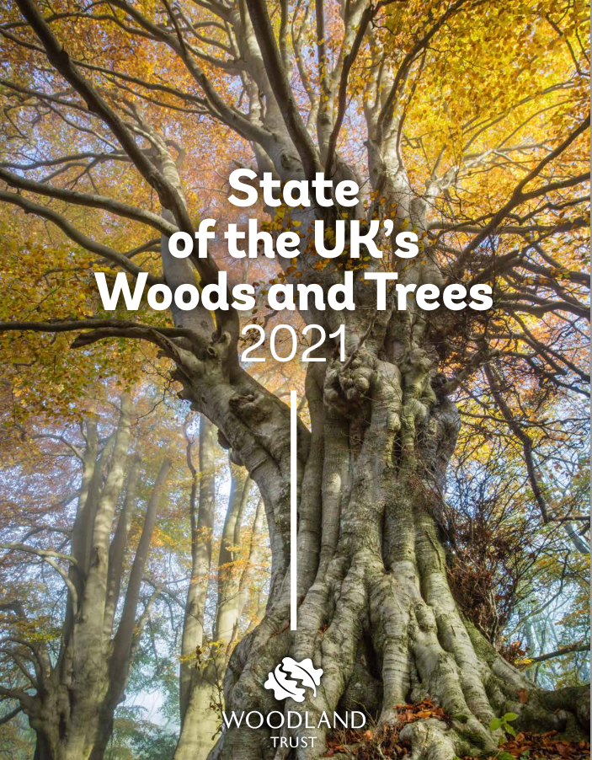

Slide 17
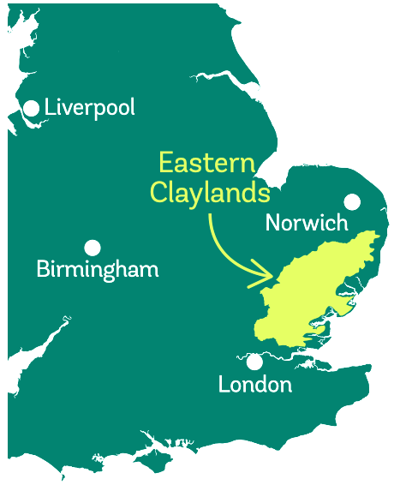
Eastern Claylands of Essex & Suffolk
5500 km²
84% arable farmland
Iconic landscape for trees outside woodland
7% woodland
7% trees outside woods

Slide 18
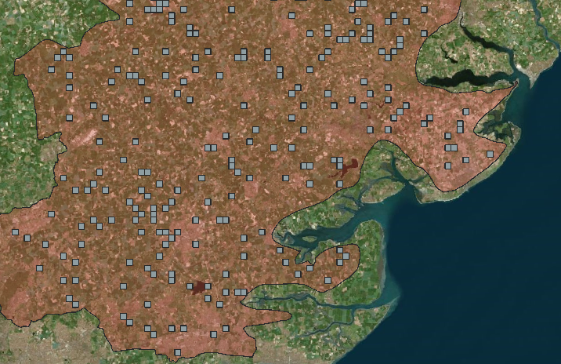
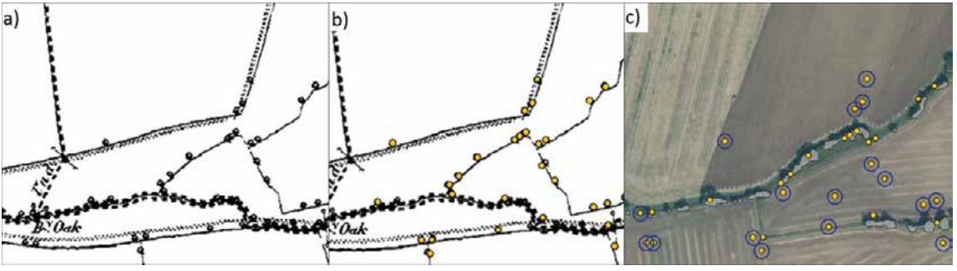
Counting 1850’s Trees outside woods
Digitised locations of 1850’s trees
350 random 1 km² grid cells
1.2 million
Trees outside woodland
218 trees per km²

Slide 19
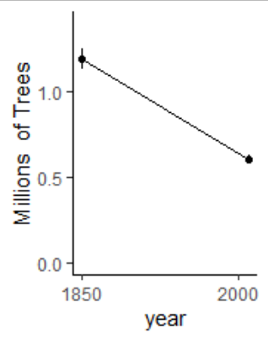

Counting the loss:
comparing to modern canopy
Average survival
51 %
0.6 million trees
lost

Slide 20
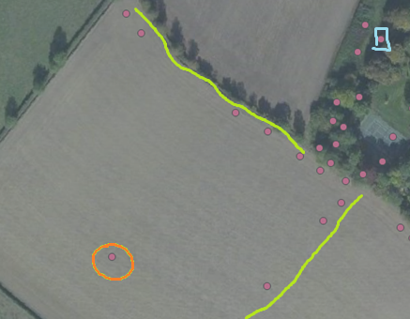
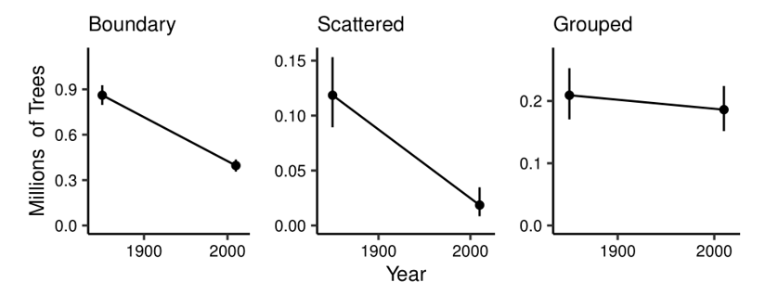
Scattered trees had it worst
16% survival
of in-field scattered trees
1.00
0.75
Survival probability
0.50
0.25
0.00
Boundary
Scattered
Other

Slide 21
Check out your own farm!
What Living Legends do you have?
How many have been lost?
What can be put back?
1850s was the industrial revolution, not some ideal gold-standard
EPOCH 1 maps available online:
Search “EPOCH 1 OS”
Woodland Trust Ancient Tree Inventory website
National Library for Scotland
british-history.ac.uk

Slide 22
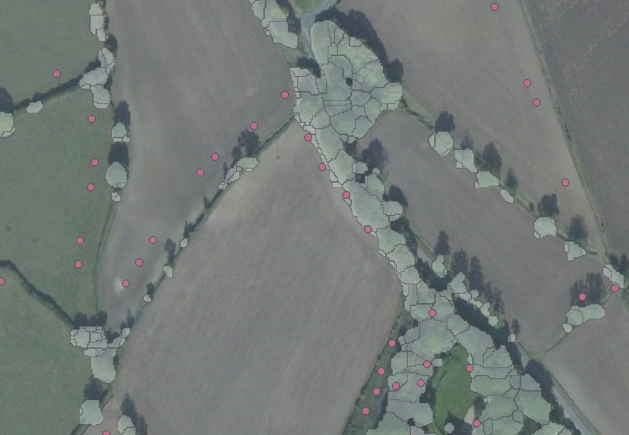
Watch out, old maps aren’t perfect!

Slide 23
