Slide 1

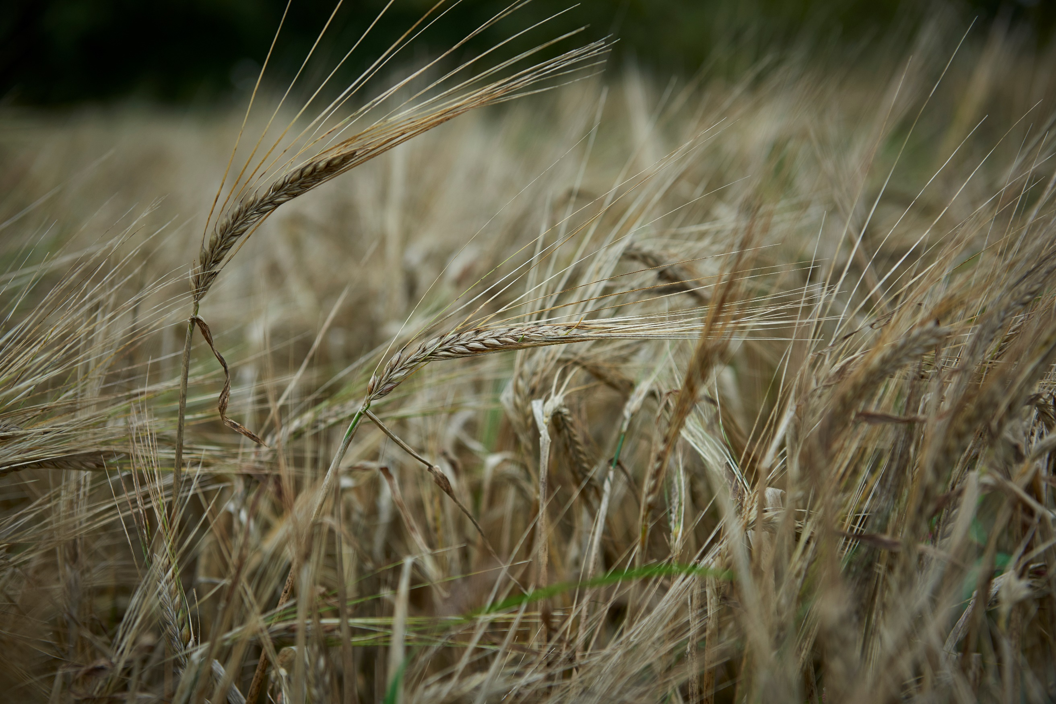
From Field to Bakery
Radical but realistic policy changes for accelerating diversified grain systems in the UK:
FUNDING
Josiah Meldrum
@hodmedods #lovepulses

Slide 2
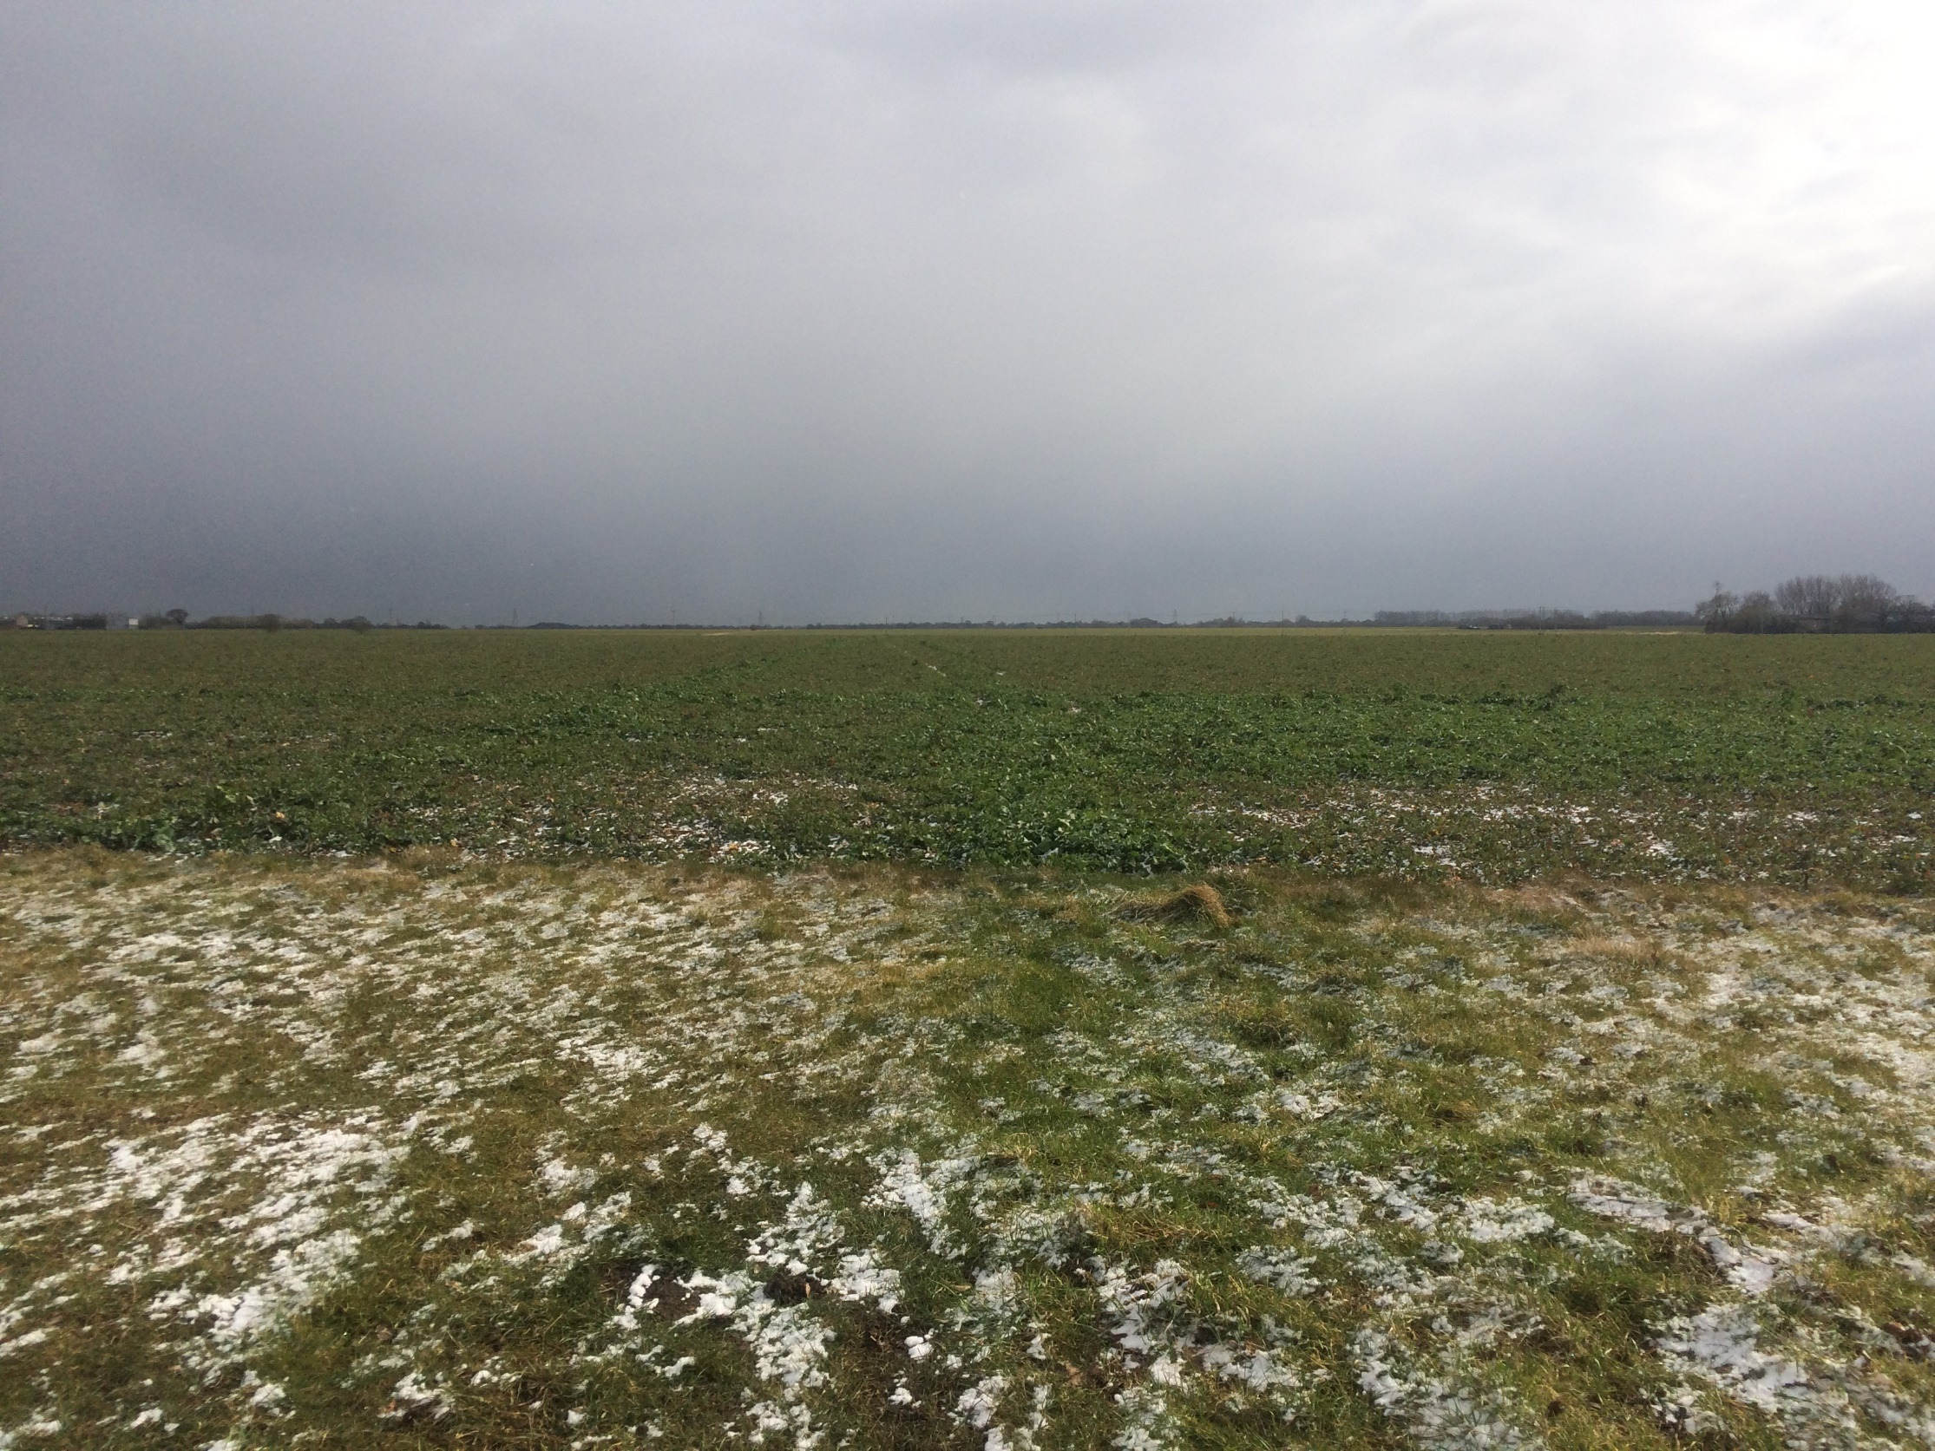

Where close to 100 years of policy has got us…

Slide 3
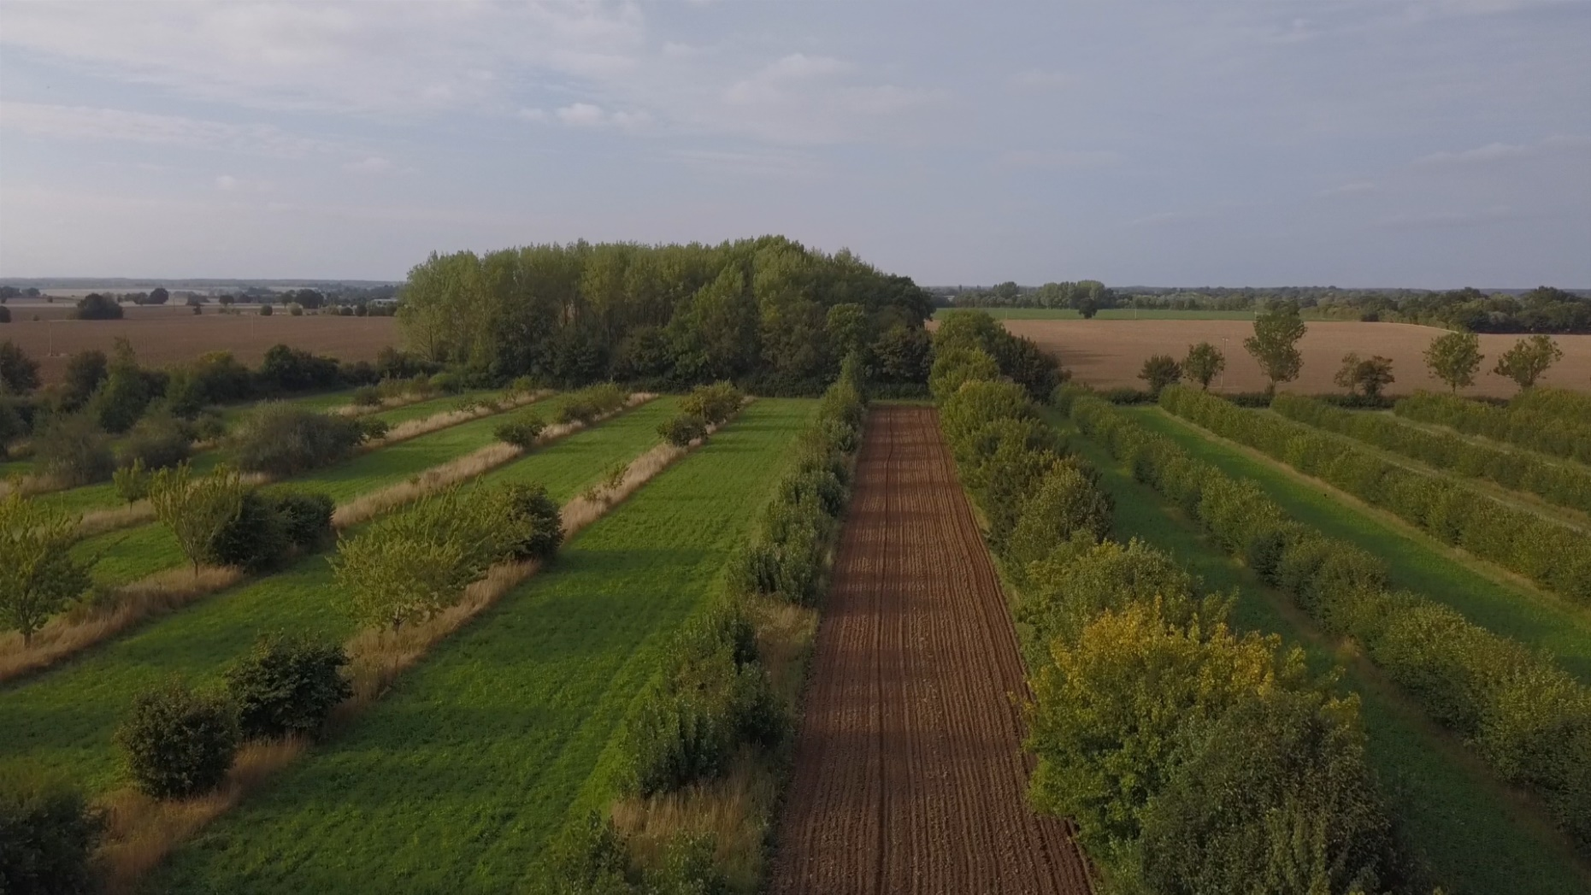
Where we need to be
But not just agricultural policy.
And not policy alone

Slide 4
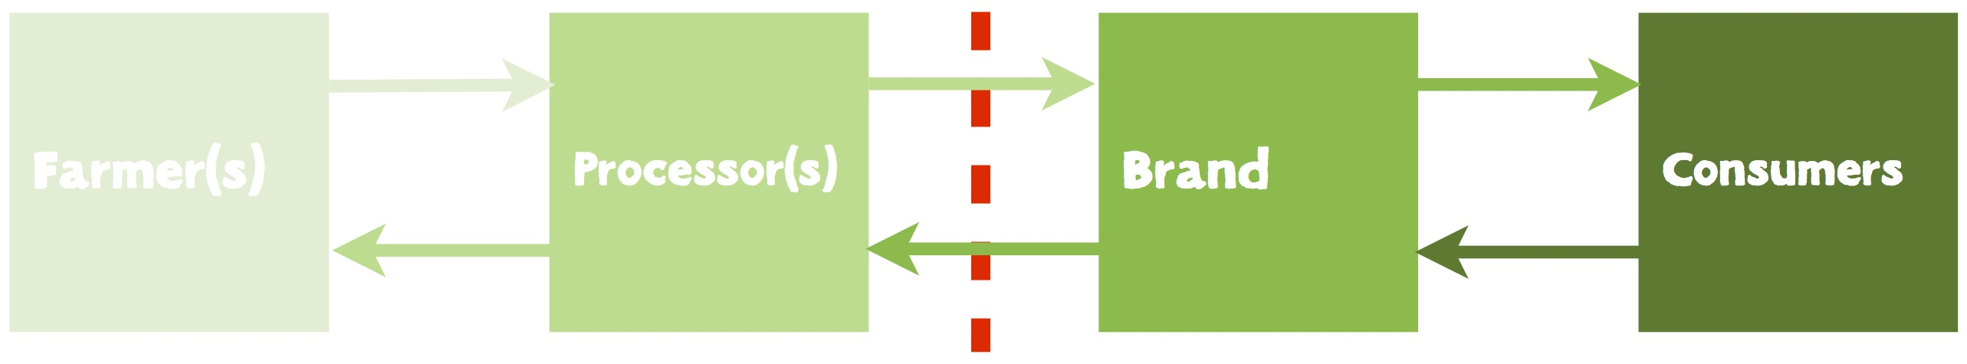
Linear Value Chains
Flow of raw material, value and information →
← Flow of information

Slide 5
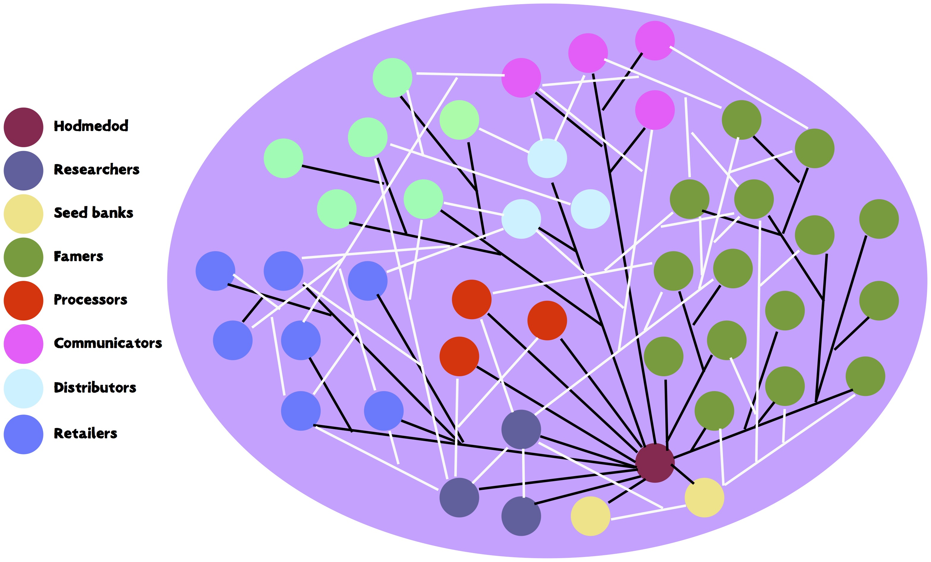
Networks of Supply
Collaborative, open, diverse, transparent; built on trust and relationships not transactions.

Slide 6

Radical but Realistic

Slide 7
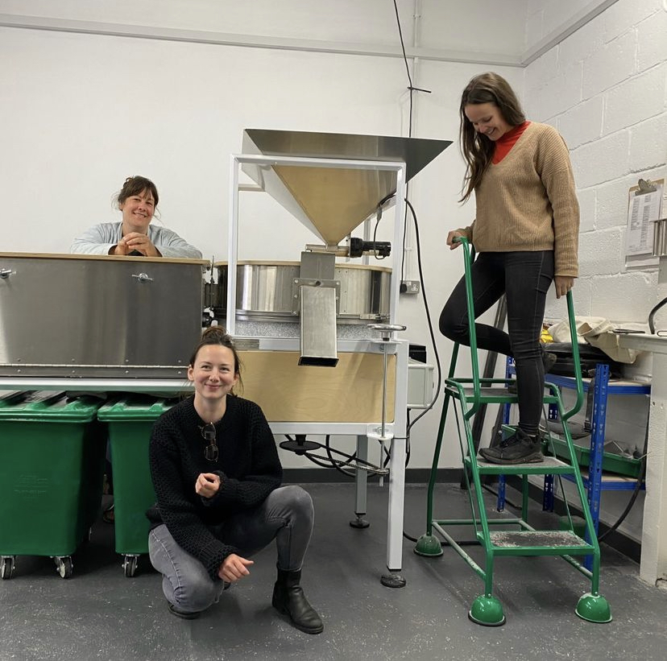
What do we need to fund?
Tempting to think that it’s all about this
When actually it’s mostly this
Notes:
Funding for small businesses

Slide 8
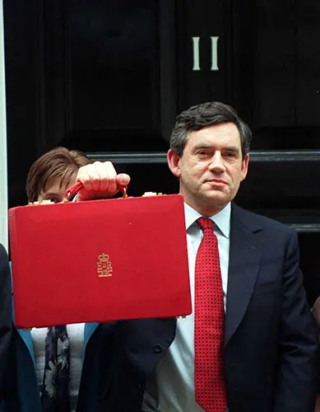
What kind of policy?
2002 Budget:
A cut in duty of 50% on the first half million litres of beer produced each year – but only for breweries producing less than 3 million litres per year.
Notes:
Do we even need policy?
The kind that:
Recognises research doesn’t have to be tied to intellectual property
Meaningfully connects food, farming, public health and the environment (agroecological policy)
Operates at a range of scales – hyper local (town, parish / business, community)

Slide 9


Slide 10
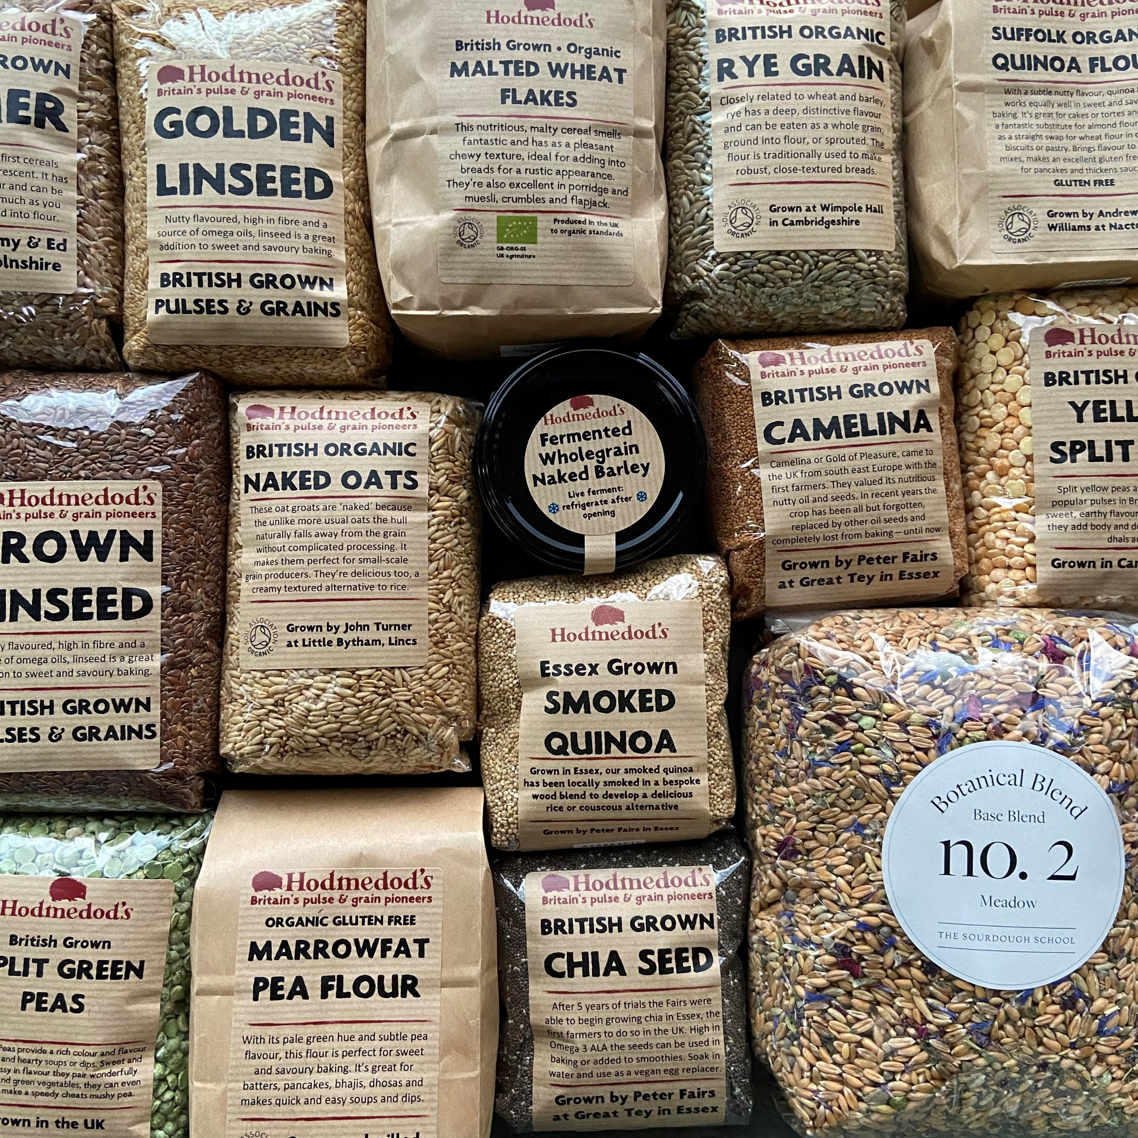

Slide 11


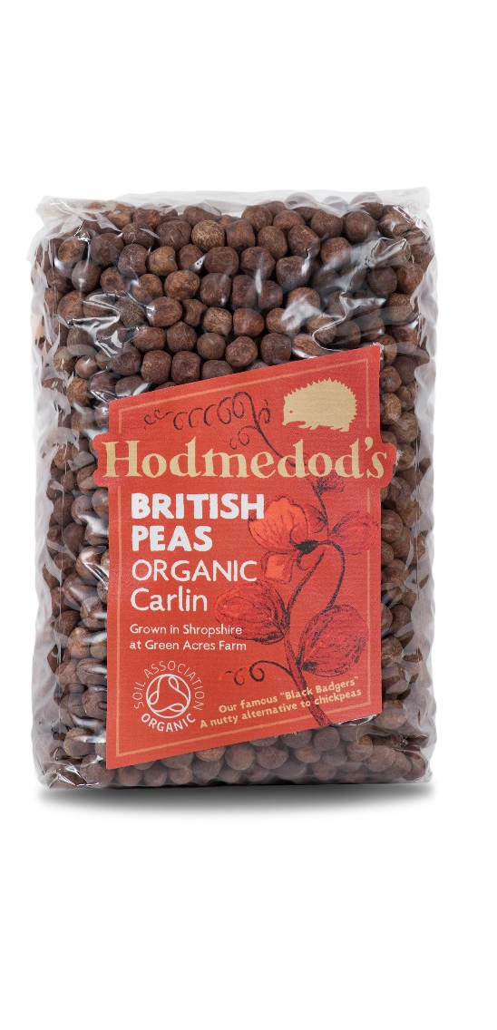
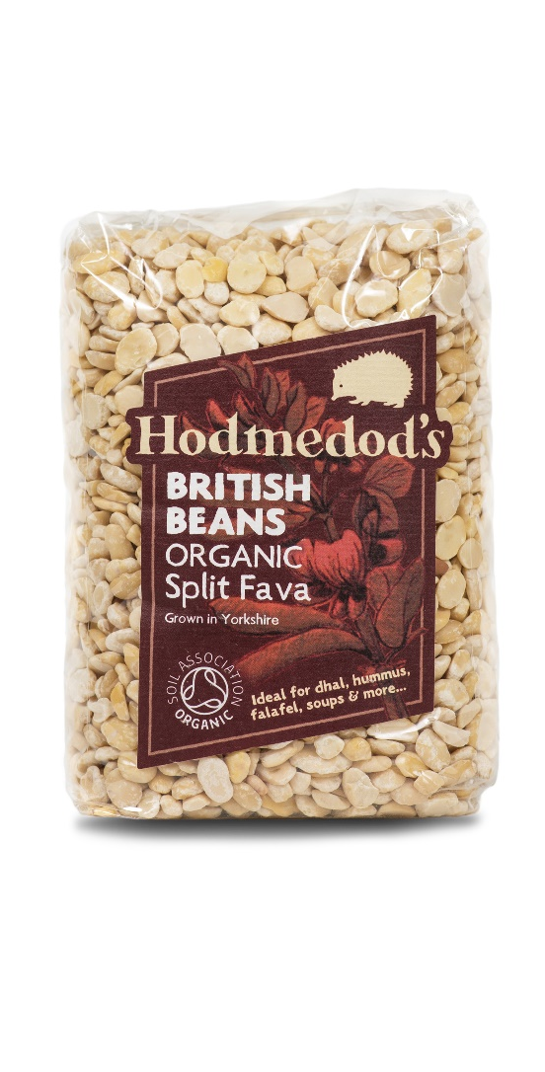
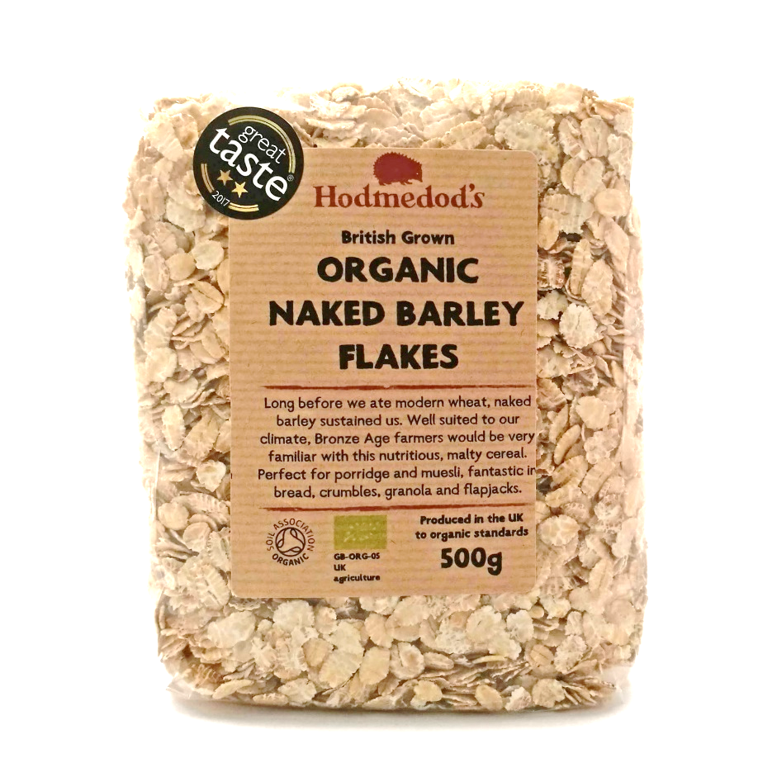
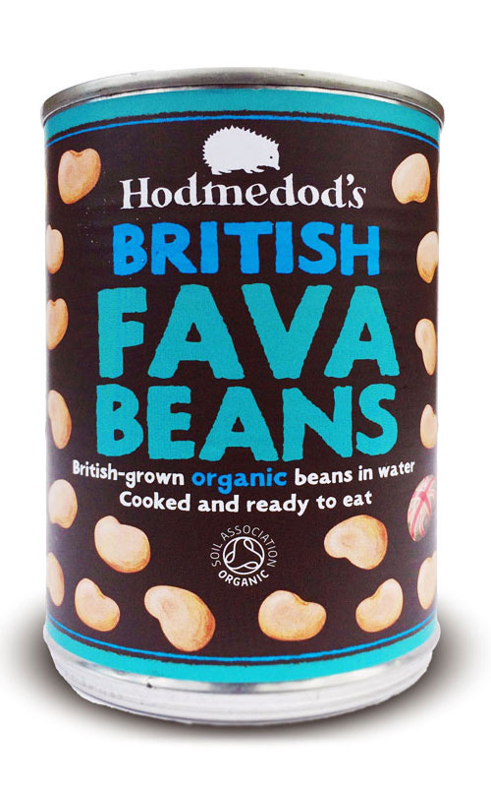
Josiah Meldrum
Josiah@hodmedods.co.uk
www.hodmedods.co.uk | @hodmedods

