Slide 1

Food for Thought
Exploring the Social Impact of Community Food Businesses
Rob Wannerton/Clare Horrell January 2023

Slide 2
Overview
About LEAP
Loan funding for established community food businesses
18pct grant focussed on social impact
Followed 8 businesses; 600 customer surveys; 51 people interviewed
Notes:
LEAP was set up as an impact first programme
Grant used to assess, monitor and develop their social impact
The aim of LEAP was that over time we would plot their progress in terms of social impact dvpt
But this has proved very challenging in the context of also trying to run a business
Mostly we have helped the orgs benchmark what impact they are already having beyond maybe some customer surveys but these were mainly focussed around the product rather than any social impact
Mostly we’ve conducted with surveys, interviews and focus groups with customers, volunteers, staff and business leaders
The report was based on a cohort of 8 businesses, currently 11, and 3 more in the pipeline
We also presented at an International Conference this summer

Slide 3
Rather than tweaking the practices of unsustainable agricultural systems, agroecology seeks to transform food and agricultural systems, addressing the root causes of problems in an integrated way and providing holistic and long-term solutions. This includes an explicit focus on social and economic dimensions of food systems.
The 10 Elements of Agroecology: Guiding the transition to sustainable agriculture and food systems
FAO, 2018
Notes:
As a reminder to ourselves about why social impact is important and how we got here:
Because we only support enterprises that produce food agroecologically so therefore we do need to be as interested in the social as well as the environmental impacts
Agroecology is a set of practices that encompass environmental and social outcomes
For highest impact, we should be (and are) aiming for both
Key to remember - these are responsibilities shared by policymakers, practitioners, and stakeholders
Also: Everyone buys into it at different levels - although its something we might talk about, its not something all the businesses would define as - but, all the businesses we work with have social aims as part of their overall mission.

Slide 4
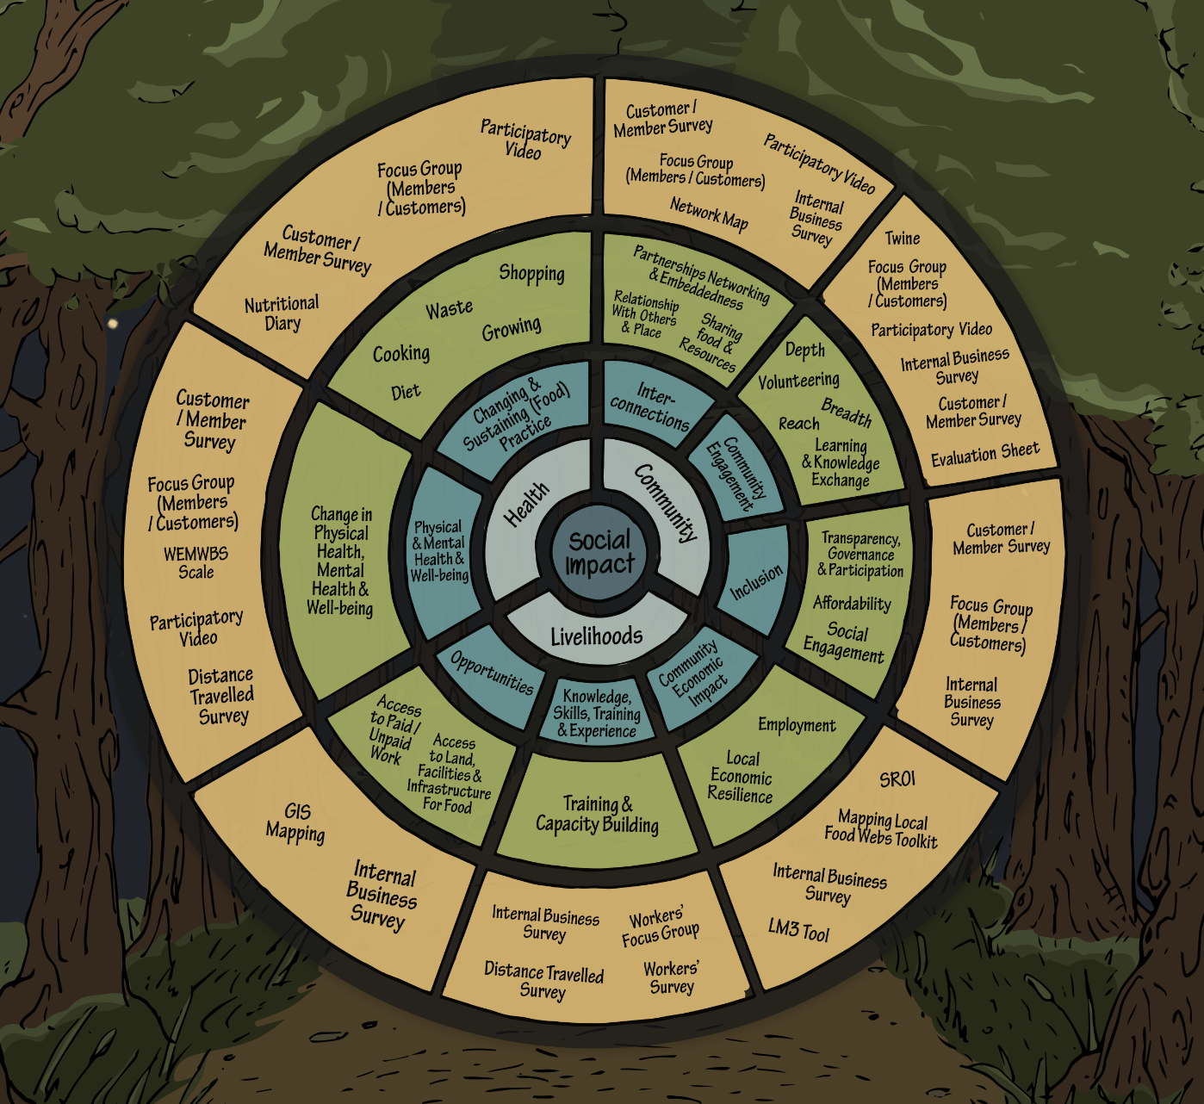
Overview
The Social Impact Toolkit
Notes:
Social impact toolkit developed over a number of years with CFBs which looks to drill down into three outcome areas
Livelihoods, training and local economic impacts
Health and wellbeing and diet
Community engagement, inclusion and connection
https://www.social-impact-toolkit.co.uk

Slide 5
Overview
Overall Impact Questions
How and why do people connect with Community Food Businesses, and how strong is that connection?
What is different because of the Community Food Business?
Who doesn’t connect, and why not?
Does it matter?
Notes:
Overall questions that we were trying to answer were:
Broadly, when we think about social impacts, whatever they might be, these are the questions we’re bringing to them.
Some of them are clearly market research - identifying current and potential customers, building your story, knowing what people are connecting with.

Slide 6
Good Jobs
What we were told
“(The challenge of)…finding a suitably qualified candidate who’s willing to work for us for the low pay and poor conditions that we can afford to offer”
Founder interview
“Becoming part of this world, in itself is a privilege, we're not being paid. Or well, we are, we have a small salary to be here. But that's like, definitely not accessible to a lot of people who might have a family or might need to pay rent, or might just need to survive and get to the end of the week. And, you know, as a group of people, as a trainee group, we're not very diverse.”
Trainee Focus Group Participant
Notes:
First area we looked at was around jobs and training
Difficult for CFBs to compete with supermarkets and the conventional food sector in terms of pay and benefits
Evenmore so now in the tight labour market in the face of Brexit makes finding people to work even more challenging
Little money/margins to provide the pay or fhe opportunities for personal development or training
Staff and Trainees often make a lifestyle choice to join the CFB rather than an economic choice
Makes it exclusive but they get positives out of it despite the physical hardships
There are negatives here though in terms of social impact if you are only attracting certain types of people to your business
But it will limit the types of people you get
Lack of resources means there is a danger that CFBs embed a cycle of privilege where only those with some resources can realistically take on the work long term or are able to take up the opportunities of training.

Slide 7
Good Jobs
What we were told
“I’m bored and unchallenged, I feel like I’m becoming deskilled”
Staff Survey Respondent
Notes:
Realities of jobs in food production is that they are often physically demanding and not always mentally stimulating - which can be an issue when you’re attracting people who are connecting to the mission, How do you keep them motivated and engaged over the long term?
What is needed to make both jobs and traineeships more attractive?

Slide 8
Good Jobs
What we were told
“The problems of the world can be very overwhelming, and as an individual it's hard to really tackle them in what can feel like an important or significant way. But working in a place like this …. it can feel like you're kind of doing some good. I think that's a massive boost to my mental health”
Trainee Focus Group Participant
Notes:
Definitely we heard a lot of stories about the positives that staff get from the job - that connection with mission – feeling they are living out their values, and their own reconnections to values and wider understanding of the realities of food production
Mental health benefits from connection with the land and easing of easing of people’s eco-anxiety around their feelings of lack of action and agency with respect to climate change

Slide 9
Volunteering
What we were told
“It's been clear to me for some time, that we are not going to be able to generate a surplus from growing and selling veg that will allow us to put on other social goods, we cannot run them off the back of it… we've never made a profit. In fact in 11 years we've managed by the unpaid input of workers”
Staff Focus Group Participant
Notes:
Historically quite often volunteers were integral to the business model. This quote summarises that aspect and the fact that delivering social impact beyond just keeping the business going is very challenging.
But increasingly we have found with our CFBs that they are seeing volunteering as a community activity rather than part of the business model
This has come from a sense of disquiet amongst some CFBs that the use of volunteering is difficult to maintain within the business model and where it happens there are issues in some cases with neither the CFB nor the volunteer getting what they want from the experience
Businesses feel that volunteering role doesn’t meet their or the volunteers expectations
Little engagement with Volunteer Support services
CFBs feel like they are not properly equipped and trained to deal with volunteers own needs and issues and CFBs don’t have training or skills to deal with this leaving both exposed
Works better when move towards volunteering being a community activity and not part of the business model. Then responsibilities are different and able to give time to focus on it. Needs and expectations of both parties are met
Is there a shift from volunteering supporting business to being a social impact only? Could this be a good thing? What does it say about long term resilience of the business if it’s one or the other? Is there a trajectory from one to the other?
What do the demographics of the volunteer pool tell us about diversity and inclusion and the community involved with the CFB? Whilst we capture information about volunteers we know relatively little about who they are and their backgrounds. More research into this would be useful
Why are CFBs not accessing volunteer support services?
How vulnerable are CFBs and volunteers where they might be managing/engaging with people with issues of their own and no formal training or support to manage that?

Slide 10
Diversity & Inclusion
What we were told
“I’d say that (proudly) coming from a working class background, there is sometimes gaps in my knowledge when it comes to certain unusual foods and products, which some other colleagues don't seem to have. Given the working class population which surrounds the areas where our shops are, I think it’s important to have colleagues like myself, as customers who come in just for a look could feel that the shop is an environment which ‘isn’t for them’”
Staff Survey Respondent
Notes:
Lack of diversity amongst staff, customers and volunteers is problematic from a social impact point of view as arguably as well from a business perspective
Is there a resilience/growth potential question around diversity which the above quote picks up on?
Not just about race but about broader demographic engagement - it taps into all those debates around food poverty, the exclusivity of food cultures, the impact that CFBs can have on gentrification
Many businesses are established by incomers, and often the staff and volunteers are as well. All sorts of reasons for this, but it does raise questions about the concept of community in Community Supported Agriculture. What is the relationship of the CFB to its immediate community?
This quote reflects the importance of a diversity of people involved in the business in order to encourage others to engage with it

Slide 11
Mission & Values
What we were told
“I would shop more with X if not everything was organic… I love your ethos in the main, but I have a bit of a "thing" about the better-than-thou attitude that is associated with the organic industry …….. (all your other good work around living wage and local growers is more important to me than being petty about organic)”
Customer Survey Respondent
Notes:
What we found out from the various interviews we did with people engaged with the CFB ipeople will connect to the bits of the mission that suit their view of the world, sometimes despite rather than because
People project their own mission onto an organisation saying things like “they reflect my values” and that they wanted to “support the ethics and values that the business represented”. But it’s not always clear exactly what those ethics and values are and customers interpret those in ways that reflect their own values. At the same time there can also be a tension between the values the founders want to embody whilst trying to do so in a neoliberal system that is stacked up against them

Slide 12
Mission & Values
What we were told
“I suspect a lot of our customers find it easy to substitute our produce with produce bought from somewhere else that’s local. And they might feel equally good about that, think, you know, it’s alright, it’s local. Whereas for us, that’s deeply problematic”
Community Business Leader Interview
Notes:
There can also be a tension between the values of the customers and the founders as this quote shows. On the one hand it’s good that people engage with just those parts of the business they like and ignore the others, but on the downside it raises the question about who is driving the mission?
This in turn raises the question Who is driving the mission? The founders or the customers?
Each customer interprets the CFBs mission in their own way – customers project their values onto the business
Environmental concerns come out as key driver as does supporting local busineses
yet organic doesn’t (under 50pct) shows disconnect between the message of organic and the environmental benefits
Linking of taste and place reflects something closer to the French terrioir which appeals to some but alienates others
The main driver for consumer engagement are environmental concerns
84pct said they wanted to use less packaging and reduce their carbon footprint
Over 70pt stated a desire to support local businesses
Only 48pctplaced organic as highly important – we’d like to understand better this disconnect between organic and environmental impact
The way customers interpret local as more environmentally friendly is also questionable but the linking of locality to taste and place reflects something closer to the French concept of “terroir” which appeals to some consumers whilst alientating others.

Slide 13
Breaking Out
What we were told
“If I'm going to be honest here, I think, eating seasonally after being spoiled by a supermarket, …… if you're going to go back to a seasonal approach, which is the sensible approach, you are going to get bored out of your brain. I mean, at the moment, if I'm being honest, I'm sick to death of carrots in my veg box”.
Customer Focus Group Participant
Notes:
So how do CFBs grow from beyond the people they are reaching now?
To grow a market, businesses face a problem of perception rooted in mainstream food cultures
Many CFBs saw a surge in numbers during Covid which seems to have been driven by availability and access rather than any connection to mission. Different CFBs however have suffered different levels of drop off since Covid and understanding more about those people to signed up during that time and why it didn’t translate to long term commitment is something that warrants further exploration and could be important for improving longer term resilience of CFBs.
It seems therefore that the Covid spike driven by access and availability rather than mission
Understanding why this is the case would be really useful for long term resilience
It is probably not too late to tap into the people who left and find out a bit more about their motivations
Gave us a chance to see into the minds of new customers

Slide 14
Breaking Out
What we were told
“You've got this conflict all the time between trying to attract customers who are going to give up their hard earned cash, in order to do this work, that is really not cash driven. It's more ethos driven....(we want to) attract people because of the ethos of the organisation because they want to be part of something. And I think what's been happening is we've been attracting people because they want nice veggies and treat us like a shop”
CFB Founder, Staff Focus Group
Notes:
The conflicts and challenges of running a business that just about washes its face whilst also delivering on the mission which costs money and doesn’t add to the financial bottom line
Is it reasonable to expect CFBs to also deliver social impacts
There isa need of an urgent reframing and questioning around who pays for that social mission and who is putting the pressure of CFBs to deliver it?. CFBs have the potential and will to deliver far more social impact than they do but the question of who pays needs to be brought to the fore and CFBs must move the focus away from an expectation that they will or should deliver this as part of their business model where the neoliberal environment in which they operate makes that impossible
Signs of a distinct disconnect
If there’s a big gap between business and mission, where is the meeting point?

Slide 15
What Next
Questions we want to explore further
What constitutes a “good job” and a good traineeship? What support do CFBs need to make this possible?
What is the role of volunteering and how can it be best managed and supported for the best benefit for CFBs and the volunteers?
What does or should “community” mean in the context of the CFB and how do CFBs relate to the place and people in which they are situated?
What are the barriers beyond price and access that exclude or prevent people from engaging with CFBs?
Who drives the mission of CFBs?
What is the role of CFBs in addressing social inequalities?
Who pays for the social good that CFBs can have?
Notes:
Answering all of these questions will help us to understand better what resilience means in the context of a CFB
We think some focus on the ecomomic benefits for the local economies also warrants some attention given the interest that customers (particularly in rural areas) have on issues of locality a
and terrior.
Some sort of low level LM3 type analysis which gives CFBs data on their economic impact could be useful in reducing drop off and fostering customer loyalty. Customers know about the environmental impacts that CFBs have but their economic impact is less well known and understood by both customers and policy holders

Slide 16
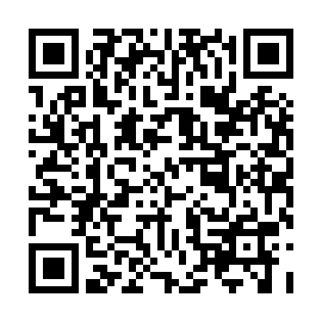
Get In Touch
QR Code to download the report
https://realfarming.org
rob@realfarming.org
clare@realfarming.org
https://www.social-impact-toolkit.co.uk
Notes:
Do contact us if you would be interested in being part of future research
Have a look at the full Food for Thought report
Have a look at the social impact toolkit
Be interested to hear your thoughts and what else you would like to know about CFBs.

