Slide 1
Principles of Meadow Restoration
Matt Pitts
Notes:
Briefly talk through the main principles of Meadow Creation
Later speakers will go into more details

Slide 2
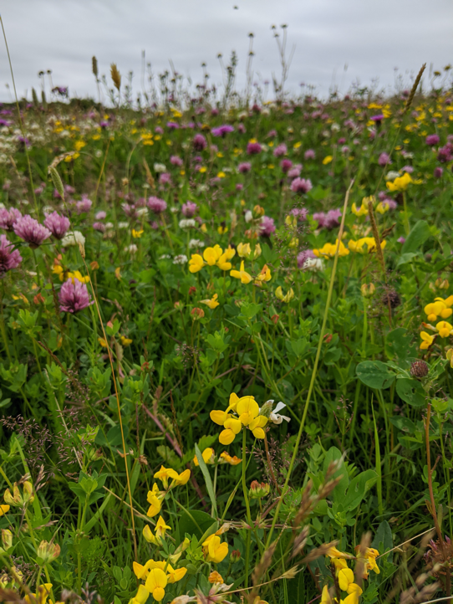
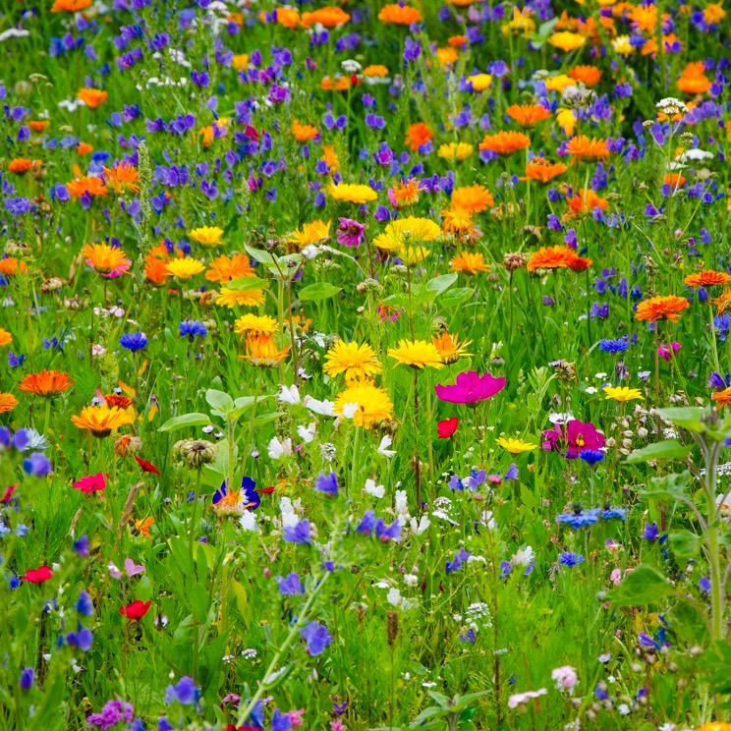
Species Rich Native Meadows
Notes:
We mean native species rich grassland, which is permanent pasture with a mix of fine grasses and mainly perennial wildflowers
Not the typical pollinator mixes or pictorial meadows seen on TV which are mainly full of annual flowers of arable and disturbed ground

Slide 3
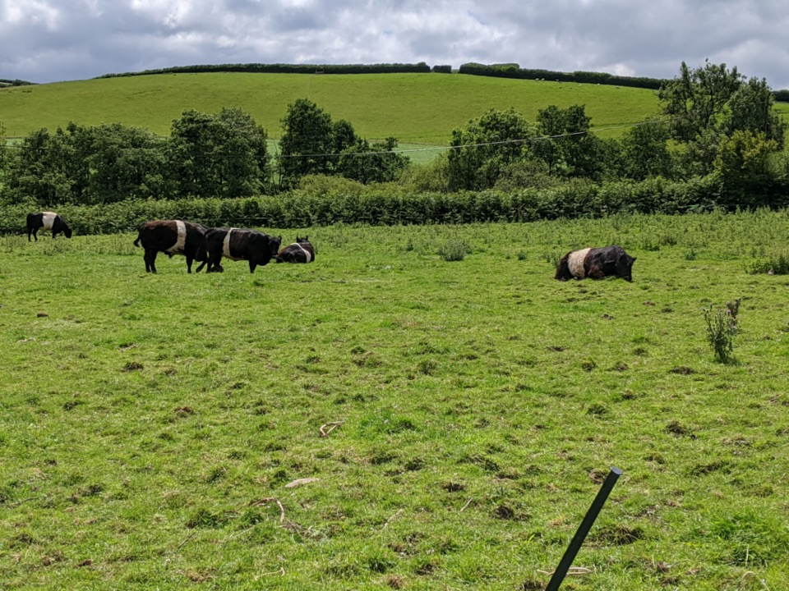
Understanding Potential of your Site
Soils
Existing land use
Existing plants (positive and negative)
Management history

Slide 4
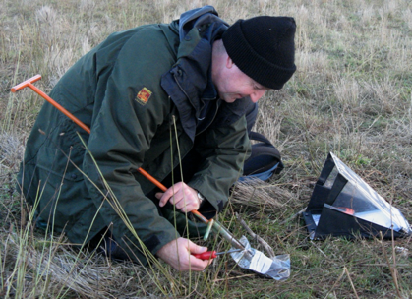
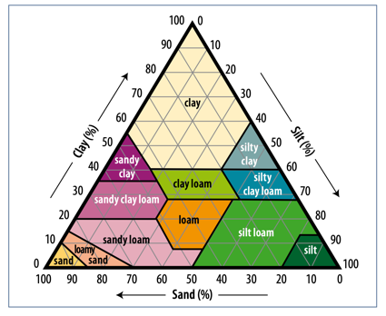
Importance of soil
Notes:
High Soil fertility will limit the potential of a site for restoration
the site and can be created?
Soil type (clay, sand, chalk)
Hydrology (wet, dry)
Nutrient levels Ideally looking for a Phosphorus index of below 3, although in some situations restoration has been possible with higher P values.

Slide 5
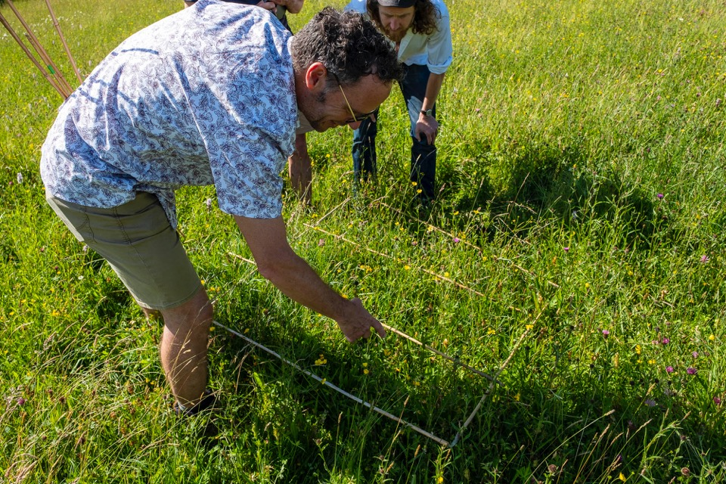
Record existing plants
Notes:
Simply way to access your meadow is a basic survey - condition assessment
Important for judging success after you have introduced seeds
Examples of positive and negative

Slide 6
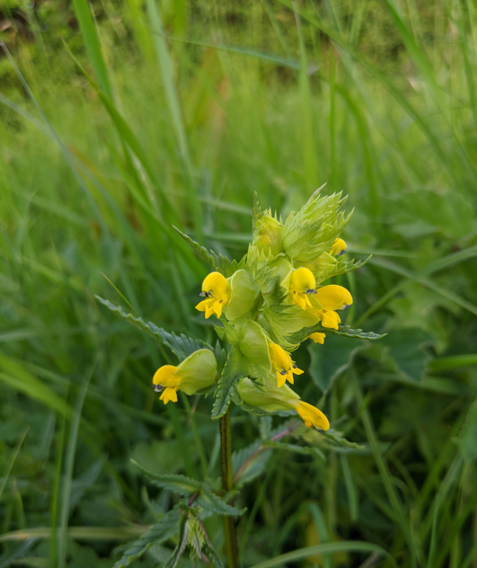
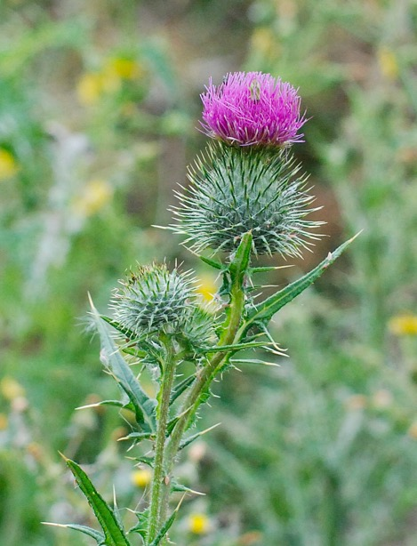
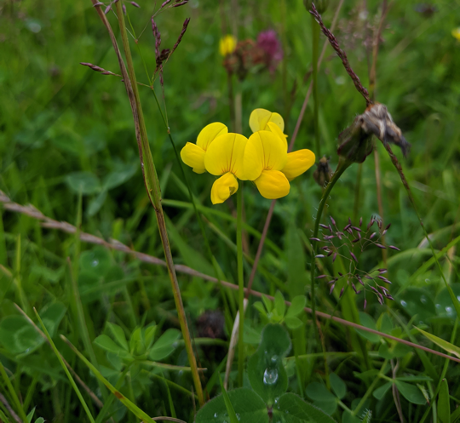
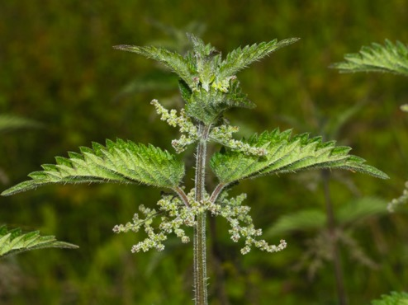
Yellow Rattle
Spear Thistle
Common Nettle
Birds-foot-trefoil
Notes:
Positive indicators in grassland would be Birds-foot Trefoil and Yellow rattle
Large quantities of the creeping or spear thistle, dock or nettles should be controlled before starting a restoration,
Spot spraying with glyphosate

Slide 7
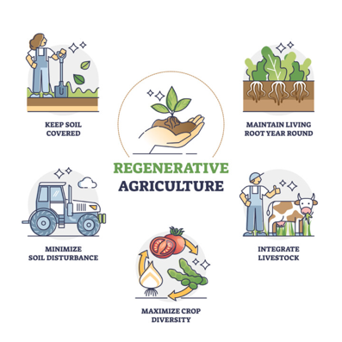
Regenerative agriculture: any type of farming which improves the environment and protects soils
The mindful fork

Slide 8
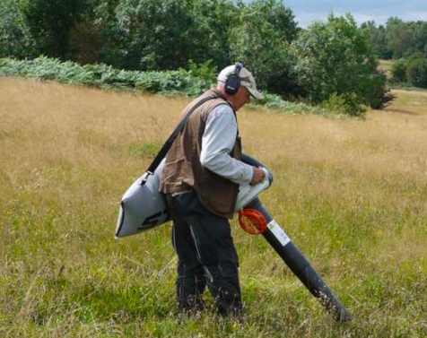
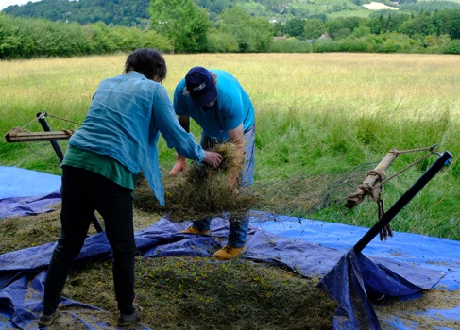
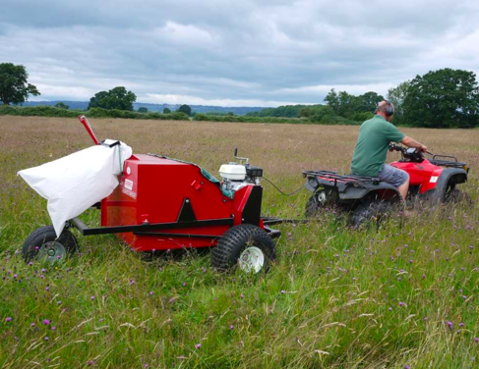
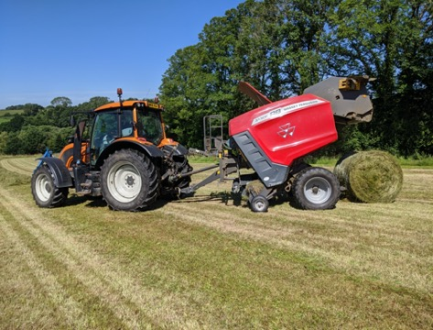
Natural Seeding
Notes:
FREE help from Plantlife in Wales and UK for help with sourcing logistics around sources natural seeds
Preserve local character of meadows which vary across the UK
Cheaper
Well suited to conditions in our area,
Native plants Better for livestock and soil

Slide 9
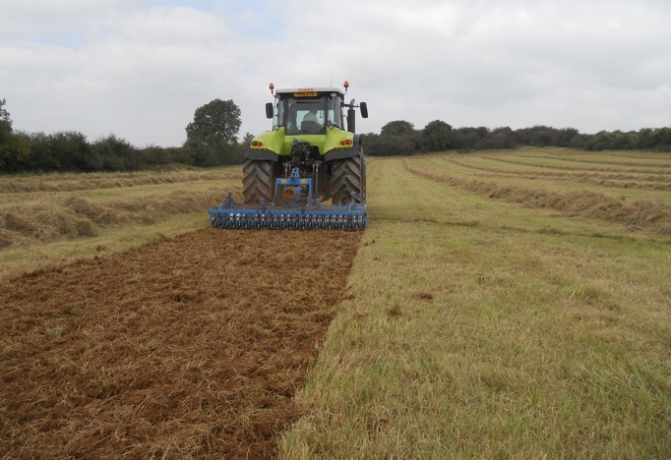
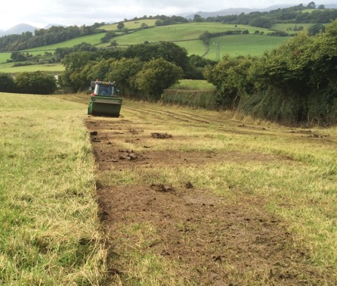
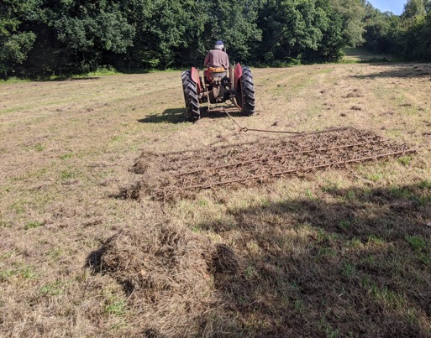
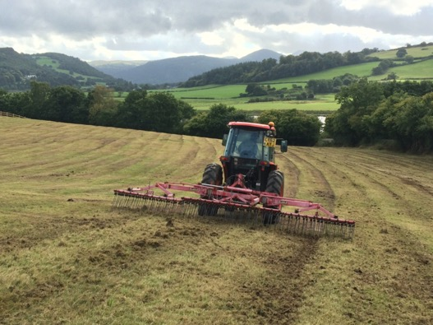
Creating Bare Ground
Notes:
Ideally create 50 - 80% bare ground
Many ways of creating bare ground some are more effective than others.

Slide 10
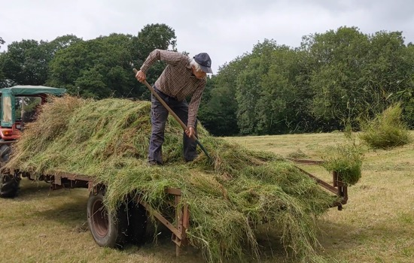
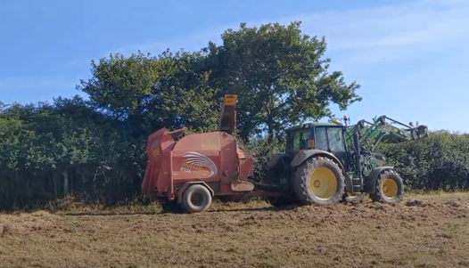
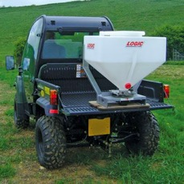
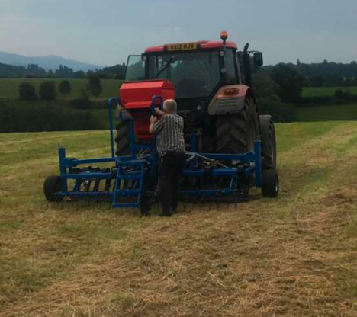
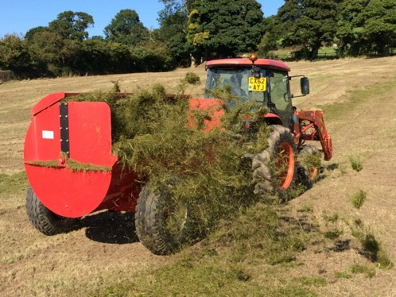
Seeding
Notes:
Many different techniques for sowing seeds
Green hay must be moved and spread quickly to avoid heating up, with a couple of hours or less
Seed should be broadcast on the surface and not buried.
Rolling or livestock should be used to help press the seed into the soil

Slide 11
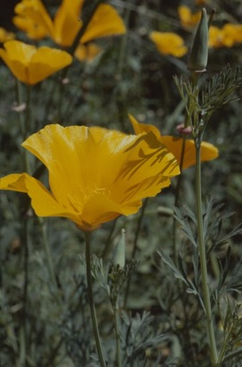
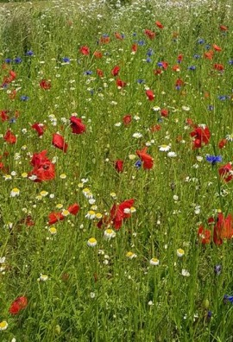
Commercial Seed
Seed provenance matters - one in ten wild flowers in the UK are threatened with extinction
Select seed mixes containing native species of known UK provenance.
Horticultural-style seed mixes often contain non-native and largely annual corn-field species
e.g. California poppy, common poppy and Austrian chamomile – not suitable for restoration of native, perennial wildflower meadows and the pollinators that rely on them.

Slide 12
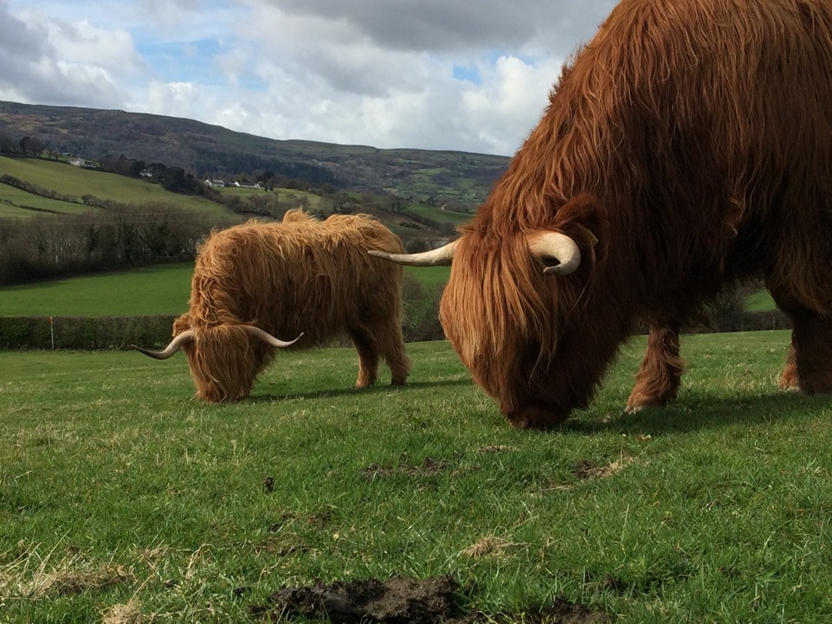
Initial Aftercare
Notes:
Keeping grass under control during first winter makes huge different to success

Slide 13
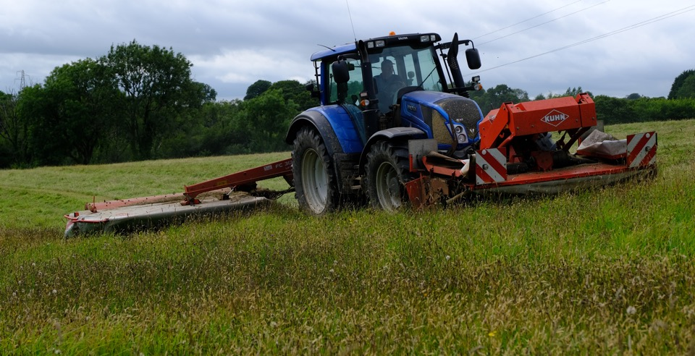
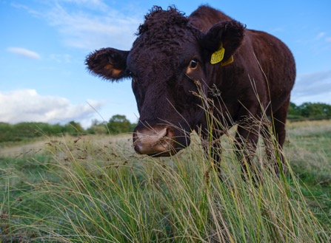
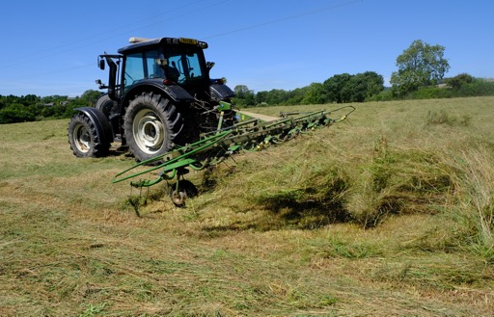
Long Term Management
Notes:
Long term management is the key to success.
Species rich grassland is typically managed as either hay meadow or pasture
Regular management is the key:
cycle of hay cutting and aftermath grazing or
grazing at the right times of year with the right numbers of livestock

Slide 14
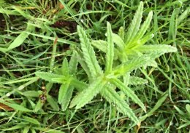
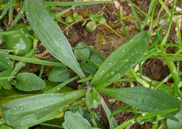
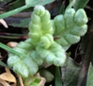
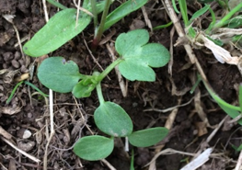
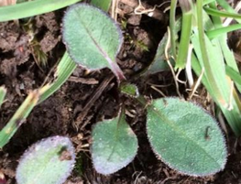
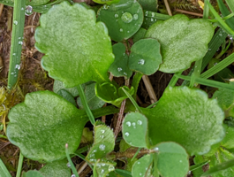
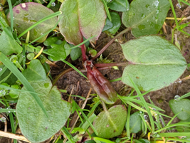
Seedlings (Feb-March)
Yellow Rattle (early/later) | Buttercup | Ribwort Plantain
Common Knapweed | Oxeye Daisy | Common Sorrel
Notes:
Yellow Rattle seedlings - not grazing too late when trying to establish Yellow Rattle

Slide 15
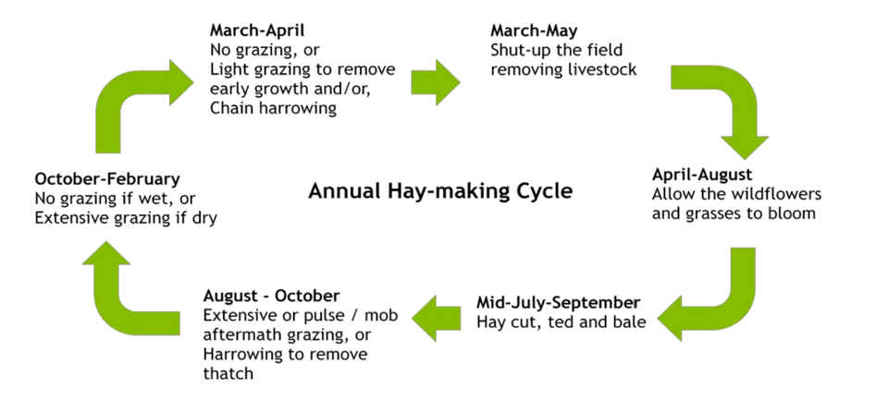
Hay Meadow Management
Notes:
Typical Hay meadow management cycle

Slide 16
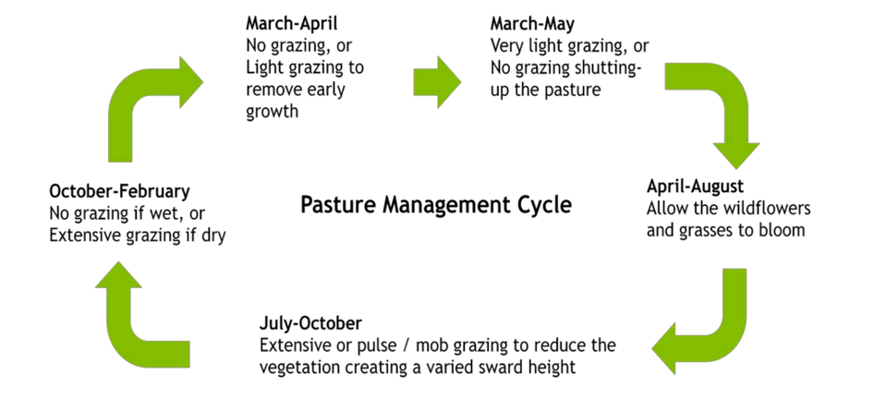
Pasture Management
Notes:
Typical pasture management cycle
Key principle of both hay meadow and pasture management is that livestock are excluded during the flowering season or maybe in very low numbers in a pasture system.

Slide 17
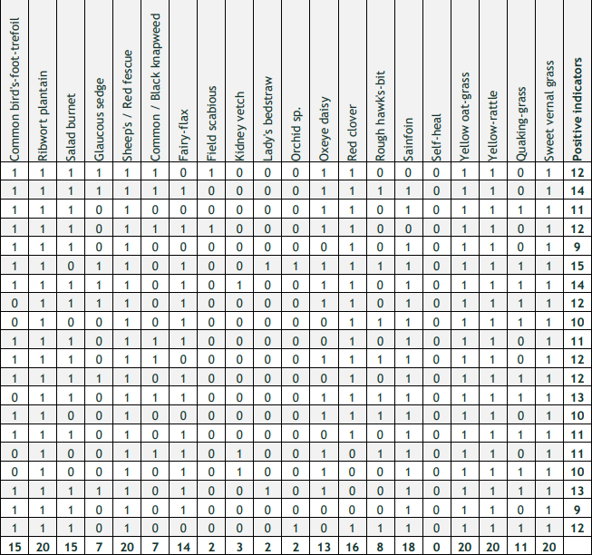
Measuring Success (monitoring)
Rapid Assessment (RA) monitoring
Baseline data - record existing plants (positive/negative +/-)
Set realistic targets, plan management and interventions
Design a RA for each meadow, recording (using multiple quadrats) coverage of +/- common indicator plants
Repeat at set intervals
Note changes in frequency of indicator plants
Adjust management accordingly

Slide 18
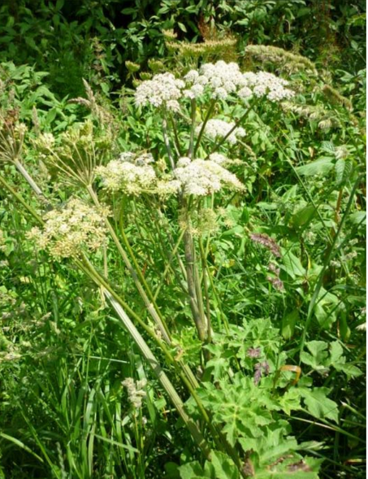
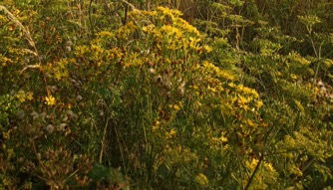
Management Problems
Creeping Thistle
Hogweed
Broad-leaved Dock
Ragwort
Notes:
Creeping Thistle
These are typical problem weeds associated with meadows.
Managing the level of perennial weeds is important - especially in the first few years after a restoration
Quickly get out of control

Slide 19
Management Problems
Notes:
Spot spraying during growing season - May - June - Check your agreement
Cutting at purple bud stage, before flower fully open
Avoid over grazing during the winter then the ground is wet
Spear Thistle, cut before seeding
Digging up had with Lazy dog

Slide 20




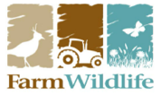
Advice and Support
www.plantlife.org.uk/uk/our-work/advice
 | www.magnificentmeadows.org.uk
 | www.herefordshiremeadows.org.uk
 | www.ydmt.org
 | www.farmwildlife.info
Notes:
Help and Support out there
Farmers Cluster groups
Plantlife
MMC
Magnificent Meadows Website
Meadows groups and projects across the UK, such as Herefordshire Meadows and Haytime in Yorkshire

Slide 21
Acknowledgements
Notes:
Presenter notes/questions:

