Slide 1
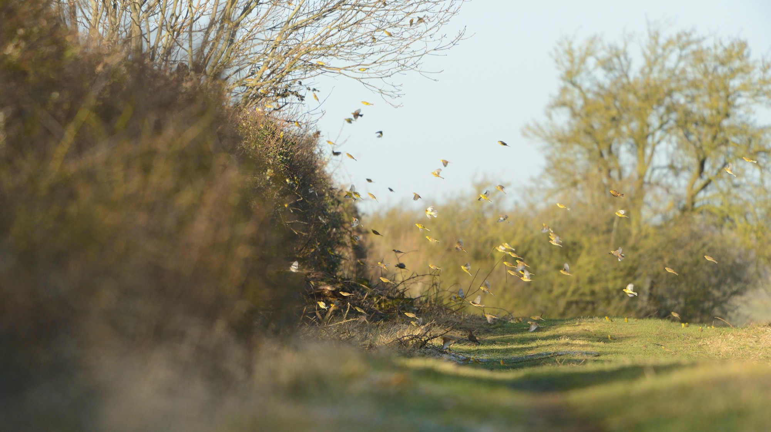
Making the best use of our land – what's the right choice for your farm in the transition to a nature positive, net zero, good food future?
Notes:
Add partner logos

Slide 2
Introduction
UK land is currently a net contributor to the climate crisis which we need to tackle. At the same time, we have an ongoing nature crisis and we need to feed ourselves well.
Emissions from farming (and peatlands) can be reduced, but almost certainly not to zero – so we need to enhance sinks from soils and plants just to get the land sector to net zero
How do we make the right choices?
Land is finite! So how do we ensure we are making the best use of it.
Notes:
In this session we are going to explore:
How do we make the right choices about how to manage our land and what land use to focus on where?
How do we determine how to manage our farmland to get the best return for people, nature and the climate?
What is stopping us make changes and what could help us?
UK land is currently a net contributor to the climate crisis – emissions from agriculture and degraded peatlands outweigh sequestration from soils and plants
Emissions from farming (and peatlands) can be reduced, but almost certainly not to zero (due to CH₄ and N₂O) – so we need to enhance sinks from soils and plants just to get the land sector to net zero
At the same time, we have an ongoing nature crisis. The two need to be tackled together.
Food (we need to produce enough that we don't increase our overseas footprint – though that doesn't necessarily mean we need to maintain production. Demand-side measures can ease pressure).
Land is finite!
There are legitime debates about how to express CH4 emissions in CO2 equivalents, given the short-lived nature of CH4. But it's a total red-herring to suggest that GWP* exempts the livestock sector from changing. Stable CH4 emissions do not warm the climate (the livestock sector likes to point), but declining CH4 emissions cool the climate.

Slide 3
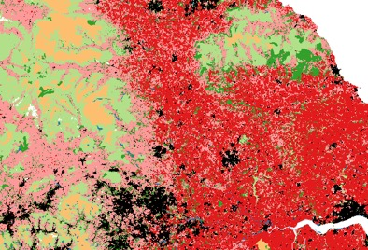
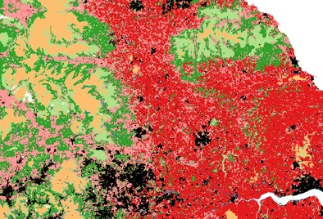
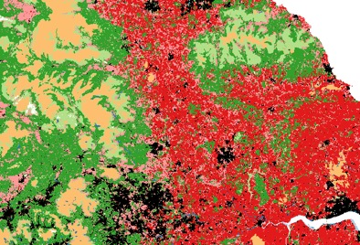
Understanding how we make the best use of our land?
RSPB Science's Land Use Scenarios Project explores 9 future scenarios of UK land use:
  Plausible pathways through which land might change to help reduce climate change
  Modelled impacts on GHG emissions, bird populations and food & fibre production
  Helping us understand the trade-offs and synergies among climate, nature and food
  Not exhaustive, nor the final word!
Nature
Climate
Production
Notes:
We carried out some modelling to understand how land use change could get us to net zero and what that meant for nature and production.
The pathways included options like what if we had more forestry or more biofuels or more organic land – they built on the cCC scenarios but with greater ambition for nature

Slide 4
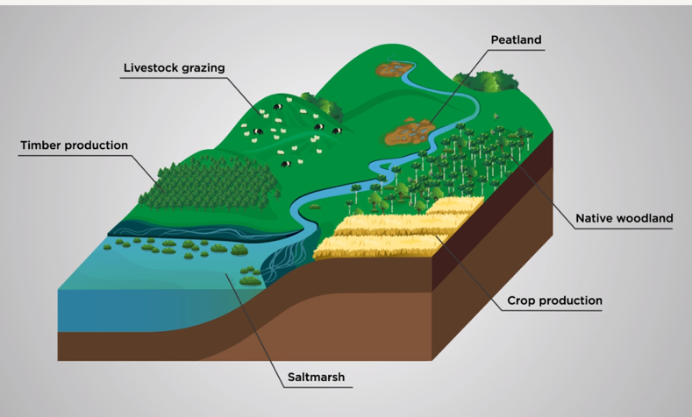
What we found
  Creating more semi-natural habitats (woodland, peatland, saltmarsh) is important for tackling climate and nature crises.
  This land use change impacts food supply so we need to take a food system approach e.g. making best use of arable land by using it to feed people directly and reducing food waste.
  More semi-natural habitat means nature can thrive there, but farmland-associated species lose habitat. We need to ensure that farmland is managed in a nature friendly way.
  Scenario design attempted to make the right changes in the right place – need to replicate this approach in the real world.
  Lots of innovative on-farm approaches are currently difficult to measure – more research is needed
Notes:
Land-use change for semi-natural habitat creation is a key lever for tackling climate and nature crises. – it can get us a long way towards net zero
Conflict with food production can be addressed by making best use of arable land (by using it to feed people directly wherever possible) and food (by not wasting it).
Not all bird species are winners, e.g. farmland-associated species lose habitat. Well-designed ELM (for e.g.) could mitigate this.
Scenario design attempted to make the right changes in the right place – need to replicate this approach in the real world – this is where a land use framework could help

Slide 5
Introduction to land use frameworks
LUF can help guide a strategic approach to change
They can help provide structure and facilitate engagement
Help direct funding to the most appropriate projects
Mediate local aspirations and national targets

Slide 6
A National Land Use Framework
Govt have committed to publishing a Land Use Framework for England in 2023
Have said it would "ensure food production is balanced alongside climate, environment and infrastructure outcomes" Hansard here
For decision-makers at many levels to plan for the future, the framework needs to take a comprehensive approach, allowing farmers to understand their options and government to meet its many ambitions.
Local leaders understand the benefits to be gained from communities being involved creatively in decisions about land. FFCC pilots supported by Geospatial Commission and Environment Agency in Devon and Cambridgeshire are highlighting the importance of an inclusive framework
More: https://ffcc.co.uk/land-use-framework
Notes:
Scotland, Wales? NI? Already have versions

Slide 7
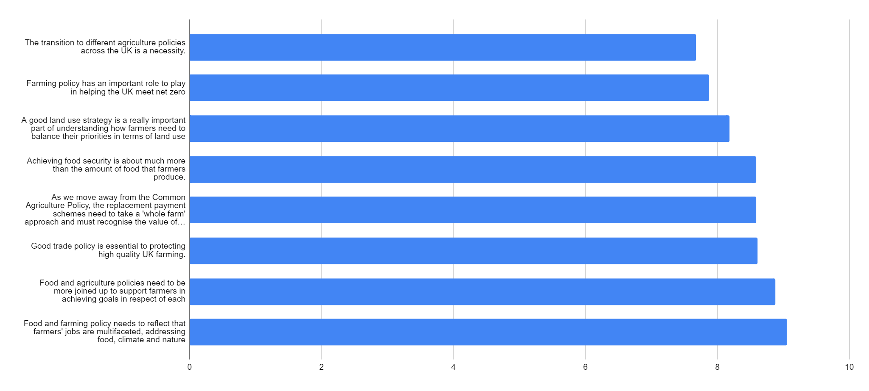
Farmer thoughts on land use strategies
NFFN survey result headlines
"The competition of land has never been greater, and a land use strategy is essential to ensure the right areas are given over to nature, development, renewables and food production respectively.
Farming and environmental gain are not mutually exclusive, and relatively modest areas of unproductive land can be used for conservation without impacting on the amount of food produced".
Notes:
This bar chart shows the mean agreement score out of 10 for the questions being asked.
The importance of land use strategies had a score of 8.18.
We had a total sample size of 264 responses, consisting of 100 telephone responses and 164 online responses with a mix of NFFN members and non members.
The data is considered statistically significant for the farming population at the 95% confidence level, with a margin of error of 6%.
I've lifted a quote from the phone calls which might be of interest too - No pressure to use, but just in case.
"The competition of land has never been greater, and a land use strategy is essential to ensure the right areas are given over to nature, development, renewables and food production respectively. Farming and environmental gain are not mutually exclusive, and relatively modest areas of unproductive land can be used for conservation without impacting on the amount of food produced".

Slide 8
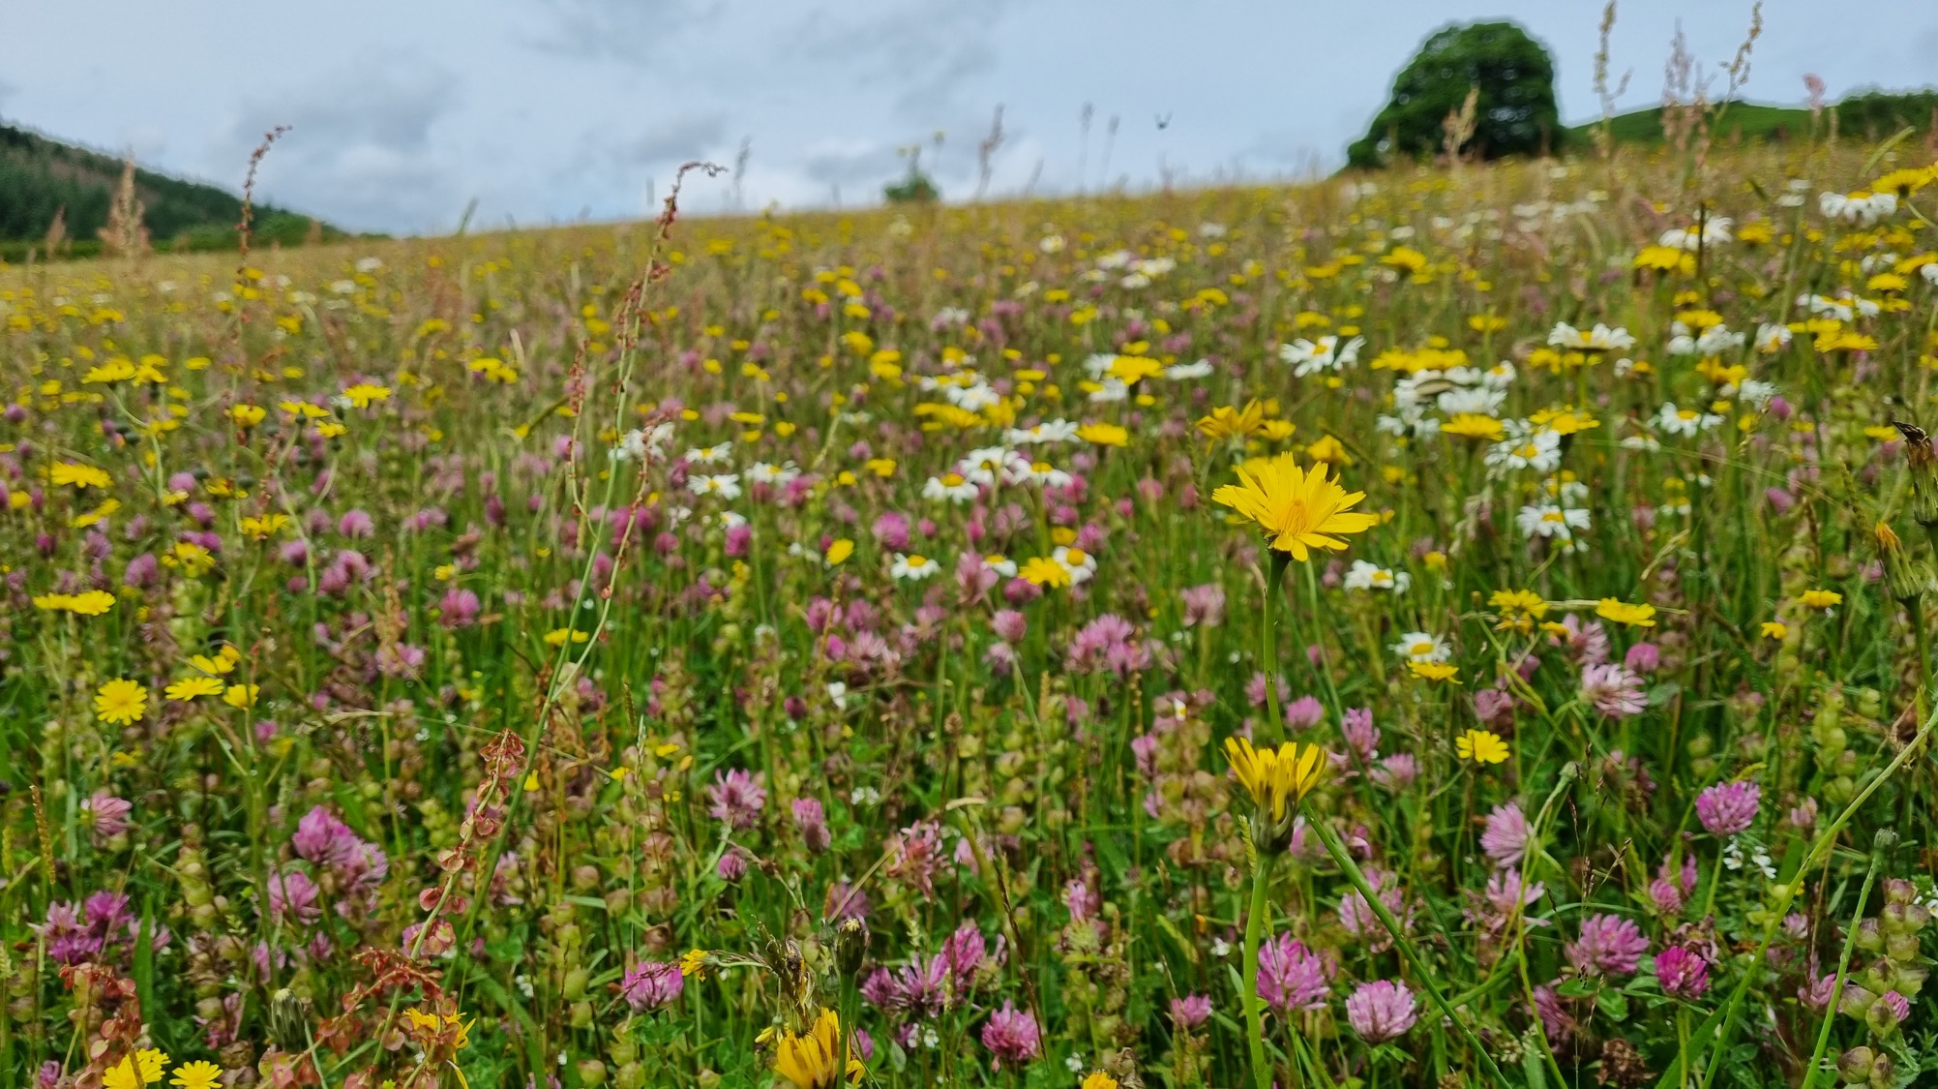
Making the best use of your land – farmer perspectives
Denise Walton, Sophie Mott, Hywel Morgan

Slide 9
We want to hear from you
Notes:
Online questions

Slide 10
Questions

Slide 11
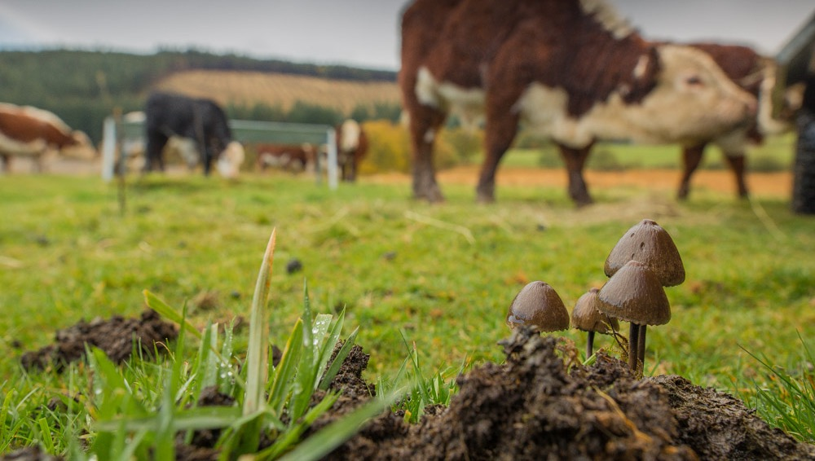
Keep in touch
Farming newsletter info for follow up resource pack, etc
Other contact info/ways to stay engaged

