Slide 1

De-mystifying permaculture
Oxford Real Farming Conference 2023
Andy Goldring, Hannah Thorogood, Rachel Philips, Matt Swarbrick
www.permaculture.org.uk

Slide 2

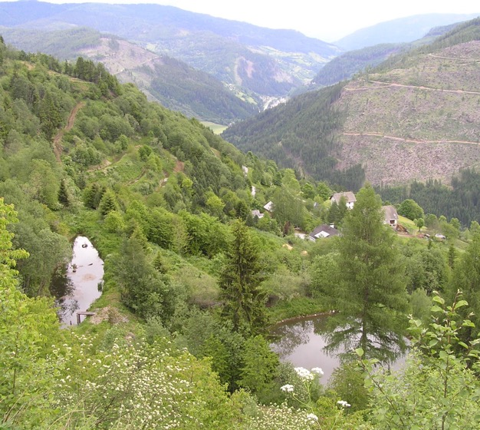
Session overview
Three great speakers
Rachel Phillips, Apricot Centre, Devon
Matt Swarbrick, Henbant Farm, Snowdonia
Hannah Thorogood, Inkpot Farm, Lincolnshire
Panel questions
Short synthesis of keypoints
Discussion and questions
“What would most help me to learn more about permaculture is…”
Final wrap up
Permaculture is being applied in many climates and contexts. Krameterhoff farming system, Austria © Andy Goldring

Slide 3
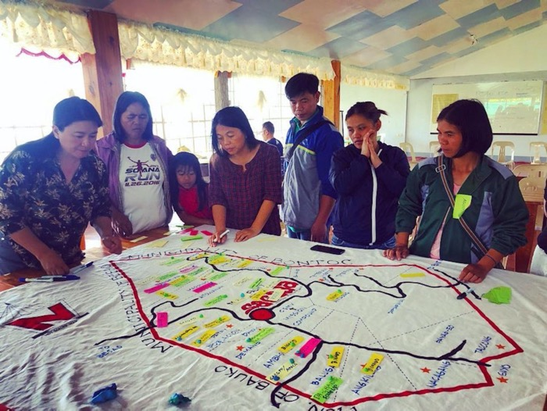
50 years of innovation around the world
Collaboration between Bill Mollison and David Holmgren, Australia, 1970s
Influences of oil crisis, self-sufficiency, environmental movement, science of ecology, indigenous wisdom
Combining agriculture + ecology + landscape design
Grassroots movement
Land focus > design > systems
Ecosystem mapping of organic farming and ecotourism initiatives in Sagada Mountain Province ©Sarah Queblatin

Slide 4
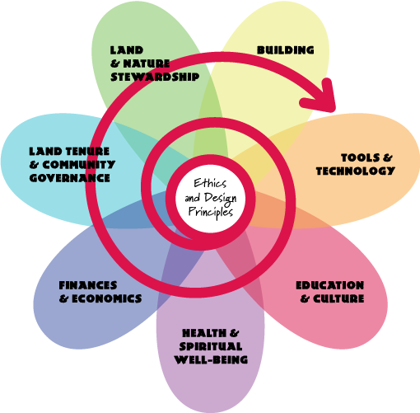
Holistic framework
Ethics
Ecological principles
Design tools and processes
Now applied in many contexts
Image courtesy of https://permacultureprinciples.com with permission

Slide 5
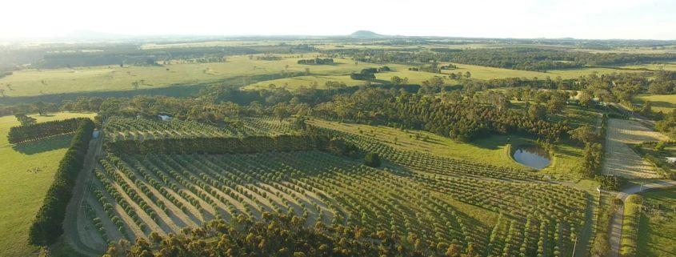
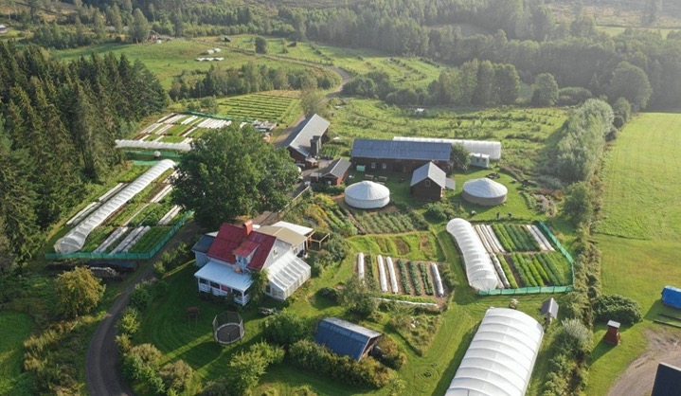
A different sort of farm
Rachel Phillips, Apricot Centre, Devon
Matt Swarbrick, Henbant Farm, Snowdonia
Hannah Thorogood, Inkpot Farm, Lincolnshire
10 mins each, then 10 mins panel questions

Slide 6
Rachel Philipps

Slide 7
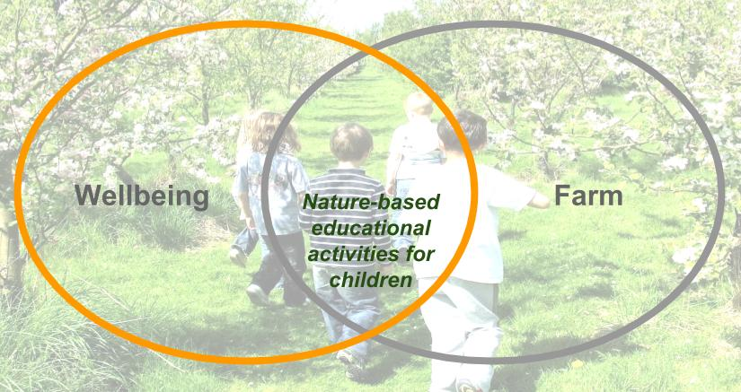
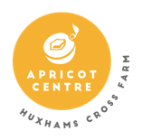

Apricot Centre @Huxhams Cross Farm

Slide 8
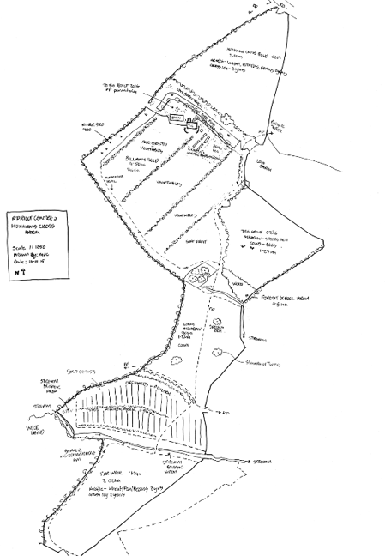
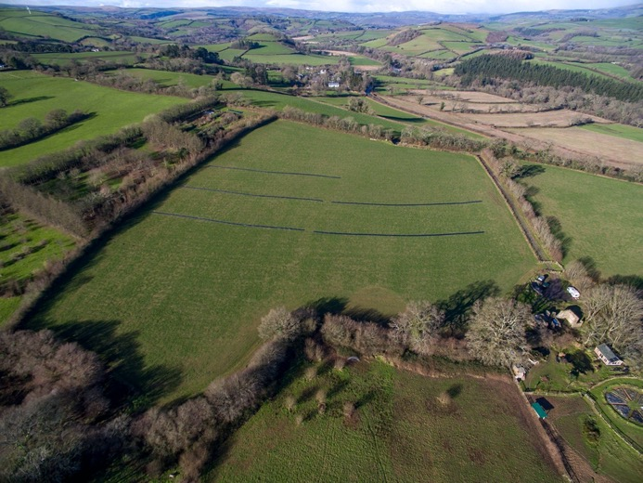
Huxhams Cross Farm Case Study

Slide 9
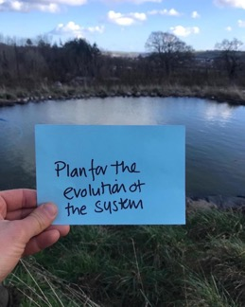
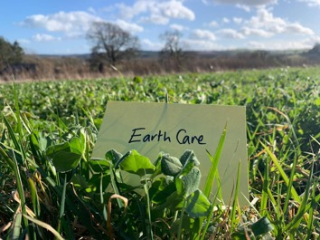
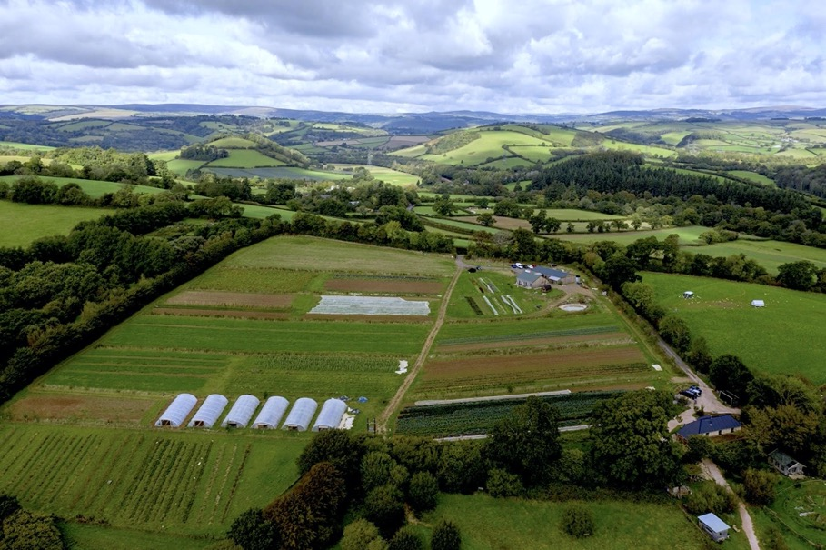
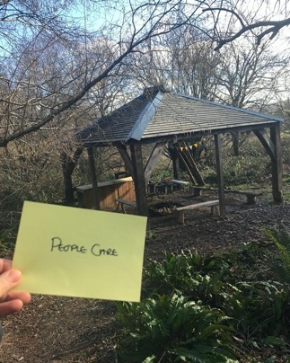
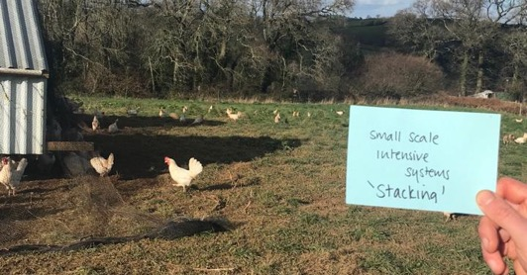

Slide 10
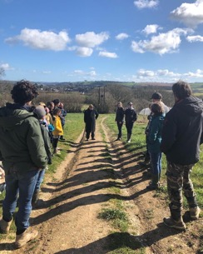
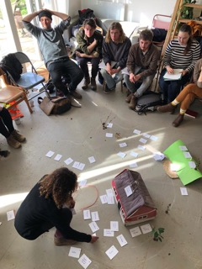




Regenerative School of Landbased Studies
In 2022 -
20 trainees qualified with a level 3
12 participants on the level 2
In 2023
22 Level 3 students
15 Regenerative Design Students on our level 4
Funded by Devon Environmental Foundation, Vivobarefoot ‘Livebarefoot Fund’ and Devon County Council.
Traineeships allow trainees to…
Work in regenerative farming or small holding type settings
Work in post-harvest roles such as food processing in regenerative food products
Work in community supported agriculture or the circular food economy;
Work in regenerative land based systems
Teach Permaculture Methodologies
Work in Consultancy on farms
Progress into higher education courses
The qualification is Ofqual-regulated and awarded by Crossfields Institute.

Slide 11
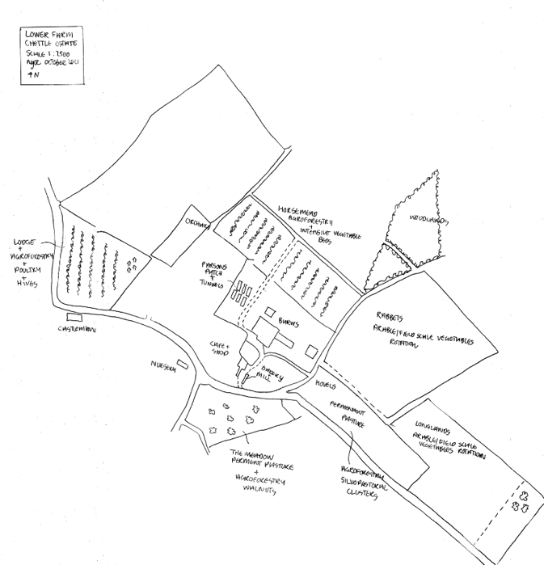
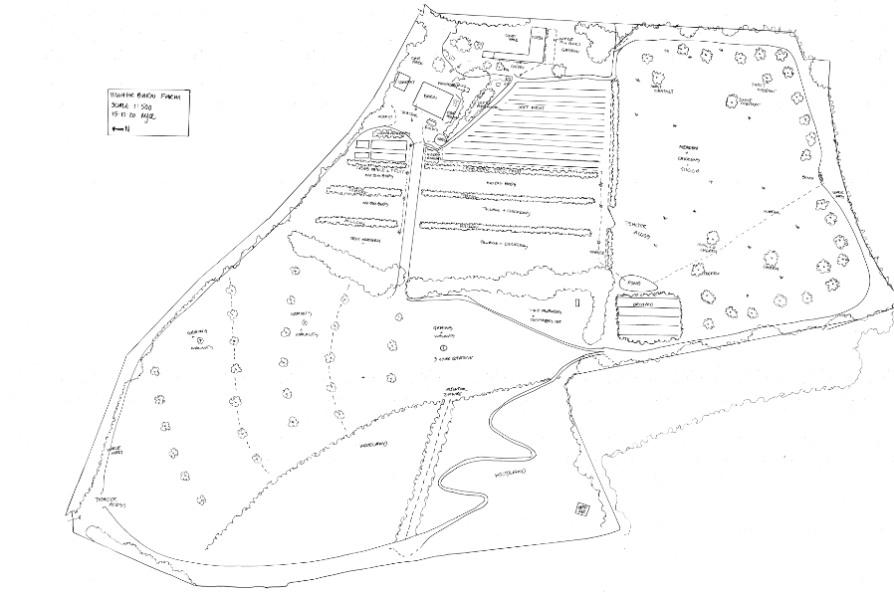
Designing Regenerative Food Systems

Slide 12
Matt Swarbrick

Slide 13

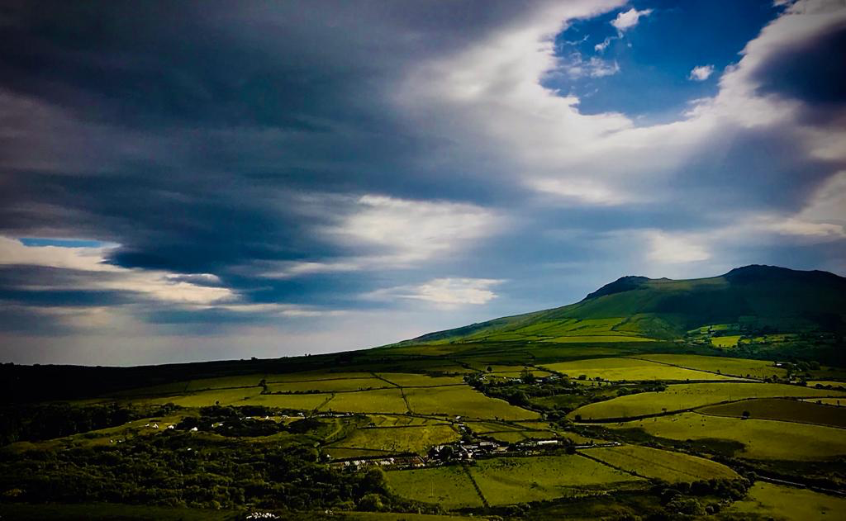
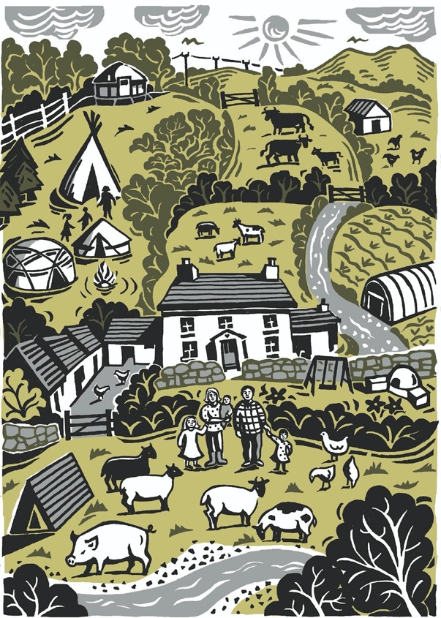
Making Small Farms Work
For people, place and planet
matt@henbant.org
Notes:
So I am lucky enough to be a permaculture inspired farmer between the mountains and the sea in North Wales
And we set out on our mission with a bit of a question..
Is it possible to buy a small farm, on a mortgage, make it pay financially, and at the same time build soil and biodiversity, build social capitol and, most importantly, enjoy it…because if you can do it then we can make the world a very slightly better place
But I think if we can help others to do the same then we can help others to do it then we can actually make a huge difference so I also spend quite a bit of my time I also do bits of teaching, consultancy and working with Welsh Government..
So I’ll just briefly talk about both those things..

Slide 14
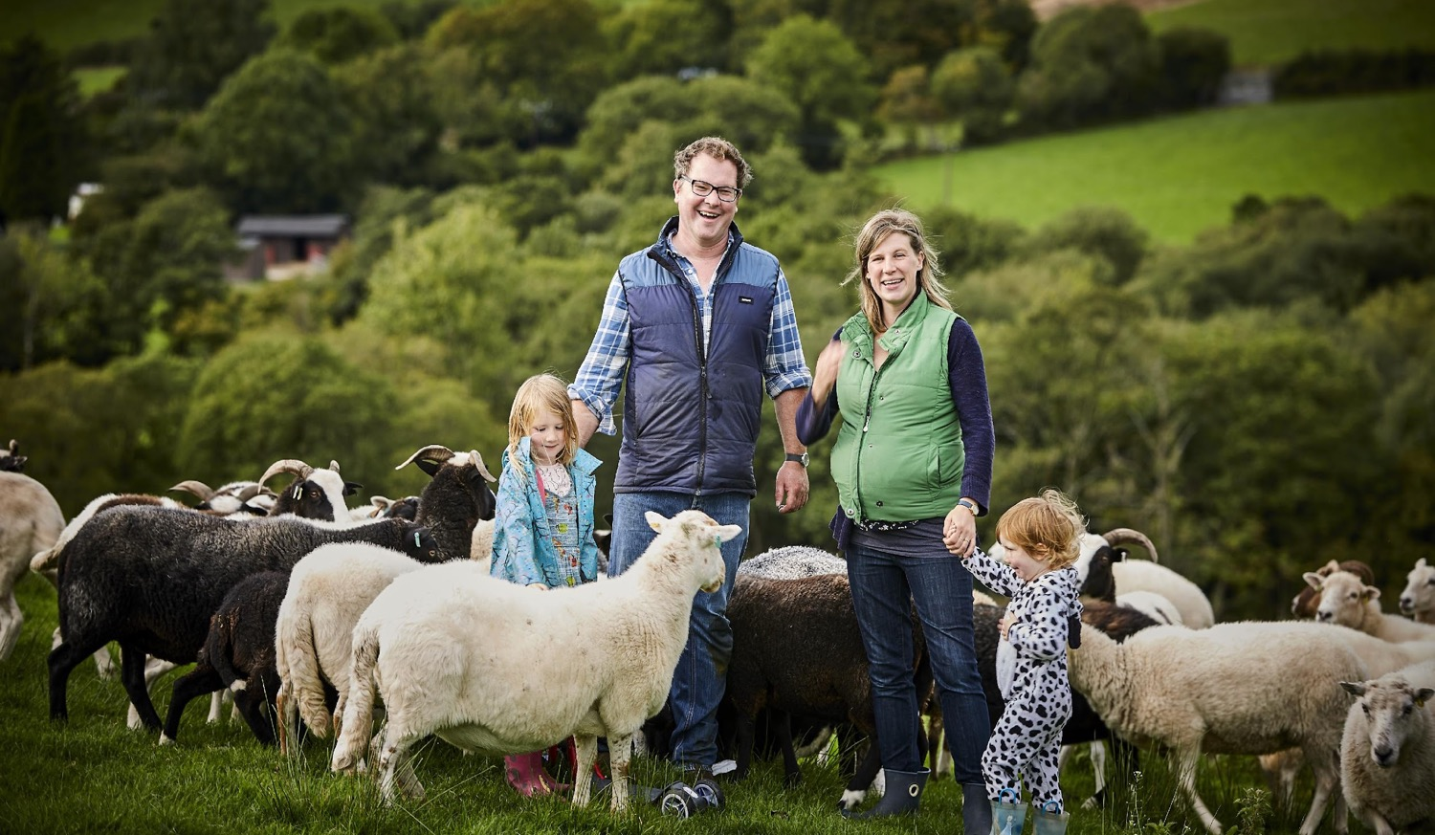
Notes:
Making it better is super important isn’t it ..
One of our biggest problems is that people, even farmers, even.. Farmers at this conference.. often think that eating has to be a ecologically negative act....
People look to reduce the problems, to make things more sustainable…
And that really just means being able carrying on doing what we are doing.. … I don’t think we are aiming anywhere near high enough..
If I ask you how your relationship with your partner is and you say ..ooo? its sustainable .. Well that’s not so good is it..
I want to be able to say my relationship with my wife gets better every day, my relationship with my children gets richer every day.. And that my farm and my community, my farms dawn chorus, my bank balance gets healthier maybe not all the time, but at least in a positive direction..
I want to live with nature, live with abundance..
And I think this is where permaculture comes in..

Slide 15
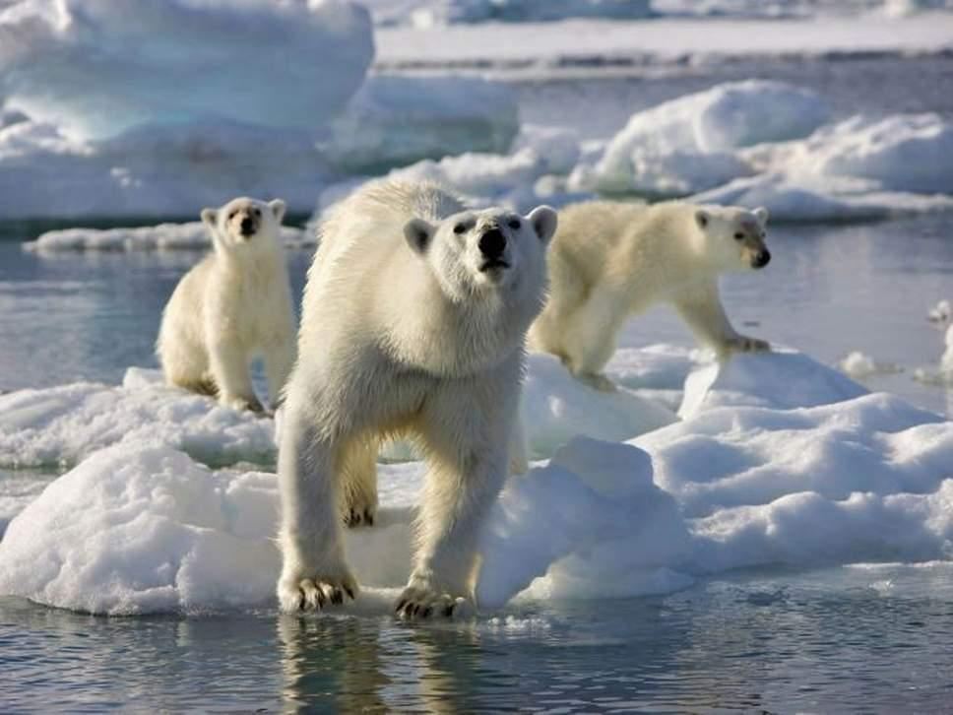
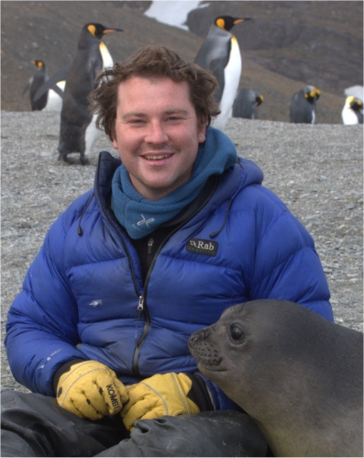
Notes:
And I became an ecologist and for a long time a filmmaker, and I made programmes like coast and countrfyfile and then I was part of a team making programmes like Planet Earth, Life and Frozen Planet and much as that was amaizing for adventure, it basically meant I spent ten years living in a tent at -20 with different camera men when I had a decent bed and a really nice girlfriend at home.. So it was time to become more domesticated but how to be more domesticated and still have great purpose ? Well to be honest, I didn't have a clue..
but then .... I found a new beareded man with strong philosphies..

Slide 16
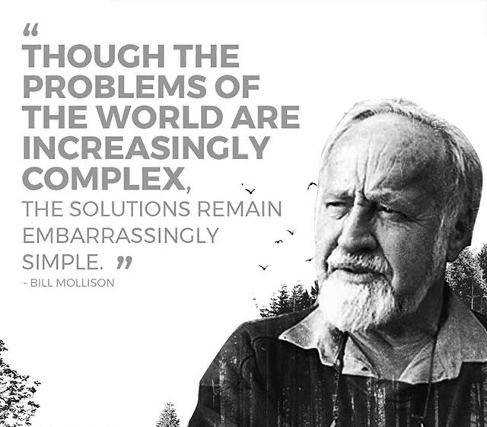
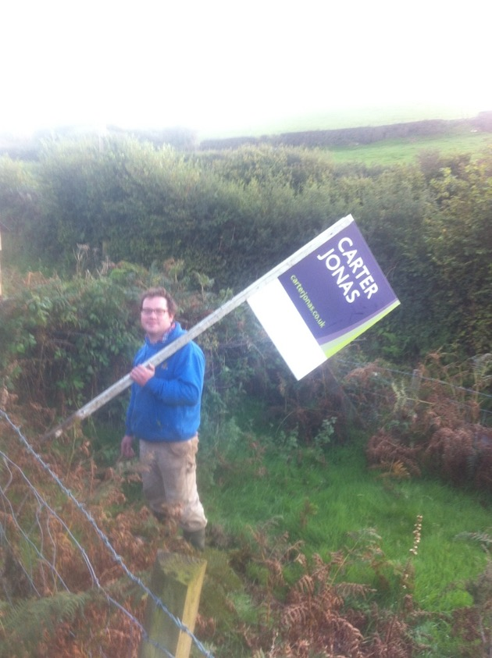
Notes:
I found the work of this guy.. Bill Mollison, who was one of the founders of Permaculture.. and from spending so long watching ecosystem processes it made so much sense.. And it made me realise that the most useful thig I could do was become a farmer..
And so quit the BBC and me and my wife Jenny, we borrowed every penny we could to buy Henbant which was completely derelict, nobody had lived here for over 50 years before but for us it was perfect.. We I really wanted to feel part of an ecosystem, We wanted to grow babies and cabbages and I wanted know every birds nest forever.. And finally, I got to become a farmer..

Slide 17
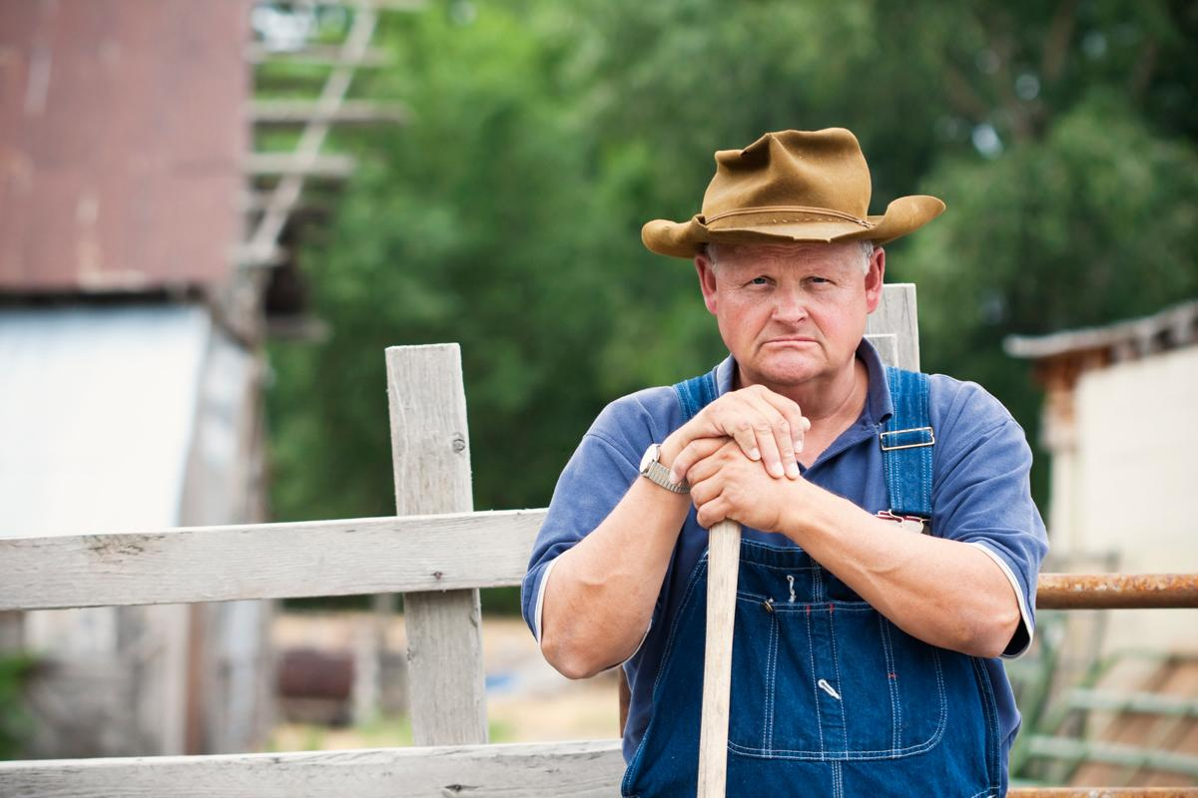
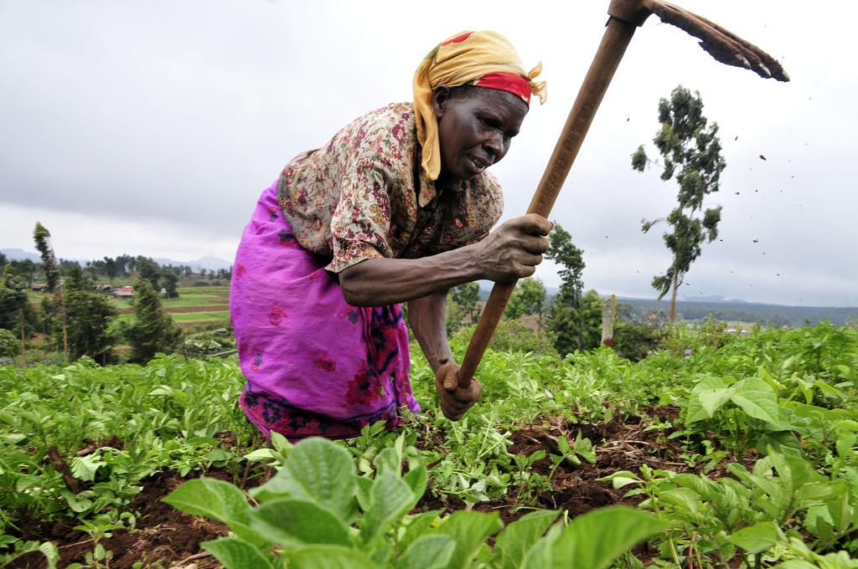
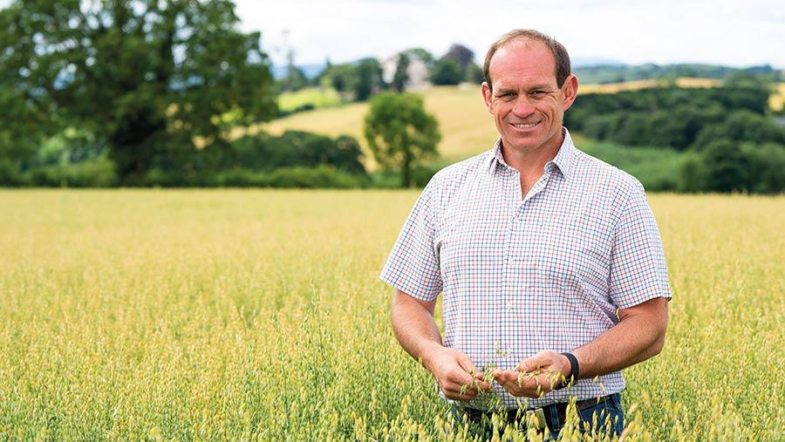
Notes:
And farming should be one of the most privileged and beautiful jobs in the world, it must be the most important.. Yet farming has some of the lowest rates of pay, is one of loneliest jobs and has one of the highest suicide rates… So what’s going on there? That was a bit of a warning!!
So we really had to think with fresh eyes on how the farm should work and use our advantages, which is really our ecology background.. and that we didn't know anything about farming..
At this point I finally realised that I was lucky to not have a dad who was already a farmer because I didn’t have to inherit a system that was out of date or so established that it feels impossible to change
So where ecology meets farming you get .. Permaculture..

Slide 18
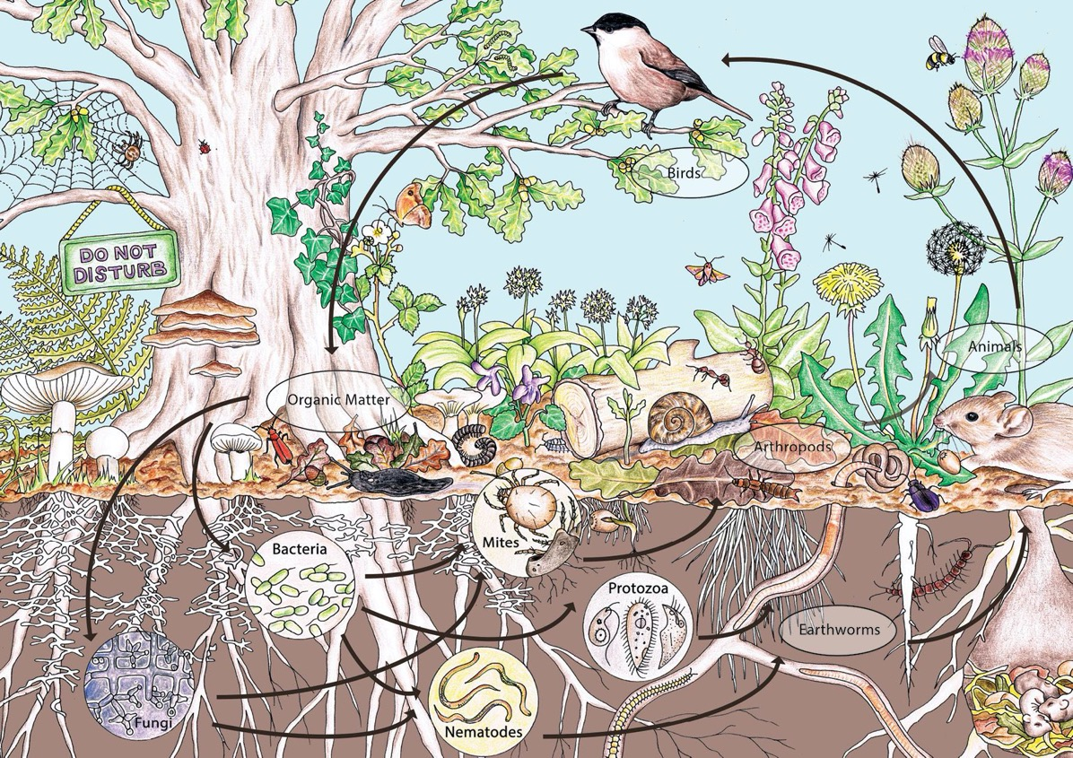

WHAT IS PERMACULTURE?
Notes:
And so what is Permaculture?
It means different things to different people..
To me Permaculture is all about copying natural patterns and integrating the into human centric systems..
You all know how good a woodland is at supporting life.. It has no significant inputs apart from sunshine, rain, air and the odd bit of volcanic ash it causes no real pollution apart from oxygen.. yet an incredible amount of things are happening there.. Everything is playing more than one function, everything gets recycled.. There are a lot of lessons for humans in a woodland.. And so permaculture has lots of principles that are really just ways of helping to bring those natural patterns into a human designed system.
And so here if I wanted to be a dairy farmer, permaculture wouldn’t tell me to look at rotating parlors and NPK application rates.. It would tell me to look at those big grassland ecosystems.. If I wanted to grow apples, I wouldn’t go to big conventional orchard, I’d go and look at some woodland glades in Kasakstan..
One of the nice things Permaculture also gives you the viewpoint that where there is a problem there is a solution and it makes you realize that beautiful world is possible..

Slide 19
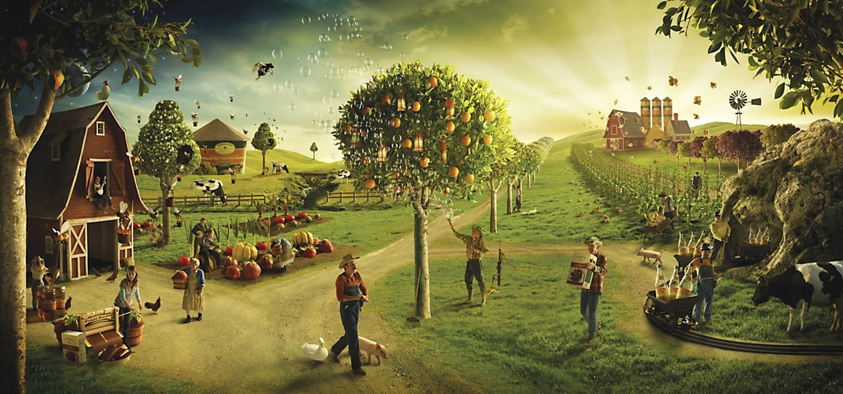
“The only limit to farms productivity is the farmers imagination”…Bill Mollison
So why doesn’t everybody farm like this?
Notes:
But there are reasons that people don't farm like this..
There are many many, good reasons why conventional farming is conventional..
One of these is complexity, It would be super easy to go mad..
It would be really easy to take on a small farm, have big ideas and just get your nickers in a massive, unproductive, twist
There is a beautiful small farm called Ragmans Lane Farm in the Forest of Dean, and the farmer here, Matt Dunwell inherited a small farm and this coincided with Bill Mollison coming to the UK, so all the great and good of the permaculture world decended and left them with a master plan… And in trying to bring together that complex web of a plan he got a bit tired and marriage fell apart.. BUT I really love my wife and so I need a way of focusing and making decisions..
I actually think the biggest barrier to a more beautiful world and making small farms work is knowing what people want with true clarity and good decision making..
but with Holistic Decision Making we have a route to getting what you want from life.. It comes from a military background
The basic principle is that you decide what you want, what you really really want and you make decisions to make it happen..
All sounds a bit guffy doesn’t it .. BUT
Imagine if just 10% of the decisions you make were more aligned to making what you want more true.. Think how much faster you will get there..
And that is powerful..

Slide 20

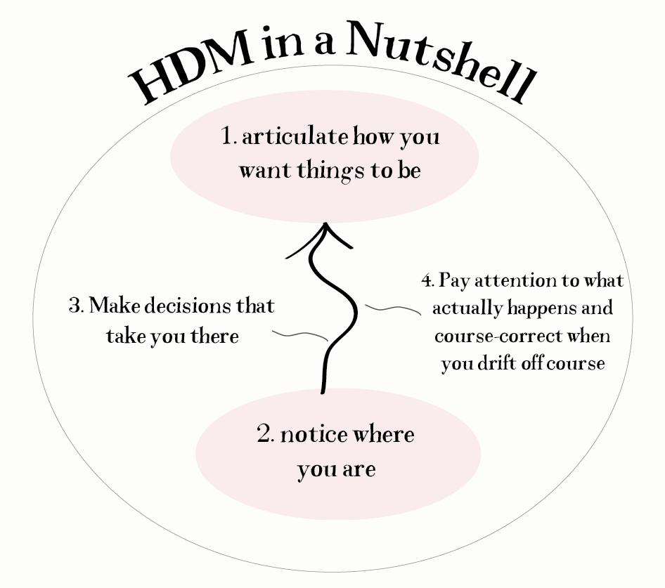
The four core practices are:
Articulate how you want things to be
Notice where you are (relative to where you want to be)
Make decisions that take you from the one toward the other
Pay attention to what happens and course-correct when you drift off course
Notes:
So HDM is all about
1st working out where you want to be,
then
2nd looking at where you are..
Then taking decisions that take you there..
And THEN
Paying attention that you don’t drift of course.. That’s the dealing with unintended consequences part
And this is the first part of the process that I work with clients.. In many ways it’s the biggest part of the survey phase of a permaculture design.

Slide 21
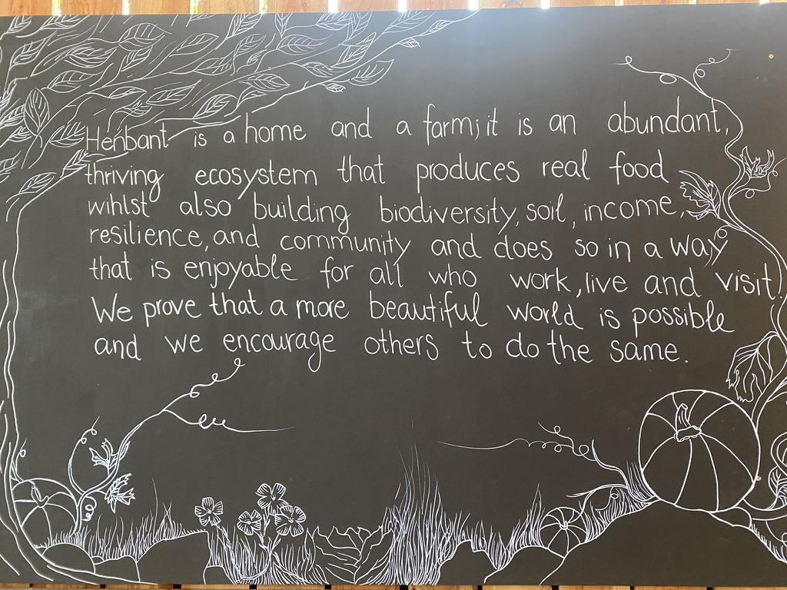
Notes:
Henbant is a home and a farm; it is an abundant, thriving ecosystem that produces real food whilst also building biodiversity, soil, income, resilience, and community and does so in a way that is enjoyable for all who work, live and visit. We prove that a more beautiful world is possible and we encourage others to do the same.
Big part of Holistic management is being conscious of your future resource base. What do you need to be healthy for you to be able to live the life you want? health of us working and living on the farm, the farm itself, our bioregion, our community, our finances..

Slide 22
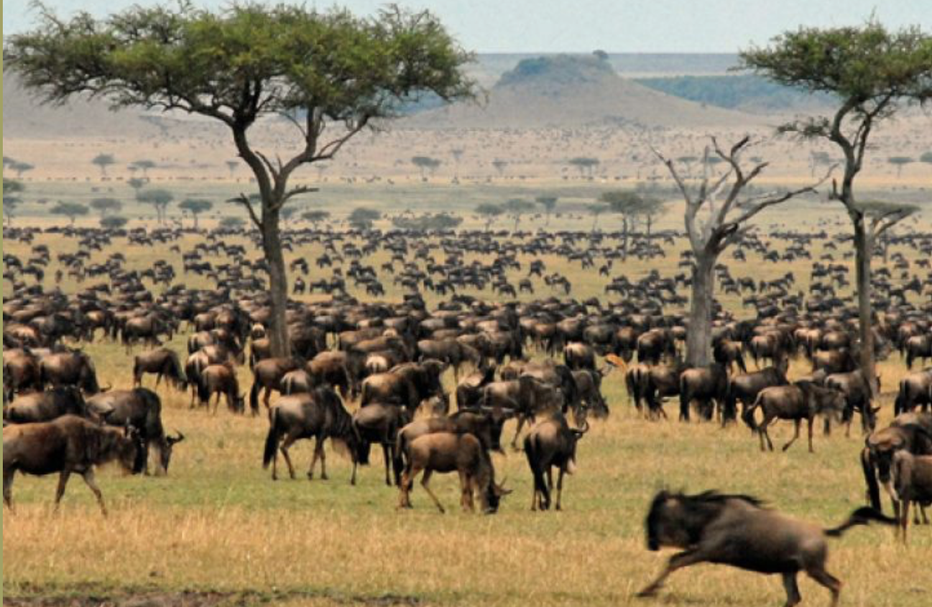
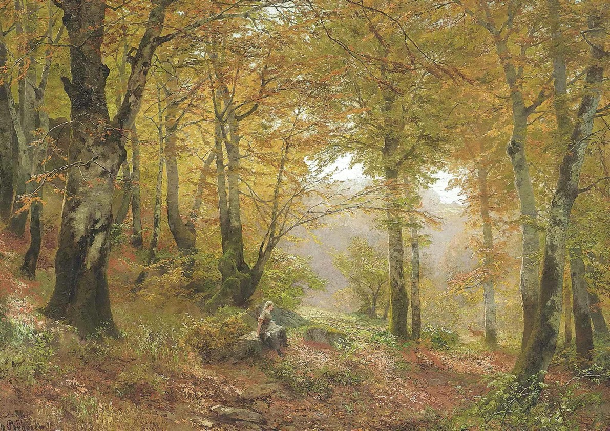
Notes:
So how does this copying natures patterns look like on our farm?
So coming back to the concept of learning from nature.. What is earths most productive, terrestrial, soil building ecosystem.. Savanah grassland..
They are grassland/tree systems that used to support the biggest animal biomass on the planet and grew the deepest top soil on earth.. they have grasses that got to express themselves fully, so they went a long time between being grazed and then when they do, they were grazed hard for a very short period.. Ruminants were always moving and were often condensed by predators.. wolves.. or bears.. things with big teeth
That may all look a bit hot and sweaty.. and look a bit equatorial for Wales but there are lots of lessons in it.. There is a pattern language..
And there is another really productive and interesting ecosystem that very much fits into Wales and that is forest glades and if you go back a few thousand years, these would have being where it was at.. This is where the humans would have been..
This woodland edge habitat is one of the most productive parts of a woodland, its also where all our fruit crops belong.. The plum, pear, apple, the nut, the currant, and the bramble..
And so what could be more exciting than dividing lots of our farm up into small pastures, sized to fit our herd for one days grazing.. where our animals are kept in a natural herd and moving every day, surrounded by rich, woodland edge influenced agroforestry, fruit lanes.. Like linear forest gardens breaking up the whole farm, a whole edible landscape, a rich productive mosaic.

Slide 23
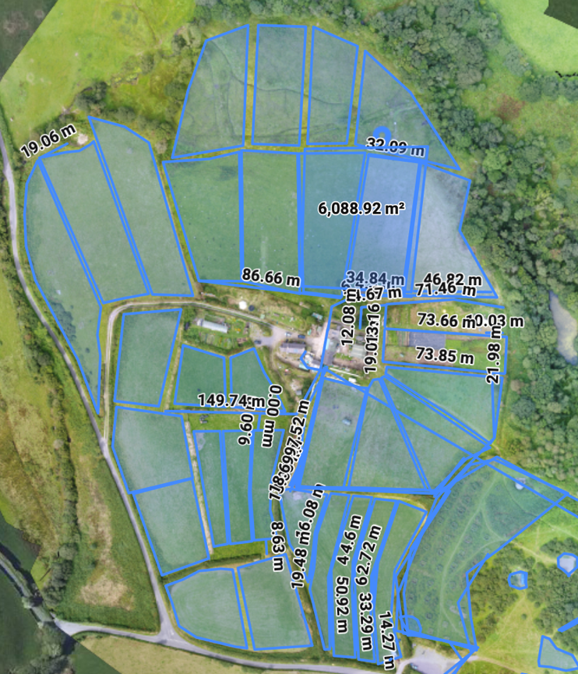
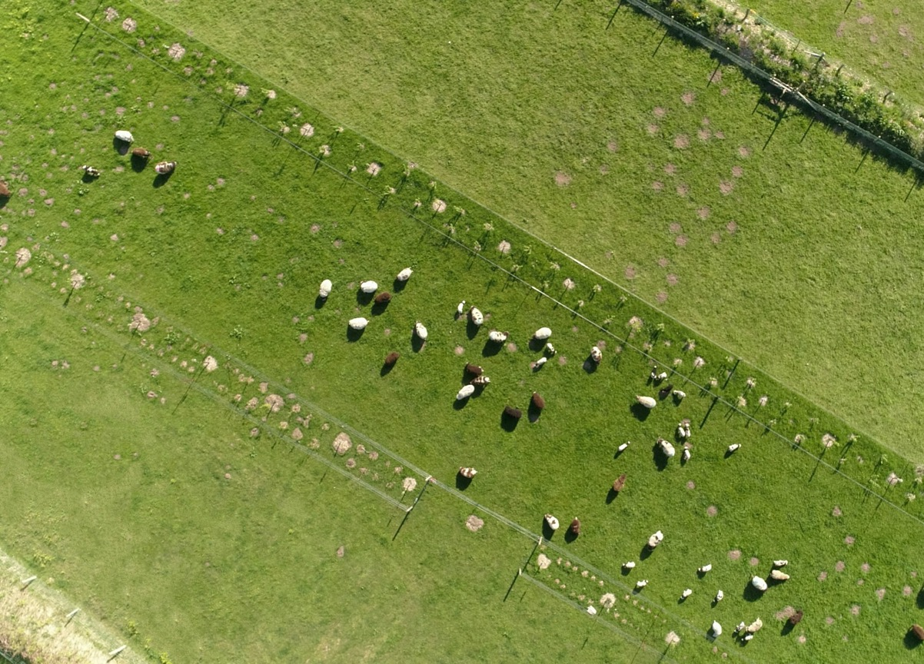
Notes:
So what we have done here is to divide the main pasture into 32 day sized grazing units.. so instead of wolves we have electric fences, we use them to keep our animals moving. The areas within the fences are our woodland edge habitat
and its this multi functional complex system.. that really starts to sing.. we have shelter and shade, browse for the animals to add to their diet, we've got way better, time controlled, grazing management..
It also fits in brilliantly with adding in much more diversity and life to the farm as well as more enterprises
So on our poorer, north facing, land we have done this mainly for browse, so cheap, edible to livestock and fast growing trees.. willow, alder, hazel, bird cherry, poplar

Slide 24
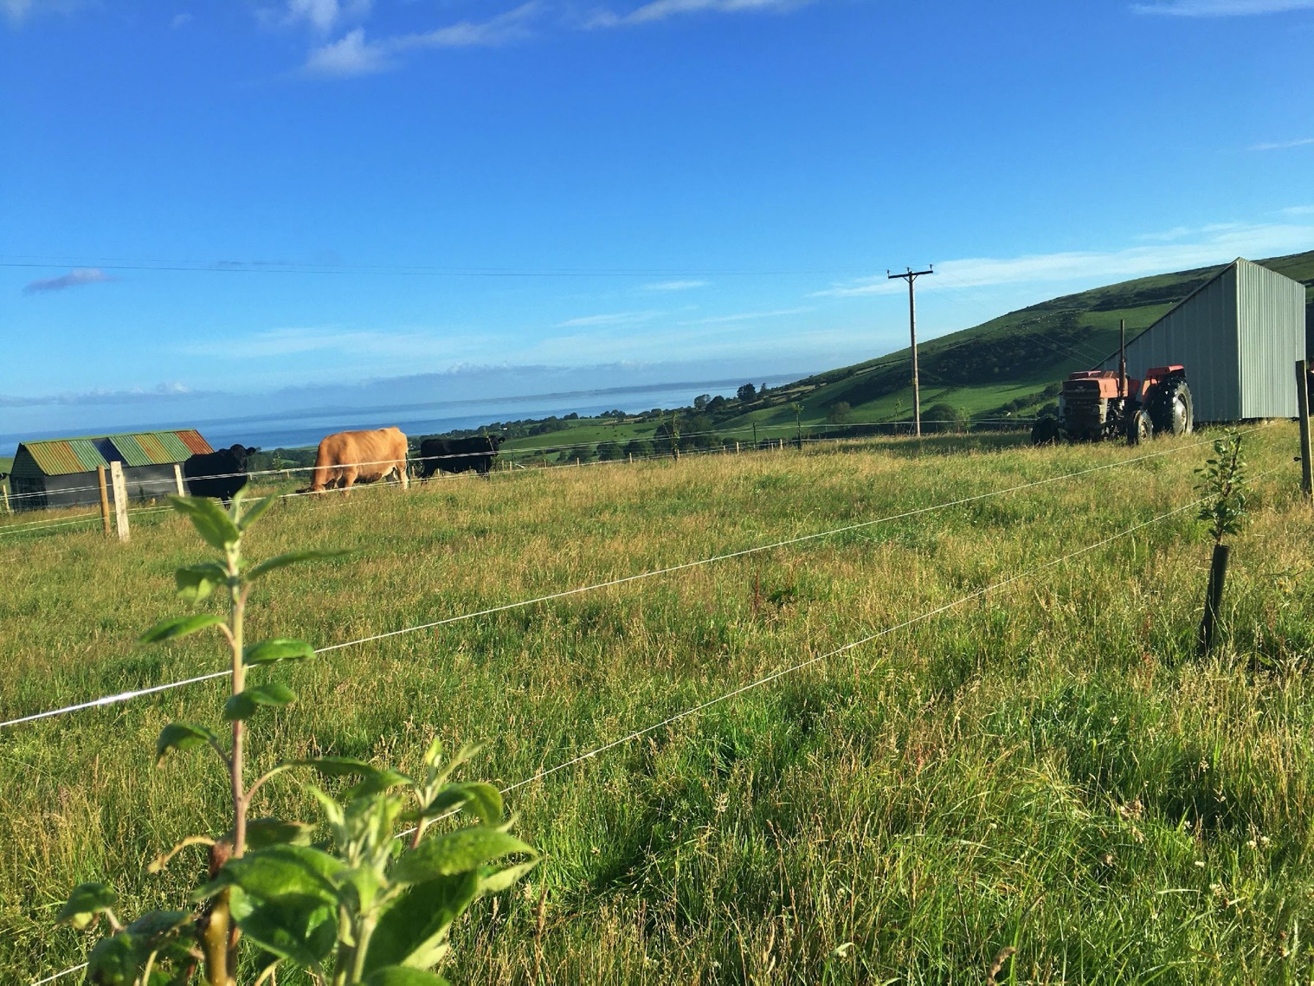
Notes:
And then on our better, flatter land we have put in more top fruit and soft fruit and other support species..
So they are mainly apple trees with some plum, pear and cherry and the shrub layer is blackcurrant, raspberry, gooseberry, sea buckthorn, aronia and then it has a layer of smaller plants, comfrey, mint, buddleia, pumpkins and rhubarb.. Lots of things actually
All this agroforestry forms the backbone of the farm ecosystem and its these constantly moving ruminants that are allowing us to lock down carbon, increase our pasture diversity and build soil… and it helps us improve the farms productivity.
So this agroforestry system is one of our crops, it’s all still a bit in the future, but we have planted up much of this to make really good fruit juice, hopefully we will make about 10k per year of the fruit juice and that’s at the same time as not losing any productivity from the beef heard or from the chickens
Infact, this shelter, this enhanced forage, this better controlled grazing means that we actually get improved shelter and pasture growth rates.

Slide 25
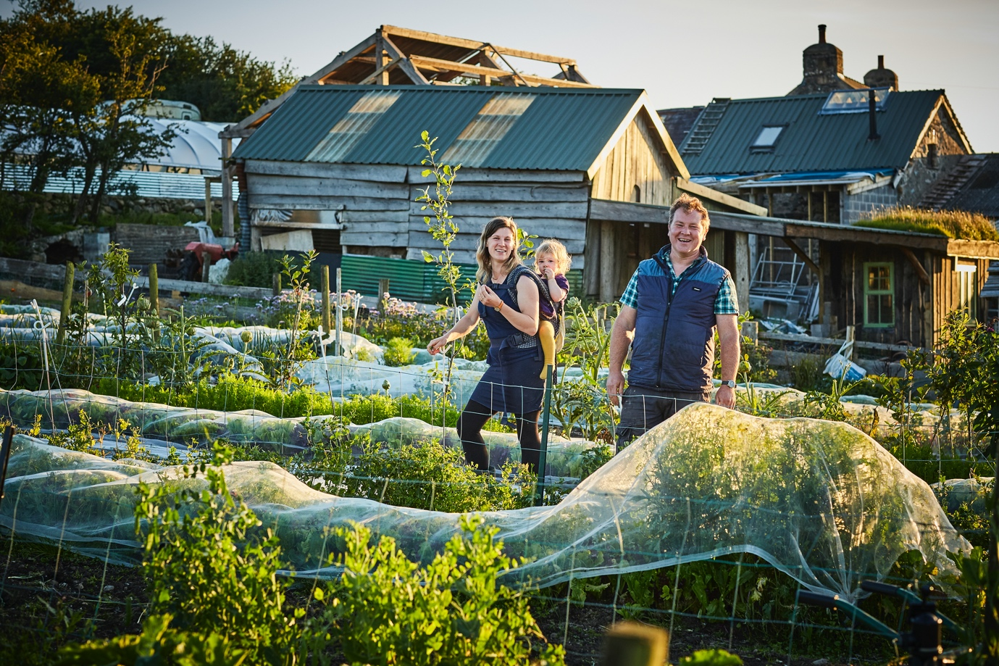

Notes:
But you can just live off beef, milk and eggs.. we need veg…Ad this is one of the most exciting parts of the farm from an area of less than one acre we produce most of the veg for 80 families between June and Christmas..

Slide 26
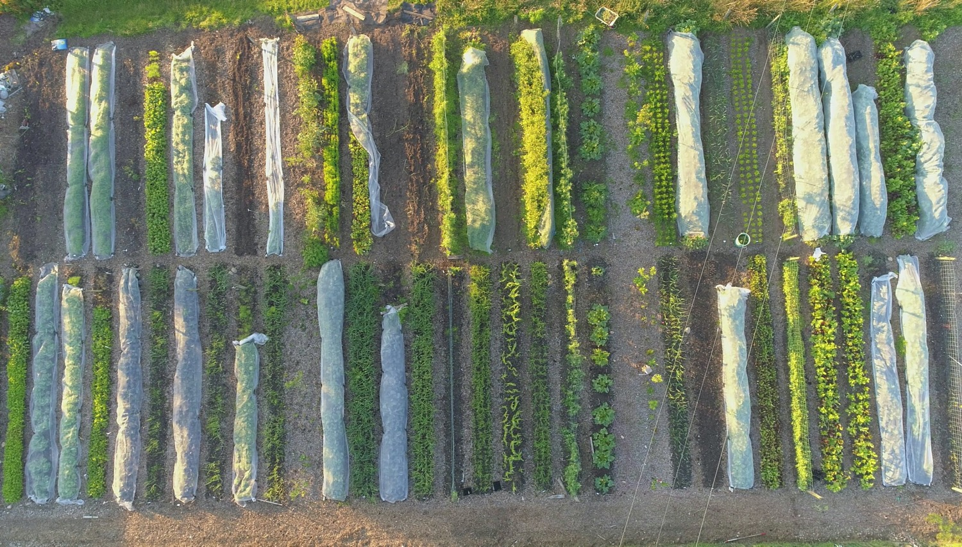
Notes:
So this is an area of land that to almost any conventional farm is insignificant ad yet it can produce a full income and so much veg…
and its the same in our garden.. We are completely no-dig, and so what we have is 120 identical beds these are all 75cm wide, 10m long beds and that uniformity means that though across the garden the overall pattern is really diverse. it means we can plan really well, we can swap beds and have all the kit fitting universally and most of these beds will do at least three crops in one summer.
What’s also exciting in the garden is that we have punctuated it so that every ten beds there is a perennial and tree row.. and this gives us a windbreak.. and most importantly it adds these beautiful little mini nature reserves.. loads of space for beetles and pollinators.. What's so important is having both the bugs and the buggers..
And the no-dig is important not just from an ecological perspective.. But also in terms of efficiency and weeding.. Because we never turn the soil, we never disturb and activate the seed bank, so our garden becomes.. Well, not weed free.. But we have much less weed pressure.
We also have two quite modest polytunnels.
And this allows us to put in about 100 hours per week and provide 70 really good veg boxes per week plus a few sales to cafes and shops..
And its this broad, whole diet approach and wide customer base actually that really holds it all together, so we are producing the meat, eggs and veg for at least 70 families.

Slide 27
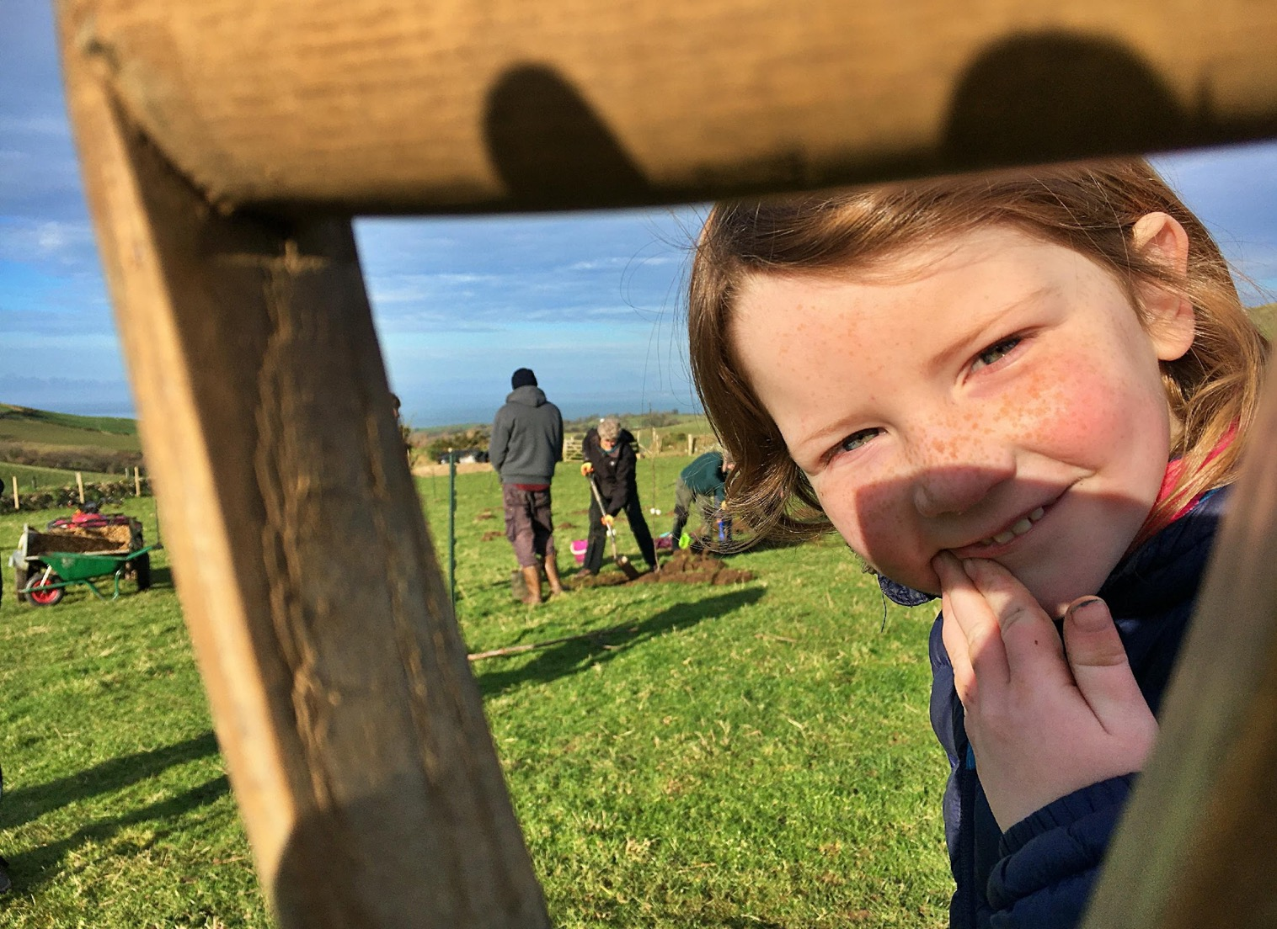
Notes:
Now this talk so far has made me look like a very busy person.. Which we all probably are.. But what is the biggest element of our farm..
Child Labour..
People, they are our farms main secret weapon..
We need them to be able to work with that complexity.. And not in a lets have loads of us slave labor way, our systems are relaly effificient. But really in having the ability to deal with the complexity that really working with nature requires… just those little bits of attention to detail
We do make sure that all our enterprises are capable of realizing at least minimum wage for the time put into them.
Often when I do the consultancy work one of the most common answers that comes up is to get more people on your farm.
Now… I did get some way down this line of Permaculture farming and I was a bit worried.. I had a huge mortgauge

Slide 28
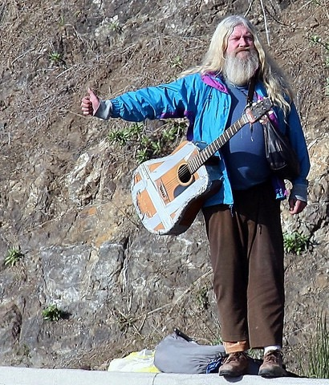
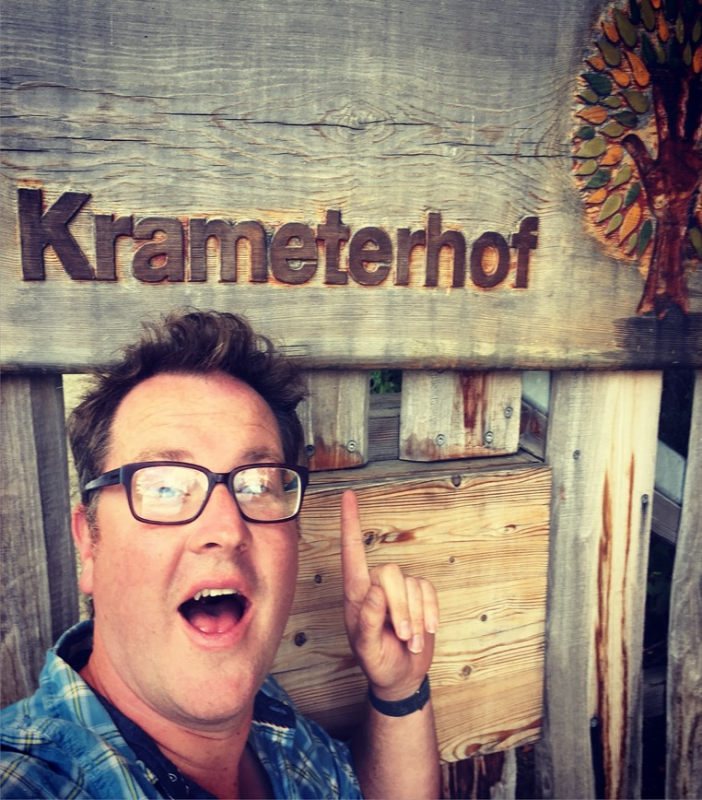
Is it true?
Notes:
And does it work?

Slide 29
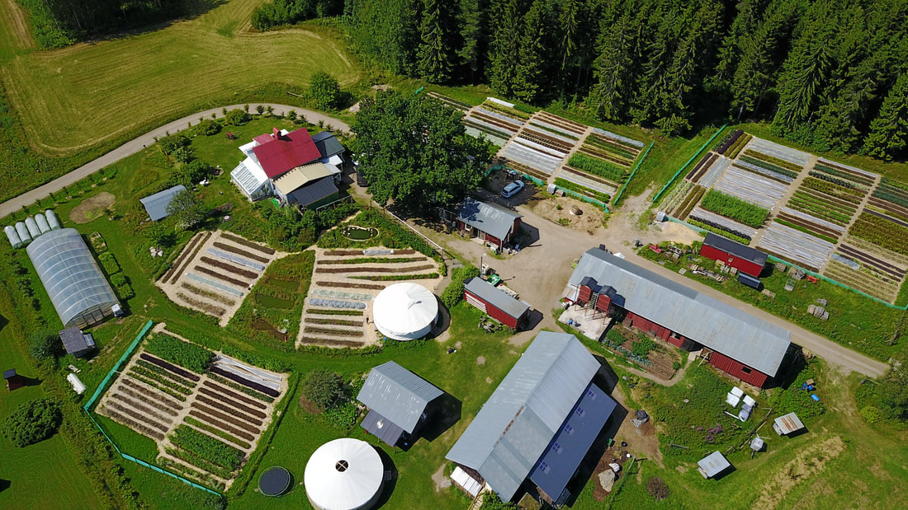
Ridgedale Permaculture
Mixed enterprises: market garden, laying hens, broilers.. Lots of smaller enterprises
Provides six incomes from a 25 acre site
Notes:
One other farm and farmer that I’ve done a lot of work with and which has really proven how far permaxulture can get you is Ridgedale in Sweden and Richard Perkins..
He is now just concrentrating on training but he took a 25 acre farm and created a turnover over E300,000 in five years.. Paid the mortgauge of.. And met NEARLY all the bottom lines that I am worried about..
But he maybe went a bit too fast and it got a bit stressful..
I think permaculture reminds us to work with multiple bottom lines.. There is a set of ethics that if you work it through really help you meet all those bottom lines..
If you think about conventional Ag, it can make a financial profit.. But its eroding its future resource base.. And this is where holistic mangemnt steps in.. And its great for planning grazing.. But its clumsy at some of the other parts..
BUT if you can click every one of those bottom line metrics into place.. soil, water, finances, biodiversity, community, personal health and happiness then you can save Humanity...

Slide 30
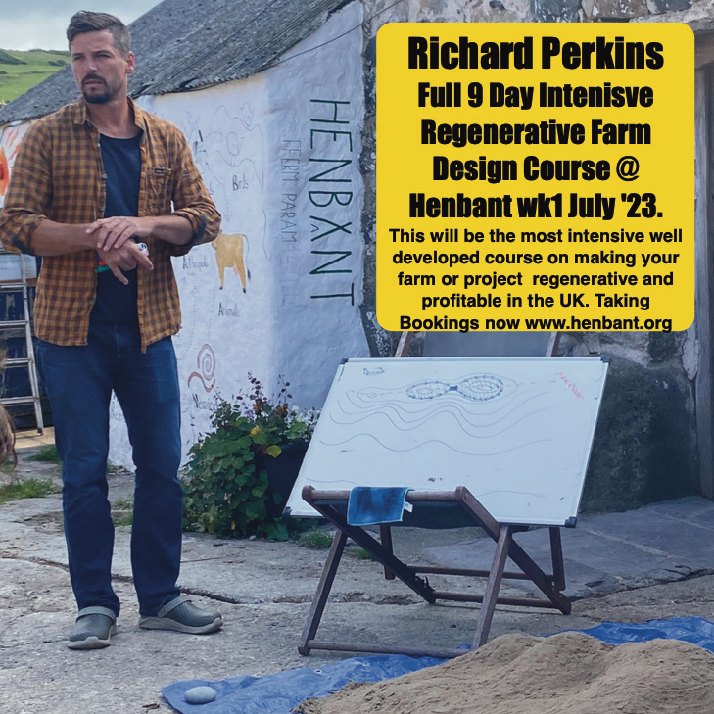
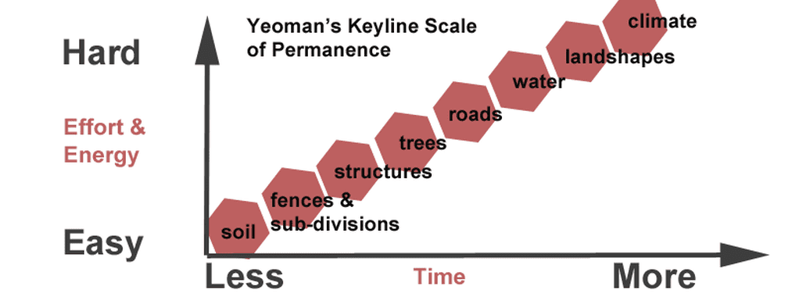
Making Small Farms Work
Build a Holistic Context
Map your farm
Yeomans Scale of Permanence
Ecology and Patterns
Working to multiple bottom lines
Complimentary Enterprises
Keep reviewing and knowing your business
Notes:
And over time I’ve been doing more and more work with Richard Perkins.. He’s a permaculture teacher and permaculture inspired farmer from Sweden Actually this summer we hosted Richard Perkins’s, regenerative agriculture design course, that is probably the best course in the world, its nine intensive days and it was very much originally developed as a Permaculture Design Course, which is a 72 hour course that covers permaculture design, but also life the universe and everything else.. And really dialed it in for a farmers context.. Which bits Permaculture really work for farm design.. Which bits of natural patterns and pattern language are really relevanat.. Which are the sharpest tools in the permaculture tool box.. For farmers…
and it was fantastic to be able to bring the course to the UK< we will do so again in summer 2023.
And my work with Richard is really great, I now teach and mentor with him and it’s the same methodology that we use for consultancy, mentoring and teaching and I think its the strongest basis to making small farms work

Slide 31
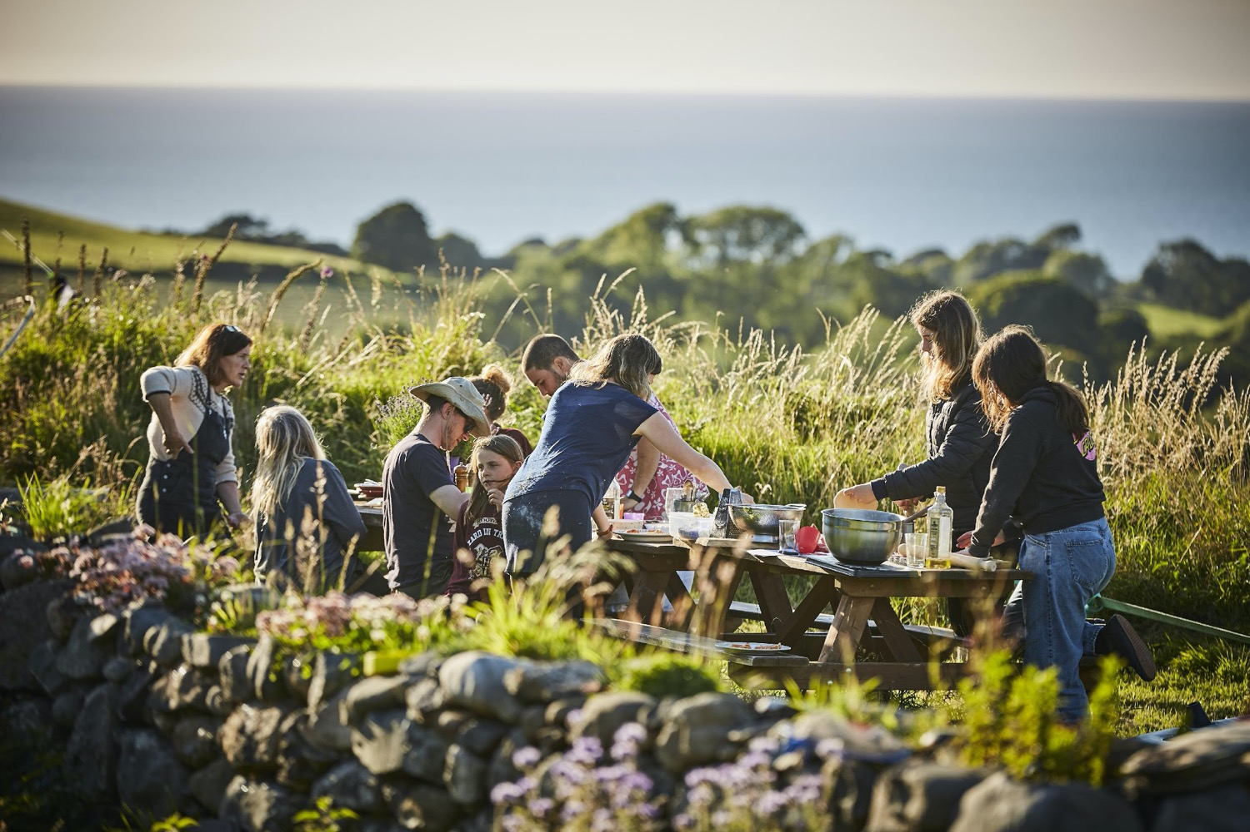

Notes:
Internship
So we have always had a fun, hardworking team of people on the farm and this year, we are employing three people full time and we are running an internship program.
The idea is that by the end of a summer with us people can leave Henbant and be able to run a farm like this of their own.. We ask for commitment of March to October and we work super hard (but we eat really well) then we do five hours a week of training. We go over Permaculture, we go over a regenerative agriculture syllabus and we do loads of Holistic Decision Making and then we go into real depth with all the farm enterprises.
One thing which I find super optimistic is the amount of interest and expansion in this space.. We had over 100 people apply for this this year .
And then we have had philantropists offer us money to supercharge what we are doing (which we've not taken as it think spoils the authenticity and replicability of what we are doing)
but we've also had people saying do we know farmers who could take on their estates.. There are billions of pounds heading to regenerative agriculture.. But its not a technology, it’s a way of thinking as so what we need more then the money are loads more famers.. Ones who can stand up and say I can do that..
We had a chap who has spent this past year with us and he wants to manage a regenerative farm in similar ways to what we are doing, he has had four job offers with salaries over 40k and people offering to buy him a farm.. The opportunity for this to happen is there...
.

Slide 32



Notes:
And it is this model that I use doing consultancy work we’ve been helping all sorts of folks get what they want from their farms, mainly those transitioning in but also some established ones..
And this seemed successful enough that we are now funded via farming connect such that any farer in Wales can get 15hours of our time..
that’s funded, via Farming Connect by the welsh government.. I could be as busy I want to be with this work.
Now.. As an English person in Wales, who doesn’t have a clue what I’m doing I’m the last person who can stand up say oo do it like this.. BUT if people come to us, I love talking about it..
Wales has got this great thig called Farming Connect whish doesn’t exist in England
So Via Farming connect we’ve become demonstaratoin farm, which means we host open days for welsh government, we are on the map for decision makers.. And its so good to be able to put permaculture into the heart of these conversations..
Ive also done a lot of talking with the Ahricultural Advisory Borad

Slide 33
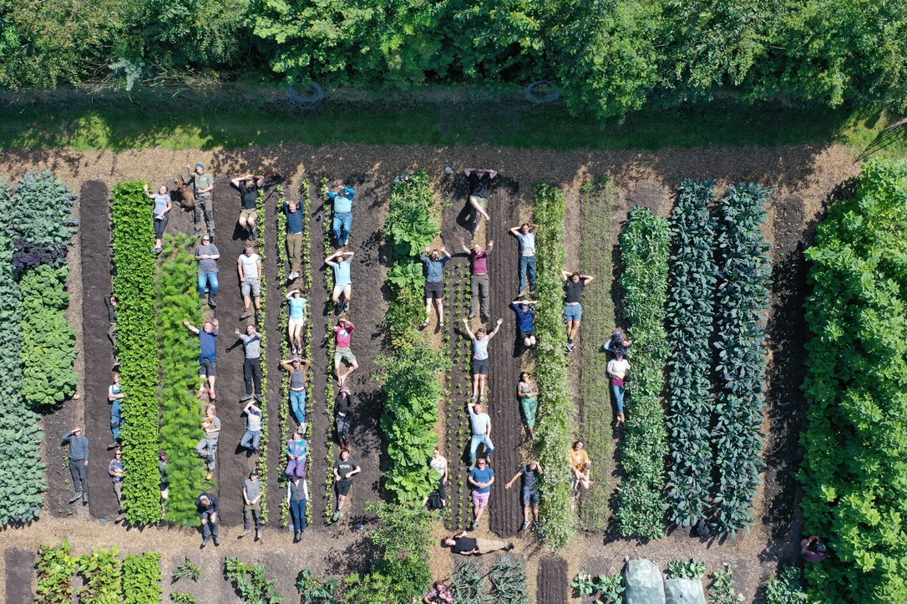
Growing Future Farmers

Slide 34
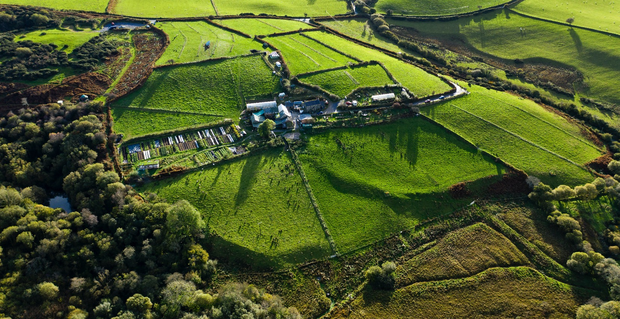
Diolch..

Slide 35
Hannah Thorogood

Slide 36
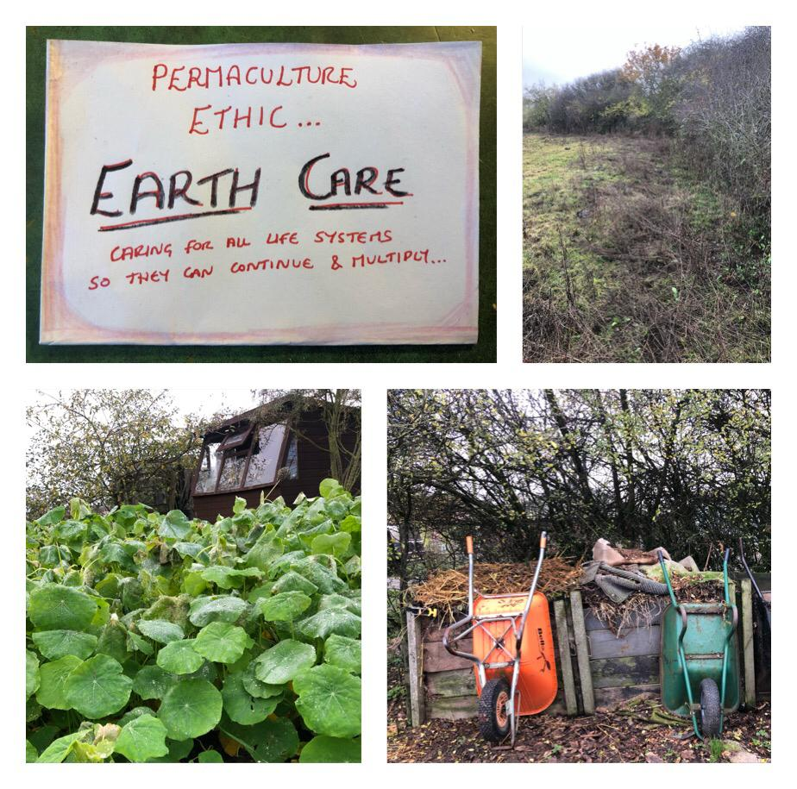

Slide 37
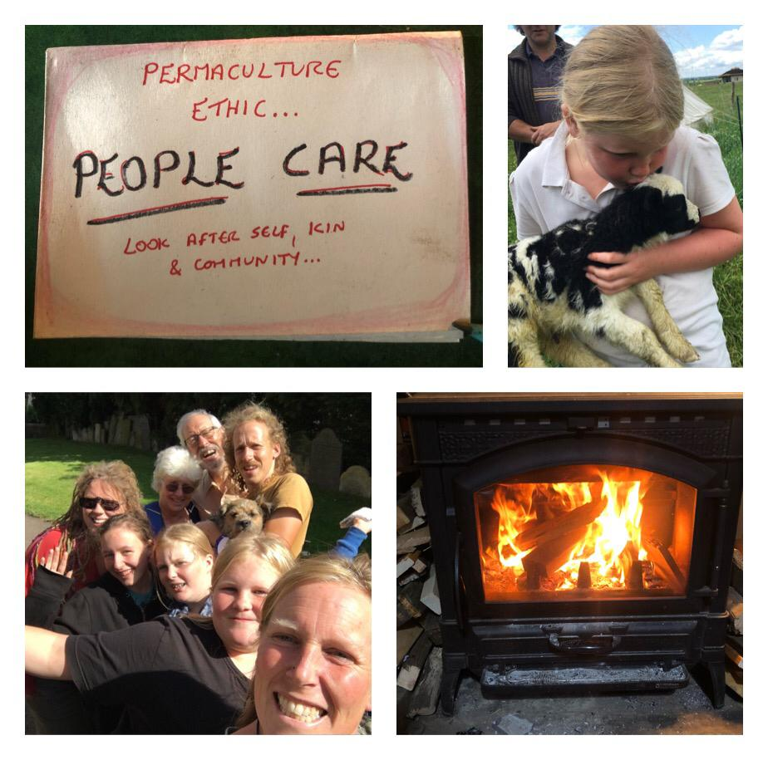

Slide 38


Slide 39


Slide 40


Slide 41


Slide 42


Slide 43


Slide 44


Slide 45


Slide 46


Slide 47


Slide 48


Slide 49


Slide 50


Slide 51

Learning pathways & support (pairs)
PAB membership - networking, map, online community, events
Training - design course /bespoke
Apprenticeships
Group visits and tours
WhatsApp list
European Forum - 1-5 March https://forum.eupc.community/
But what do you need?
“What would most help me to learn more about permaculture is”

