Slide 1
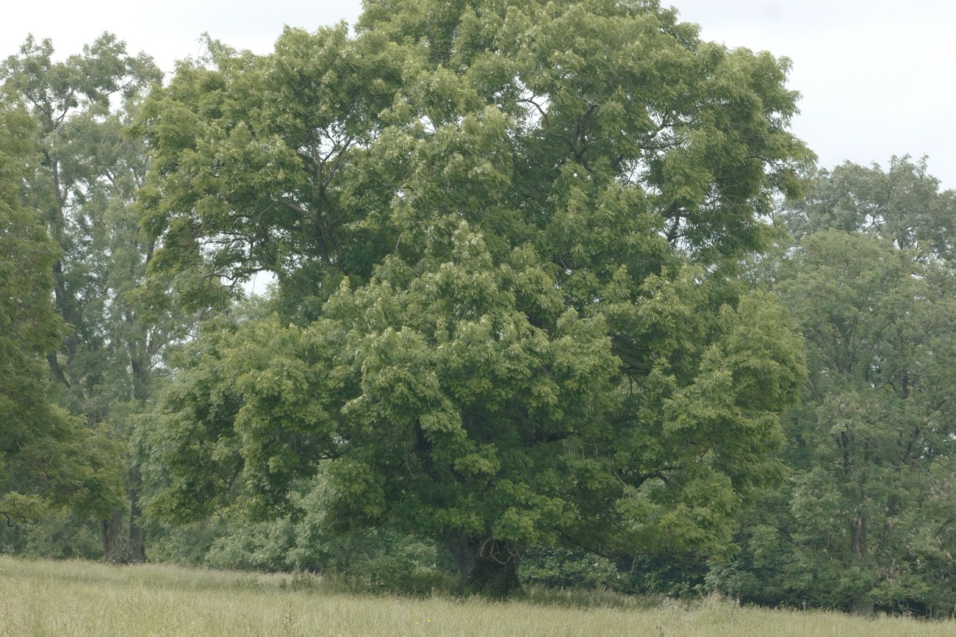
LIVING LEGENDS
THE ANCIENT AND VETERAN TREES OF COMMON FARM, HATFIELD, HEREFORDSHIRE

Slide 2
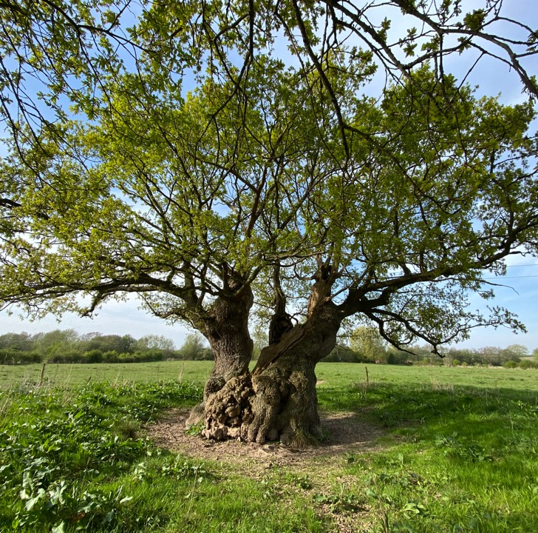
FARM ROOTS
Family farmed in and around Herefordshire for hundreds of years.
Tenant farmers moving around the county
Main farm – 450 acres owned by Brasenose College
  Organic 20 years.
  Beef, arable, veg, flowers
  Great soil.
  Very productive.
  Floods A LOT.
  Only really 2 interesting “ancient trees”. But they are DAMN good trees

Slide 3
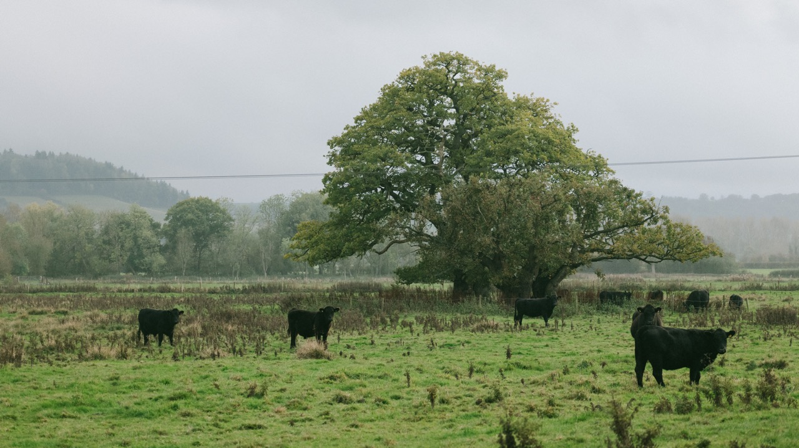

Slide 4
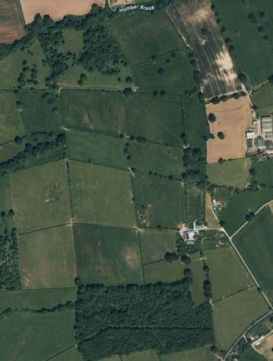
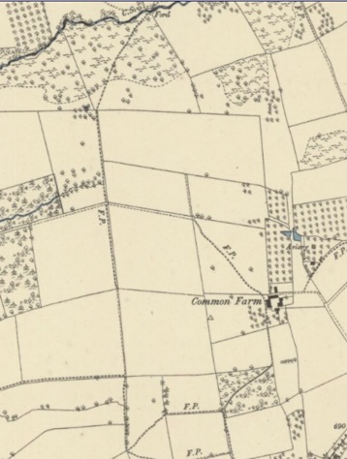
NOW AND THEN
RECENT GOOGLE MAPS IMAGE VS 1885 OS
Common Farm, Hatfield
Land purchased in 2020.
Appeared to have been low input/management.
Many mature trees
Field boundaries largely unchanged from 1885
Some trees thinned/woodland cleared
Ash dieback taking its toll

Slide 5
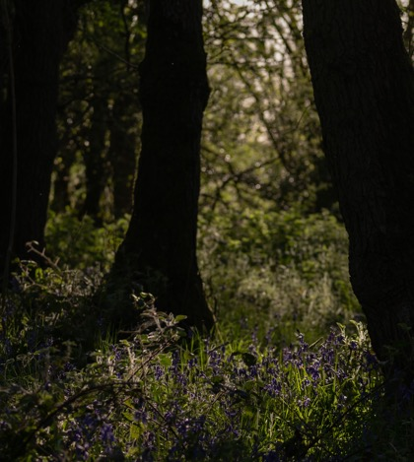
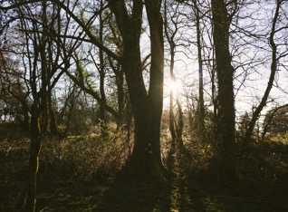
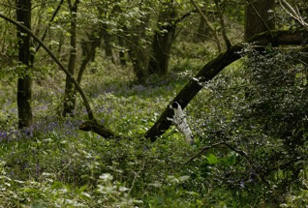
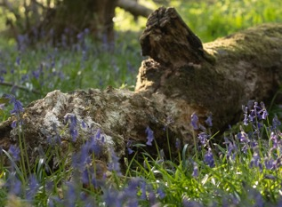
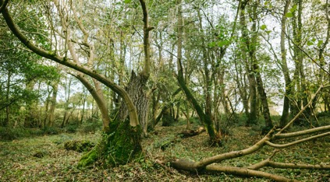
THE TREES – ANCIENT WOODLAND
Unmanaged except by the cattle that graze and browse through once the bluebells have finished flowering
Dead wood left to rot
Mix of alder, hazel, beech, ash…

Slide 6
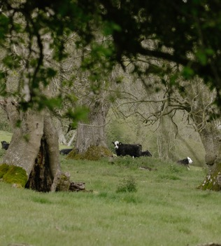
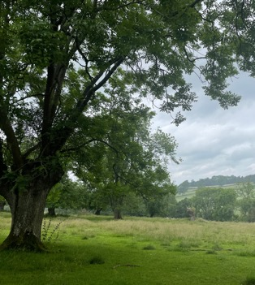
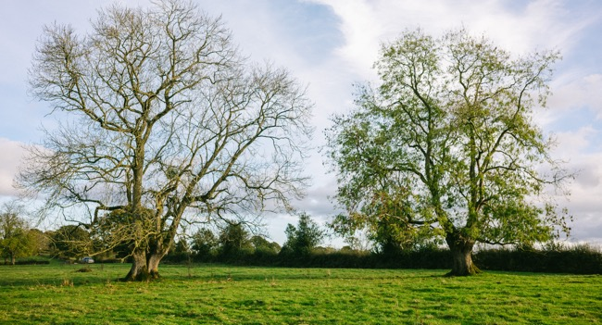
THE TREES – “PARKLAND”
Woodland bleeds out to lower density of tree cover.
Lapsed Ash pollards
Many succumbing to dieback
Providing shelter and food to cattle

Slide 7
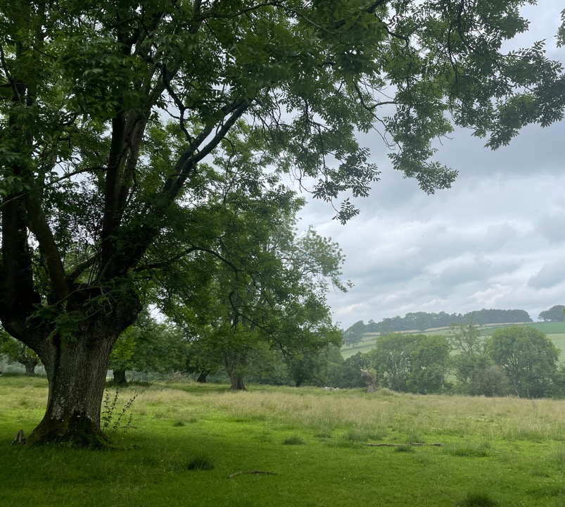
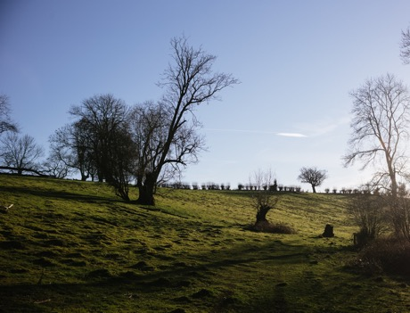
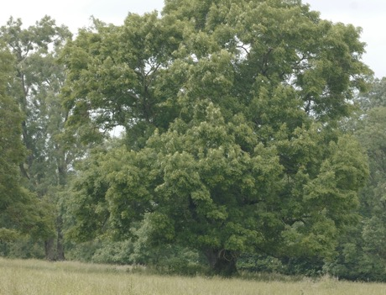

Slide 8
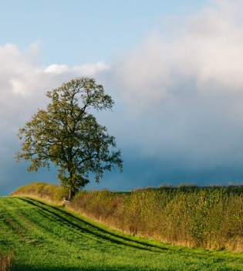
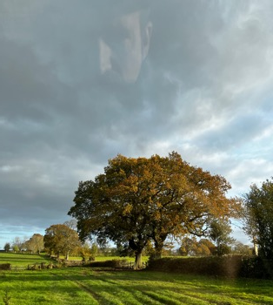
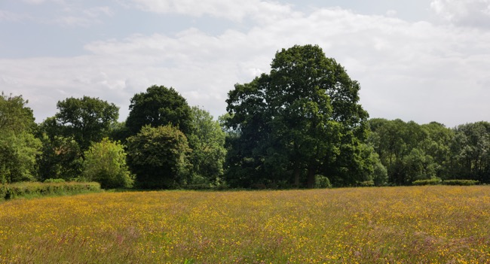
HEDGEROW TREES
Top left used to be an “in field” tree. Hedge put in as part of stewardship scheme.
Top right – gateway needs moving
Hedges need work!

Slide 9
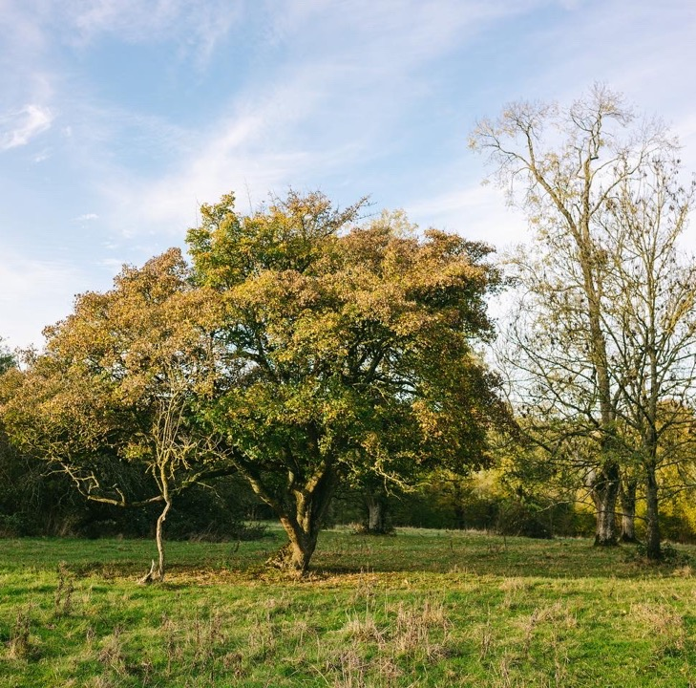
ANCIENT/VETERAN TREES DON’T NEED TO BE BIG
This gnarly field maple is one of my favourite trees on the farm.
Just because it isn’t going to grow as big as an oak or ash, doesn’t mean it isn’t important.
Diversity = Resiliance

Slide 10
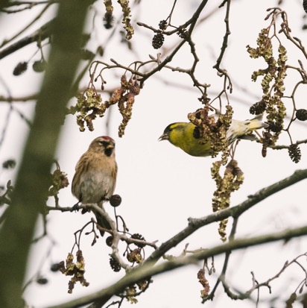
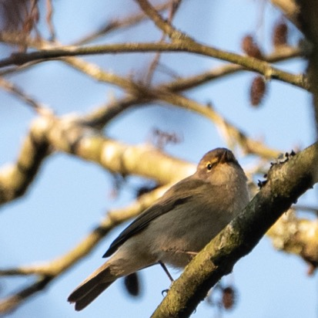
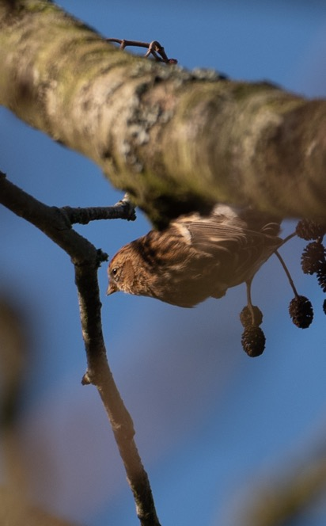
LIFE IN TREES
Different species of bird rely on different species of tree in different settings for different purposes.

Slide 11
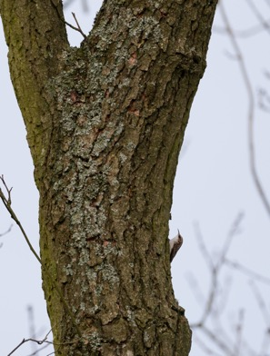
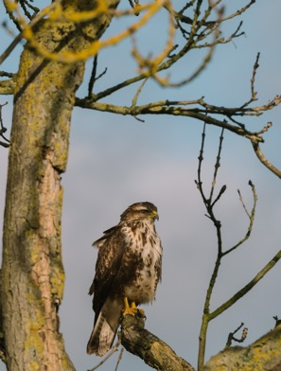
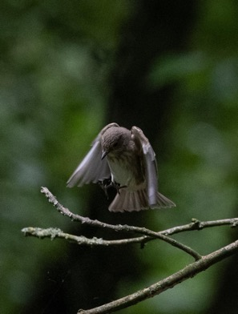
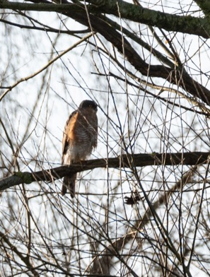
PROTECTION, FOOD, HOME, HUNTING

Slide 12
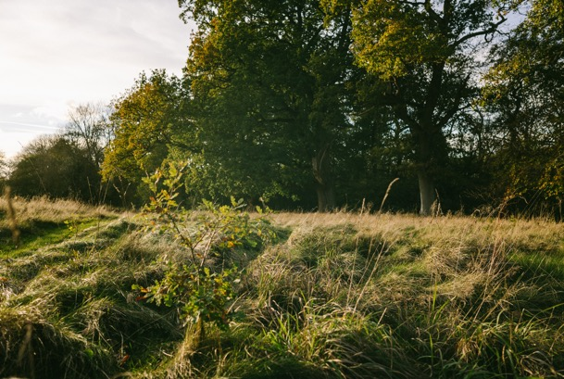
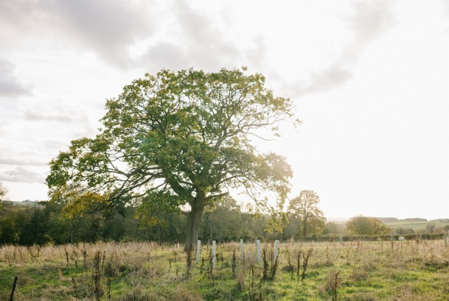
FUTURE ANCIENT TREES

Slide 13
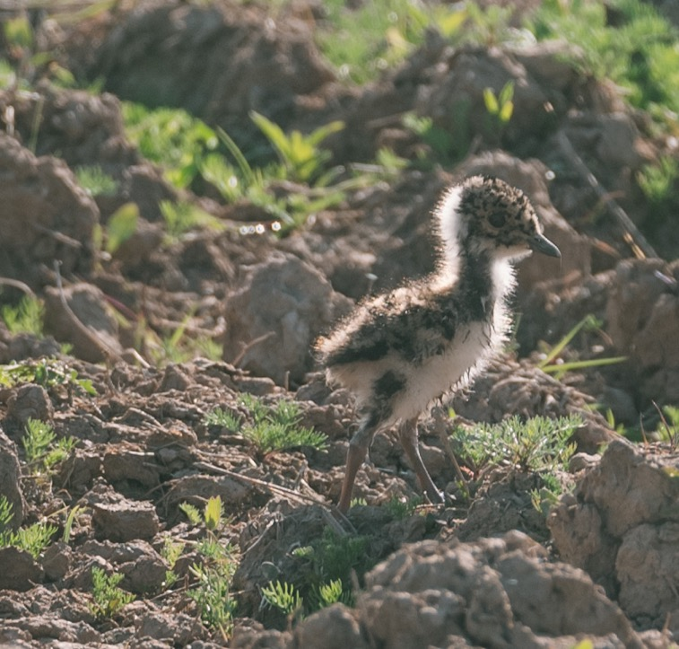
RIGHT TREE
RIGHT PLACE
Some birds REALLY don’t like trees.

