Slide 1
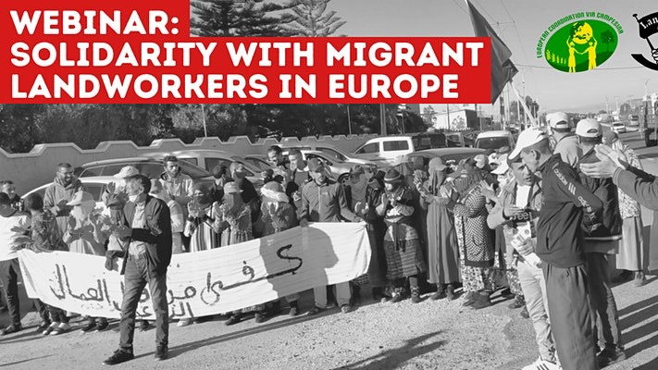
Supporting Migrant Workers in Agroindustry

Slide 2
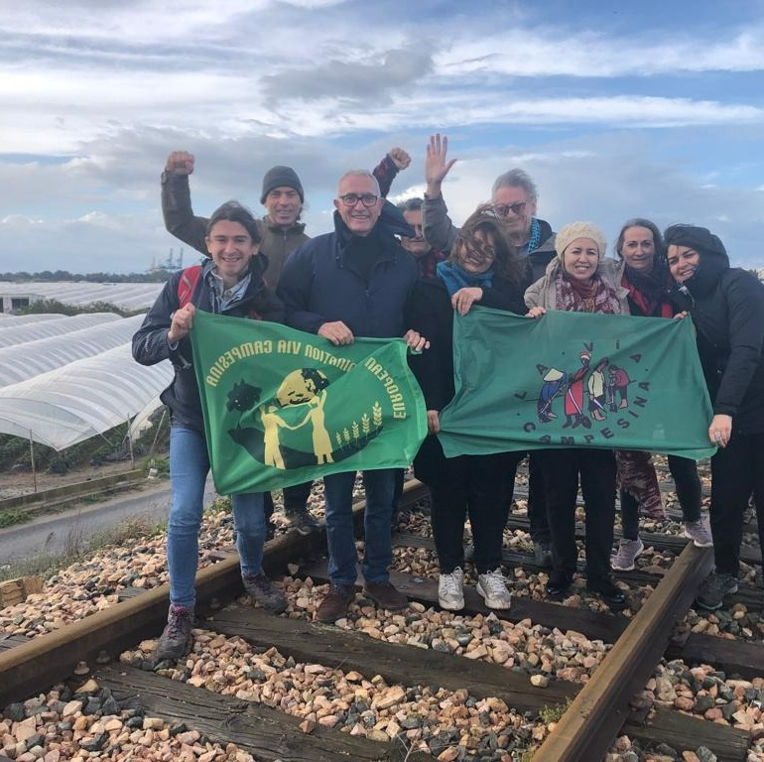
Organisations and elements of work
ECVC Migrants & Rural Workers Working Group
Aim: Bring together agricultural workers’ unions to campaign for better conditions and against agroindustry
LWA (UK) & Uniterre (Switzerland) – Commercial Pressure in support of worker protests
SOC-SAT (Spain) & FNSA (Morocco) – agricultural workers’ unions
SLG (Galicia), ARI (Italy) CNA (Portugal) & COAG (Andalucia) – Small Farmers Unions

Slide 3
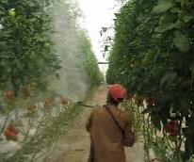
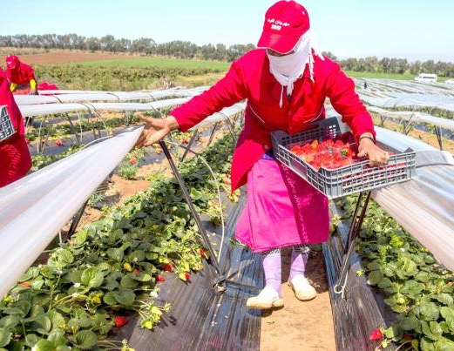
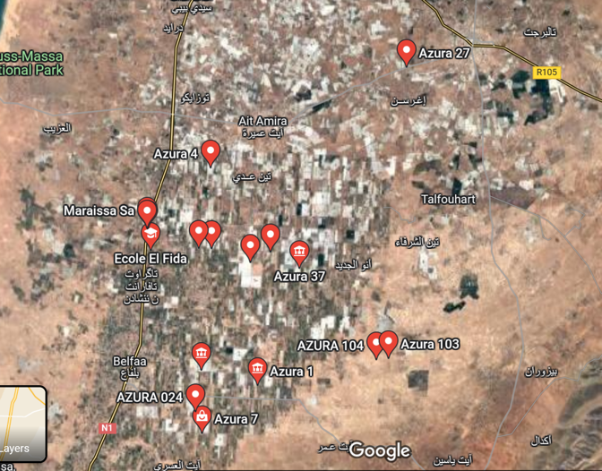
Industrial agriculture in Morocco
Post Brexit, Morocco is one of the main sources of produce for the UK (25% of tomatoes and 23% of soft fruit)
Production mostly concentrated in Souss Massa region – experiencing severe water shortages, 90% of water is used by agriculture
92% of 70,000 agricultural workers are women in a country with one of the lowest rates of female employment in the world
The Agricultural Minimum Wage is 7 euros a day, compared to 12 for other professions

Slide 4
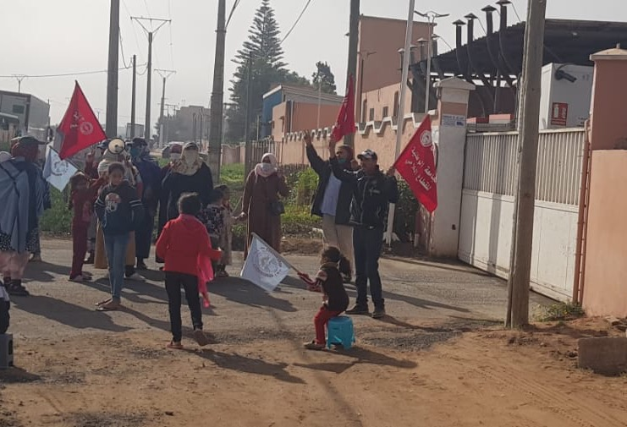
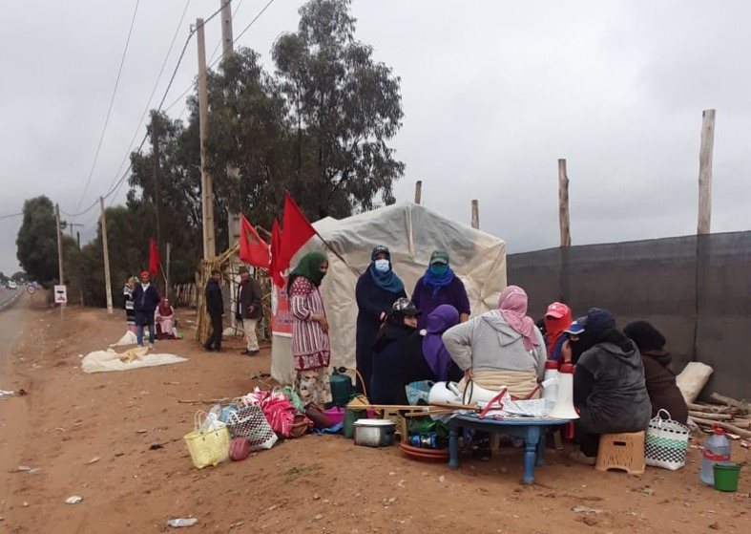
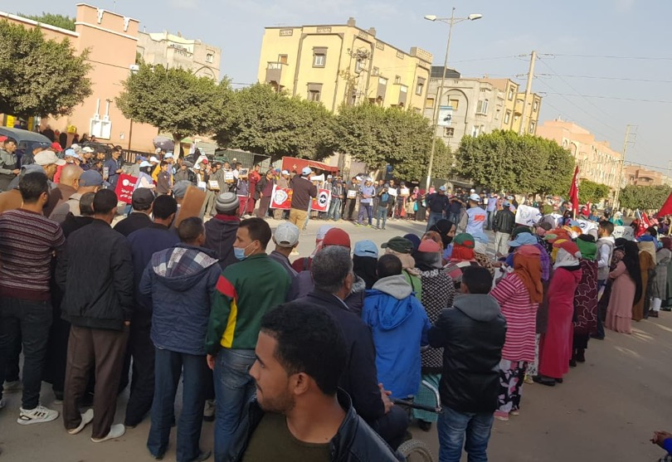
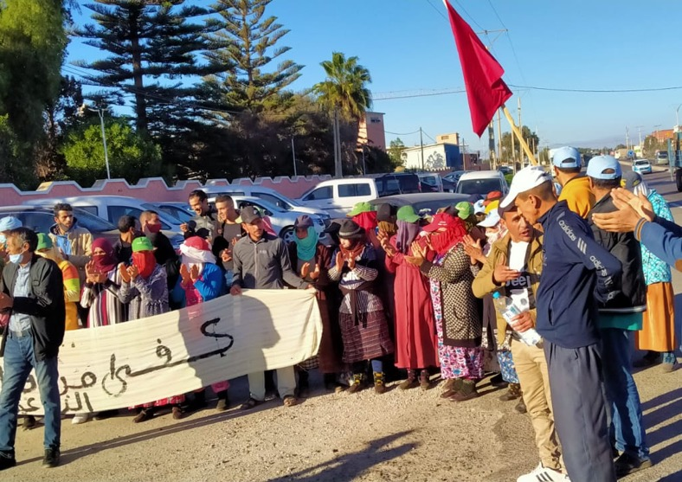
Strike at Azura – success of commercial pressure
Illegal dismissal of union delegate at Azura’s Farm 9 in Ait Baha – discussed at last year’s ORFC https://www.youtube.com/watch?v=RLR4UzOTFW0
Sit in of FNSA members outside Farm 9 and Azura’s facilities from 9th December until 15th January
Death of Sabah Dinah, 30 year old worker with 4 children, on 2nd January
International solidarity campaign targeting buyers and mobilisations of workers result in victory
Payment for time in sit in; compensation for dismissed delegate; dismissal of human resources team; education for Sabah’s children paid for by Azura; however, promises of negotiations by Azura not met

Slide 5

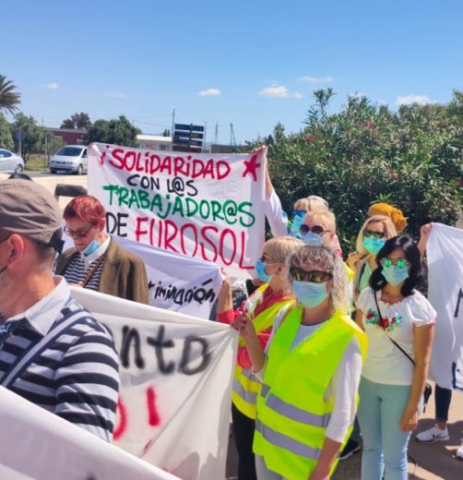
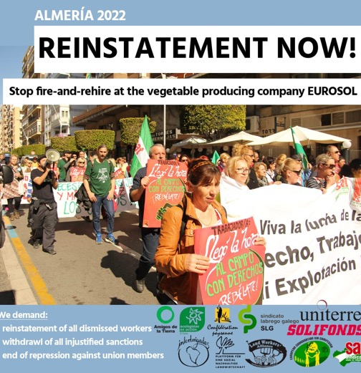
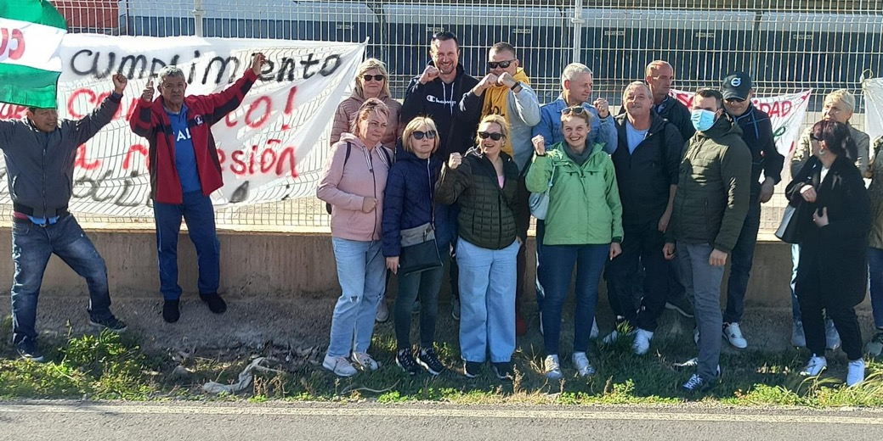
Union busting at Eurosol
Successful strike at Eurosol, produce grower and exporter in Almeria, in 2018, strong growth of SOC-SAT membership
Won representation on Works Council, successfully took Eurosol to court to win holiday pay and paid breaks
Fire-and-rehire begins in mid- 2021. New workers from Mali, under the strong influence of a gangmaster, hired to change composition of Works Council and replace SOC-SAT member.
Bogus dismissal claims introduced against SOC-SAT members. 23 have been fired, SOC-SAT membership reduced from 60 employees to 10. One worker, Andrius Jonaiti, a Lithuanian worker with thirteen years of service under his belt, took his own life after being dismissed
We demand that supermarkets that purchase from Eurosol, namely Migros and Albert Heijn, intervene to resolve this situation. Migros has investigated the situation but refuses to release the report.

Slide 6
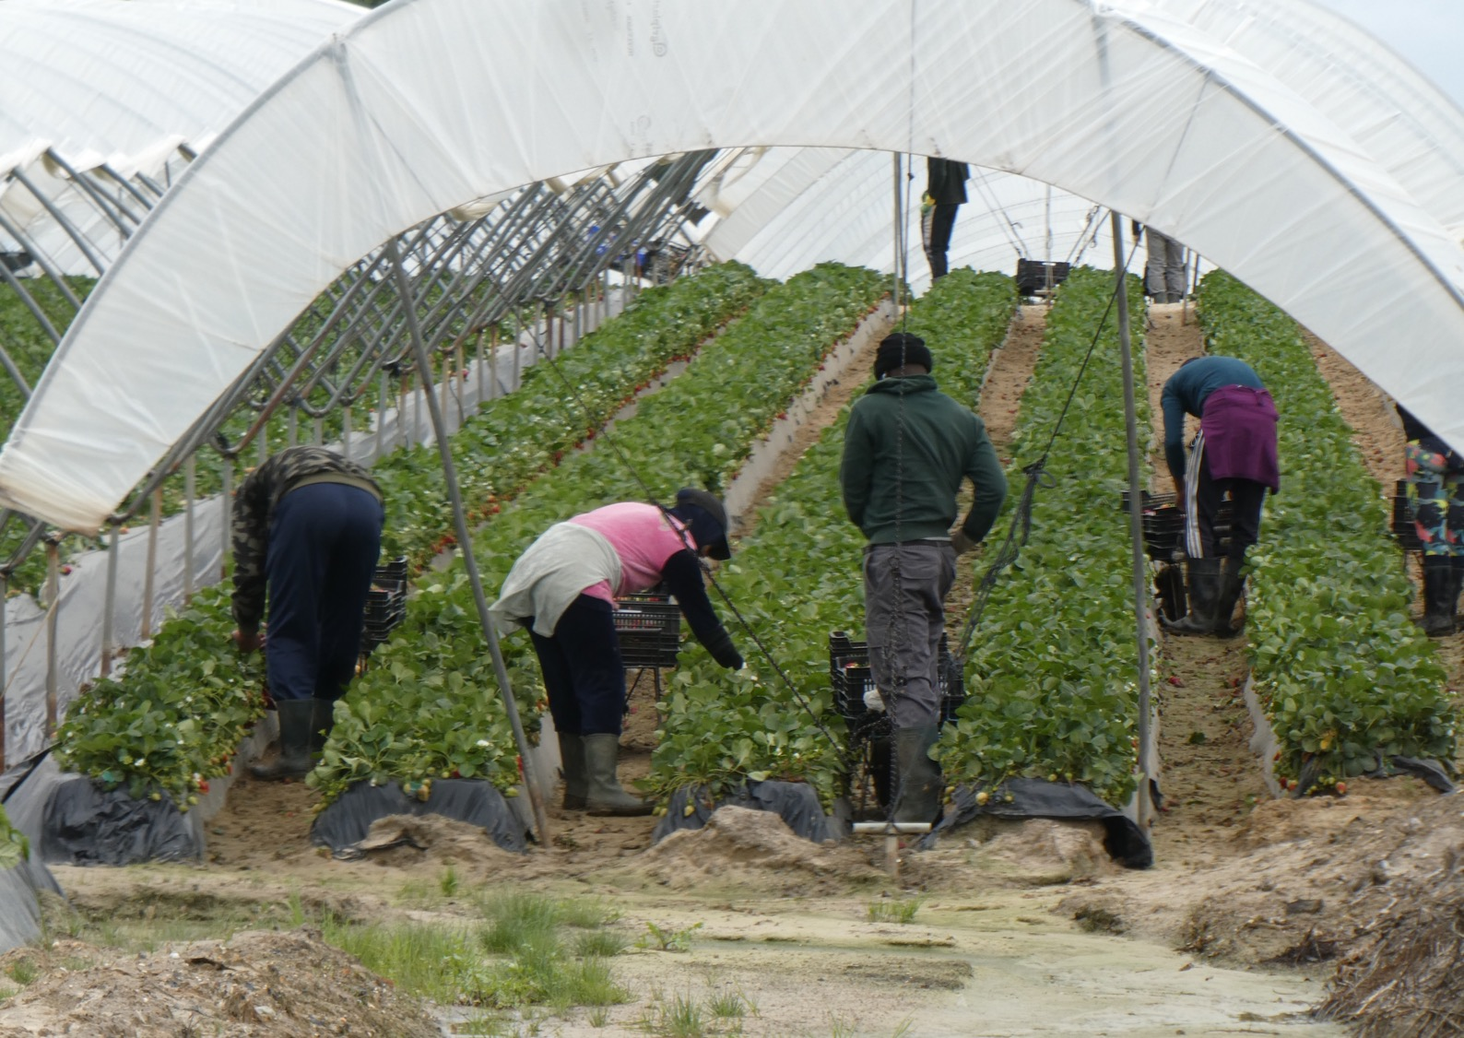
Industrial Agriculture in Huelva
Aim of delegation: to investigate farms belonging to the multinational SurExport
350,000 tonnes of strawberries grown in Huelva each year
100,000 workers required to pick and pack the harvest for export
Crop worth €1bn, wages worth €510mn
12,500 workers hired through contract-in-origin
35,000 workers from West Africa and Eastern Europe

Slide 7
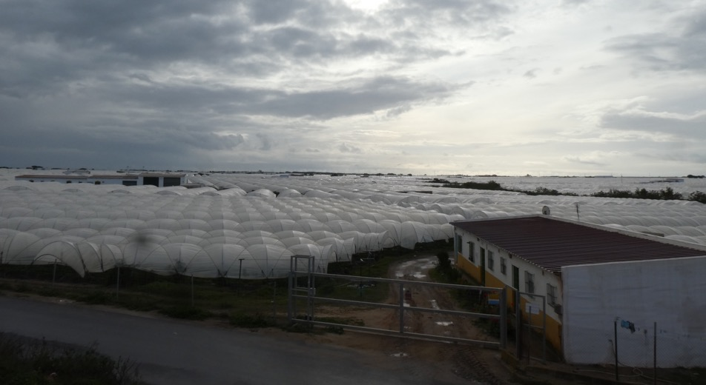
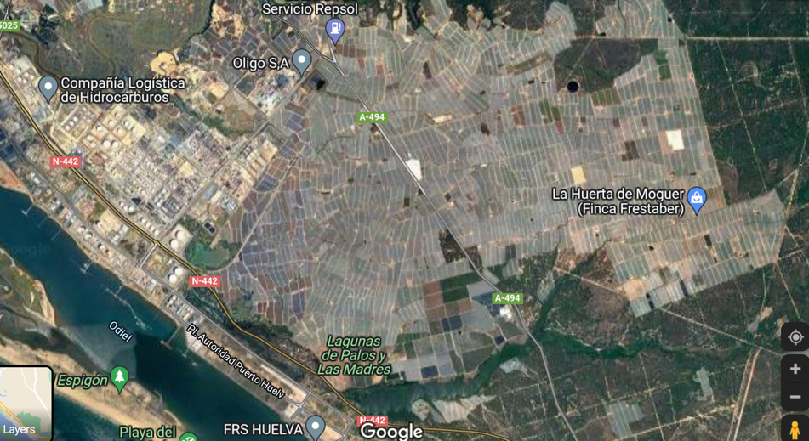
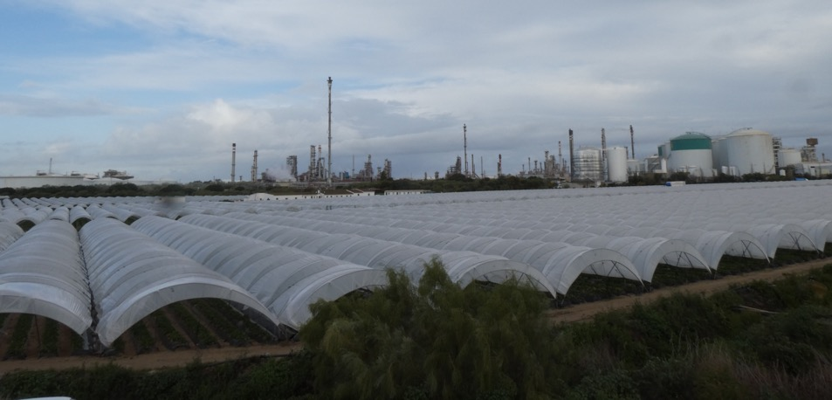
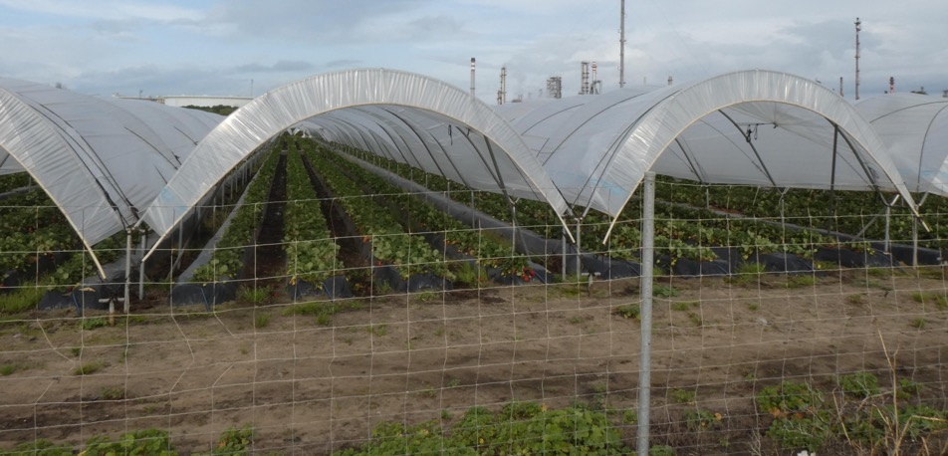

Slide 8
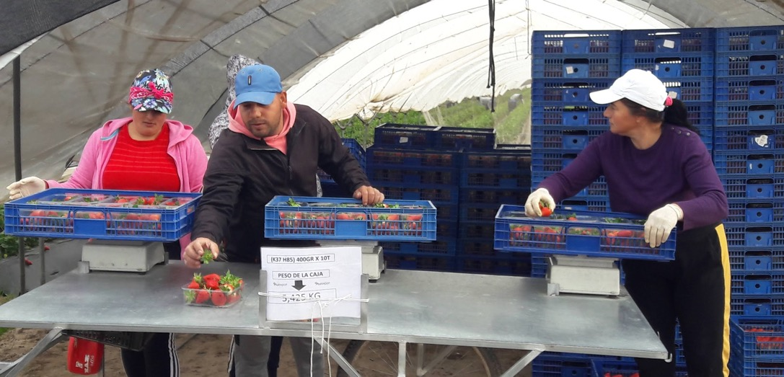
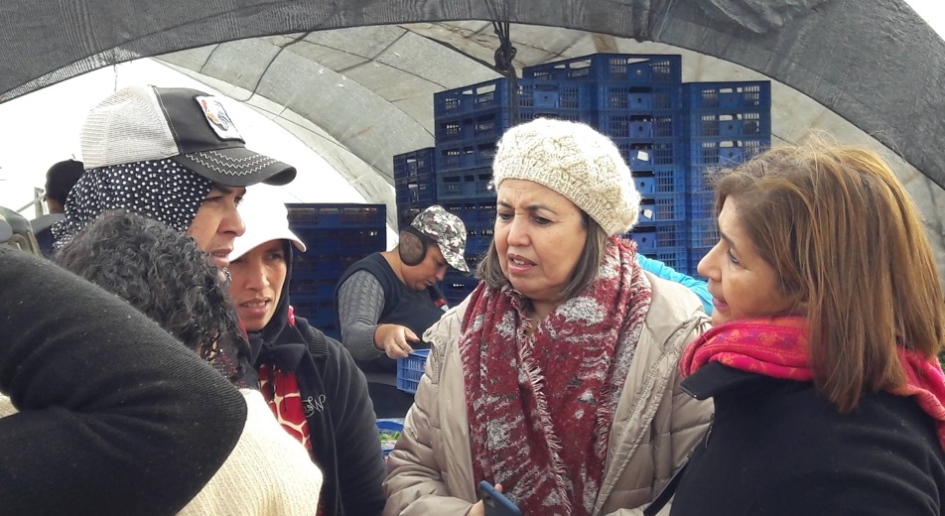
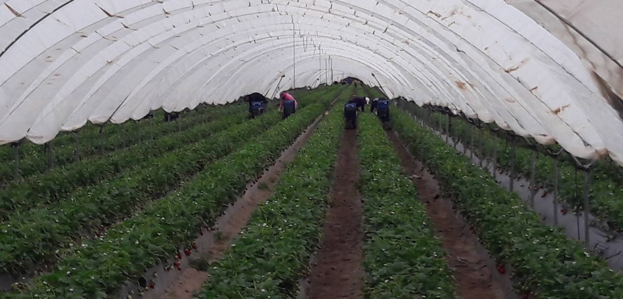
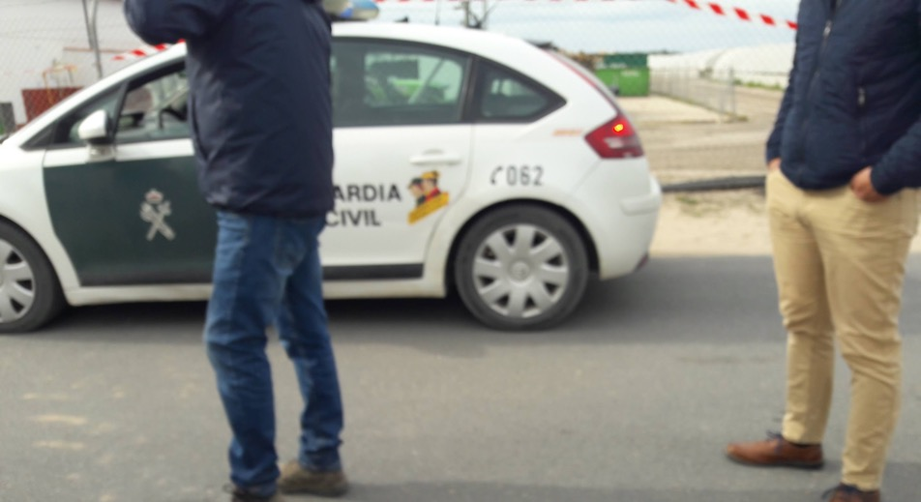

Slide 9
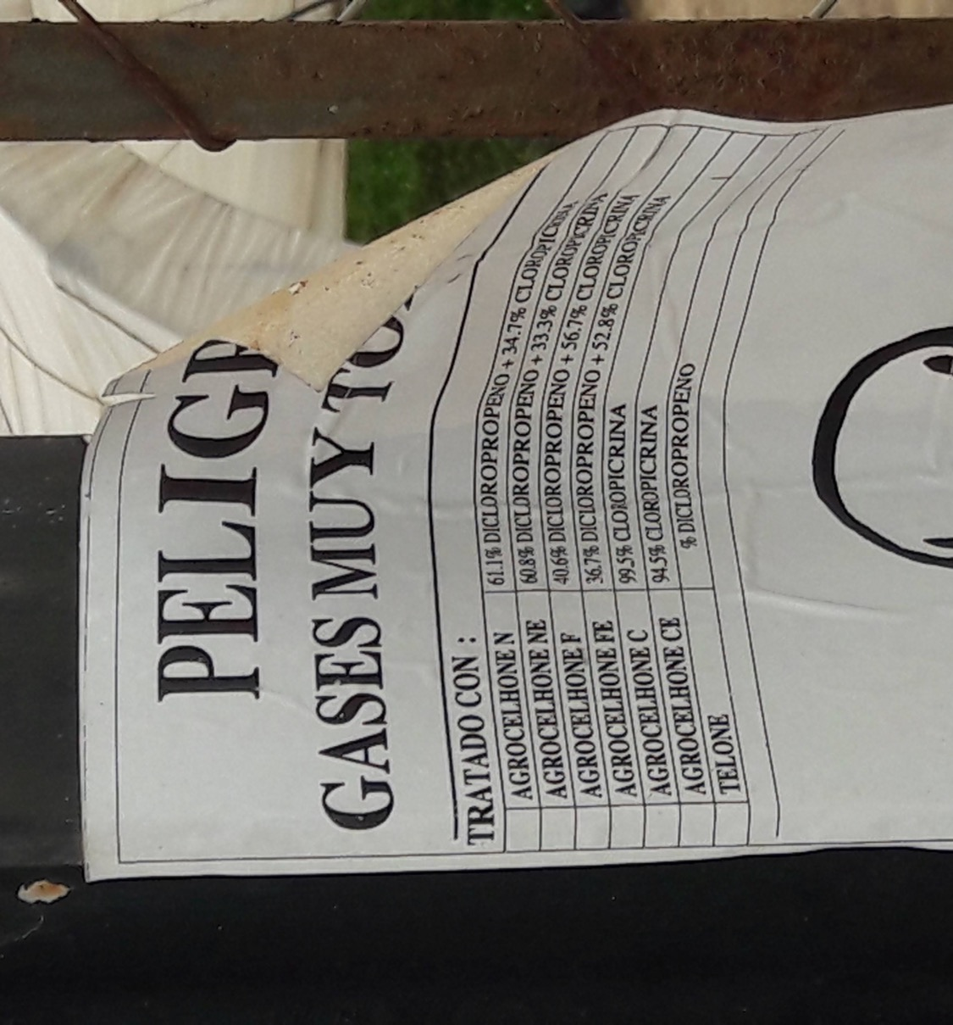
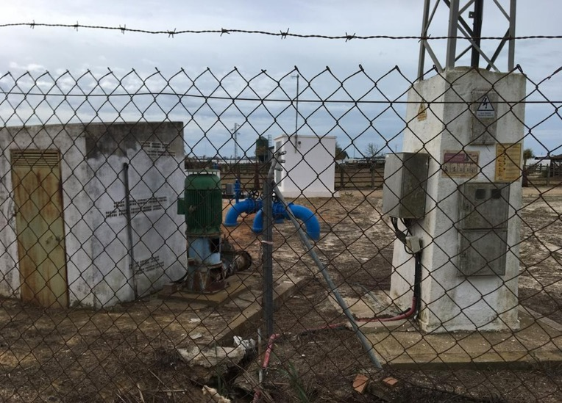
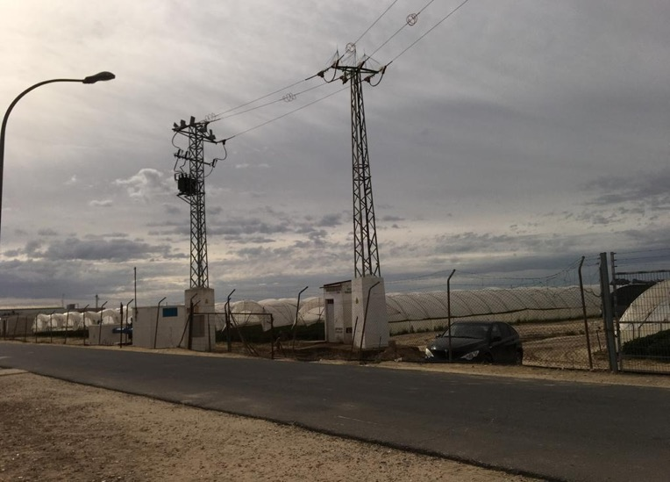

Slide 10
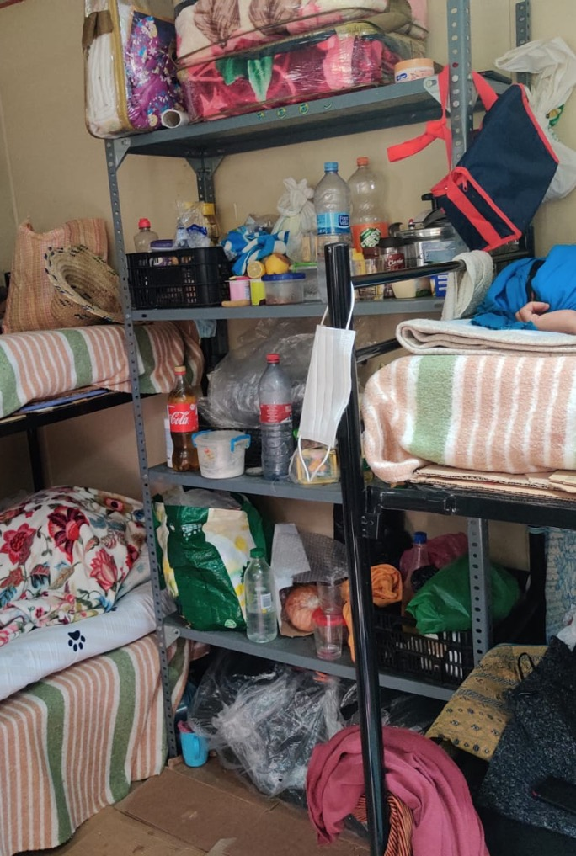
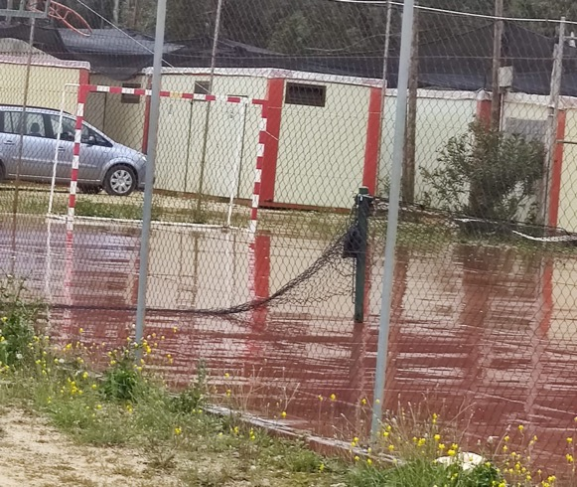
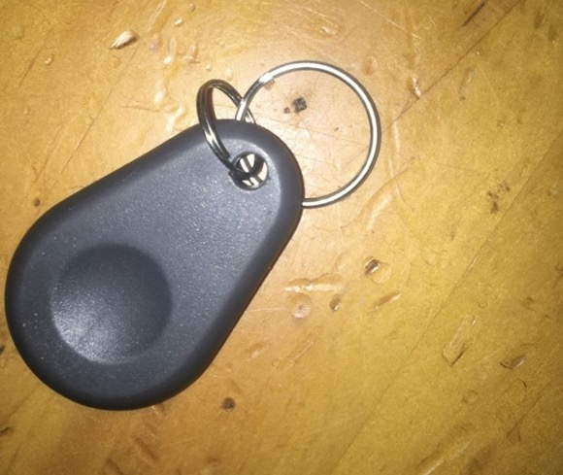
Living conditions for Contract-in-Origin workers

Slide 11
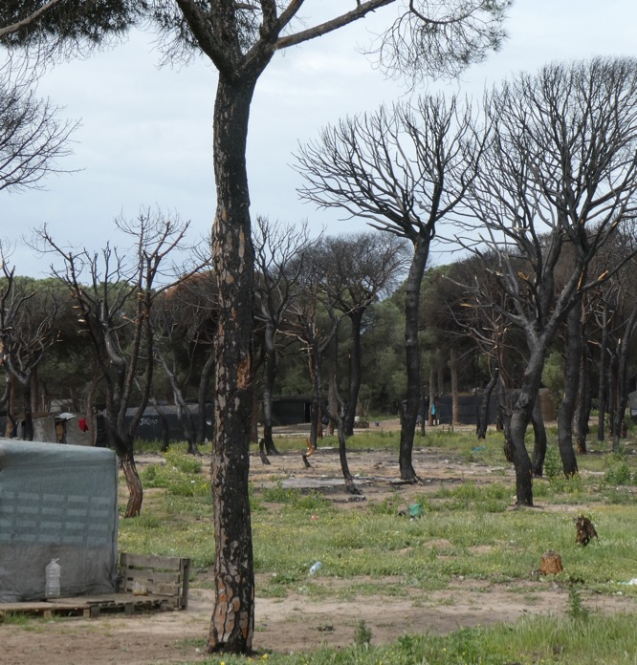
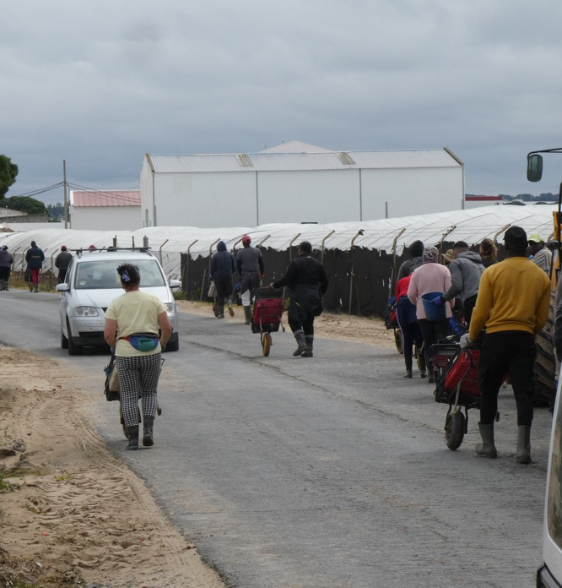
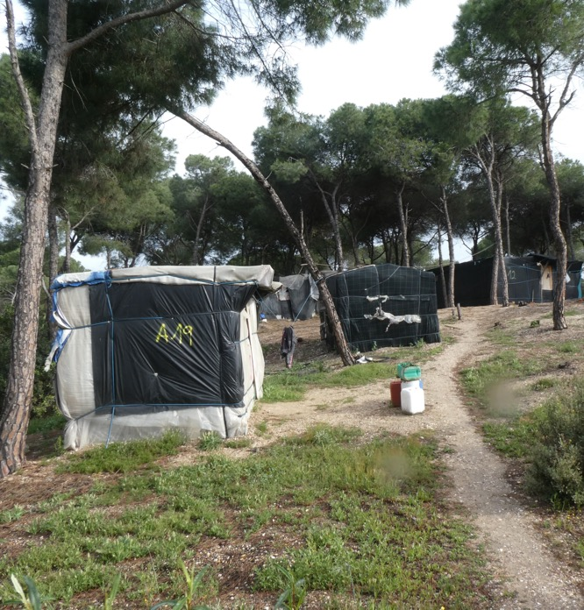
Chabolas

Slide 12
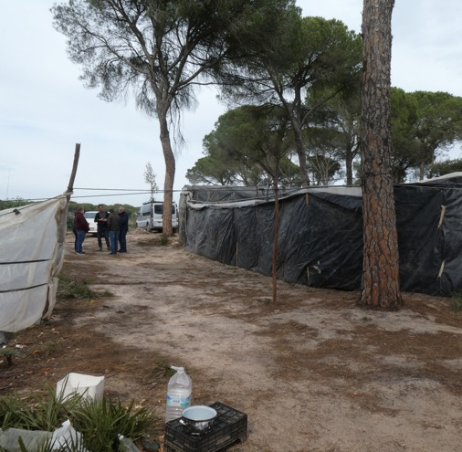
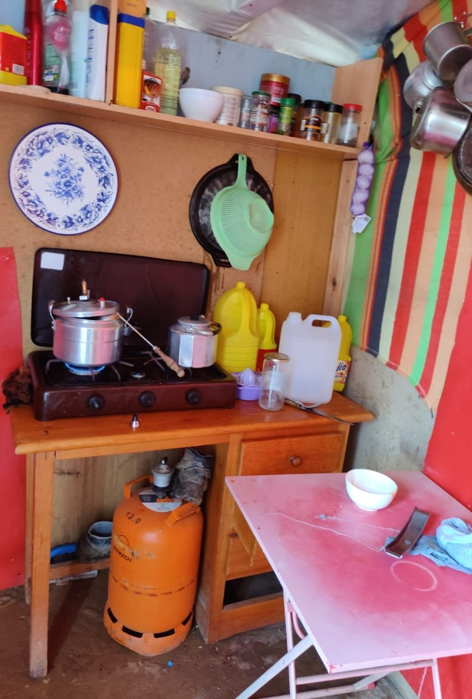
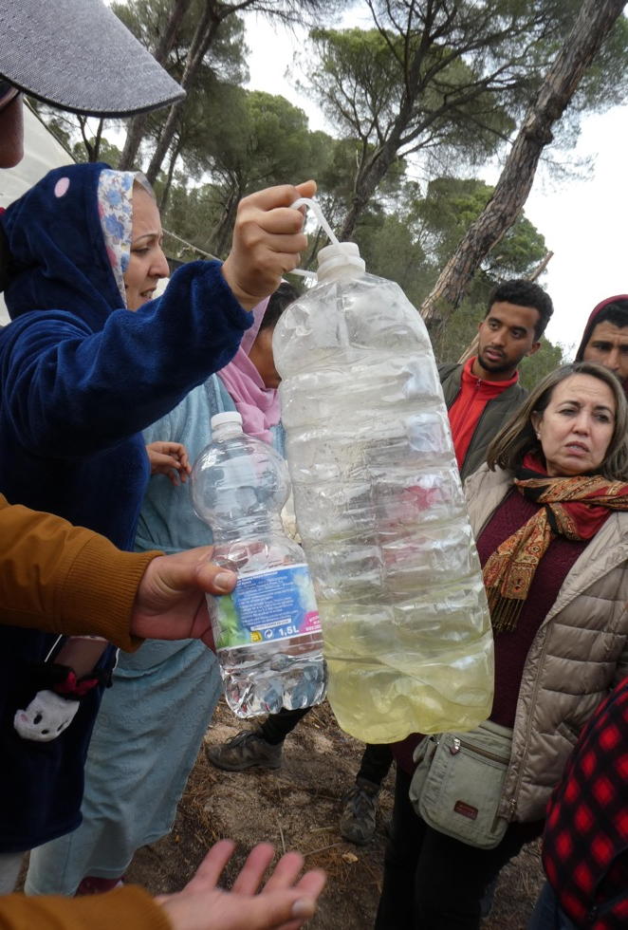
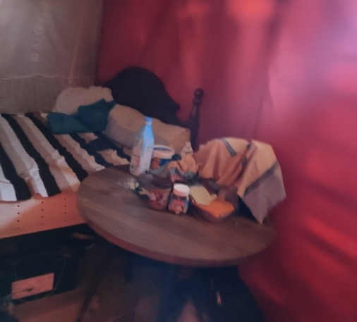

Slide 13
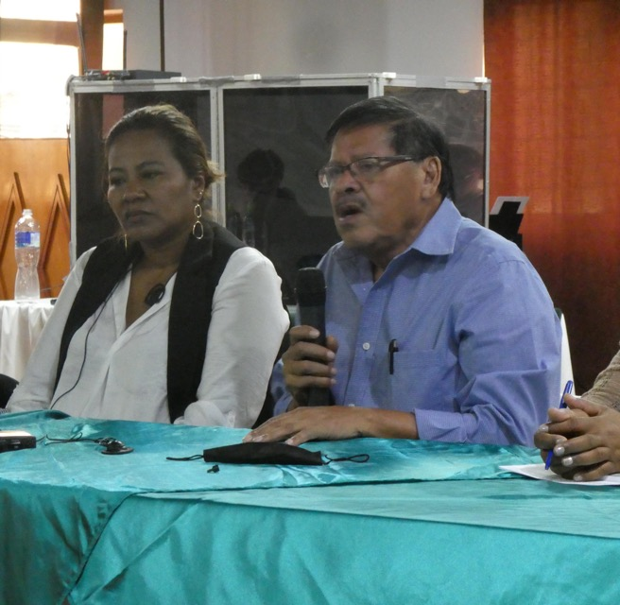
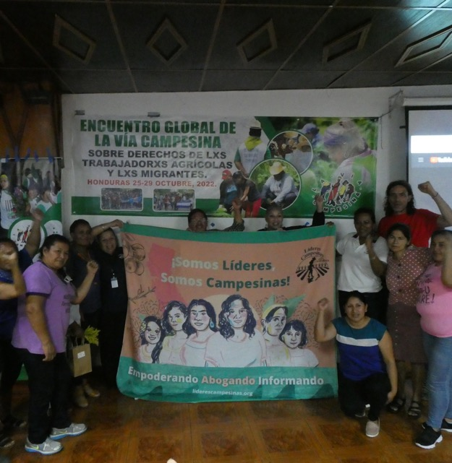
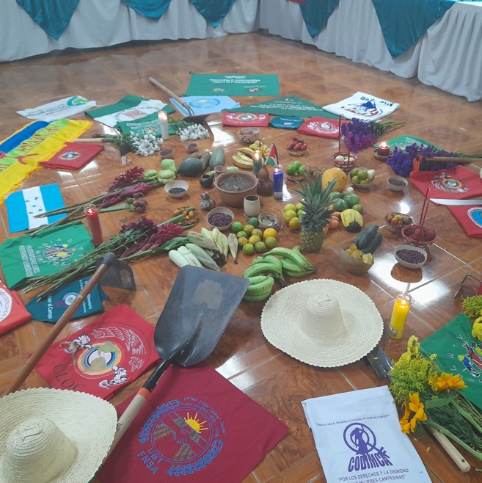

LVC Global Meeting on the Rights of Migrants and Agricultural Workers - Honduras
Hosted by the Vice Minister of Agrarian Reform Rafael Alegria, to prepare for LVC 2023 Congress
International meeting of wage worker unions affiliated to LVC to discuss coordination, prepare policy, and the implementation of the UN Declaration on the Rights of Peasants
Additionally, to support the new LIBRE government in Honduras, overturning 12 years of military installed right wing government

Slide 14
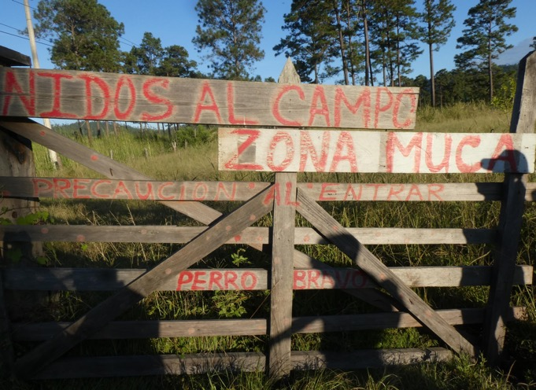
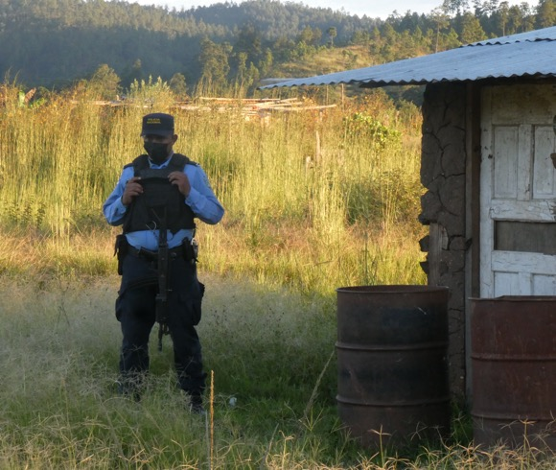
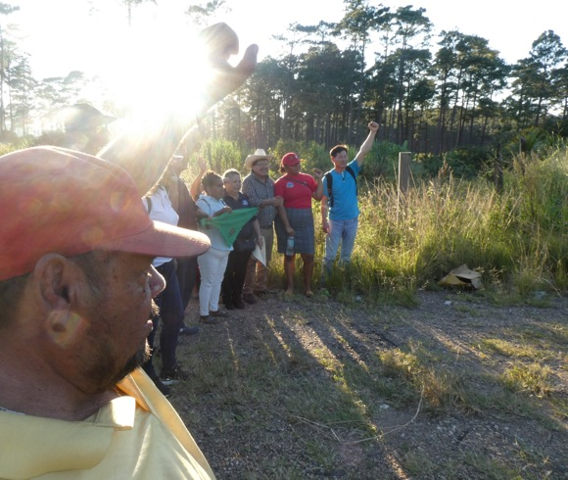
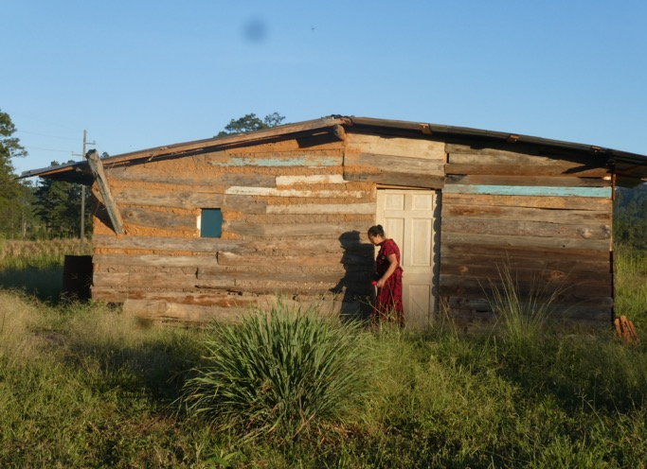
Landgrabs in Guaimaca

Slide 15
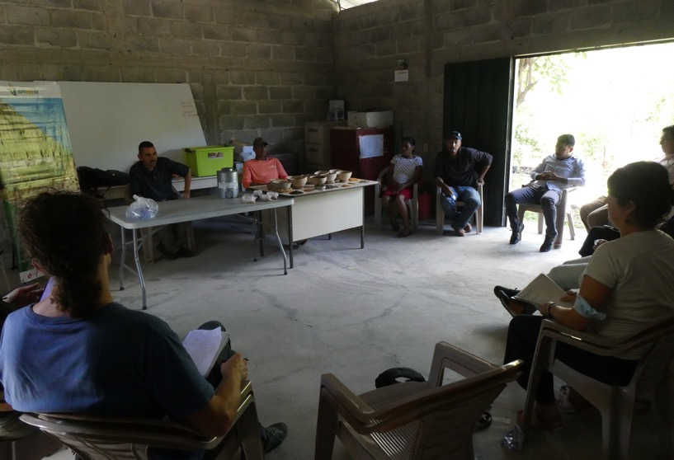
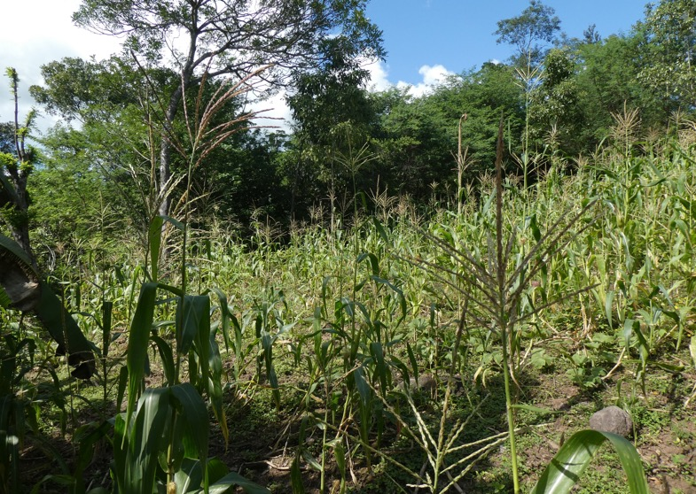
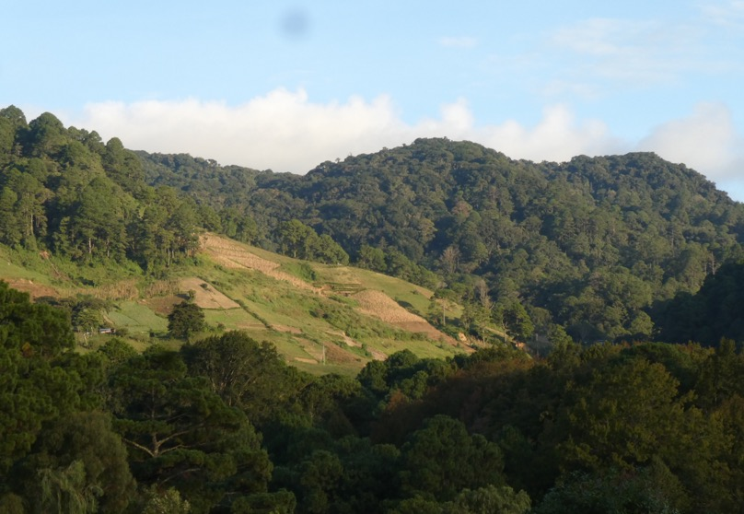
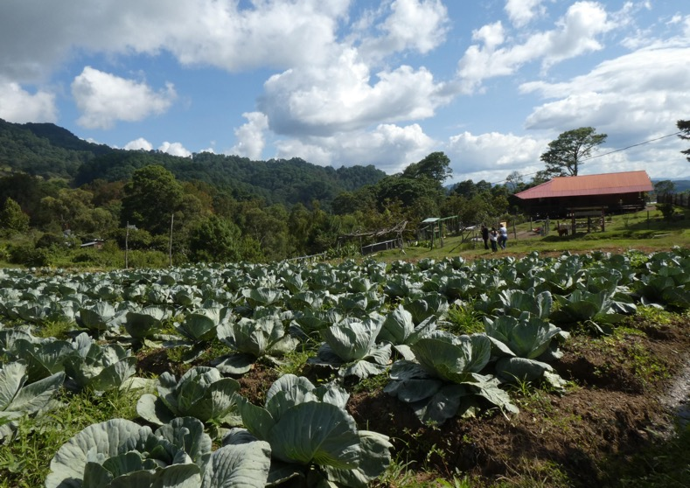
Alternatives in Formation
Association of Experimental Producers of Moropocay
Seed bank and agroecology school
Buena Vista Cooperative
Longstanding mixed agriculture cooperative established over 40 years ago

Slide 16
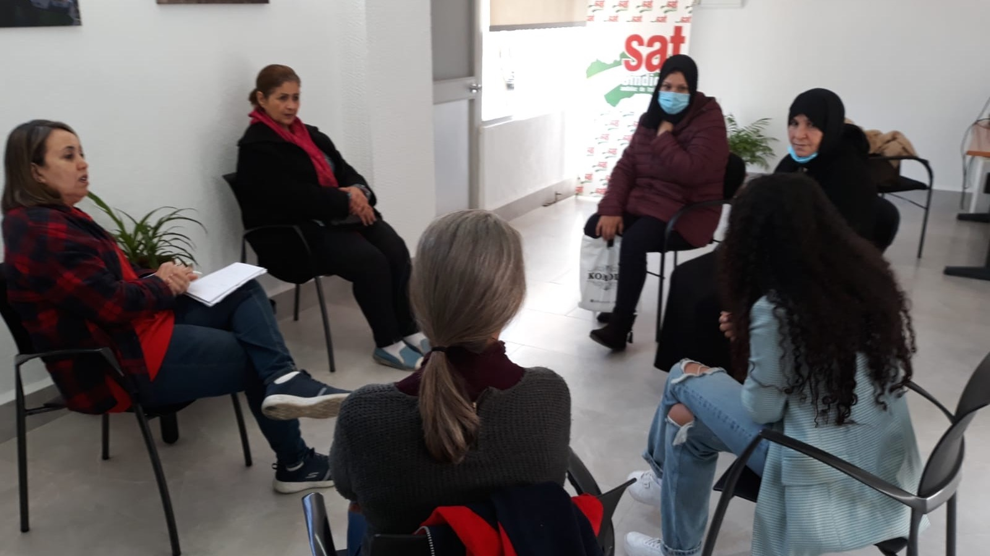
Next Steps
Raise funds to send FNSA organisers to Huelva and Almeria to organise Moroccan workforce – crowdfund to be opened soon
Discussions with the Coalition of Immokalee Workers for campaign targeting supermarkets
Present policy at the 2023 Congress – coordination along migration routes, international pressure against agribusiness, defence of peasant food systems

Slide 17
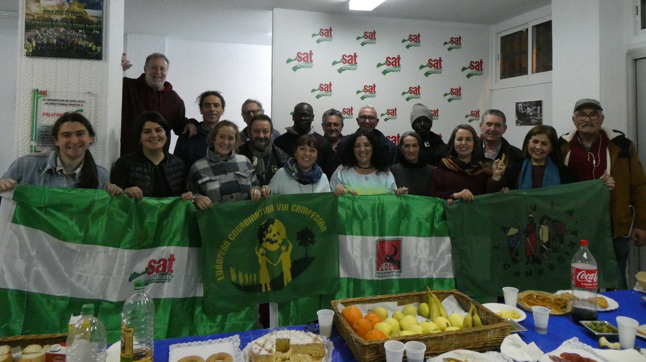
Get involved in the Group!
Email Catherine at catherine.mcandrew@landworkersalliance.org.uk
Or email migrations@eurovia.org to join ECVC lists related to migration

