Slide 1
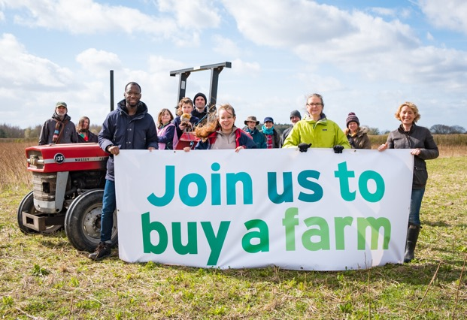
Lessons from Kindling Farm’s Community Share Campaign.

Slide 2

Helen Woodock & Chris Walsh
Kindling.org.uk
@kindlingtrust
helen@kindling.org.uk
chris@kindling.org.uk

Slide 3
This session will cover:
Brief introduction to Kindling Farm & the Share Offer
Work we had done up to the campaign’s preparation
Campaign preparation
Business Plan, Share Offer Document
In person materials and activities
On line promotion and events
Our Community
Campaigns costs and resources
What the campaign achieved
Campaign lessons & reflections
After the campaign

Slide 4

The Vision for the Farm

Slide 5

Community Shares Offer Summary:
Ran from Saturday 3rdApril to Saturday 3rd July 2021
Minimum investment was £200
Investors could request 0%, 1%, 2% or 3% return
Shares could not be withdrawn in the first 3 years & returns begin in year 3
Our target was : £390,000 (30% of the purchase price) to £650,000 (50%)
Hosted with Ethex at: Ethex.org.uk/invest/kindling-farm

Slide 6
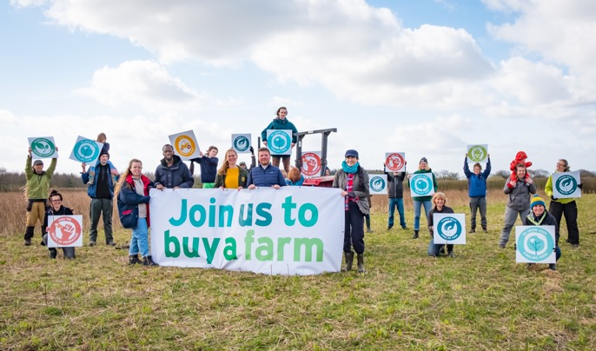
Running a Community Share Offer during Covid

Slide 7
Work before our Community Shares Offer Preparation
Over 10 or so years before the community shares campaign we:
Market development & running initiatives
Established an advisory group
Visited farms and refined our vision
Wrote and rewrote our business plan dozens of times
Flipped from a business plan laser-focused on food production to one that shared all elements of our vision and back again
many times

Slide 8
Campaign preparation: Business Plan, etc.
From Spring 2020 to Winter 2021 we:
Refined out business plan – (82 pages)
Wrote our share offer document w/ Terms & Conditions- (32 pages)
Developed answers for FAQs – (30 questions)
Secured Community Shares Standard Mark
Got approval from ETHEX
Secured match investment for campaign momentum

Slide 9
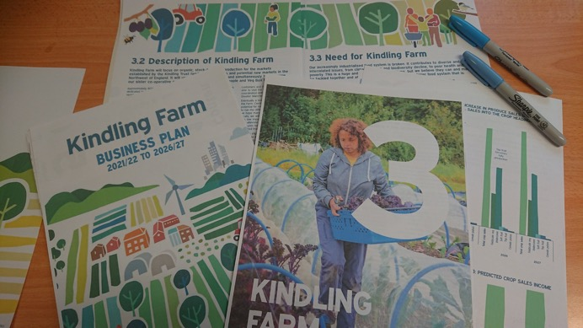
All these documents were created with a style guide, glossary and endless proofreading

Slide 10
Campaign preparation: In person materials and activities
We had to greatly reduce the number of face-to-face activities planned:
Less opportunities, but also needed to be sensitive to people’s concerns
We decided to focus on leafleting houses in key areas
Displays, posters and pull-up banners in shops
Be present at some key shops, but let people approach us
More dependent than ever on colourful visuals and simple messages

Slide 11
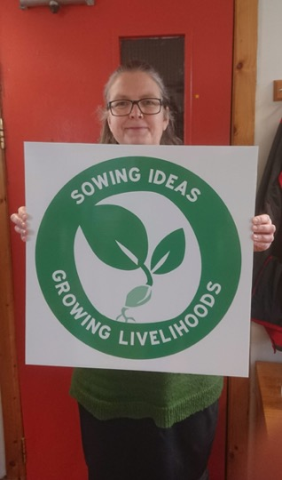
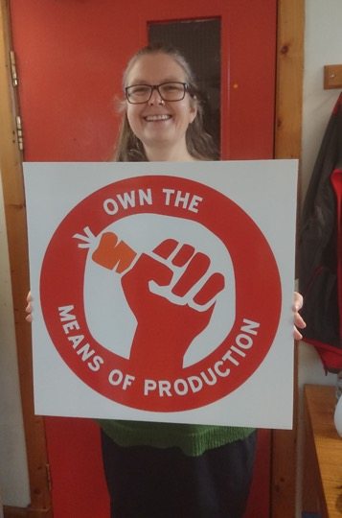
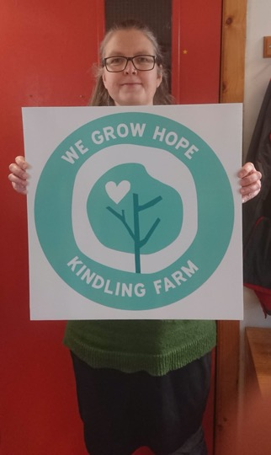

Slide 12
Campaign promotional materials
We had ready:
A4 & A3 posters
Postcard sized leaflets - ten different ones with tailored messages
A4 article style magazine inserts
5 different stickers
Banners and pull up banners
T shirts & placards

Slide 13
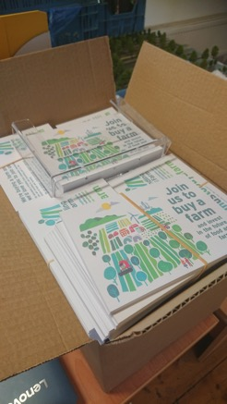
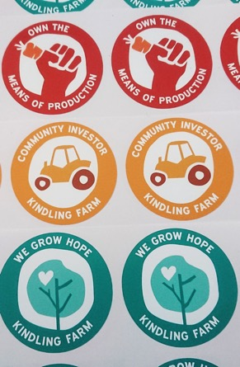
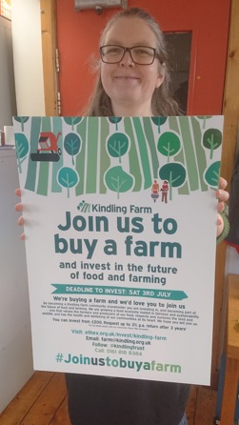

Slide 14
Campaign preparation: online promotion and events
We wanted to be accessible, informative and point to the Ethex platform.
So we planned 3 types of online activity around 4 campaign messages:
    Online Surgeries
    Webinars
    Social Media Promotion #Joinustobuyafarm
Videos for the Ethex platform and social media was obligatory
A lot of preparation was setting up 3rd Party media,
e.g. blogs, newsletters, mailings etc.

Slide 15
Online Surgeries:
      Informal, opportunity to ask questions and meet us
      Every two or so weeks on different days and at different times
Webinars, promoted via Eventbrite and on timely topics:
      Land access and food sovereignty
      Women in Farming
      Community owned farms
      Wildlife and farming
      The importance of co-operation

Slide 16
Campaign Messages:
Good food for everyone | Sustainable farming | Community ownership | Viable business
Health & well being of communities | Environment, climate change | A farm owned by its community, for the benefit of the community | Impressive track record in practical food & farming initiatives
Need for more food & hope | Sustainable livelihoods | A farm with co-operation at its heart | Markets developed for local organic produce
Responding to a growing demand | Biodiversity and wildlife | Working together to confront challenges of today | A strong network of support to make it a success

Slide 17
Campaign Message Periods
3rd April - 16th April We have launched!
9th April - 22nd April Good Food for Everyone
17th April - 30th April Sustainable Farming – Environment & Climate Change
1st May - 14th May Sustainable Farming –Livelihoods
15th May – 28th May Community Ownership
29th May - 4th June Undecided
5th June - 17th June Sustainable Farming – Biodiversity & Wildlife
17th June - 3rd July Everything!

Slide 18
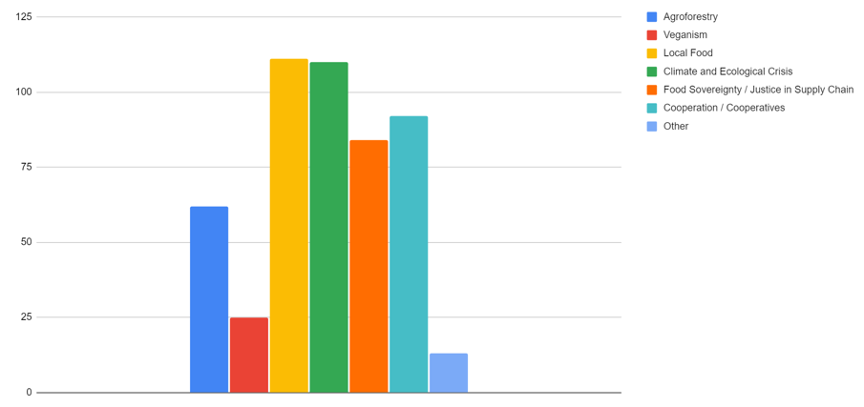
Why people invested in Kindling Farm

Slide 19
Campaign preparation: Our Community
As well as 3 full-time staff we had volunteers involved in a range of activities:
    Pre-campaign training and briefings
    Interviewed for videos
    Some investors ready to invest on day one
    Campaign launch photo shoot (27th March)
    Speaking at our webinars
    Distributing posters, leafleting houses etc.
    Staffing a limited number of stalls

Slide 20
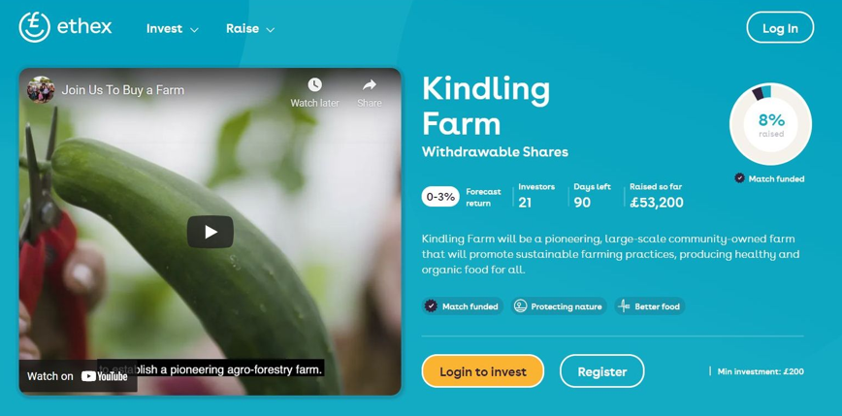
Day 1 of the Campaign

Slide 21
Community Shares Campaign Costs:
Staff input:
      John Lewis Partnership full-time secondee in 2020 for 6 months
      Contribution of ~£15,000
      3 full-time staff for 6 months (1st Jan to 31st July)
      Direct costs ~£26,000
Volunteer input:
      Approximately 120 days Contribution of ~£12,000

Slide 22
Community Shares Campaign Costs:
External expertise:
      Financial modeling, business planning, wording of the share offer document & Community Share Mark assessment: ~£10,500
      Business Plan & Share Offer document design & layout: ~£3,500
      Photography & videos ( 2 min video & 8 shorts): ~£3,500
Materials:
      Leaflets, posters, newsletter inserts: ~£3,500
      Banners, pull up banners, t-shirts etc.: ~£1,500
Online Advertising:
      Facebook and Ecologist Magazine: ~£500
TOTAL (excluding staff costs) : ~£23,000

Slide 23
After Campaign Costs:
ETHEX fee: £15,000 + 2% of what was raised
650 Share certificates: ~£300
Envelopes & postage: ~£500
TOTAL Tally (excluding staff costs) : ~£40,000
TOTAL Tally (w/ rough staff costs) : ~£66,000

Slide 24
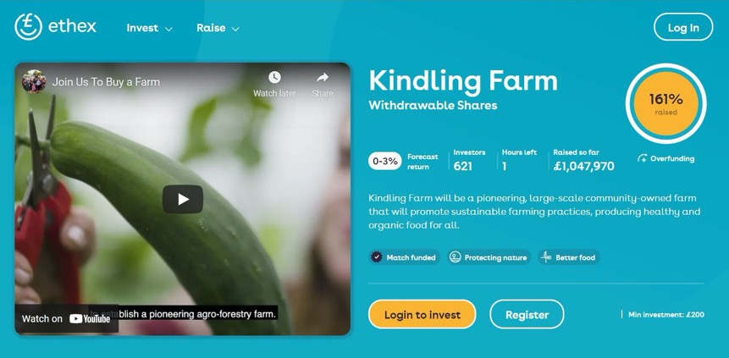
What the campaign achieved

Slide 25
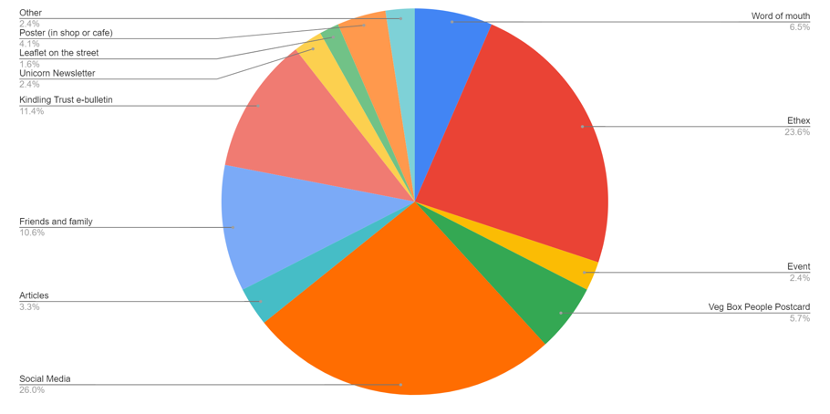
How investors found out about the Campaign

Slide 26
Campaign lessons & reflections

Slide 27
Questions

Slide 28
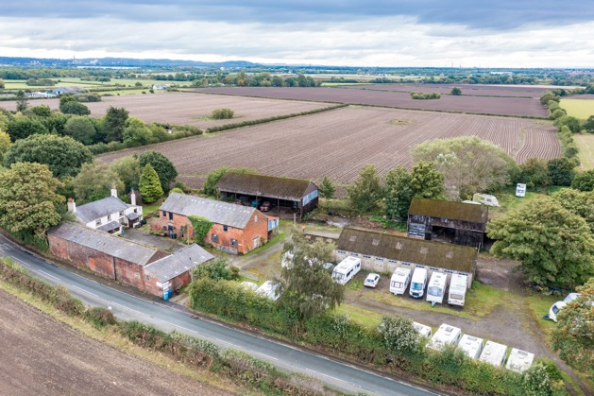
After the Campaign

Slide 29
Helen Woodock & Chris Walsh
Kindling.org.uk
@kindlingtrust
helen@kindling.org.uk
chris@kindling.org.uk

