Slide 1



Introduction to beneficial beetle monitoring and identification
Dr Kelly Jowett
Matt Hampson

Slide 2
Carabid Beetles
There are over 350 species of carabids beetles in the UK, they live in all habitats- generally as omnivorous scavengers.
In farmland carabid beetles are vital providers of pest control services.

Slide 3
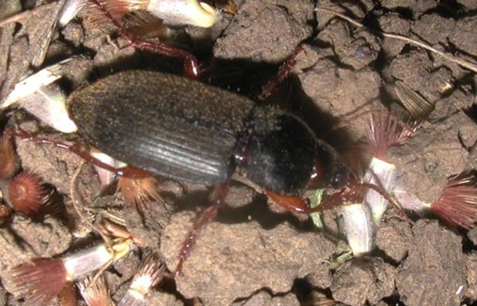
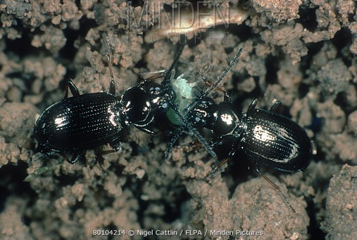
Pest control by carabids
Harpalus rufipes, Harpalus affinis, and Amara aenea can help to reduce seed stock of a weed species in the range of 65 to 90% (Honek, 2005, J Ecol, 93:310).
Carabidae beetles caused an 81% decrease in emerging adults of orange wheat blossom midge (Sitodiplosis mosellana) (Kromp, 1999, Agric. Ecosyst. Environ,187:228).
Eggs and first-instar larvae of the cabbage root fly (Delia radicum) may be reduced by 90% by such carabids as B. lampros and T. quadristriatus (Finch and Elliott, 1992, IOBC/WPRS Bull. 15, 176–183).
The population of Colorado potato beetle (L. decemlineata) is reduced by up to 30% in presence of such Carabidae species as C. auratus or P. melanarius (Kromp, 1999).

Slide 4
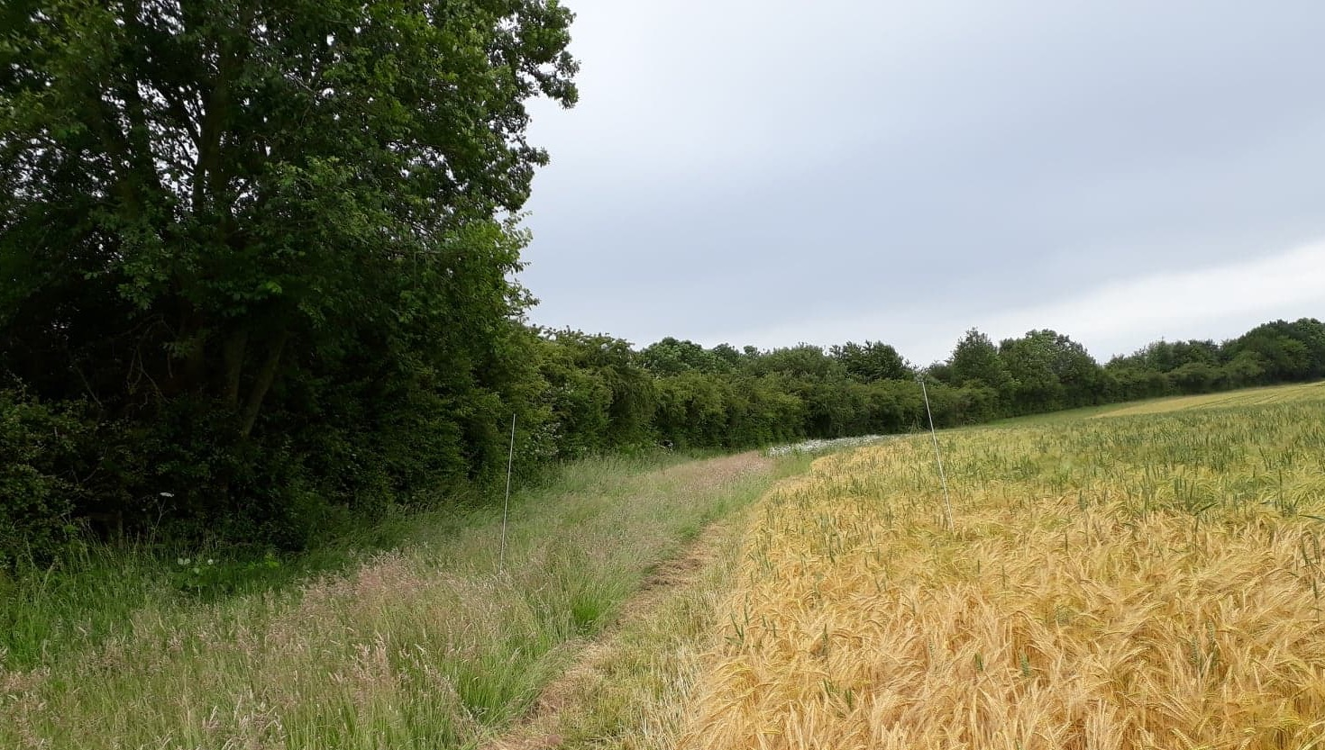
Carabid needs
Eggs
To boost numbers, farm environments should provide the resources they need to:
feed
breed
& shelter
Invertebrates have a number of life stages, from eggs, to larvae, to nymphs, to adults. These may live in different places and eat different things, at different times.
Adults
Larvae
Pupae
Migration
Overwintering
Foraging
Resting and refuge
Breeding

Slide 5
Carabid needs:
Refuge from pesticides
This minimises population losses, and ensures populations recolonise fields
Preventative broad spectrum pesticide is effective, but kills both beneficial and pest insects.
Unfortunately pest species recover more quickly- meaning pesticide use must increase to ensure the same level of protection, causing further problems (e.g. resistance).
General advice:
Think about buffering resource areas
Use less
Use less toxic or persistent chemicals
Use more targeted programs
Chemical
Biological
Physical/ mechanical
Prevention

Slide 6
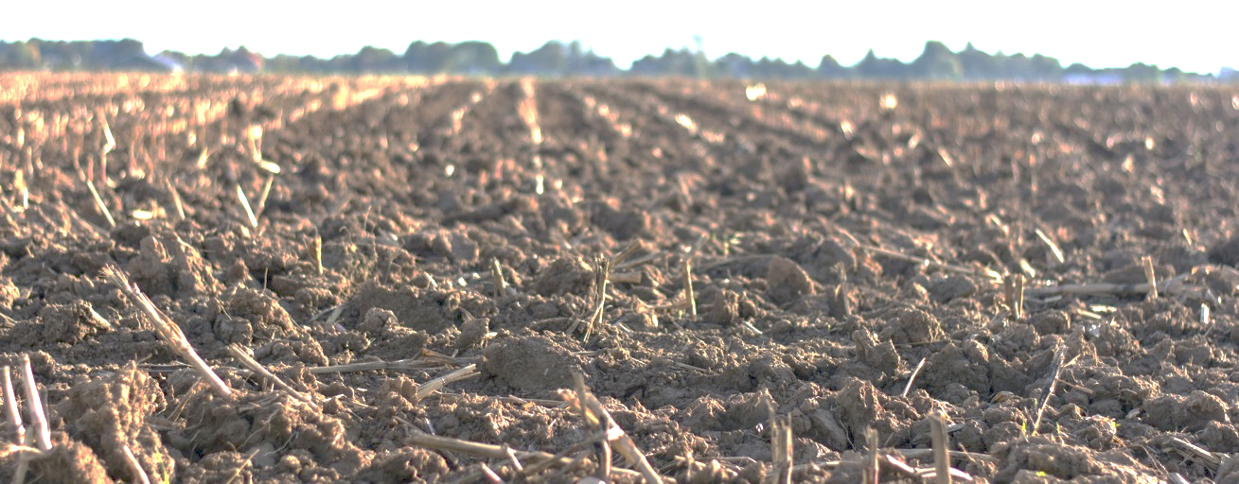
Service efficiency and stability: lots of different species
Different species specialise in different useful ways
Different species can tolerate different conditions
This means that a diverse assemblage can cope with changing needs (e.g. crops, pest occurrences) and conditions (e.g. weather)
Key aphid predator
Can colonise quickly after disturbance
Tolerates drought
Slug predator
Active late summer
Prefers damp areas

Slide 7
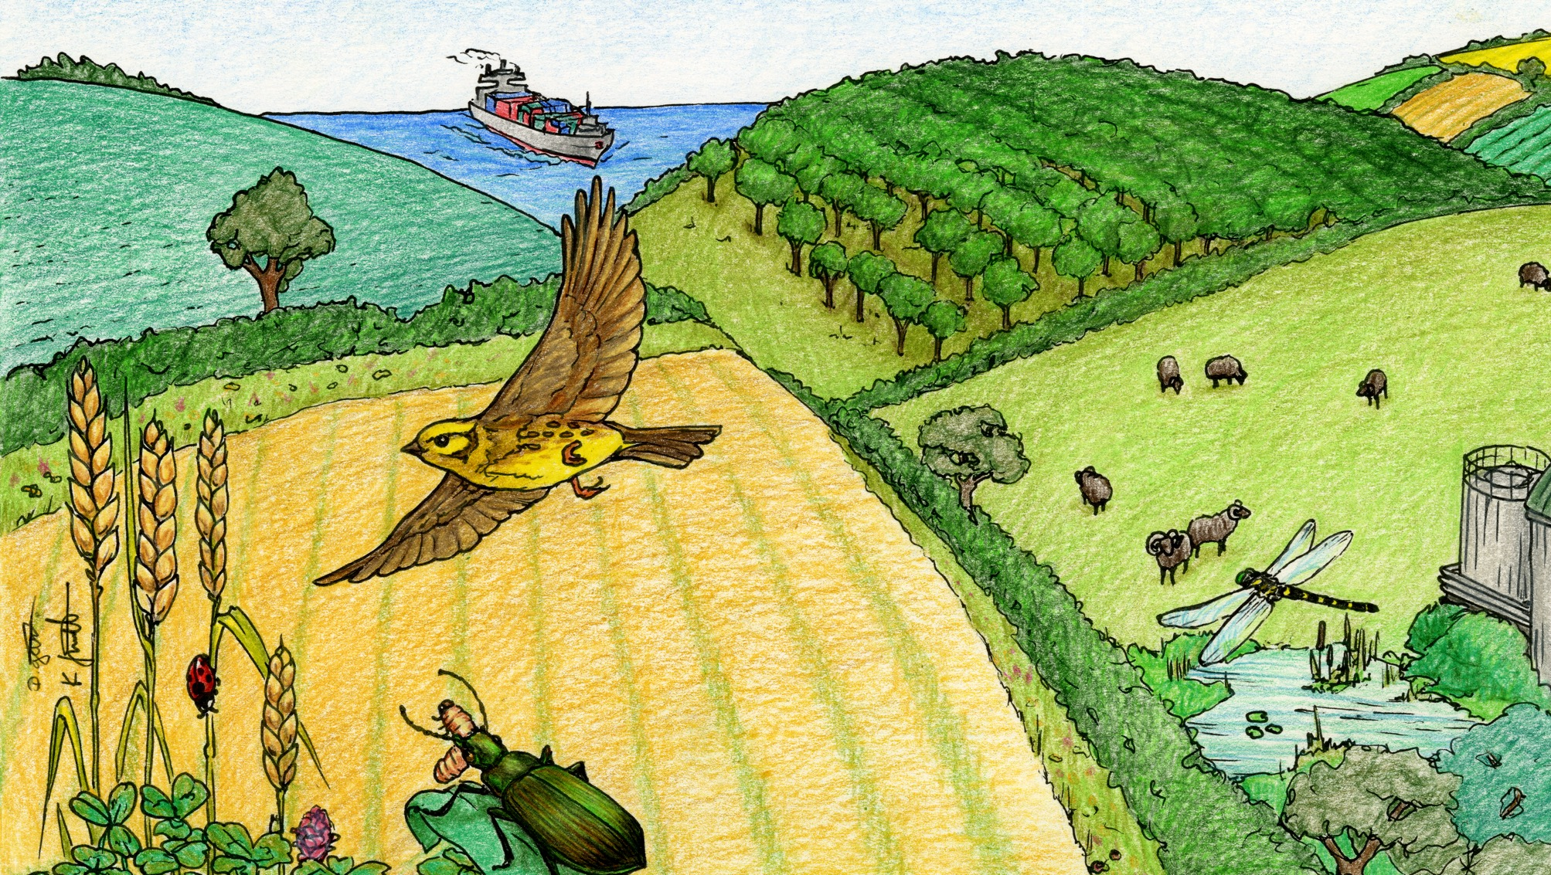
AES measures
Sown nectar flower mix or legume fallow
Diverse swards permanent grassland with low inputs
Taking field corners out of management
Tussocky grass margins and beetle banks
Periods of no grazing or reduced grazing
Hedgerows
Ponds and ditches

Slide 8
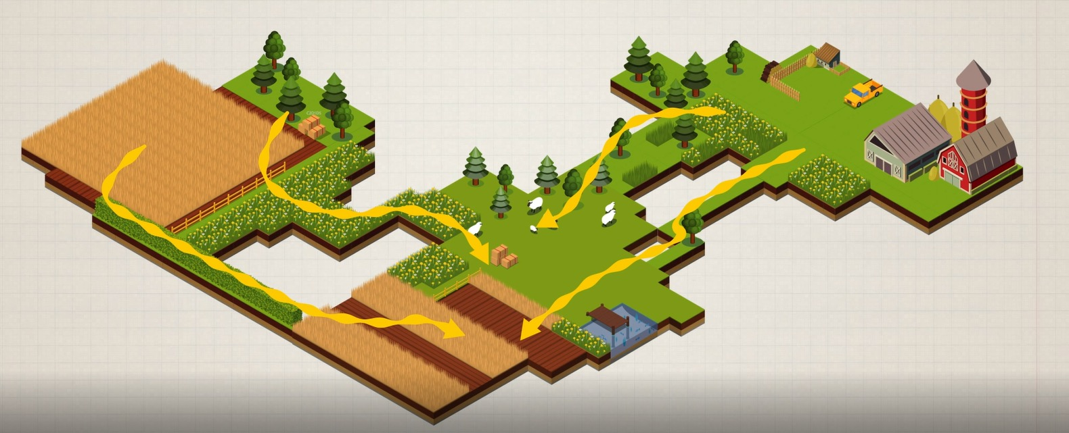
Where to put them?- farm scale
At the farm scale beetles have two sorts of movements:
Population movements of immigration and emigration to different fields and pastures as conditions and resources change
Seasonal movements to and from hibernation and aestivation areas
The areas they move to and from, and the way they move varies by species

Slide 9
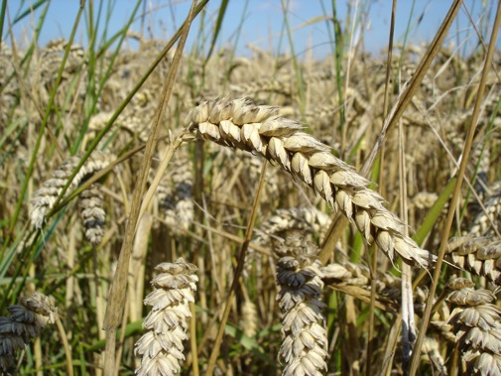
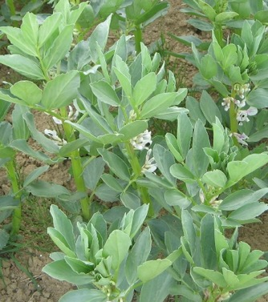
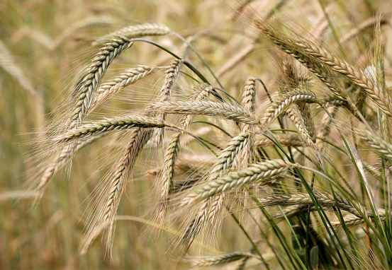
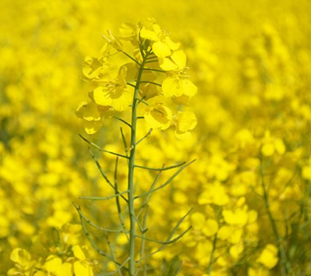
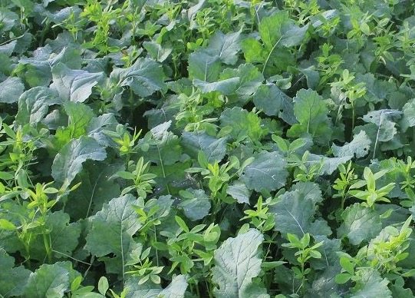
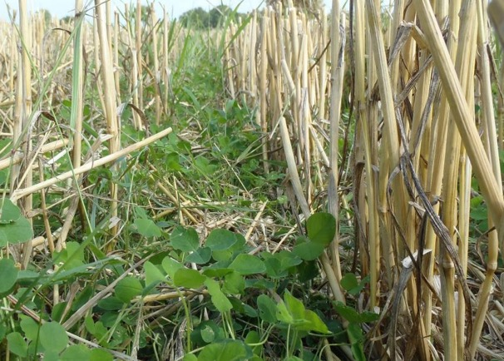
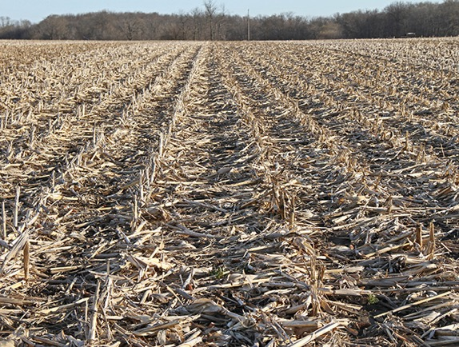
Crop diversity
In-field measures

Slide 10
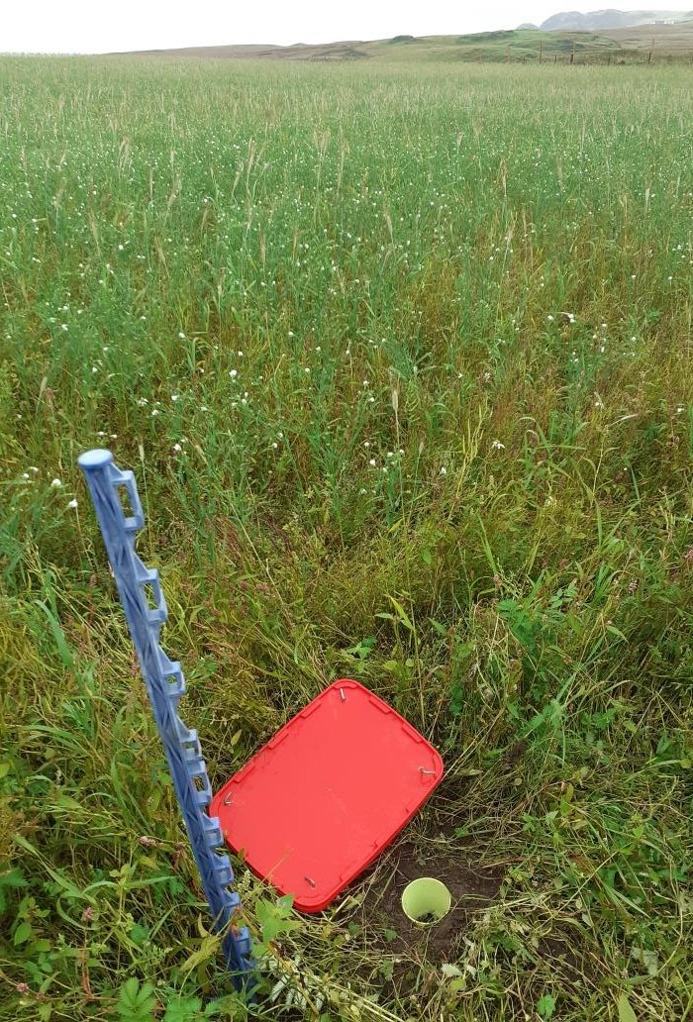
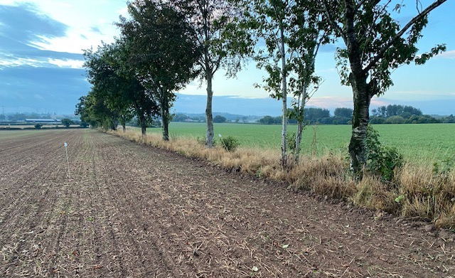
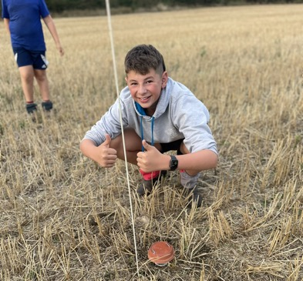
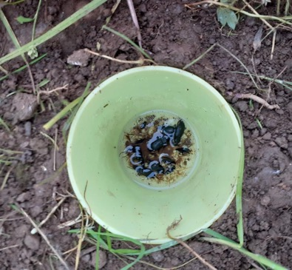
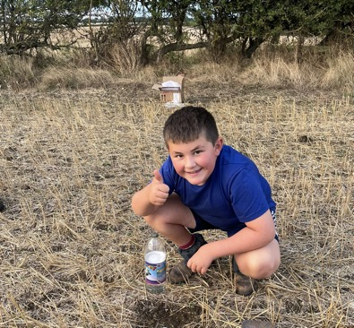

Slide 11
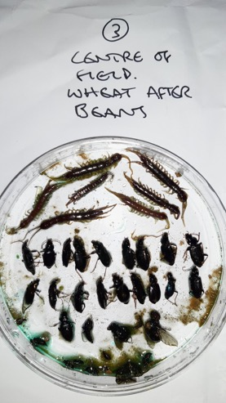
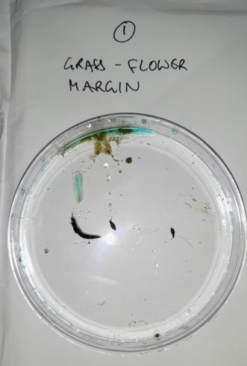
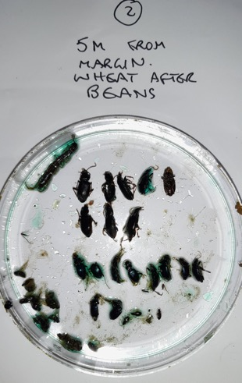
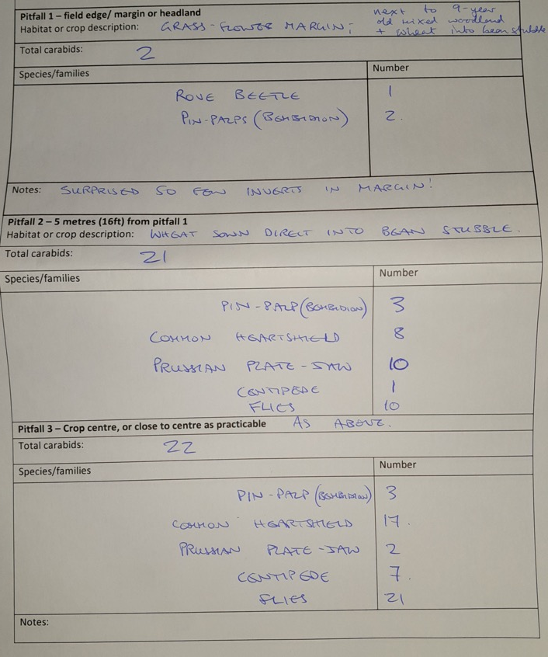

Slide 12
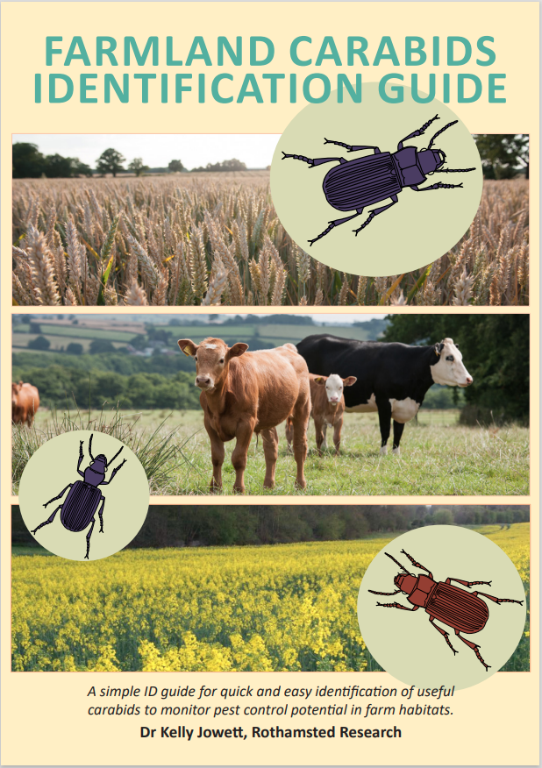
Step 1: Is it a carabid?

Slide 13
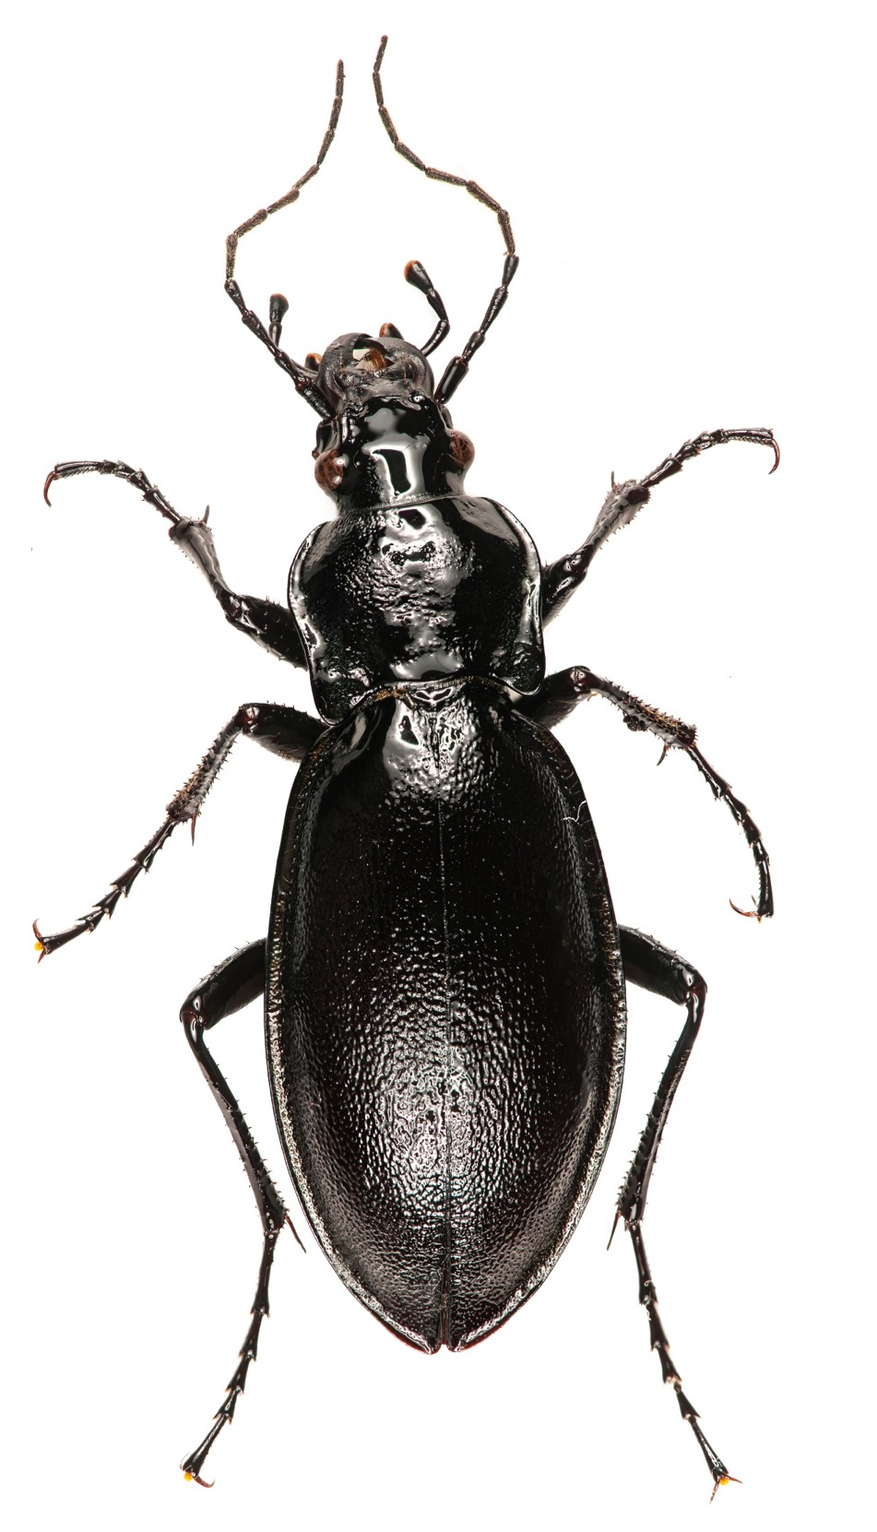

Slide 14
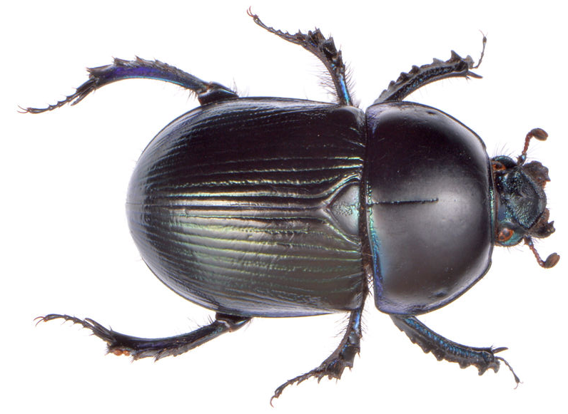

Slide 15
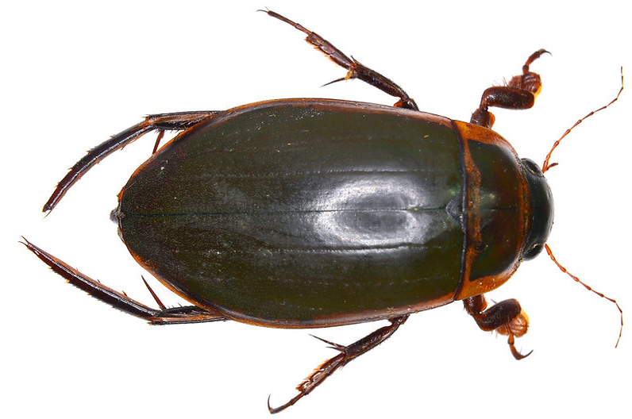

Slide 16
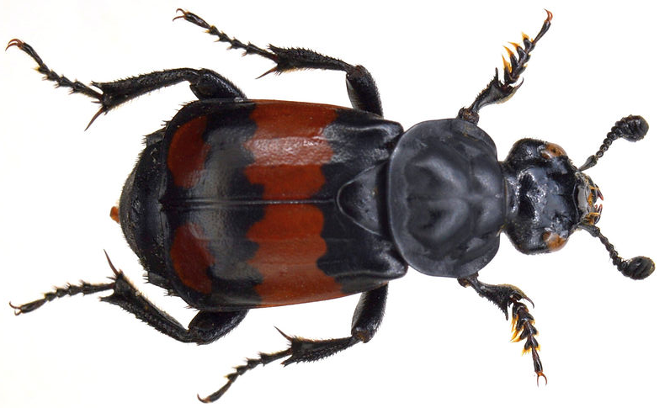

Slide 18
Species level Identification

Slide 19

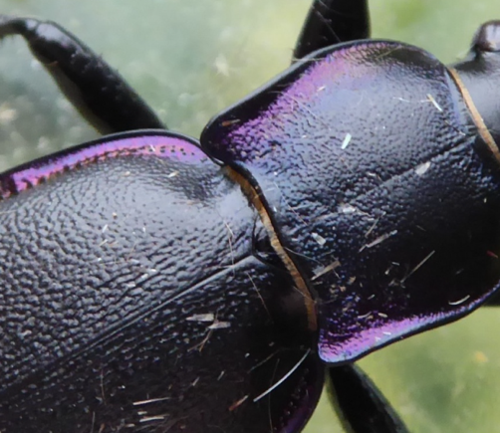
Size : over 21mm

Slide 20

Size : 13-21mm

Slide 21
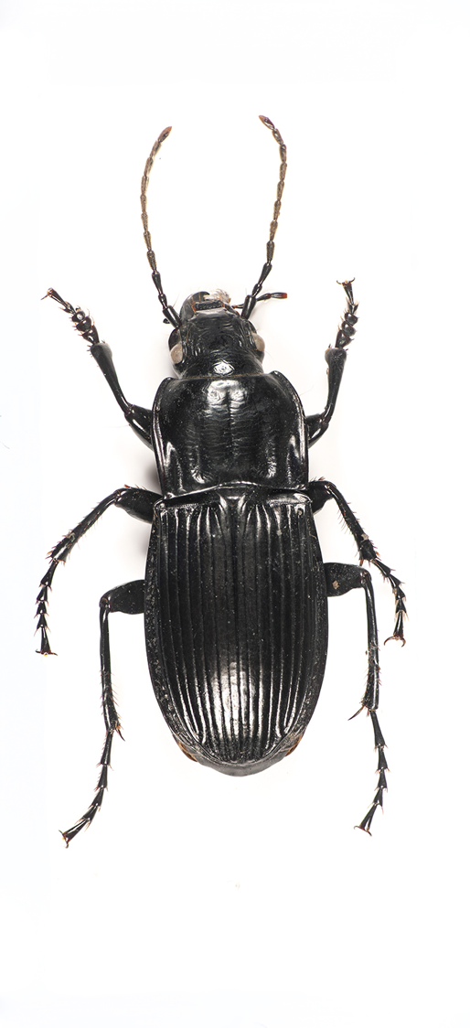
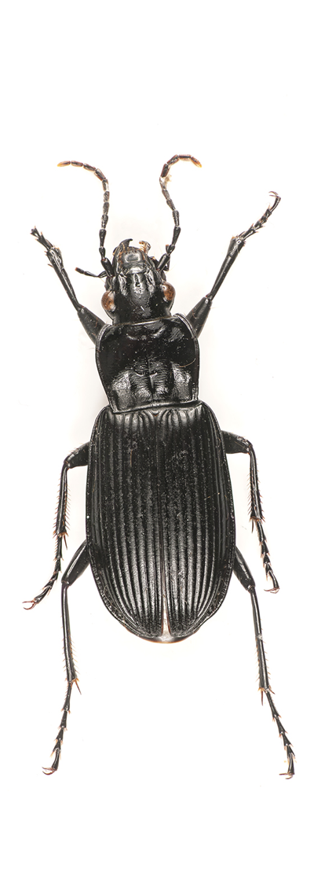
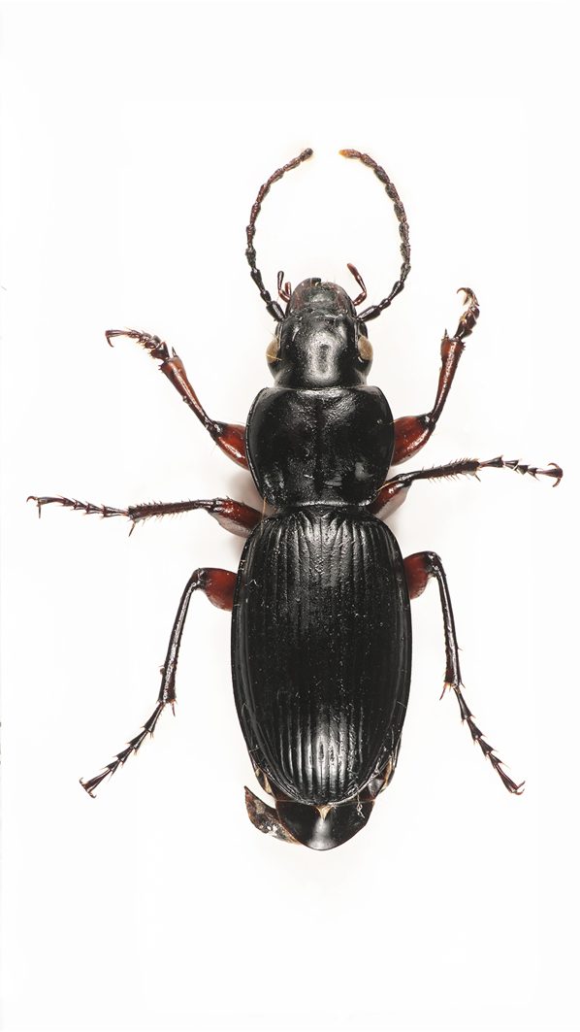
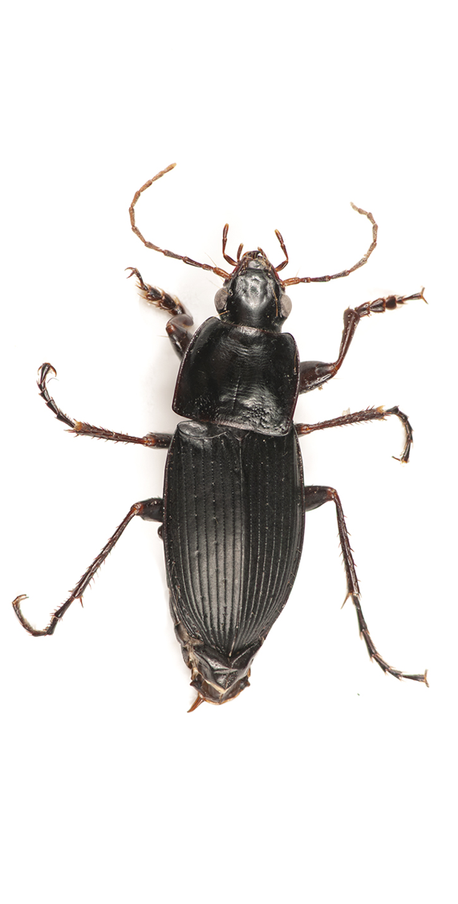
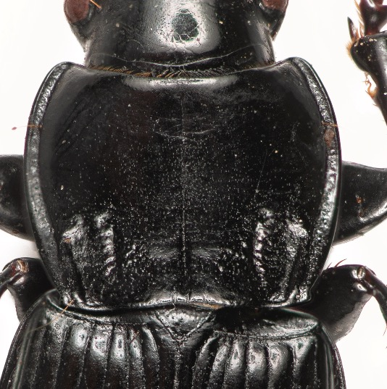

Slide 22
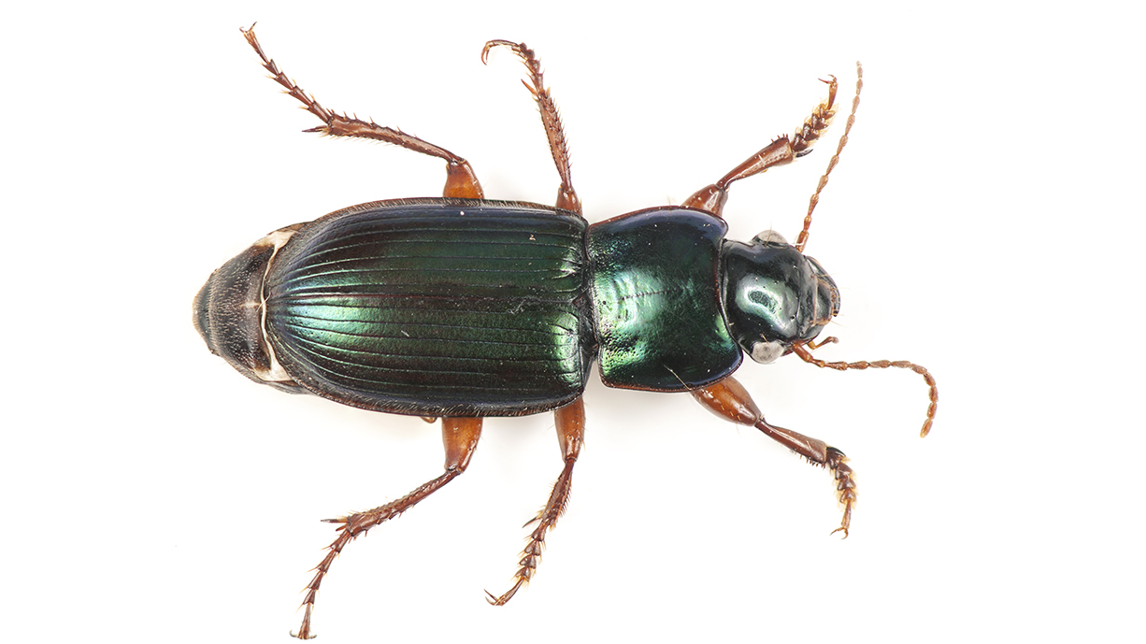
Size : 7-12mm

Slide 23
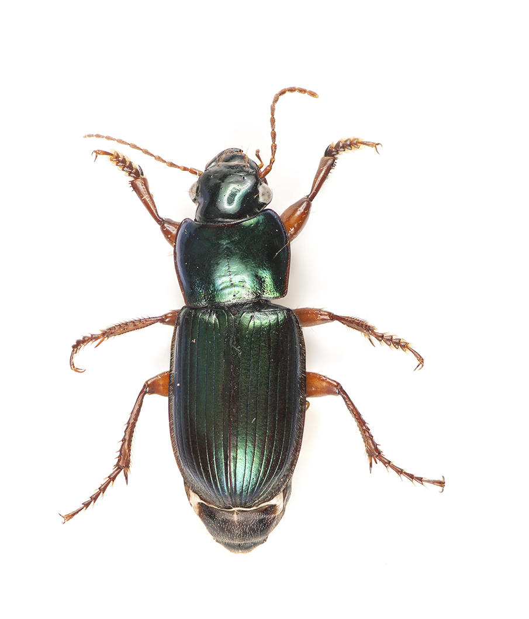
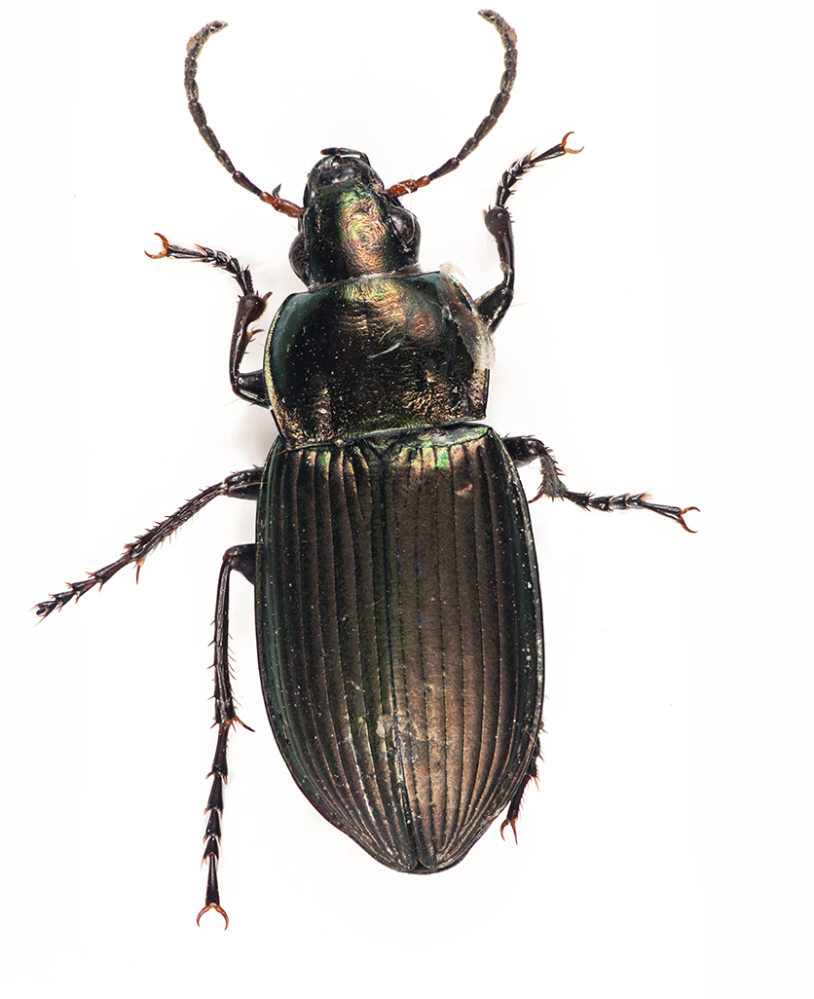

Slide 24
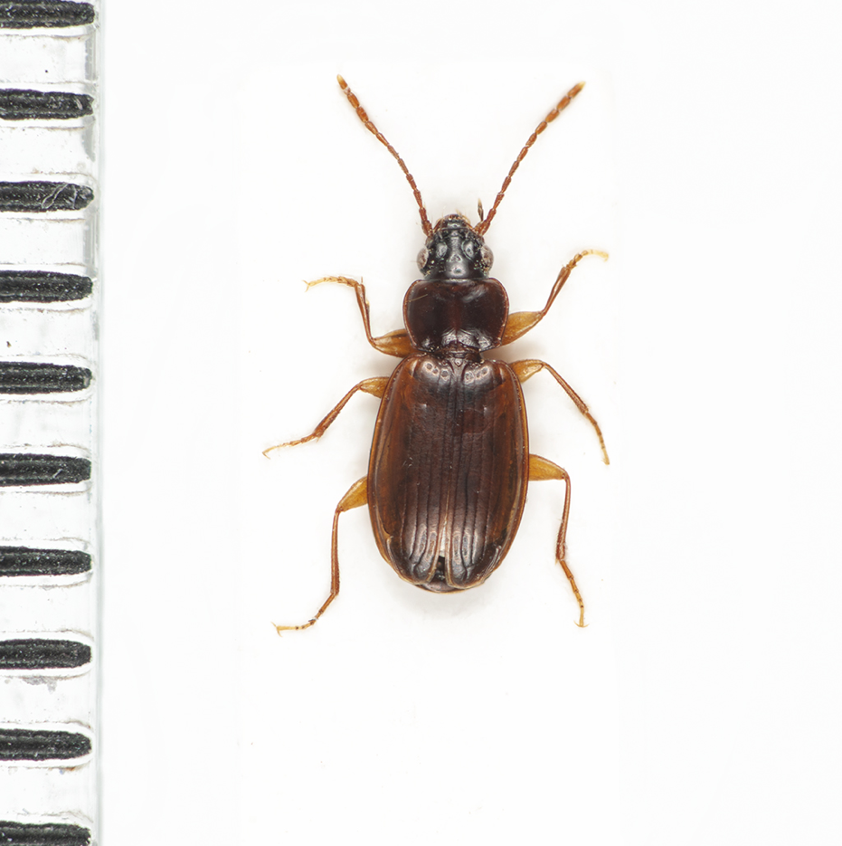
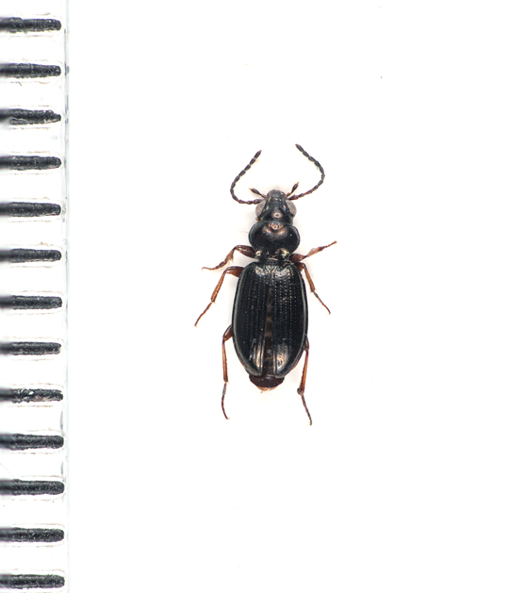
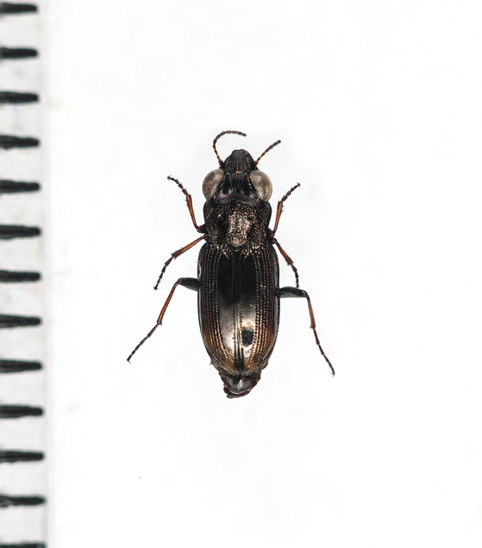

Slide 25
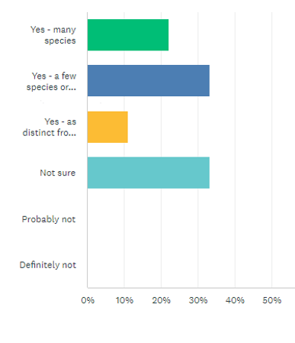
Pilot carabid monitoring
Pre-survey to feedback survey

Slide 26
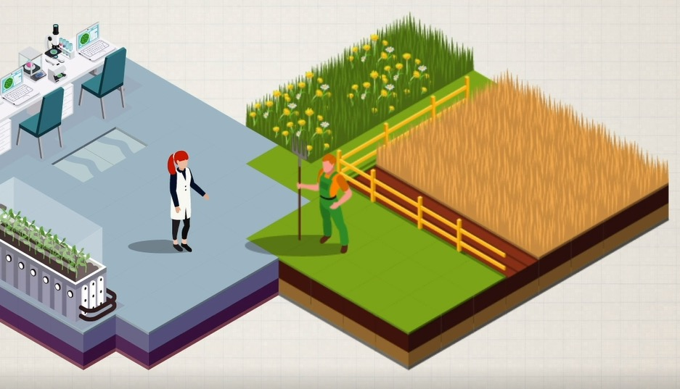


Kelly.Jowett@rothamsted.ac.uk

