Slide 1


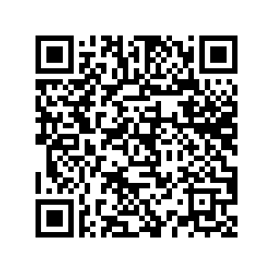
Land Justice Soundscape
As you listen to this selection of clips from the Landworkers’ Radio and Farmerama Radio, think about the following questions. You can write down your thoughts, or get chatting to someone else in the room.
1. What is your relationship to land? EG: Do you enjoy privilege, or have you experienced marginalisation?
2. What role could you play in working towards land justice?
3. What emotions are you experiencing whilst listening?
4. Do these clips make you think about land justice in a new or surprising way?
5. Imagine you are from a different country, of a different gender, sexual orientation, race, class or age, what if you lived in a different city or different rural area? How might your relationship to land be different?
6. Whose voice connected with you the most, and why?
Scan for transcript & references:

