Slide 1
Can Farmed Salmon Ever Be Sustainable?
Oxford Real Farming Conference 2025
Friday 10 January | 9.00 – 10.30 am
Town Hall Assembly Room

Slide 2
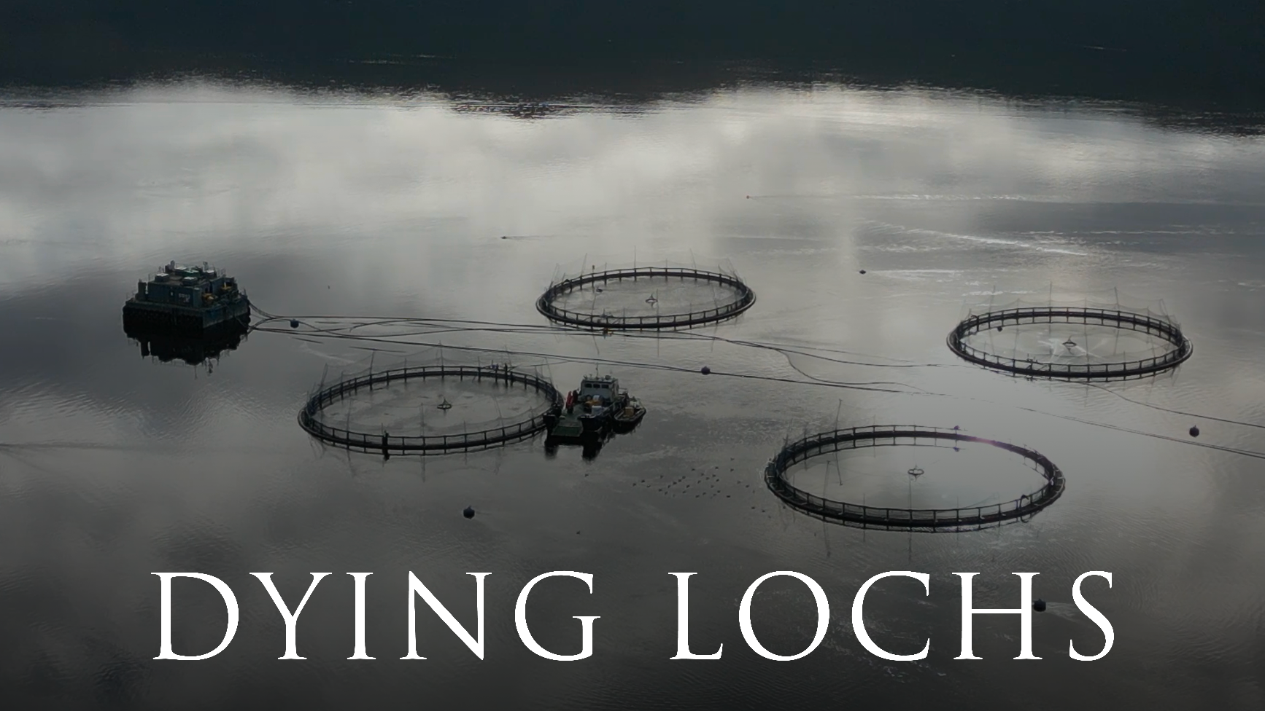

Slide 3
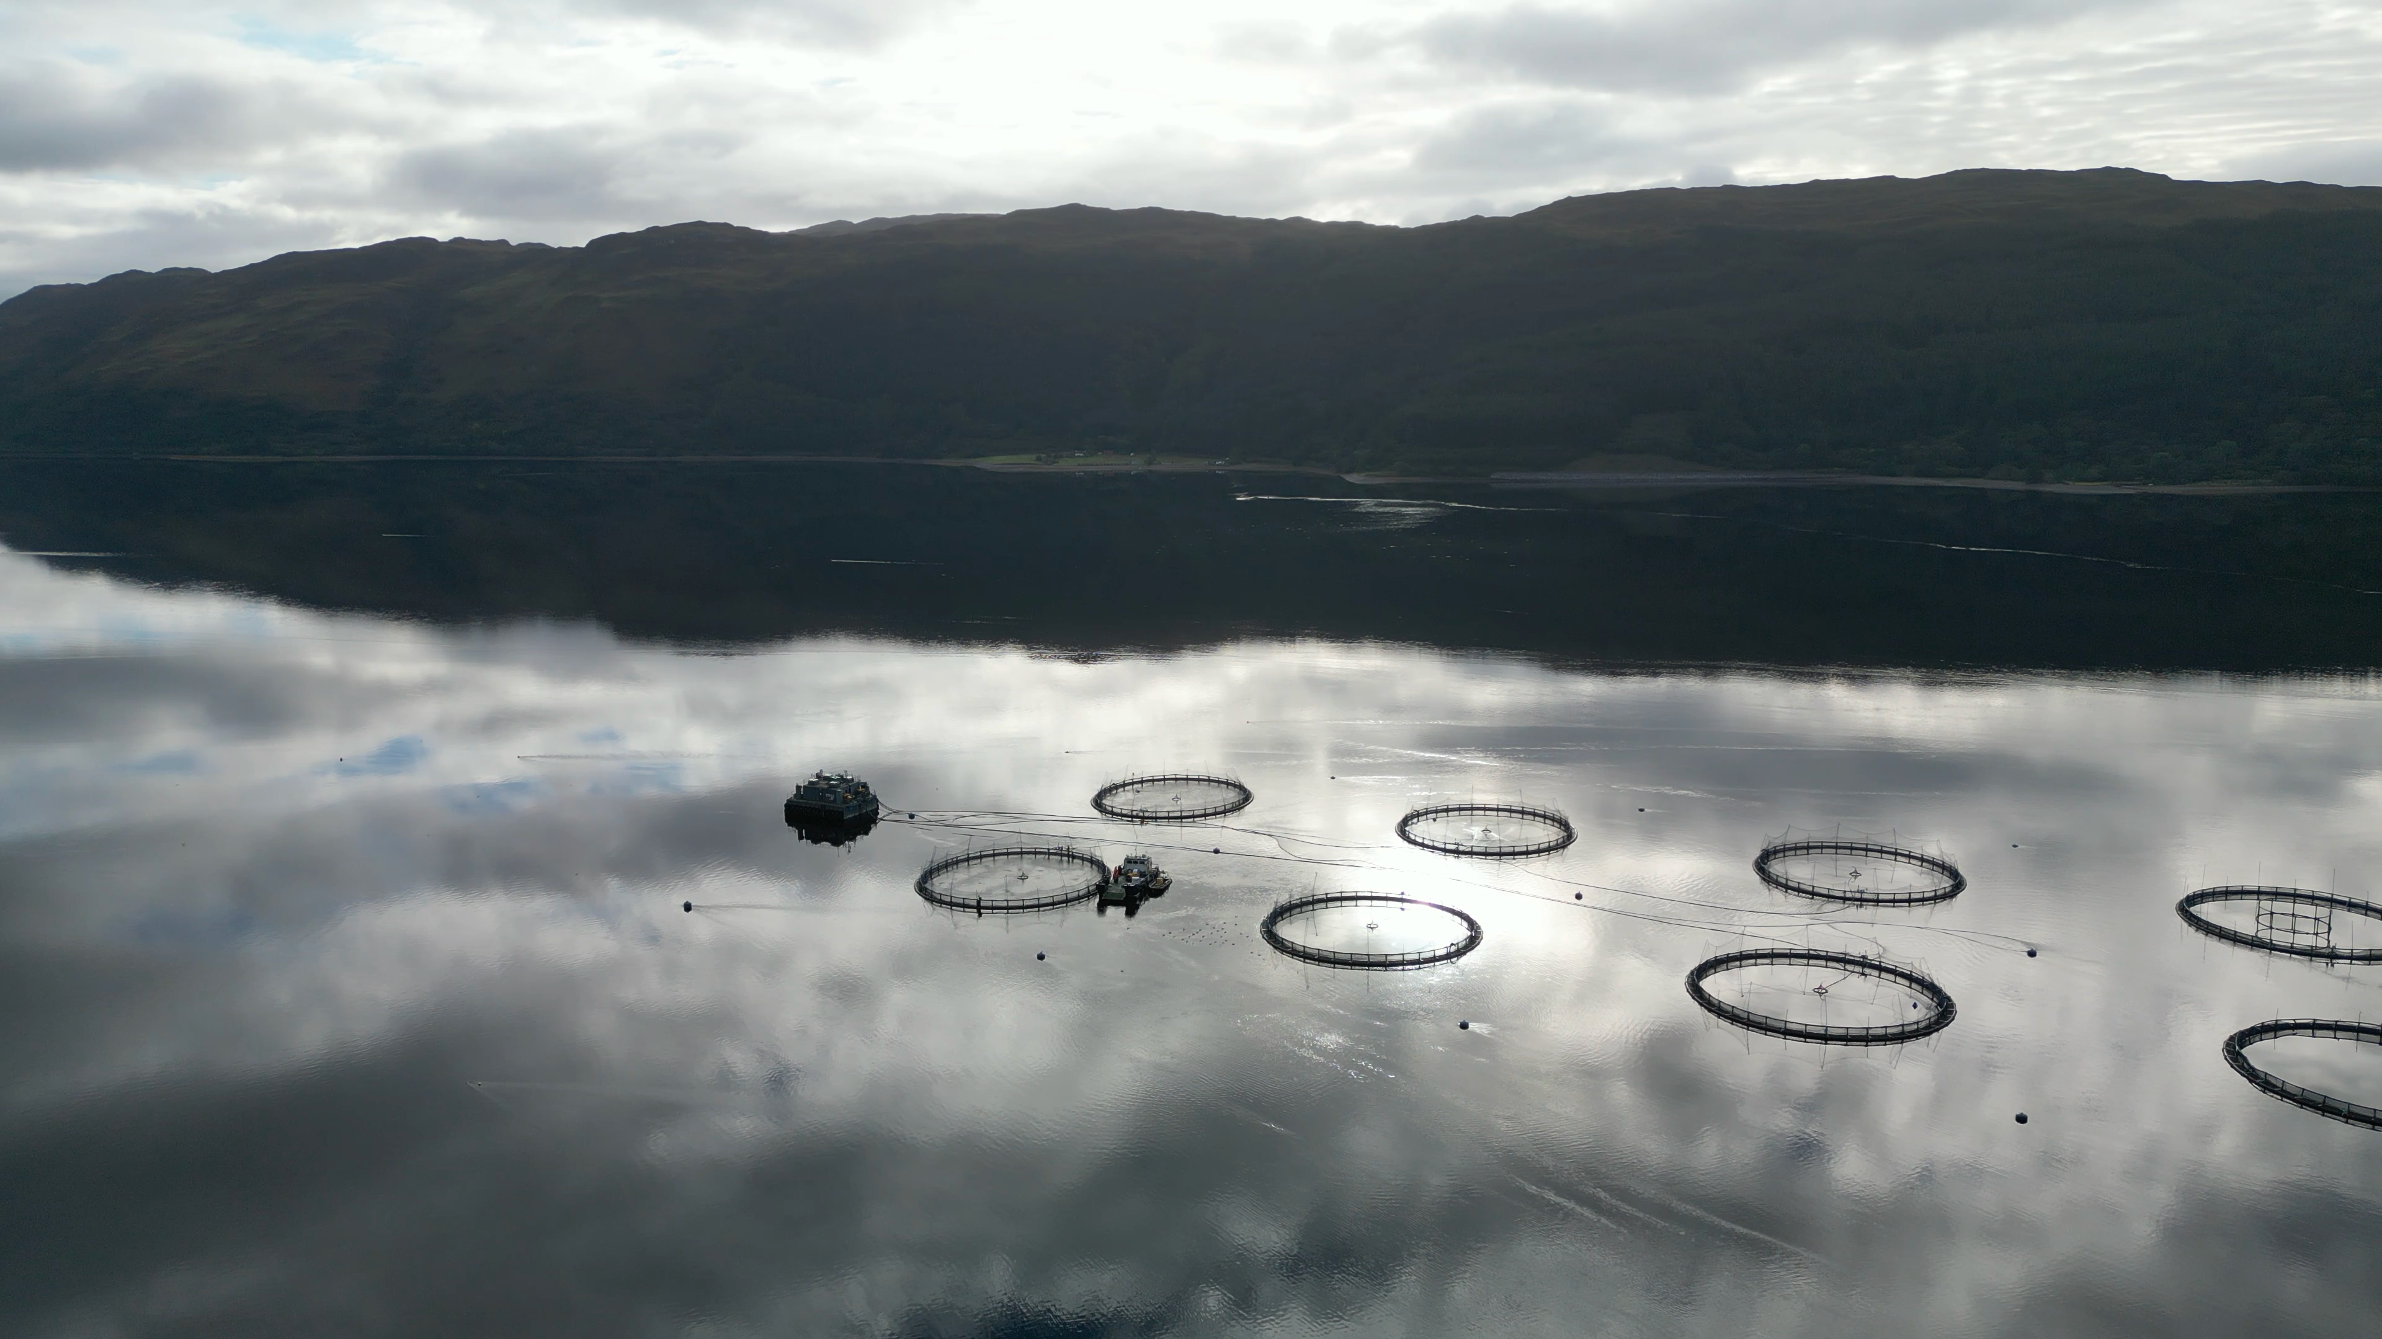
Film Director
Francesco De Augustinis

Slide 4
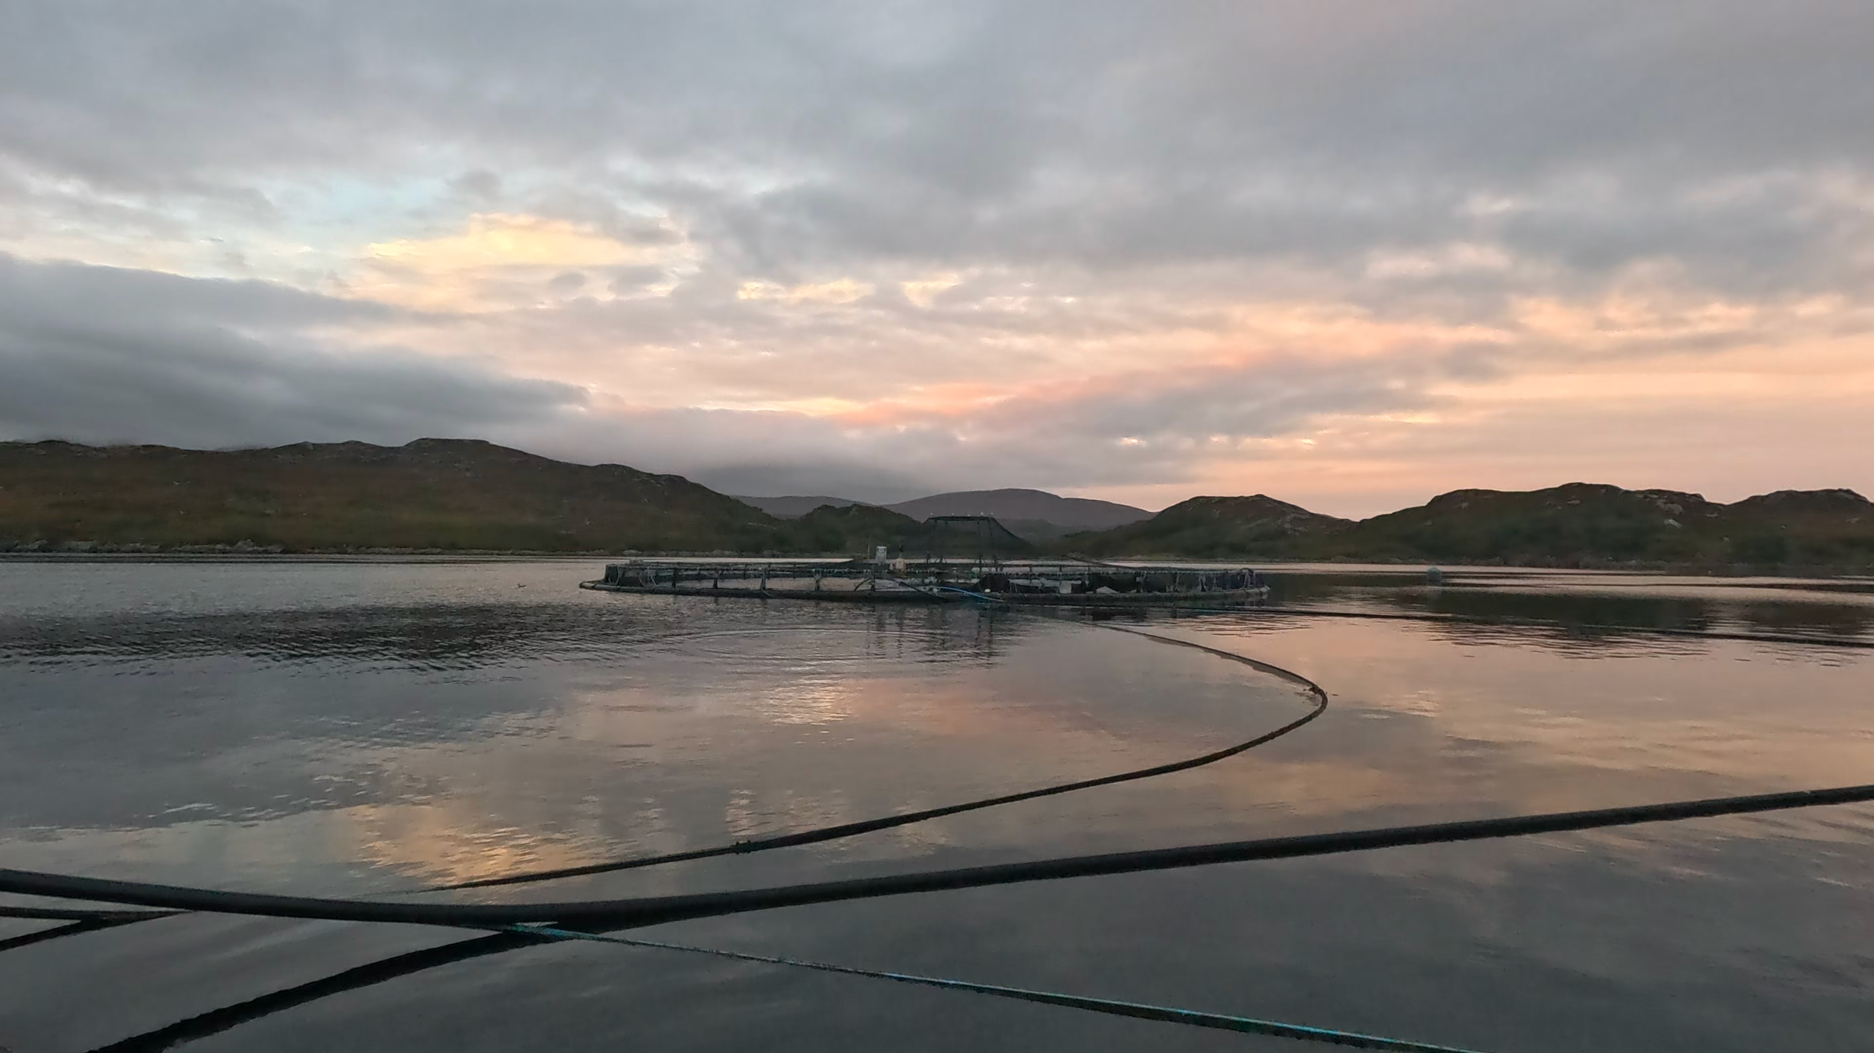
Panellists
Rachel Mulrenan, Scotland Director, Wild Fish
Caroline Bennett, Founder, Moshi Moshi & Sole of Discretion (CIC)
Ailsa McLellan, Oyster Farmer and North-west Co-ordinator, Seawilding

Slide 5
Total staff employed in salmon production 2013-2023
Source: Scottish Fish Farm Production Survey, Scottish Government.
Survey information is collected from all 10 companies actively involved in Atlantic salmon production, farming 210 active sites, representing the entire industry operating in Scotland.

Slide 6
Employment comparison
Total employment in the Highlands & Islands: 122,000
Tourism employment in the Highlands in 2022: 18,000
Source: Office of National Statistics / Employment, unemployment and economic inactivity in the Highlands
Source: VisitScotland.org
Jobs in wild salmon fishing in rivers and coasts: 4,300
Fishers employed on Scottish vessels/wild fisheries: 4,241
Source: Scottish Parliament report 2019
Source: Gov.Scot/publications/Scottish-sea-fisheries-2021

Slide 7
Panellists
Rachel Mulrenan, Scotland Director, Wild Fish
Caroline Bennett, Founder, Moshi Moshi & Sole of Discretion (CIC)
Ailsa McLellan, Oyster Farmer and North-west Co-ordinator, Seawilding

Slide 8
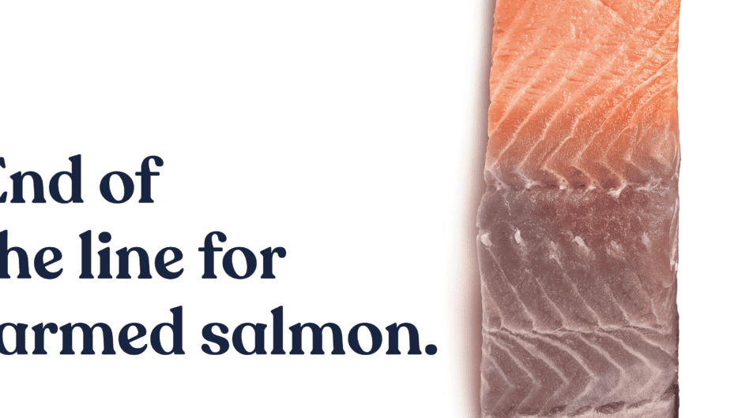
Off the Table
Offthetable.org.uk/get-involved

Slide 9
Thank you

