Slide 1
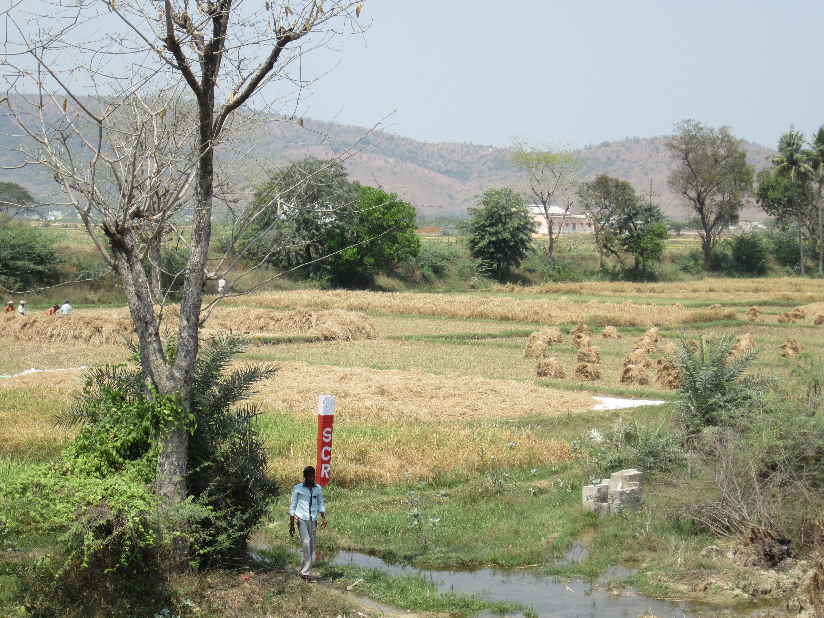
Help!
How should we understand biodiversity in polycultures?

Slide 2
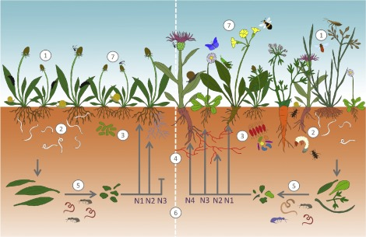
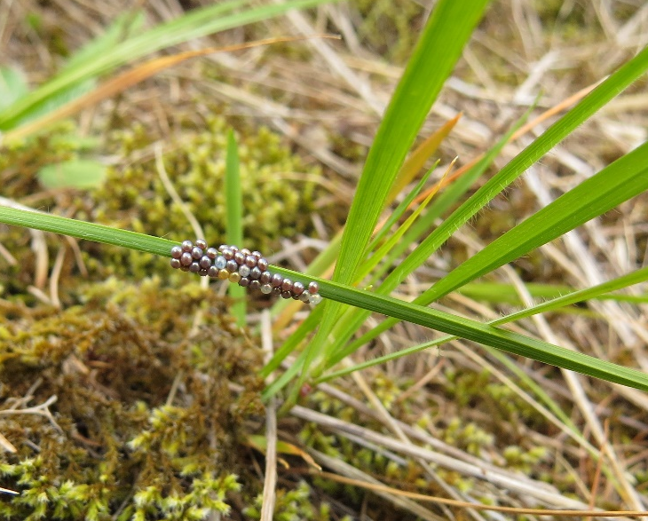
If agriculture was designed by an ecologist: biodiversity, production, polyculture
Weisser, W. W., et al. (2017). "Basic App Ecol 23: 1-73
Alfy Gathorne-Hardy
University of Edinburgh
a.gathorne-hardy@ed.ac.uk
Notes:
This is on the back of some work barbara and I have been doing on yield in agricultural systems.
I want to highlight 3 points today, with a focus on biodiversity: the importance of production,

Slide 3
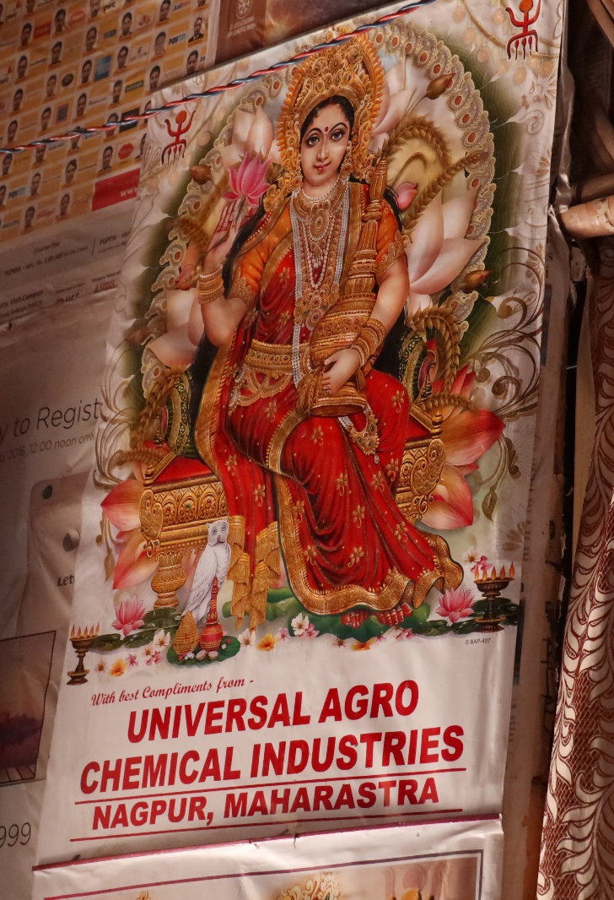
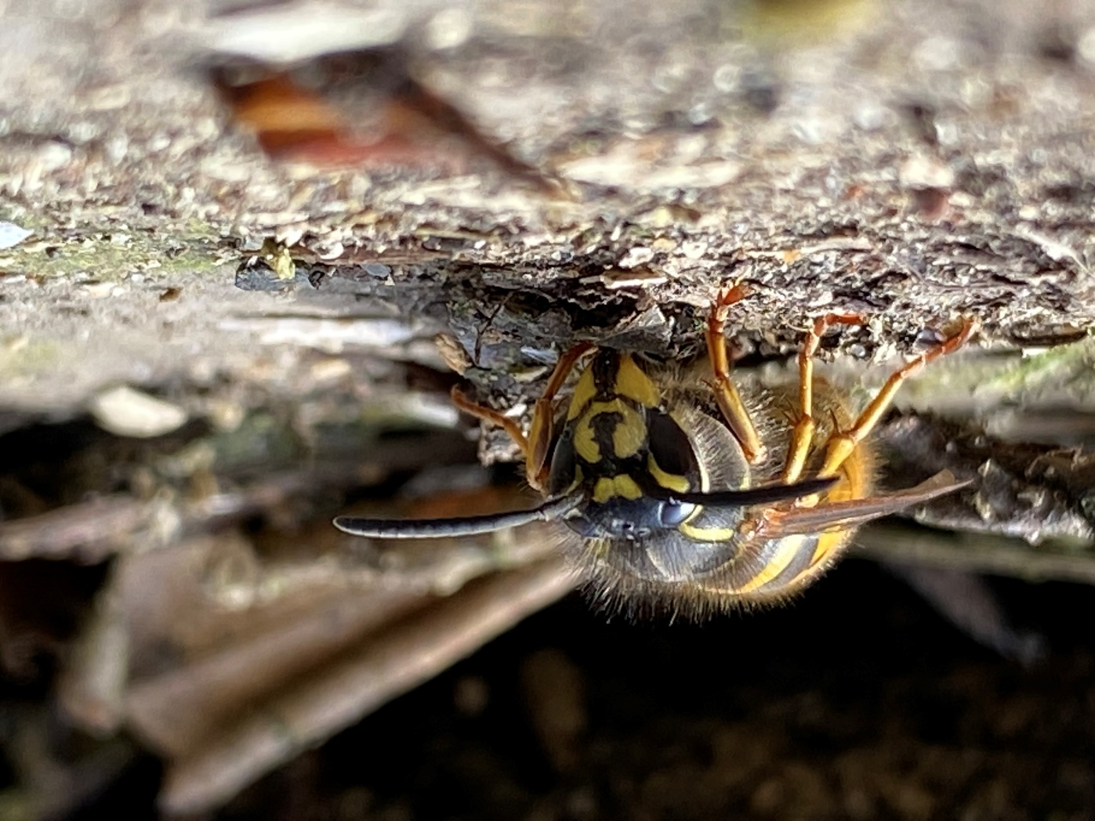
Agriculture and global biodiversity loss
What’s the problem with present agricultural systems?
  Dominates global land area
  Typically low biodiversity (+ GHG, fert/pesticide pollution etc).
So what do we want?
  Smallest area
      Max production per unit area (but production of what? over what area?)
      Lower demand (food waste, meat, lettuce, etc)
  Max environmental good per unit area
  (min environmental ‘bad’ per unit area)
.

Slide 4
Four indicators for agricultural environmental ‘good’:
constant or increasing production of food
constant or increasing supportive and supported on-farm biodiversity
neutral or sink of atmospheric/water polluting elements/molecules
good employment

Slide 5
i. constant or increasing production of food
Local biodiversity gains can = massive global loss:
Indirect land use change
change in local production/markets in one part of the world can indirectly drive land use change many thousands of miles away

Slide 6
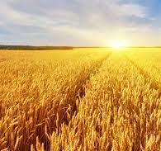
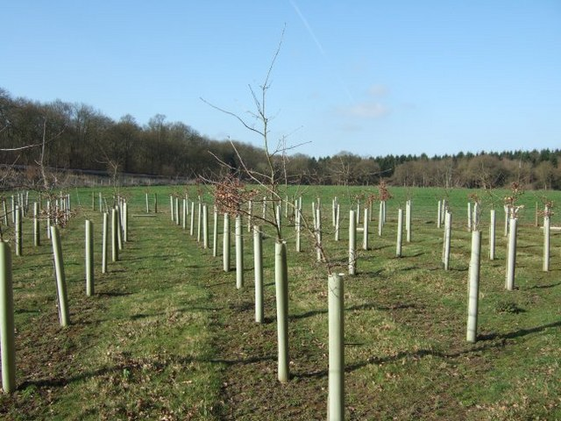
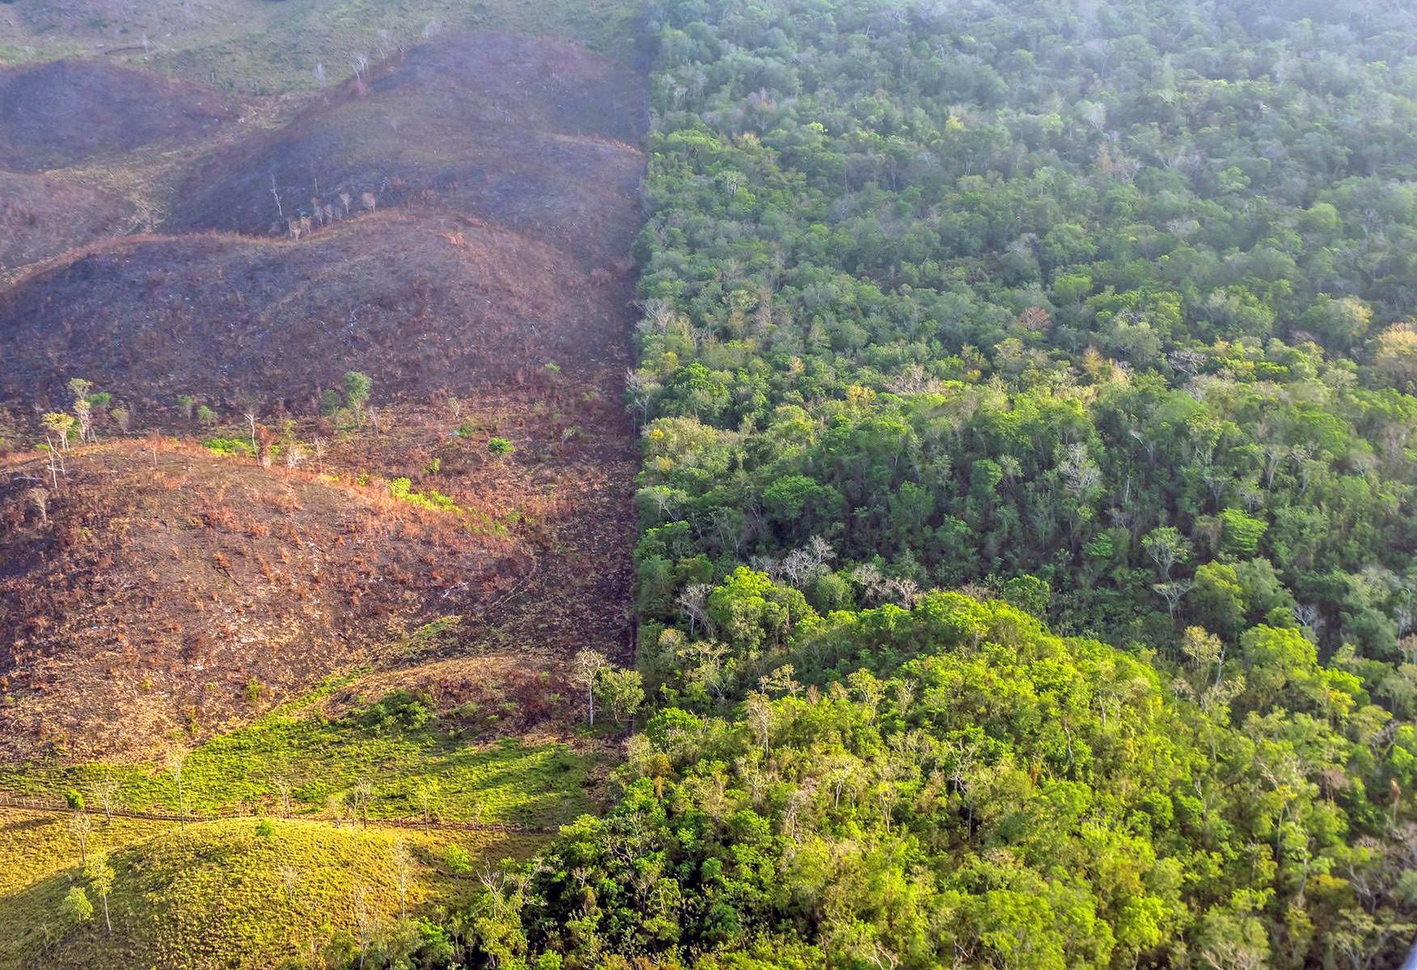
Local biodiversity gains can = massive global loss:
i. constant or increasing production of food
1 hectare cereal
1 hectare wood
New land needed for agriculture
=
+
we calculated that converting 1ha of UK cereal to 1ha of UK woodland ≈
→ 1.67 ha of new land converted to agriculture*
*Assuming zero commodity-price elasticity

Slide 7
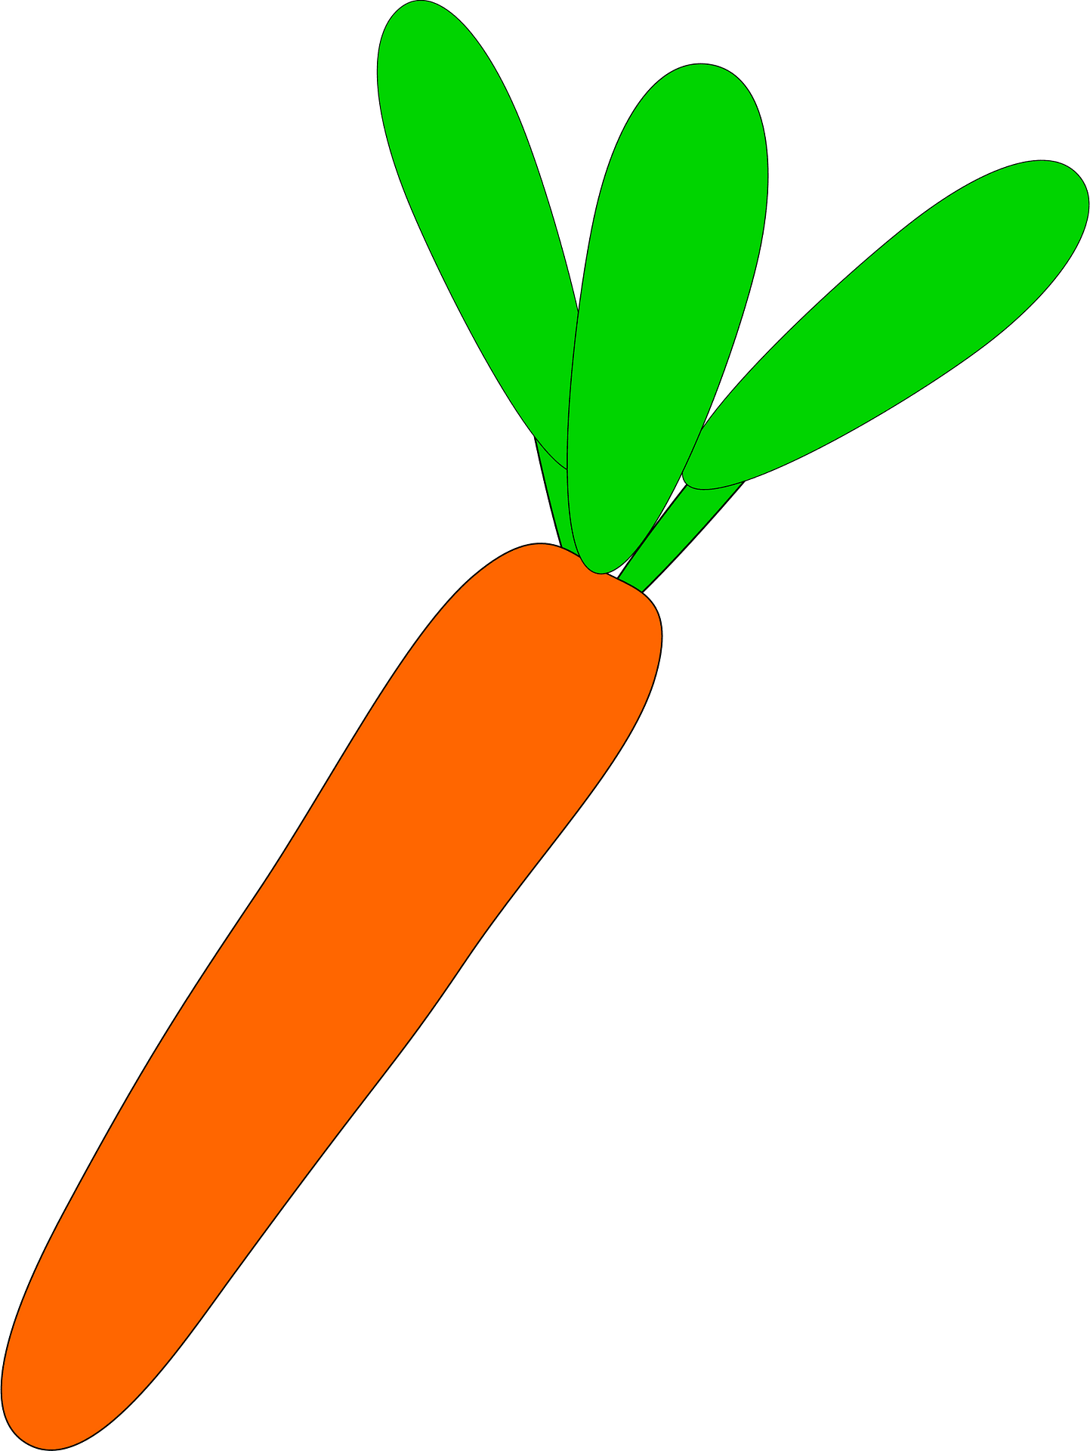
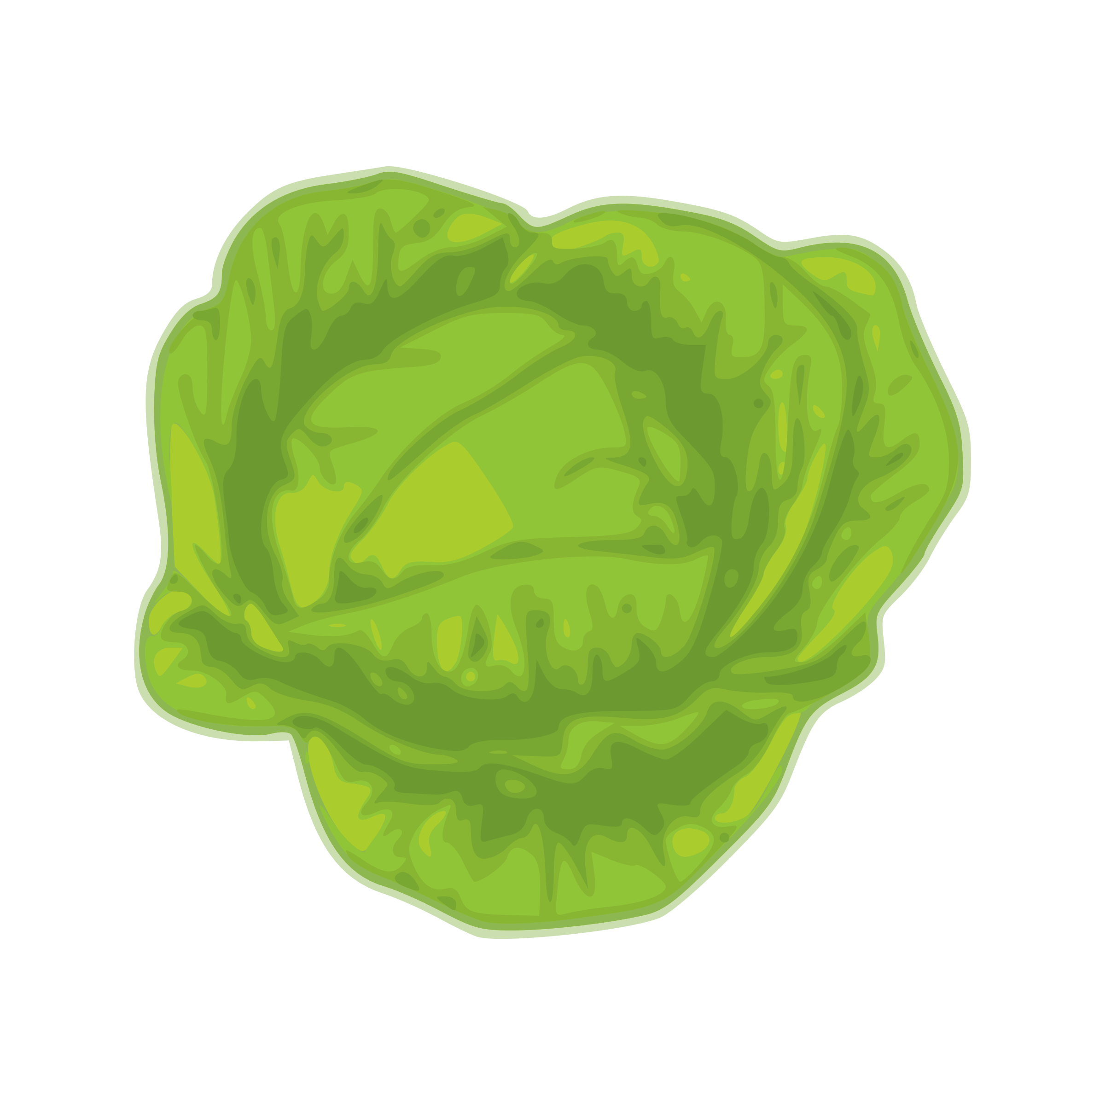


Local production gains can = massive global gain:
i. constant or increasing production of food
40 t/ha carrots
20 t carrots, 20 t cabbage, 10 t tomatoes, 5 t beans…
Land globally saved for wildlife*
=
+
every 1 ha of UK arable ‘saved’ ≈
→ 1.67 ha* of global non-agric land ‘saved’
*Assuming zero commodity-price elasticity

Slide 8
How should we measure production (space)?
i. constant or increasing production of food
(nutritional)?
(energy)?....
Monoculture
(1ha cropped)
Market garden (0.8ha cropped)
→
BUT
Paths
What is the right baseline for comparison?
→

Slide 9
How should we measure production (resilience)?
i. constant or increasing production of food

Slide 10
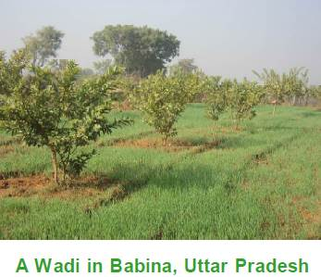
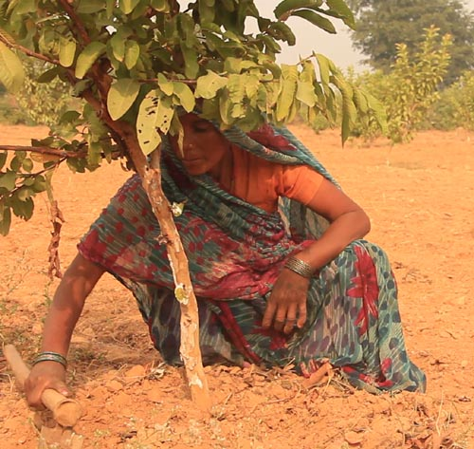
How should we measure production (resilience)?
i. constant or increasing production of food
AND
Fruit consumption increased
Income increased
Insecticide use decreased
Deccan Plateau, India
Intercropping of crops with fruit trees to address the increasing frequency of drought
Development Alternatives (DA) + Jasmine Hussain
BUT
Still hard work
Little evidence, globally.
Limits to resilience
88% of WADI farmers did NOT want next generation to be farmers.
Under drought conditions:
tree crops declined by 14%
monoculture crops 47%

Slide 11
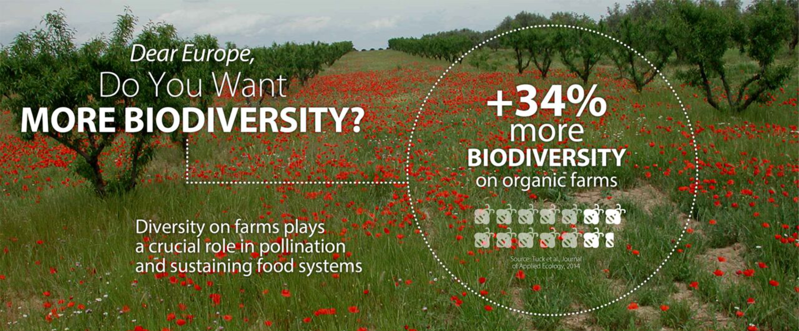
ii. constant or increasing supportive and supported on-farm biodiversity
Which biodiversity do we want (less of)?

Slide 12
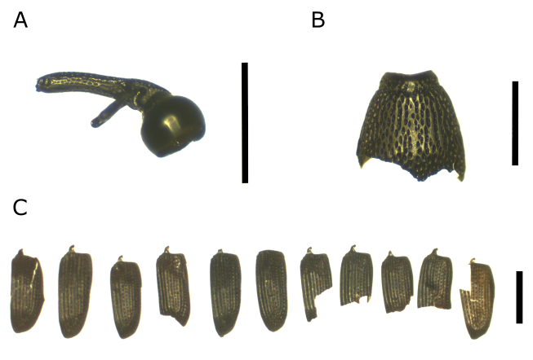
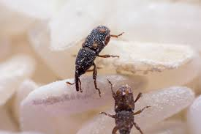
ii. constant or increasing supportive and supported on-farm biodiversity
Sitophilus granaries Grain weevil. (A) head; (B) pronotum; (C) elytra. Scale bar = 1 mm. Lin ca. 5900 to 4700 cal BC
(Thanks to Sesilia Niehaus)

Slide 13
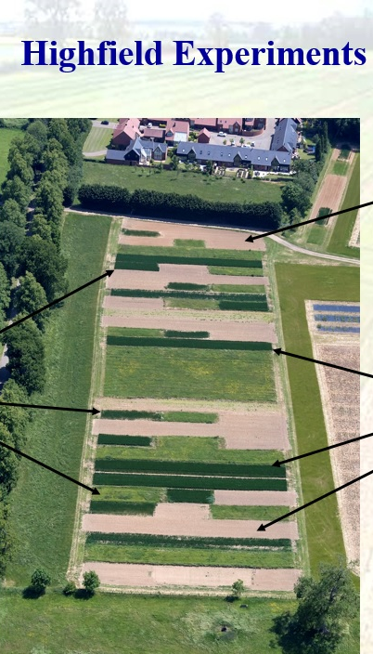
We can’t have it all
ii. constant or increasing supportive and supported on-farm biodiversity
‘More’ biodiversity is not necessarily better
Target ecosystem is one that
Persists: (e.g. soil erosion is less than soil generation)
Maintains high production
Resistant and resilient to shocks and change (flooding, increased aridity)
Hirsch, P. R., et al. (2009). "Starving the soil of plant inputs for 50 years reduces abundance but not diversity of soil bacterial communities." Soil Biology and Biochemistry 41(9): 2021-2024.

Slide 14
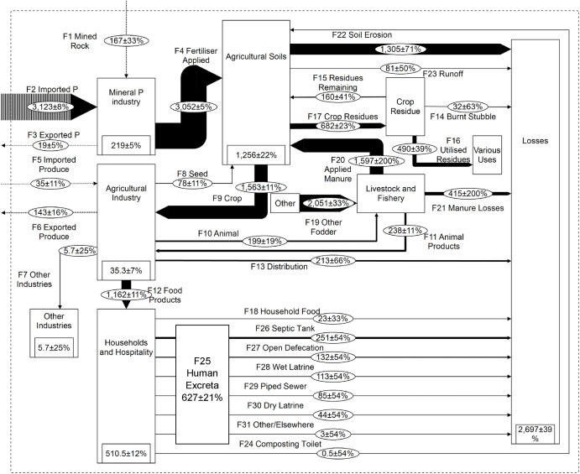
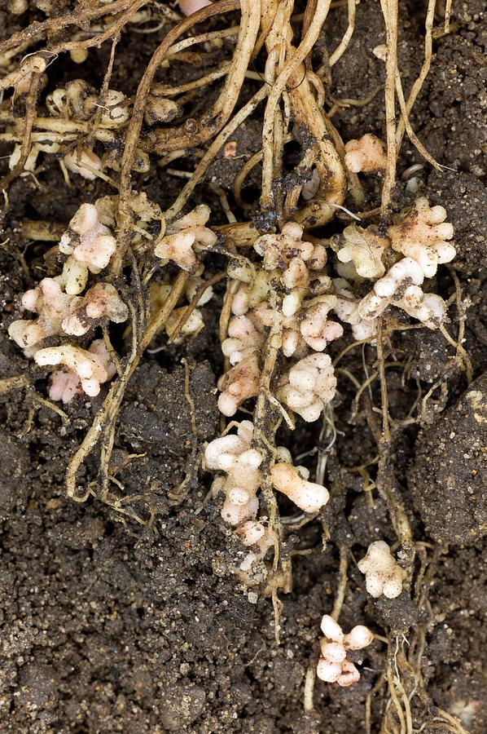
Nutrients - Cinderella of the food systems
iii. neutral or sink of atmospheric/water polluting elements/molecules
Wentworth, D., et al. (2024). Cleaner Environmental Systems 14: 100220
Notes:
key driver of biodiversity loss, GHG emissions, and costs
Polyculture appropriate for this – legumes, mycorrhizae, but little research so far
Needs whole food system approach
Could be key for reaching ‘conventional’ yields

Slide 15

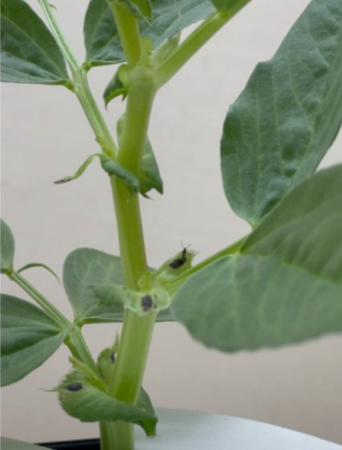
The pasta problem
Nurainie Wan Ismail

Slide 16
Polycultural systems have potential to support:
i. constant or increasing production of food
Total production is important. The choice of baseline is complicated. Resilience is key
ii. constant or increasing supportive and supported on-farm biodiversity
Likely increased biodiversity, but of disturbance tolerant species
iii. neutral or sink of atmospheric/water polluting elements/molecules
Increased nutrient use efficiency, but minimal research, and wider food system engagement needed for circular economy
With many thanks to colleagues, students, farmers and friends for ideas, data and inspiration

