Slide 1



Eliminating peat from propagation using growing media blocks
The Sow and GrowBlocks project
Audrey Litterick, Earthcare Technical Ltd
audrey@earthcaretechnical.co.uk

Slide 2
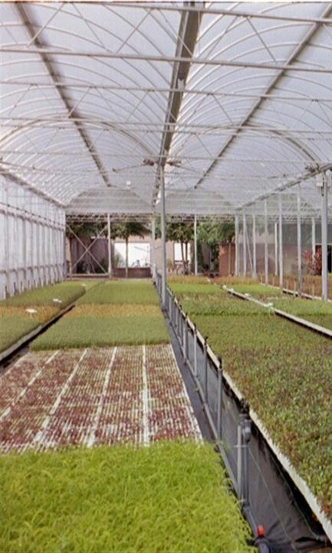
Project aims
To eliminate peat and minimise use of plastic in veg/salad propagation through the use of nursery-produced growing media blocks based on “hot bin” compost, soil, leaf mould and coarse washed sand.

Slide 3

We wanted to:
put some science background into practical work on composting and growing media.
avoid the confusion that often surrounds discussions about composts, composting and growing media - clearly defined key words!
Help project participants learn a bit about:
  composting;
  growing media;
  current relevant work going on elsewhere.

Slide 4
What we have done
Preliminary work trial on performance of proprietary amateur and professional growing media
Four main trials on three separate host nurseries/market gardens, supported by staff and volunteers
Five guidance notes describing compost, composting, growing media, how to make and use growblocks and testing of growing media.
Literature review and information gathering exercise to look at what other growers and research organisations have done in this area (ongoing).

Slide 5
Trials hosts – small-scale commercial growers
Wester Lawrenceton Farm
  Forres, Moray (Pam Rodway)
  Large garden scale
East Neuk Market Garden
  Anstruther, Fife (Connie Hunter and Tom Booth)
  1.8 ha and 756 m² of tunnel space
Tombreck Farm
  Lawers, Aberfeldy, Perthshire (Rachel Wake and Ian Machacek)
  0.14 ha and 202 m² of tunnel space

Slide 6
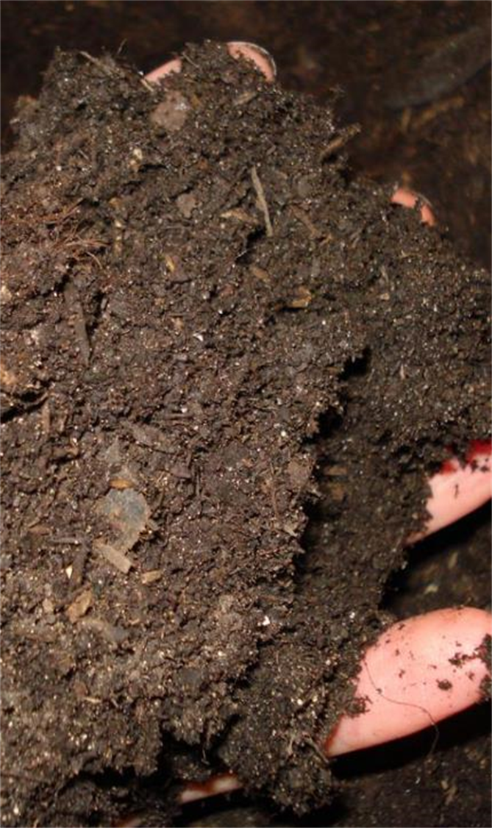
First we made “hotbin compost”:
Vegan and non-vegan composts
Recipes differed slightly between nurseries.
  Contained only constituents which can be sourced locally to each nursery;
  peat-free;
  suitable for blocking;
  suitable for raising veg/salad seedlings in (e.g. adequate nutrient content);
  largely free of viable weed propagules (?!)

Slide 7
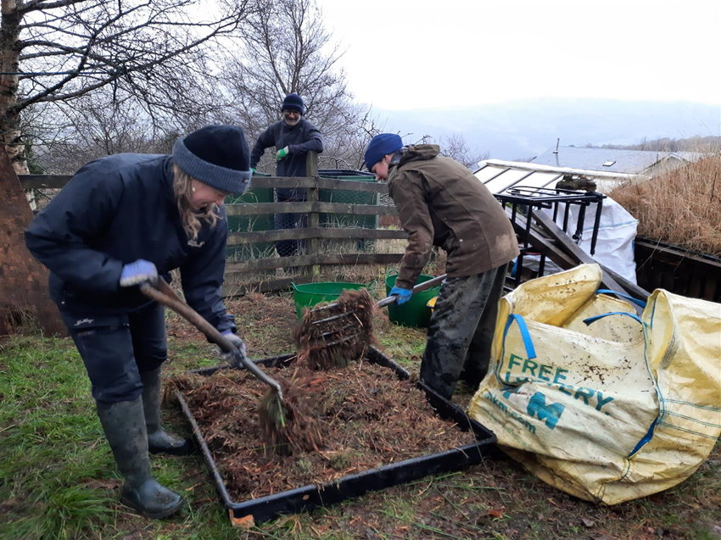
Then we mixed our growing media on the nurseries
Finished media had to be:
  sufficiently fine and sticky to form good, cohesive blocks;
  suitable for raising veg/salad seedlings in (e.g. adequate nutrient content);
  largely free of viable weed propagules (?!)

Slide 8
Growing media recipe (same on all nurseries)
4 parts by volume Aerobin compost (sieved through 10 mm then 6 mm sieve)
4 parts by volume leaf mould (sieved through 10 mm then 6 mm sieve)
1 part by volume coarse river sand (sieved through 6 mm sieve)
1 part by volume loamy soil (sieved through 6 mm sieve)
We decided to embrace the microbiology present in the sand and soil! We chose these carefully but did not sterilise them.

Slide 9
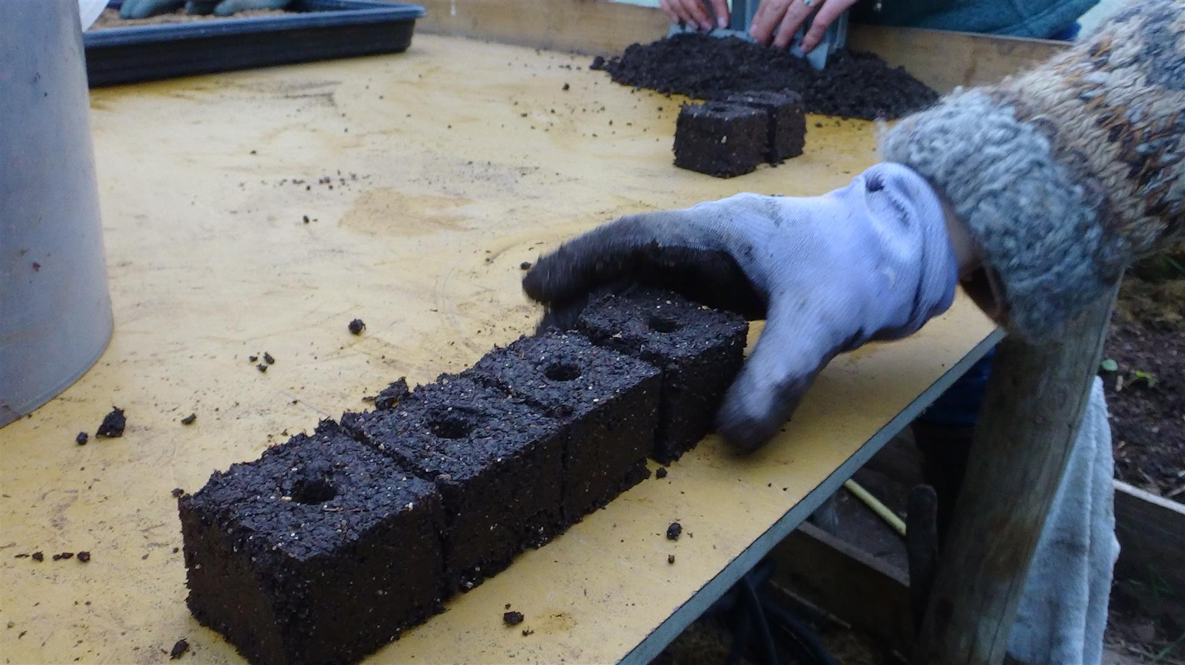
Then we made GrowBlocks
Used Ladbroke hand blocking tools (4-module for peas and 5-module for kale and lettuce)
Practised until we managed to make firm, cohesive blocks.
Then made the blocks for the trial.

Slide 10
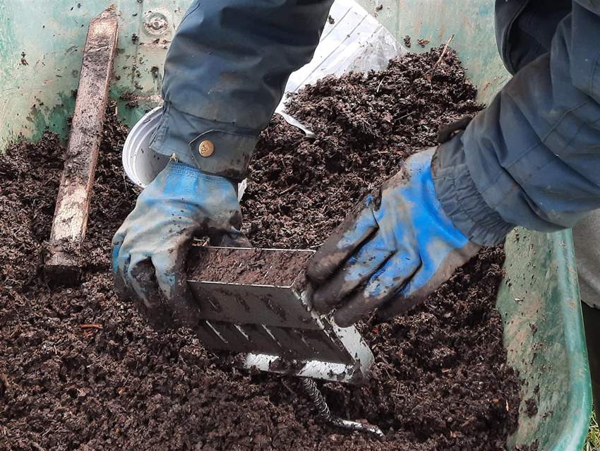
Making GrowBlocks
Had several volunteers so job was done fairly quickly, but it is still time-consuming, when all jobs are taken into account:
  sourcing compost ingredients
  compost production
  sourcing growing media ingredients
  mixing growing media
  making and setting out blocks
  sowing (more or less time-consuming than standard practice?)

Slide 11
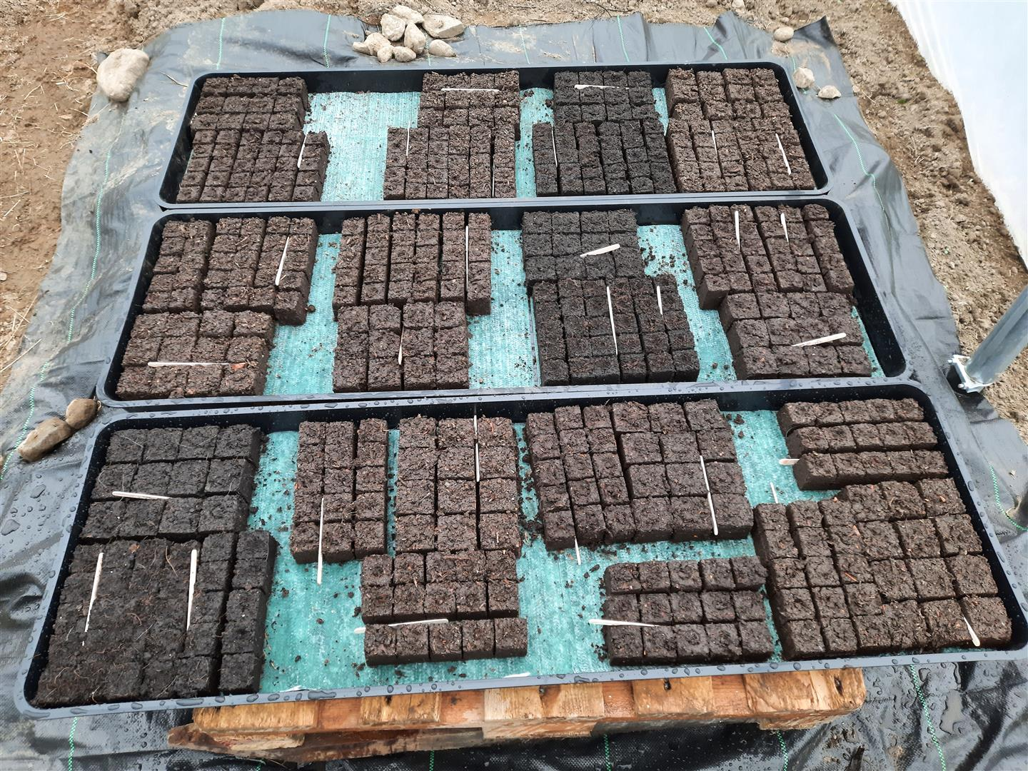
Control treatments
In all four trials, we included a control treatment (a proprietary growing medium “Moorland Gold” based on 100% waste peat filtered from drinking water supplies).
One trial also included a second control (Klassman reduced-peat propagation medium).

Slide 12
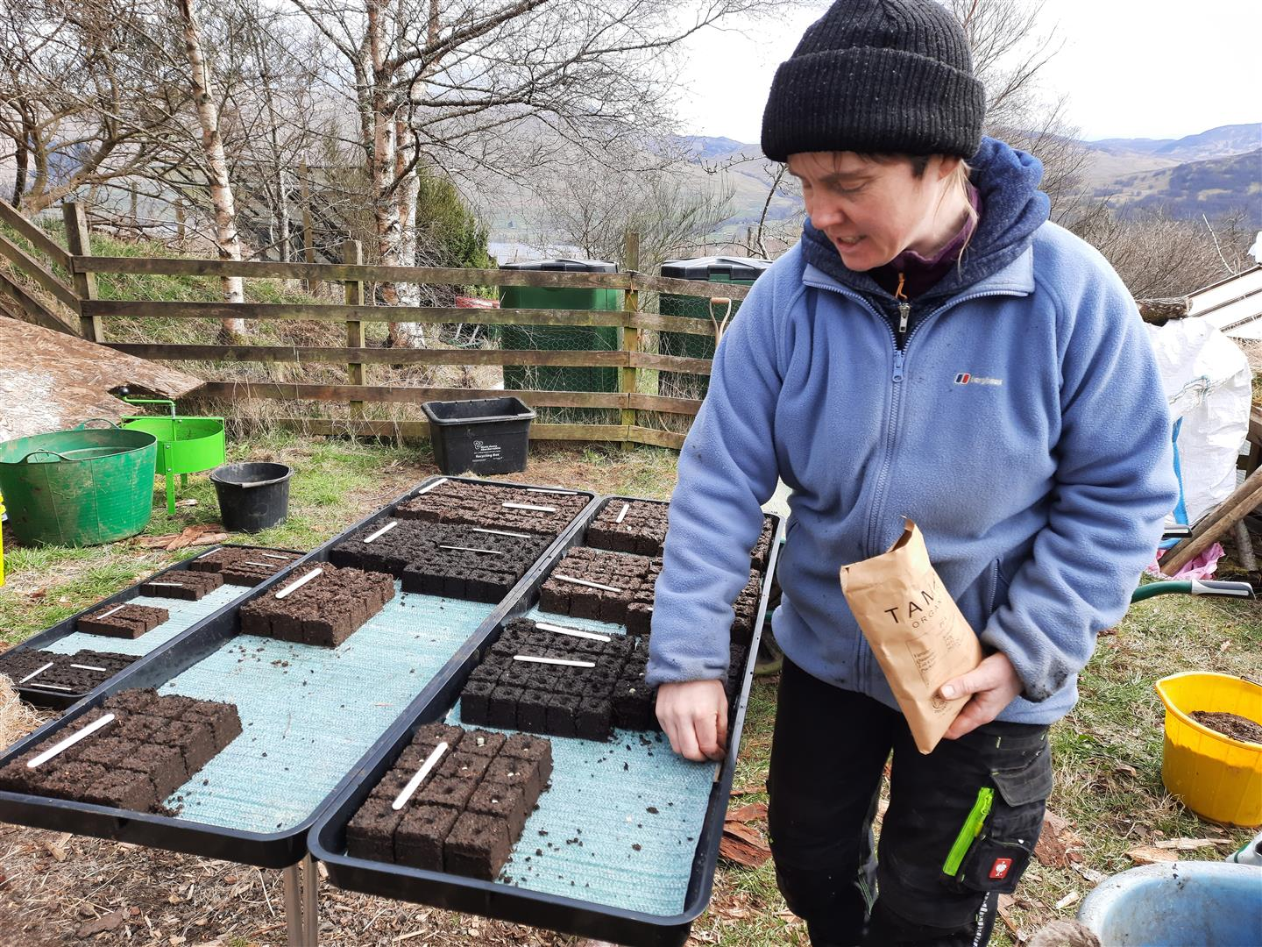
At each nursery, we:
sowed 12 blocks of peas and 15 blocks of kale or lettuce in each plot;
set the blocks on capillary matting on plastic trays in a replicated (3 reps), randomised block design;
kept each replicate on a separate plastic tray;
covered the blocks with protective mesh until the young seedlings were through, watering regularly.

Slide 13
Lab testing and seed germination/plant growth
  Tested the constituents, nursery-made growing media and controls for a range of physical, chemical and biological parameters
    Aimed to help determine the reason for good/poor growing media performance.
  Measured seed germination, seedling performance and plant growth over a period of several weeks

Slide 14
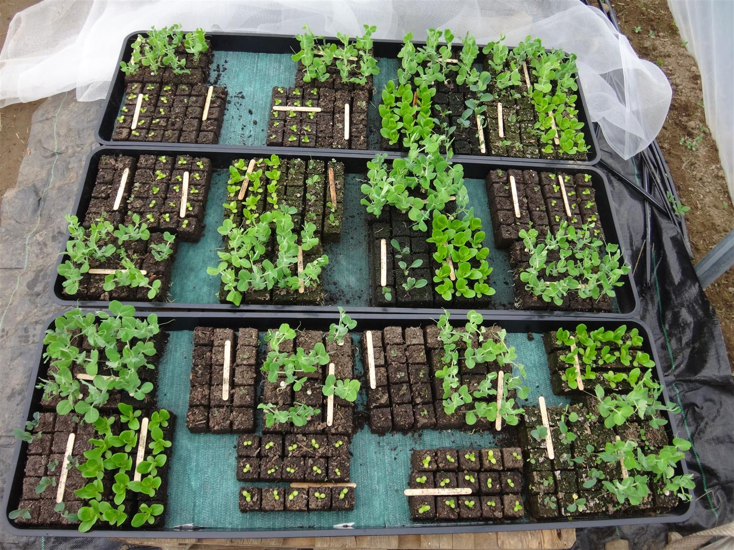

Slide 15
Results
Our nursery-made media generally performed very well!
In most repects, the nursery-made, compost-based media in each trial performed as well as the Moorland Gold control in terms of:
  seed germination (of lettuce, pea and kale)
  plant growth (of lettuce, pea and kale)
In one or two cases, the nursery-made media performed better than the Moorland Gold control.
In no case where the Klasmann reduced-peat medium was used was it out-performed by one of our nursery-made media.

Slide 16
Key messages from GrowBlocks trials
Commercial growing media can be very poor! Always run germination trials before buying any medium in bulk!
If making your own:
  know that good compost, good media and good blocks takes time. Consider carefully the full cost implications of making both:
    your own growing media and
    your own blocks
  yes, nursery-made media can be good enough:
    potentially much better than the worst proprietary brands
    probably not as consistently good for all plant species as the best proprietary brands, but with practice, perhaps it could be.

Slide 17
Key outputs from GrowBlocks trials
Innovative Farmers GrowBlocks Project web page, which is updated regularly (https://innovativefarmers.org/field-labs/peat-free-blocking/)
Guidance Note 1: A new field lab
Guidance Note 2: The composting process
Guidance Note 3: Making and using growing media
Guidance Note 4: Testing growing media
Guidance Note 5: Results of testing nursery-made growing media
Final Project Report

Slide 18


Thankyou!
On behalf of the Sow and GrowBlocks team
audrey@earthcaretechnical.co.uk

Slide 19
Table 1. Vegan compost feedstock mixes used at the three trial sites
Wester Lawrenceton (tractor bucket volume = 50 litres) | Tombreck (5 loads per aerobin using 15 litre hand buckets) | East Neuk Growers (Standard wheelbarrow)
1.5 buckets brown bracken 1.5 buckets spent strawberry straw with small amount of chopped cardboard 1.3 buckets finely chopped ramial willow woodchip 0.6 buckets very wet grass mowings, 0.6 very wet fresh nettles, 0.3 shredded comfrey leaves No water added | 4 buckets of finely chopped ramial woodchip 2 buckets of brown bracken 2 buckets of fresh grass clippings with some rushes 2 big handfuls of wood ash 2 big handfuls of smashed up charcoal 2 big handfuls of mature garden compost | 4 barrowloads containing 2 forks of: straw seaweed comfrey bracken plus 3 barrows of wood chip

Slide 20
Table 1. Non-vegan compost feedstock mixes used at the three trial sites
Wester Lawrenceton (tractor bucket volume = 50 litres) | Tombreck (5.5 loads per aerobin using 15 litre hand buckets) | East Neuk Growers (Standard wheelbarrow)
1.25 buckets brown bracken 2.25 buckets spent straw, mostly chicken bedding 0.25 buckets chopped wool 0.25 buckets shredded cardboard 1.3 buckets finely chopped ramial willow woodchip 0.25 buckets dried leaves 2 buckets equal quantities fresh nettles, grass mowings, shredded comfrey leaves 10 L diluted comfrey liquid 15 L water | 1 bucket of finely chopped ramial woodchip 2 buckets of coarse softwood chip 2 buckets of brown bracken 1 bucket of fresh grass clippings with some rushes 1/10 of a bucket of rabbit poo plus bedding ¼ bucket of well-separated daggy sheeps wool 1 shovelful of well-rotted strawy FYM 2 big handfuls of wood ash 2 big handfuls of smashed up charcoal 2 big handfuls of mature garden compost | 6 barrowloads containing 1 fork of: straw seaweed comfrey bracken wool manure food waste plus 1 barrow of wood chip

