Slide 1
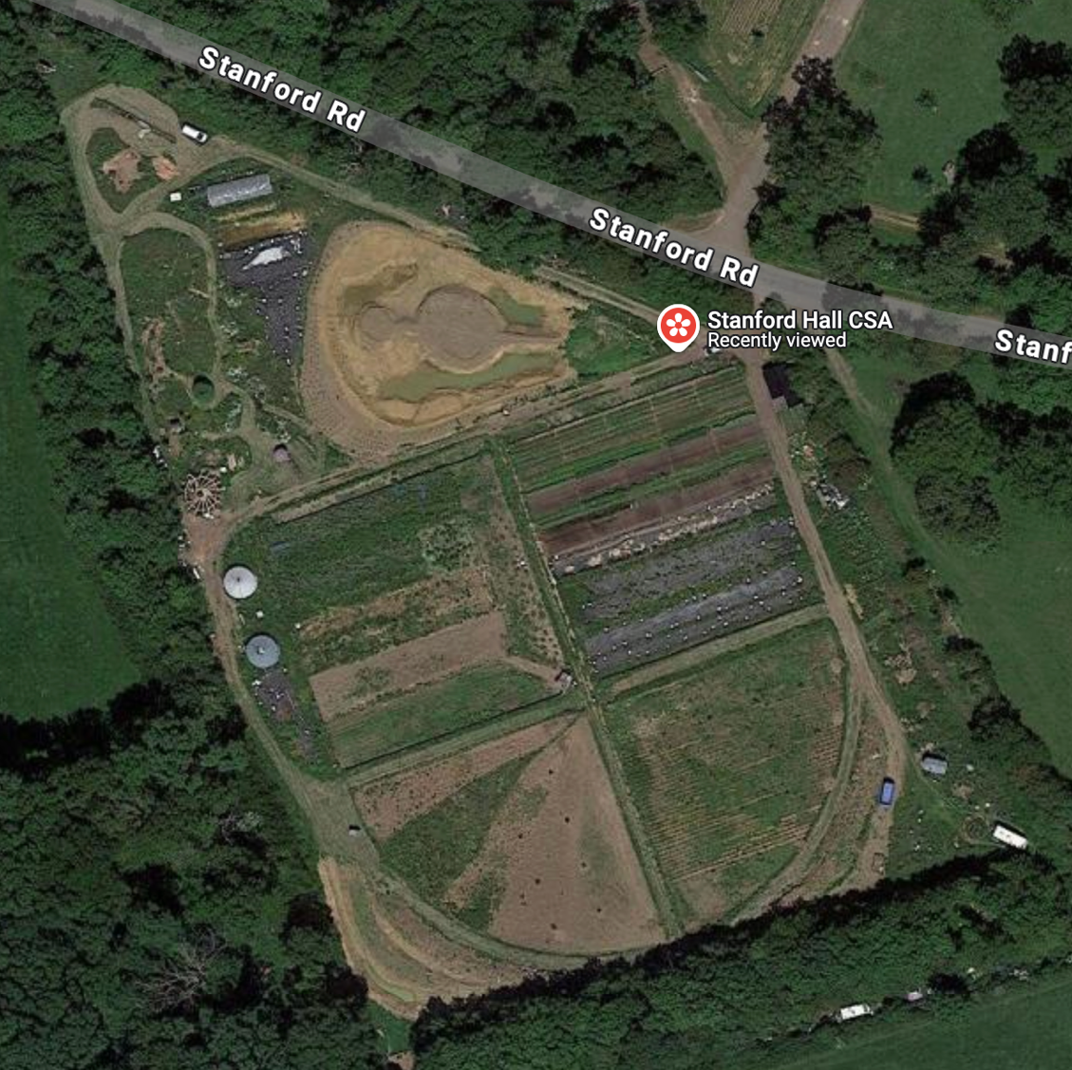


What can polyculture add to the wider landscape?
Barbara Smith

Slide 2
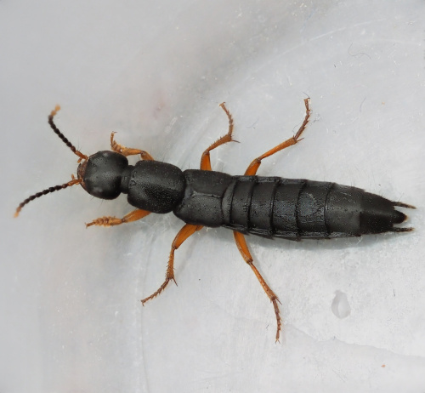
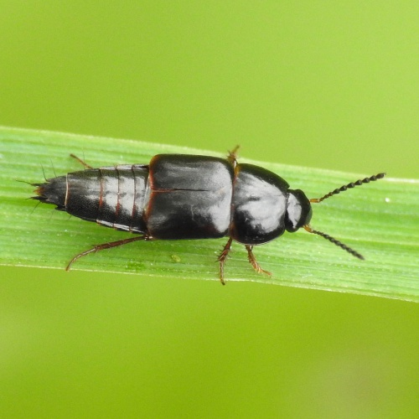

Slide 3
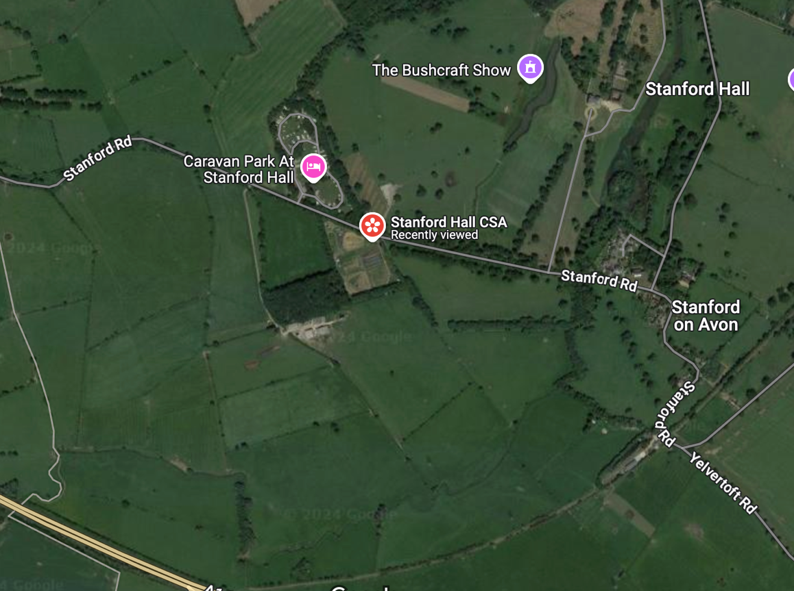
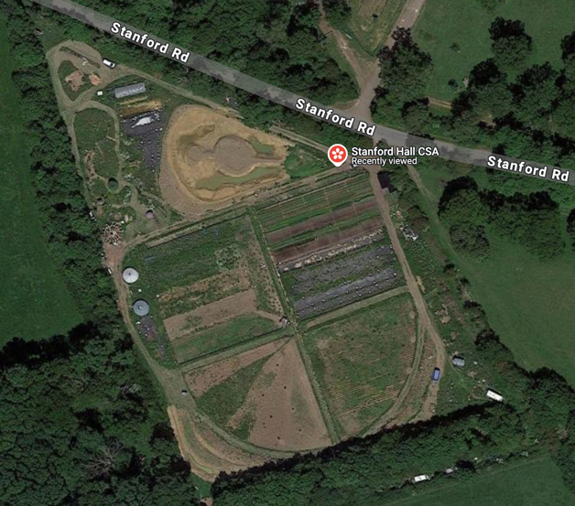

Slide 4
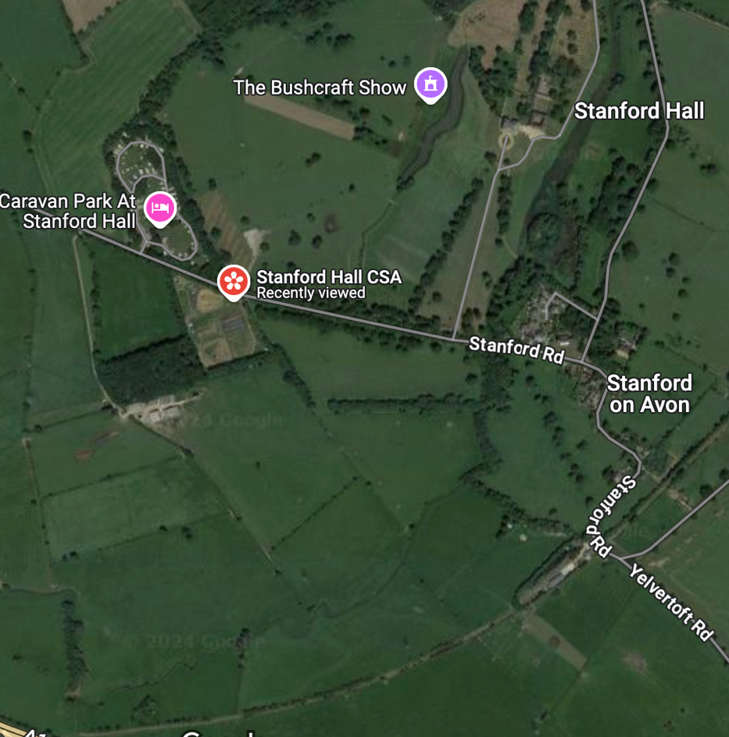
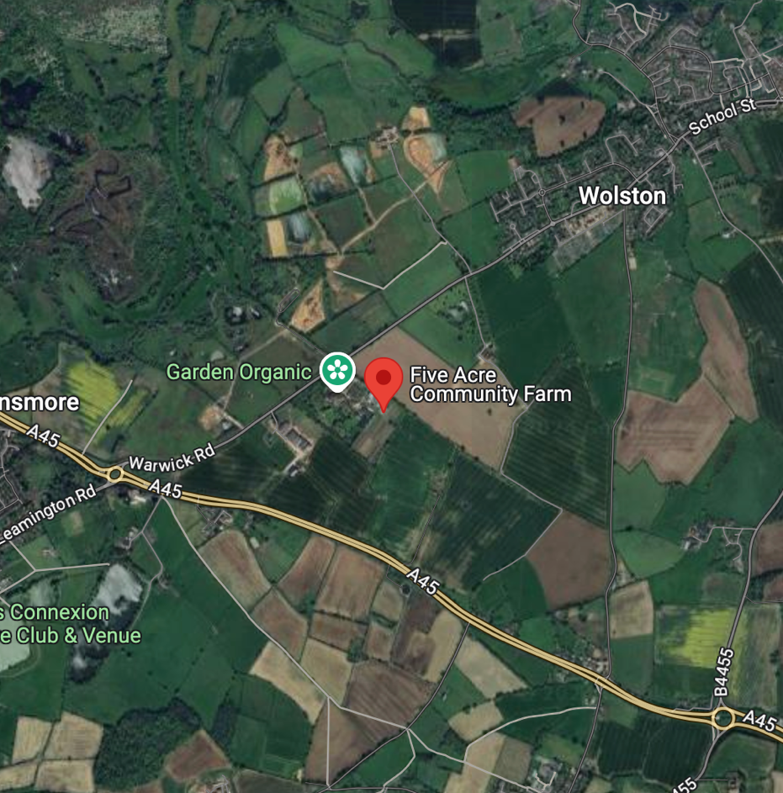

Slide 5
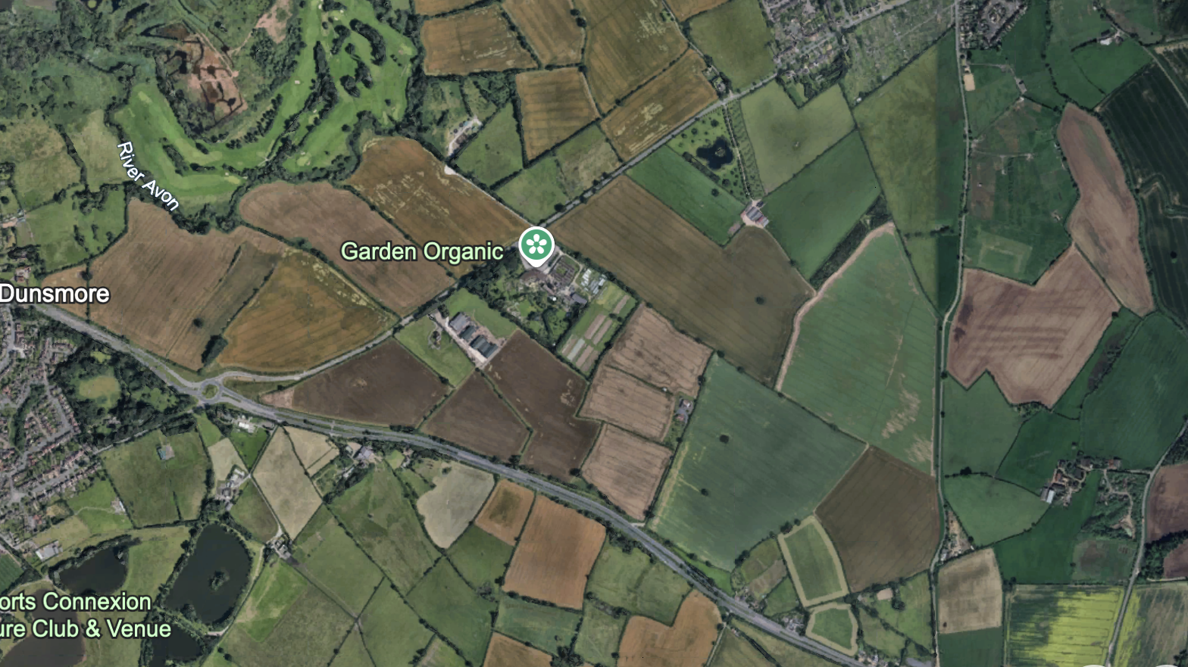

Slide 6
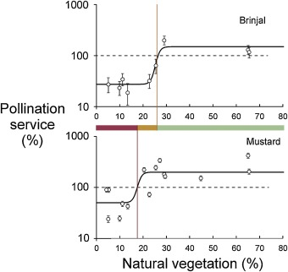
In order to deliver adequate pollination for vegetable pollination in fields in our case study in NE India we need 26% natural vegetation cover to fully pollinate Aubergines (brinjal) and 17% natural vegetation to fully pollinate Mustard.
(measured in a radial diameter of 2 km around the farm)
Chattergee et al., 2020, Agriculture, Ecosystems & Environment

Slide 8


Slide 9
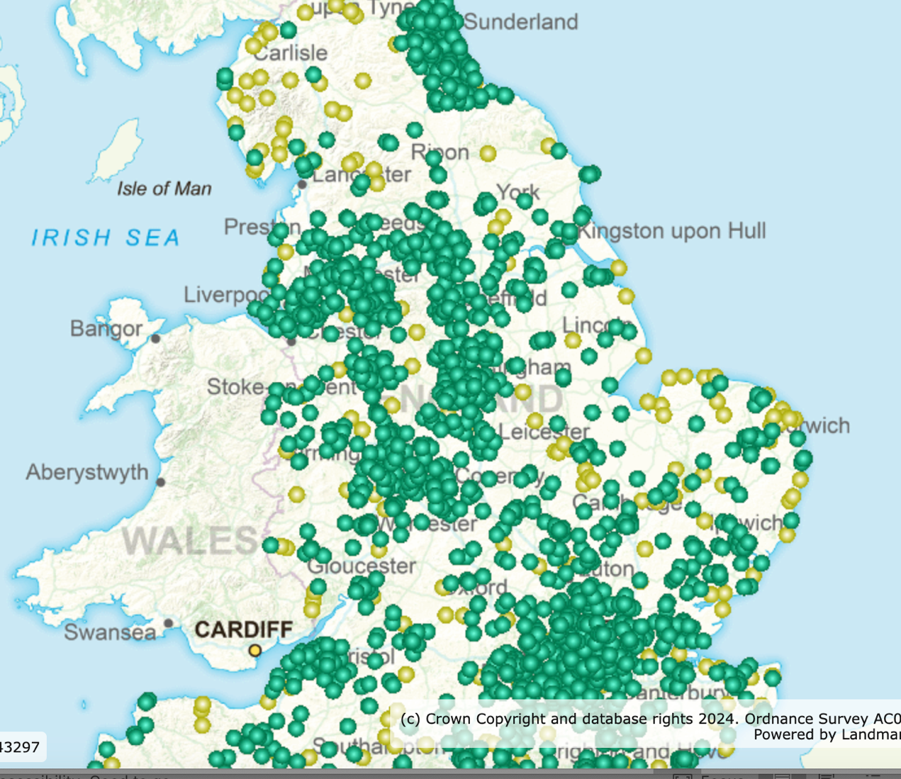
Local and National
Nature reserves
England

Slide 10
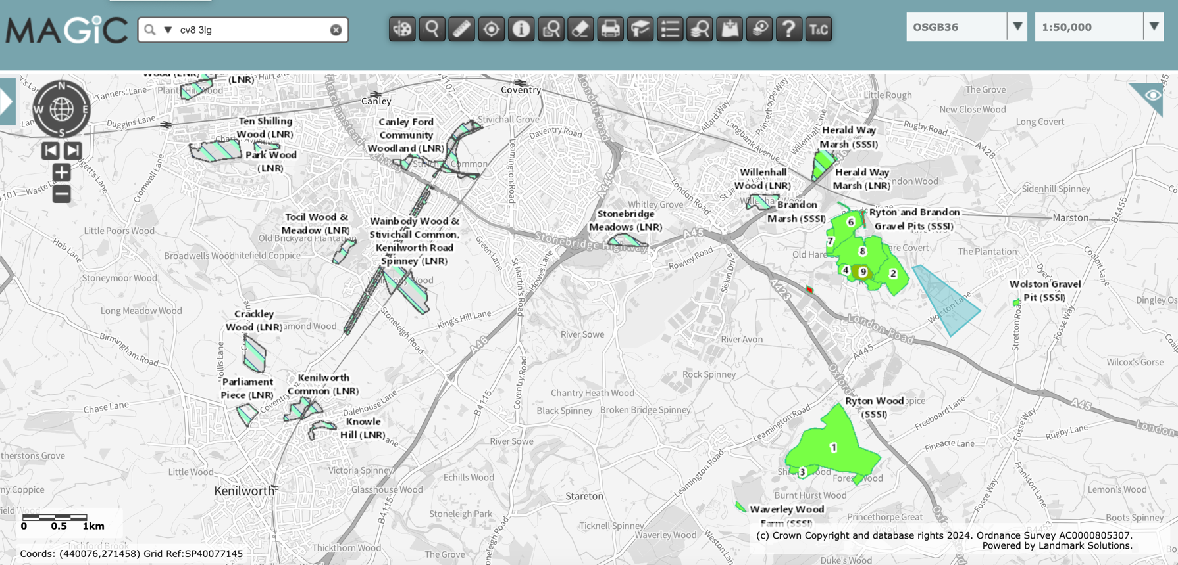
Local nature reserves and SSSI

Slide 11
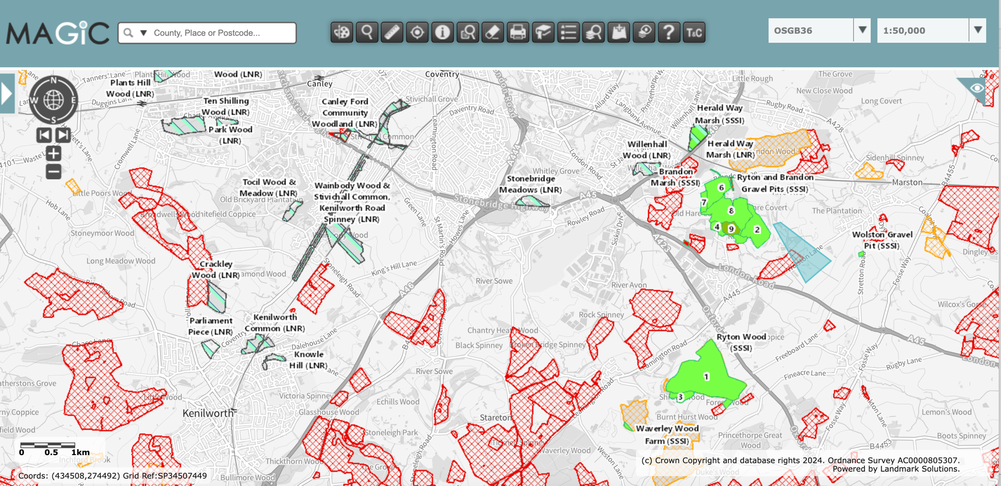
Local nature reserves and SSSI, and farmers fields in mid-tier CSS schemes

Slide 12
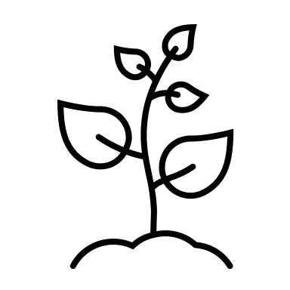













< 50m
< 100m
< 500m
< 1 km
< 5 km

Slide 13
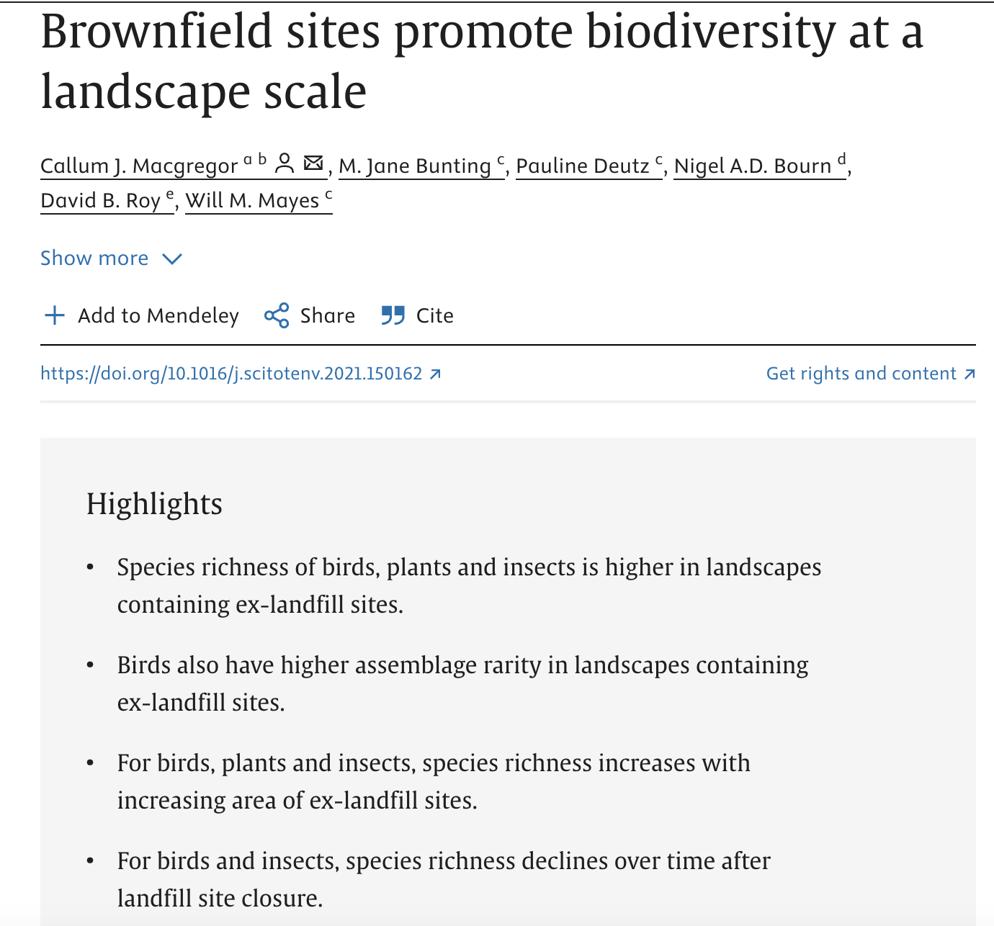
We would like to do this kind of analysis for small diverse polyculture sites.

Slide 14
Can small diverse polycultures sites deliver biodiversity to the landscape and act as stepping- stones between biodiversity rich areas?
What potential is there to get support for putting small scale biodiverse agriculture into the landscape (and how does this map over food deserts? Can we win-win?)
How can we make funding systems work for us?

Slide 15

Speaker contacts
Barbara Smith: barbara.smith@coventry.ac.uk / barbarasmithmail@gmail.com
Alfy Gathorne Hardy: a.gathorne-hardy@ed.ac.uk
Daisy Martinez: Daisy.Martinez@ed.ac.uk
Beth Nicolls: E.Nicholls@sussex.ac.uk
Ulrich Schmutz: ab6217@coventry.ac.uk

