Slide 1
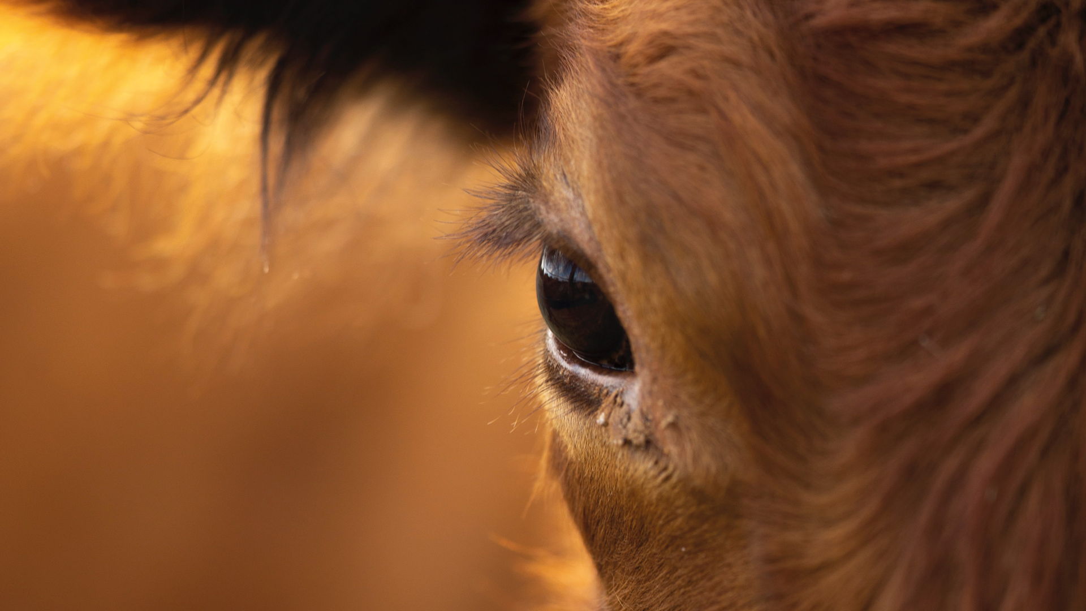



What will cultured meat mean for farming?
Is it a gamechanger?
A disruption? Or a load of hot air?
Dr Lisa Morgans, Royal Agricultural University

Slide 2


























The Team
Research team*
Industry / NGO partners**
Funded by
*Tom MacMillan, Katherine Lewis, John Dooley, Lisa Morgans, Alex Sexton, Mustafa Ali, Scott Allan,
Iain Argyle, Illtud Dunsford, Mike Goodman, John Lynch, Louise Manning, Viren Ranawana, David Rose, Rachael Rothman, Will Sibly, Anastasios Vasilopoulos and
Adele Wylie
** Two further farming partner organisations opted not to be named

Slide 3



Until recently, hardly anyone had asked what cultured, or lab-grown, meat might mean for
UK farming.
Or asked farmers what they think. After two years of study, here’s what we found
After two years of study, here’s
what we found…
Notes:
Point here is that farmers were being left out of the conversation
But also, recognising that if we’re to hit global emission targets then we do need gamechangers. Which CM is being billed as.
Therefore, rather than shying away from it, it makes sense to find out what it might look like.
After the ’what farmers think’ bit I reckon do a super speedy summary of what we did – social media trawl, focus groups, partner farms, which will lead on to the ‘After two years… bit.

Slide 4




1
It’s slow-burn
compared to things like shifting
Weather patterns
Markets
Policy

Slide 5




2
There’s big-picture concern
about impacts to society such as…
Public health
The food system
Rural life

Slide 6



3
But also pragmatism
about ways farming could adapt, such as…
New markets
On-farm production
Differentiating their products
as ‘the real stuff’

Slide 7


4
There could be synergies
We found cultured meat could be made more cheaply and sustainably using agricultural by-products such as…
Rapeseed meal or
Bovine blood
and bone meal

Slide 8
Table 1: Comparison of total media costs (per litre wet basal media) formulated using valorised sources of amino acids and pure ingredients against costs for basal DMEM at various grades
100.00%
0.00%
20.00%
40.00%
60.00%
80.00%
120.00%
Amino acid source | Valorised amino acids |  | Pure amino acids | Total cost per litre final wet basal media
 | Wt.% of the total amino acids | Wt. % in final dry basal media | Wt. % in final dry basal media | Pharmaceutical grade | Food grade | Feed grade
Oilseed rape meal | 52% | 4.91% | 4.49% | £1.81 | £0.04 | £0.02
Hoof and horn meal | 68% | 6.36% | 3.04% | £1.43 | £0.03 | £0.02
Bovine blood | 51% | 4.82% | 4.58% | £1.83 | £0.04 | £0.02
Baseline: cost of basal DMEM without valorised ingredient sources |  |  |  | £4.67 | £0.05 | £0.03
Global warming potential
Fine particulate matter formation
Terrestrial acidification potential
Land use
Figure 1: Comparison of valorised growth media and baseline (DMEM)
Fossil resource scarcity
Baseline
Bovine blood
Water consumption
Horn/hoof meal
Rapeseed meal

Slide 9



5
It’s becoming polarised
The conversation online is divided. And the way the cultured meat industry communicates is fuelling the fire.
Over ‘hyping’
Mis-representing farming
Making unfair comparisons
Notes:
Worth mentioning that Italy and Florida have cited the impact on farming as the reason behind banning CM.
And in Florida, there’s the start of it being drawn into a culture war which could also happen here which would shut down reasonable debate.

Slide 10

6
There’s appetite
for healthy debate
Both farmers and cultured meat companies told us they’d rather talk in the open and in person
Notes:
Rather than getting into a fight online!

Slide 11


Download the report
and have your say
on the future of food

Slide 12
With thanks to

