Slide 1

Progress to a peat-free horticultural system
Friday 10th January 2025
Town Hall Court Room
Notes:
This session focuses on four contrasting projects which are all looking at ways to move away from peat in horticulture. Peat has been a widely used ingredient in growing media during the 20th century because it is uniform, lightweight to transport, stable and low in nutrients (so it can be predictably amended with fertilisers).

Slide 2
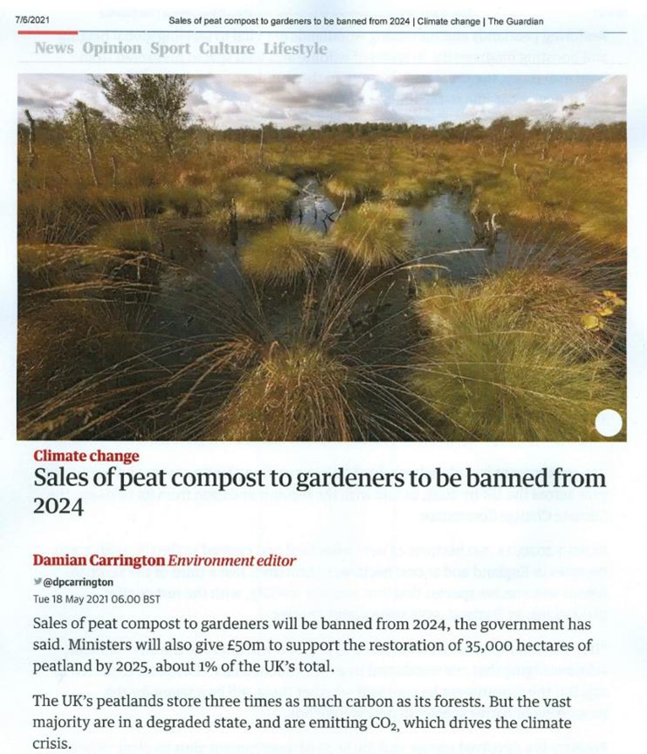

Why peat free?
Peatlands provide valuable ecosystem services:
  Habitats and biodiversity
  Natural water (flood) management
  Significant carbon stores
UK amateur growing media now largely peat free
Various targets for phasing out peat use in amateur and professional sectors proposed but not passed into law
The Peat-free Partnership supports and campaigns for proposed changes
Notes:
During the 20th century peat became a widely used ingredient in growing media because it is uniform, lightweight to transport, stable and low in nutrients (so it can be predictably amended with fertilisers).
Peatlands are one of our most valuable ecosystems. They are home to many species of rare plants, insects and birds. They are also our largest terrestrial carbon store, containing more than twice as much carbon as is stored in all the world’s forests. That’s why it is vital that we act now to eliminate our use of peat in horticulture

Slide 3
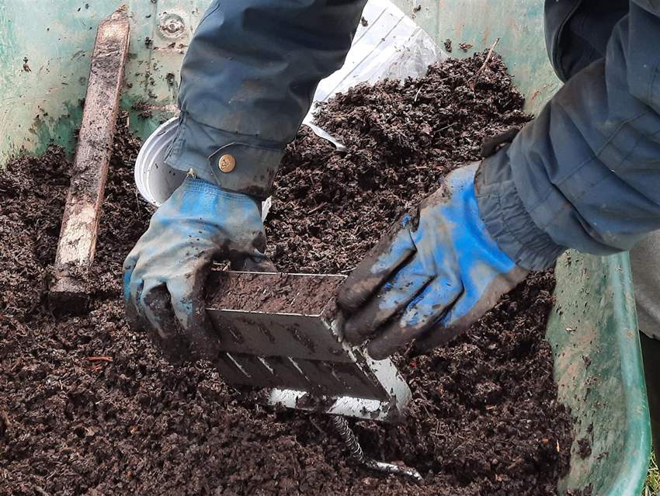
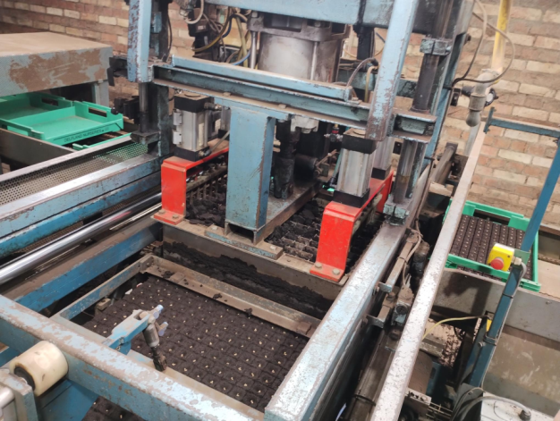
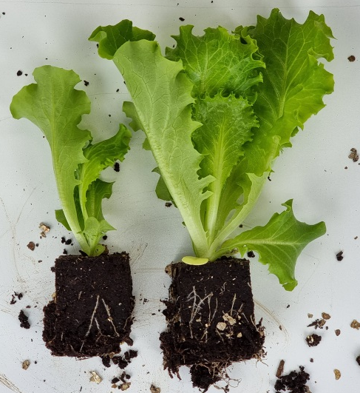
What is blocking media?
Largely peat-based growing media
Compressed into blocks
Cohesive not adhesive
Seeds sown into blocks
Germinate in glasshouse or polytunnel
Block with seedling planted out
Earthcare Technical
Delfland Nurseries
Riverford
Notes:
Blocking media is a specific type of peat-based growing medium that is used in professional horticulture. Rather than being free flowing for potting, blocking media needs to be cohesive and stick together when it is fed through a blocking machine. At the same time it must not stick to the blocking machine.
The lettuce seeds are then sown into these blocks and placed in a glasshouse where they germinate and grow to planting-out size. When they’re ready, they’re planted into the fields and polytunnels, including at Riverford.
R&D trials must be carried out on all species to ensure peat-free mixes will produce crops at the quality and quantity needed to meet market demands

Slide 4
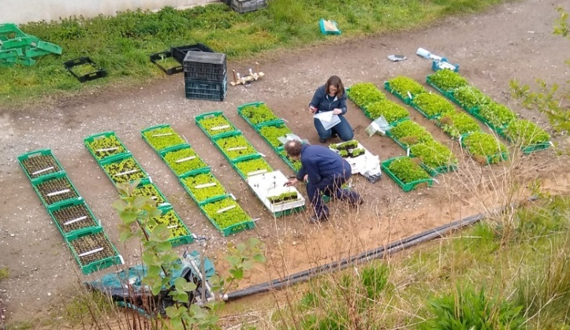




Peat-free blocking media challenges
R&D trials needed for all crops to ensure peat-free mixes can produce crop quality and quantity to meet market demands:
Physical and chemical properties
Plant performance
Cost of peat-free vs peat-based media
Stable supply of consistent ingredients
Imports from countries still using peat
Coventry University
Notes:
Defra and AHDB are aware that there are no current, viable solutions to replace peat blocks for UK vegetable propagation
Technical challenges of combining peat-free materials to match peat block properties:
Physical properties: suitable cohesive properties for block formation, stability over time and during planting out
Chemical properties: EC, pH, nutrients for commercial lettuce production. Plant performance: supporting the germination and growth of lettuce
Market challenges:
Can produce marketable, quality lettuce. Can meet organic certification requirements. Acceptable cost of production. Stable supply of consistent ingredients

Slide 5
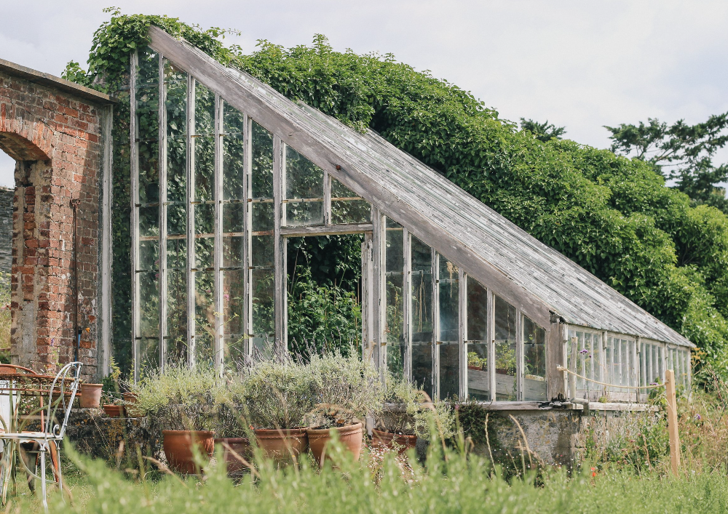








Progress to a peat-free horticultural system
Chair:
Mary Dimambro (Cambridge Eco Ltd)
Speakers:
Emma Restorick (Prideaux Walled Garden)
Audrey Litterick (Earthcare Technical)
Francis Rayns (Coventry University)
Sebastian Kipp (Klasmann-Deilmann)
Notes:
Emma Restorick will start the session by talking about her experience of creating peat-free blocks at Prideaux Walled Garden.
Dr Audrey Litterick will discuss an Innovative Farmers project that focuses on helping small-scale growers develop their own growing medium.
Dr Francis Rayns from Coventry University will present the findings of a larger collaborative research project led by Riverford Organic Farmers with support from Delfland Nurseries and Cambridge Eco that aims to identify and evaluate fully traceable peat-free growing mediums in larger scale horticulture.
Sebastian Kipp from Klasmann-Deilmann will discuss peat reduction in the growing media industry.
Reference to Innovative Farmers as they have funded Emma and Audrey to be at the conference.

