Slide 1





NEW NARRATIVES FOR FOOD SYSTEMS TRANSFORMATION
Guide
authors.
Workshop
facilitators.
Cristina Consuegra
Carmen Posada
Luis Camargo
Carmen Posada
Charlotte Dufour
OXFORD FARMING CONFERENCE 2025
AGROECOLOGY COMMS NETWORK 2025
A Project by
for

Slide 2


Objectives
Introduce participants to the "Ecologies of Food" concept and the role of more-than-human beings in our food systems, and nature as a character.
Highlight the power that all humans have as storytellers, not only journalists.
Facilitate active exploration and narrative creation based on Chapters 2, 4 and 6 of the guide.
Inspire the transition from storytelling to storydoing.
Empower participants to develop actionable pitches for food systems transformation using the guide's beacons.

Slide 3
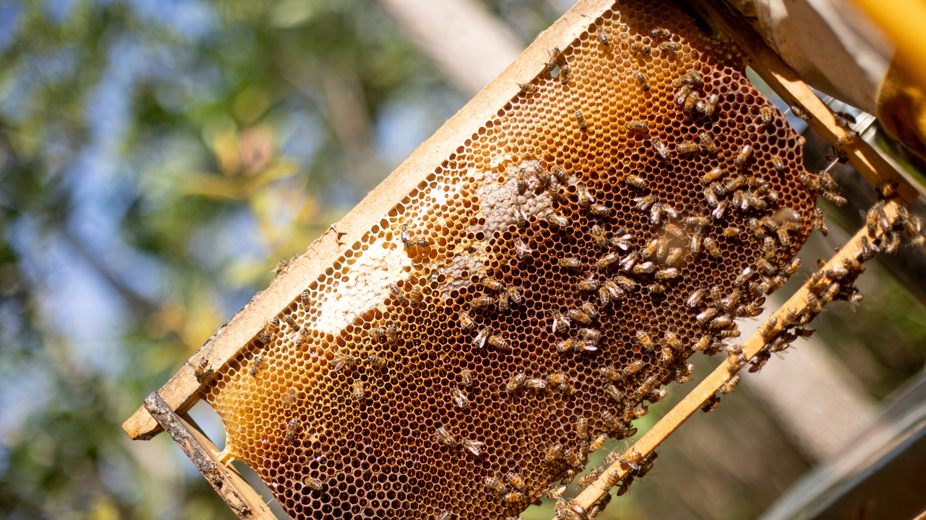
Honey:
A fruit of collective work
Photo by Carla Isaza

Slide 4


Get ready
NOTEBOOK AND PENCIL
Observe, smell, taste and touch the honey. Reflect on the collective work behind its creation (origin, geography, biome, soil, flowers, bees, beekeepers, microbes).
What interconnected processes made this honey possible?
Think about the systemic challenges of our food systems and how they affect the honey and its ecosystem.
What are the main structural cracks and holes of our relationship with food?
What food system pain hurts you most?

Slide 5

The Pains
We Eat
Generational pain
DIGESTING THE PROBLEM
Climatic
pain
Pain of
disease
Hunger
pain
Cultural pain
Ecosystem
pain
Pain of
waste
Biological
pain
Forest
pain
Ethical
pain
Disconnectedness
pain
Water
pain
Standardized
pain
Pain of
the sea

Slide 6

From Food Systems
to the Ecologies of Food
TO EAT IS TO PARTAKE OF LIFE
How do we depend on our planetary colleagues for survival, and what responsibilities do we have towards them?

Slide 7




“By eating, we transform the body of the world into the body we are.”
Michael Pollan
A Communion of Subjects
We are heterotrophic beings
Gratitude
Planetary
metabolism
Reciprocity
“Sustain those who sustain you and the Earth will last forever”
Robin Wall Kimmerer
Beings
Microorganisms
We are made out of the outside
Humans
Nature as
a resource
Animals
Abundance
Human – Nature separation
From resources to gifts
Plants
Everything eats and is eaten
Fungi
Biodiversity inside and outside
Food
Systems
We are Nature-
Inter being
Relationships
Ecologies of Food

Slide 8
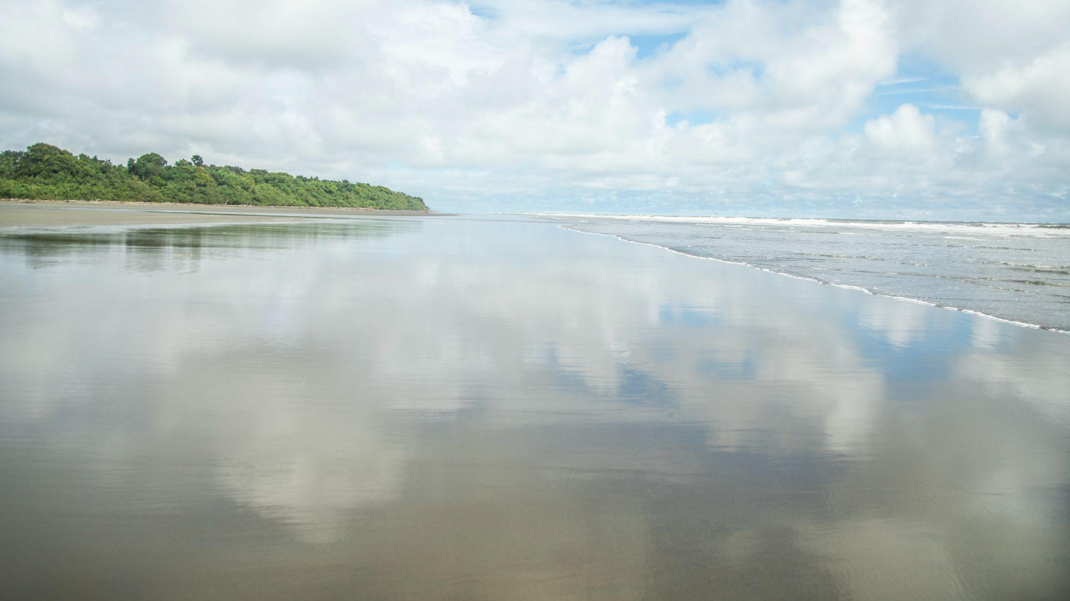
The story of salt
Salt: A Link Between Humans and the Environment
Salt's Roles: Purifies, cleanses, highlights flavor, preserves.
Key Idea: Eating forms our bodies with elements external to us
The Physiological Need for Salt
Body Composition: 70% of the human body is salt water (plasma, lymph, cerebrospinal fluid, bile etc.).
Homeostasis: Salt maintains fluid balance inside and outside cells.
Nerve Function: Essential for nerve impulse transmission and brain activity.
Salt and the Ocean: Shared Mysteries
Was the sea always salty?
Do salt and water share a common origin?
Does all salt come from the sea?
Hypothesis: Our dependence on salt ties to our marine ancestry.
Connection to Our Aquatic Past
Baptiste Morizot's View: Eating salt reconstructs our inner salinity, reflecting our origins in the ocean.
Earth's Parallel: 70% of the Earth's surface is water, 97% salty.
Humanity's Connection to the Sea
Shared Essence: Both the ocean and the human body are harbors of life, connected by salt.
Ancestral Roots: Our ancestors' bodies formed in Earth's "amniotic fluid" – the sea.

Slide 9
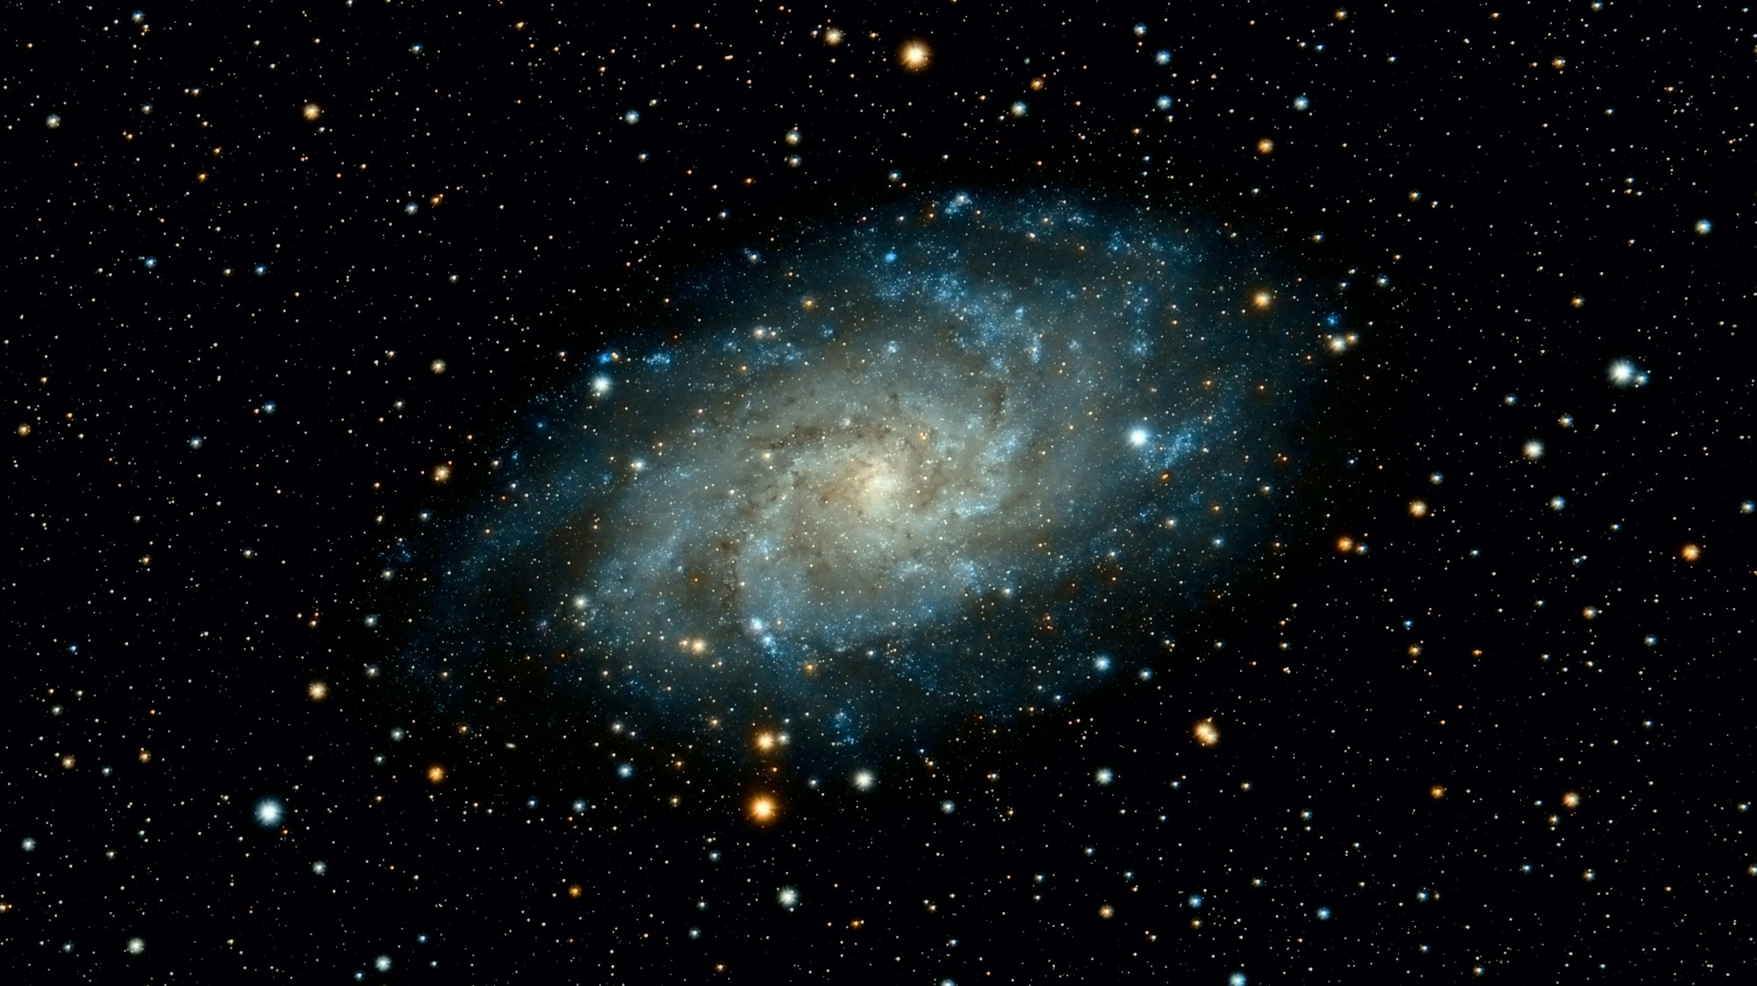
Una guía de nuevas narrativas para la transformación de los sistemas alimentarios
We are Made of the World
“The Bread in your hand is the body of the Cosmos”
Thich Nhat Hanh
“The universe is a communion of subjects, not a collection of objects.”
Thomas Berry
“ The air we inhale is the breath of all other living beings with whom we share the atmosphere.”
Emanuele Coccia
Photo by Guillermo Ferla from Unsplash
Taken from: The most beautiful Story – Hubert Reeves

Slide 10



Get Ready
1.
2.
Embodying Nature
Mapping Life
Each group maps out this being’s ecosystemic role and dynamics and identifies the threats it faces (habitat loss, pollution, deforestation, etc) and propose solutions for its protection.
Creative exercise: each participant writes an individual letter of gratitude to this being.
Group sharing
One member of each group becomes a more than human being throughout the workshop. Plants, animals, fungi, microorganisms, etc.
This person will represent what we commonly and wrongly refer to as nature throughout the workshop.

Slide 11

THE POWER OF COLLECTIVE STORYTELLING
NEW
NARRATIVES
Beacons to illuminate the journey

Slide 12

WRITE A NEW STORY
GRATITUDE
New
Narratives
Generating
Active Hope
AMAZEMENT
ACTION
THE PAINS
WE EAT
SEE WITH NEW EYES
WAKING UP

Slide 13
BEACONS TO ILLUMINATE THE JOURNEY
1. Telling stories with new eyes that highlight the beauty and complexity of food ecologies in everyday life, and that illustrate the exquisite multidimensionality of food.
2. Leveraging the multiple intersections of the food system with other spheres to tell new stories with broader perspectives.
3. Identify and communicate stories of hope that show that change is already happening and positive contagion has reached many corners of the world.
4. Develop the strategic capacity to build new "tailored" or personalized narratives, taking into account the infinite possibility of motivations that move different audiences.

Slide 14
BEACONS TO ILLUMINATE THE JOURNEY
5. To develop a critical sense of the narratives of the dominant model and its effects, allowing us to tell stories that explain the pains of food.
6. Develop the ability to identify dominant narratives disguised as new narratives.
7. Incorporate “Storydoing”, moving beyond storytelling by actively involving people in creating meaningful experiences, fostering deeper engagement. Unlike storytelling, which aims to persuade through narrative, storydoing invites audiences to participate, making them part of the story. In journalism, it inspires action and behavior change by using immersive formats that connect with people's everyday lives and emotions.
8. Develop the capacity to build new narratives using different formats and channels to reach wider and more diverse audiences.

Slide 15
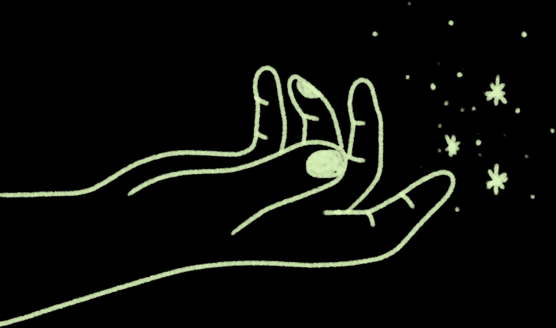
Choose a beacon or beacons to create a new narrative
Roles
Narrative designer
Researcher
Writer
Presenter
Use flipchart to outline pitch, including core message, target audience and formats

Slide 16
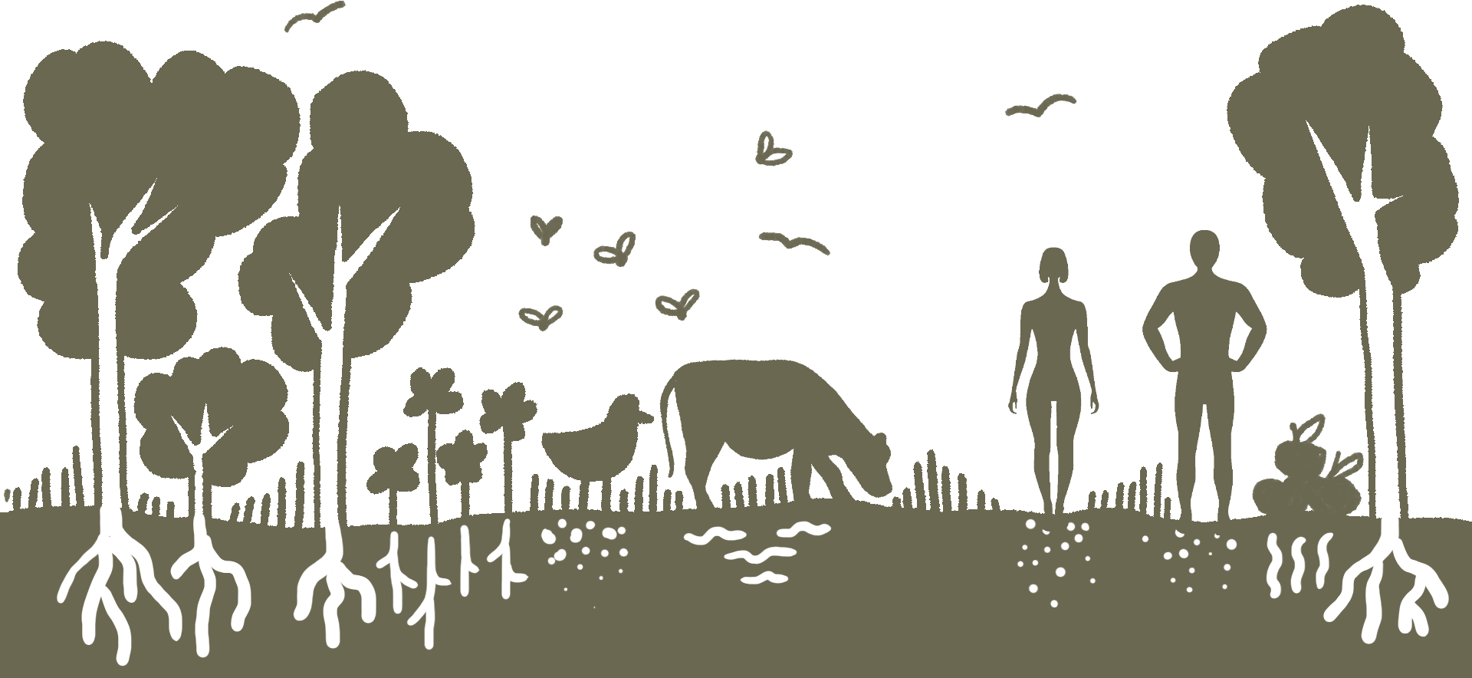
Sharing Time

