Slide 1




Strengthening Public Good Narratives
for Beef and Sheep Systems
Presenter: Amber Lawes-Johnson, PhD Researcher at the Royal Veterinary College
alawesjohnson22@rvc.ac.uk, https://www.linkedin.com/in/alawes127/
Chaired by Gabriel Kaye & Supported by a panel of experts.
Oxford Real Farming Conference 2025

Slide 2

Welcome
STRENGTHENING PUBLIC GOOD NARRATIVES FOR BEEF AND SHEEP SYSTEMS The UK Government's Post-Brexit policy “Public Money for Public Goods” presents an opportunity for agriculture to redefine its role in delivering food production alongside ecosystem enhancement.
A sustainable transition requires a long-term vision that includes social, cultural, and environmental dimensions of animal-based farming and how these systems provision public good outcomes.
This session gathers experts from across the beef and sheep farming sectors to define the opportunities and challenges in using public money for public goods to support context-specific agroecological outcomes; and how future financial support can be better tailored across the agri-environment schemes.

Slide 3
Strengthening Public Good Narratives For Beef And Sheep Systems
Our Session format is
Intro by the chair
Presentation of the research; a case for policy adjustment
Panel’s response to the presentation
Questions and responses from members of the audience
Rounding up and thanks

Slide 4
Our Panel of Experts
Speakers:
Amber Lawes-Johnson - PhD Researcher at the Royal Veterinary College
Christine Meadows brings a lifetime of skills in ecological farming, science, business, woodland management and mentoring
John Powell is head of the Agriculture Sectors Team at Defra
Keziah Suskin is a committed first-generation regenerative biodynamic and organic livestock farmer
Hannah Thorogood is a pasture-for-life facilitator and organic regenerative, livestock farmer in Lincolnshire
Chair: Gabriel Kaye is Executive Director at the Biodynamic Association and life-long biodynamic gardener.

Slide 5
Setting the Scene
Beef and Sheep Systems as part of an Agroecological Food System
Agroecological Principles:
Management practices that reflect the carrying capacity of the land
Management practices that seek to maximise the health and wellbeing of soils, animals, and people
Management practices that view the entire landscape as a self-sustaining cyclical ecosystem
Recognition that today’s topic is sensitive and emotive
We are not the only experts in the room, share your views and thoughts in the Q&A

Slide 6
Background to the Agricultural Transition 2021-2028
Policy change from EU Common Agricultural Policy Basic Payment Scheme (BPS) to “public money for public goods”
Incentivising farmers to deliver environmental outcomes through the Environmental Land Management schemes (ELMs)
Basic Payment Scheme Payments under the Common Agricultural Policy end in 2028
Defra target to secure 70,000 agreements, aiming to cover 70% of farmed land by 2028

Slide 7
Key Challenges Across Policy
Details on the definitions of what is a public good and the types of animal-based systems to deliver public goods is vague.
Policy overgeneralises “livestock systems” failing to account for individual species needs in different management systems.
Policy conflates animal health with animal welfare, overlooking welfare’s multidimensional aspects (5 Needs Framework).
Trade agreements set with countries outside of the EU with different standards of production.
So what?
Policy needs a more thoughtful analysis of where animal-based systems fit within the wider food system, and how policy can become more aligned to support a diverse set of public good outcomes in different contexts.

Slide 8
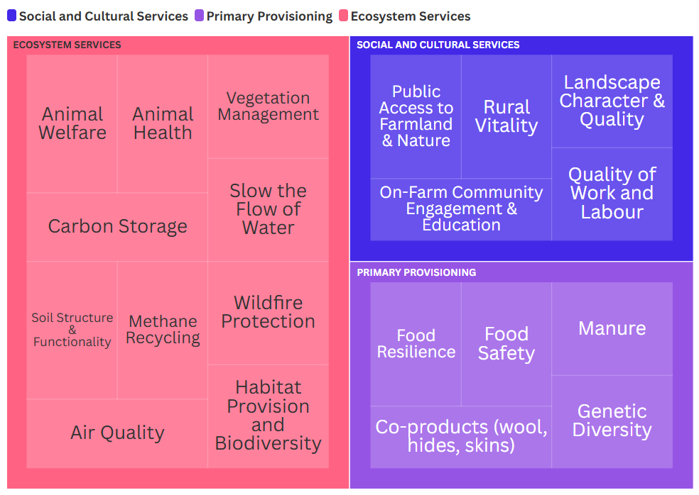
Public Goods Perceptions from Beef and Sheep Experts

Slide 9
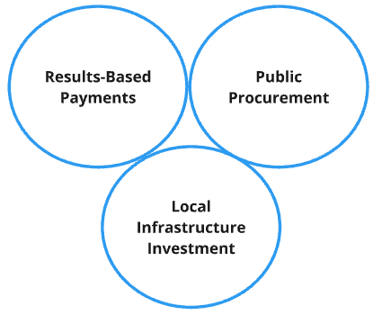
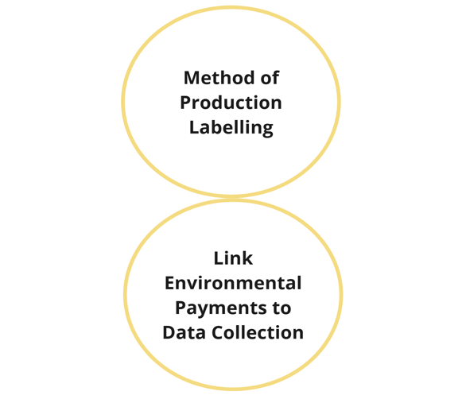
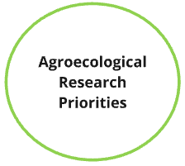
Strengthening Policy Levers for Transformative Change

Slide 10
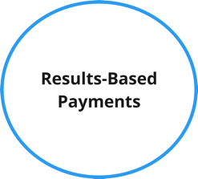
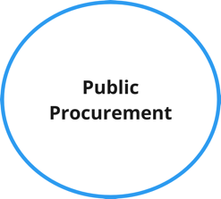
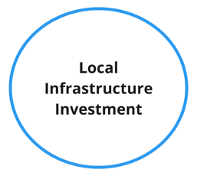
Results: Policy Levers and Stakeholder Responses
Fair Payments for Targeted Landscape-specific Outcomes
“Low Hung Fruit” Actions in Agri-Environment Schemes to become Regulatory
Land Tenure Challenges
Rewarding Social and Environmental Outcomes across the Supply Chain
Versatile Food Procurement for Imperfect Produce from Extensive Farming
Regulatory Reform to Shift away from a One-Size Fits all Approach

Slide 11
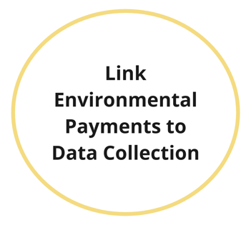
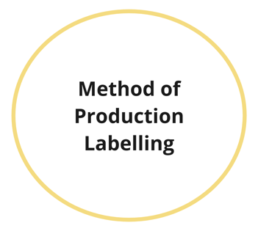
Results: Policy Levers and Stakeholder Responses
Data Collection as a Tool for Empowerment
Integration of Data Systems to Streamline the Process
Raising the Legislative Baseline and Phasing out Harmful Practices

Slide 12
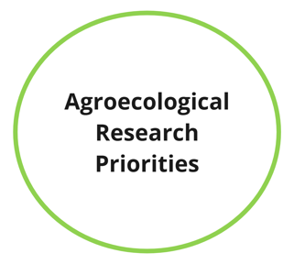

Results: Policy Levers and Stakeholder Responses
Integrated Research and Development in Agroecology
Farmer Clusters, Knowledge Sharing and Peer-to Peer Guidance
Building Models of Mixed Land Tenure and Supporting Succession Challenges

Slide 13
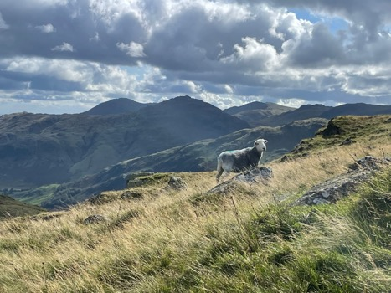
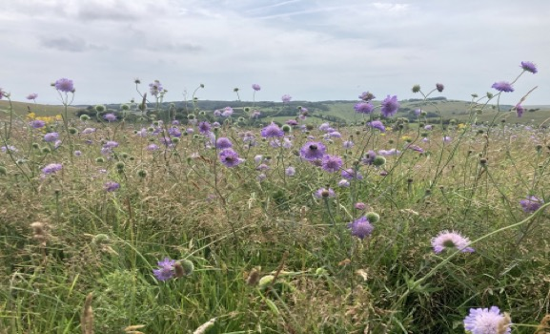
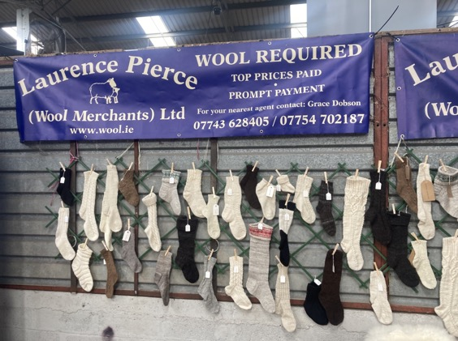
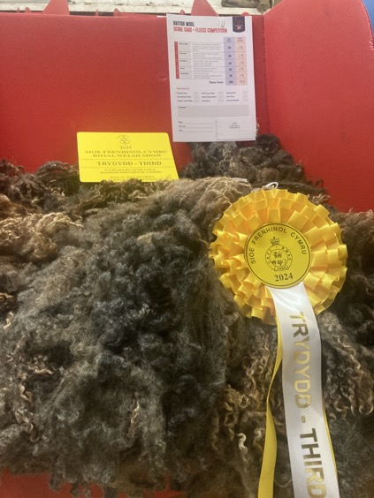
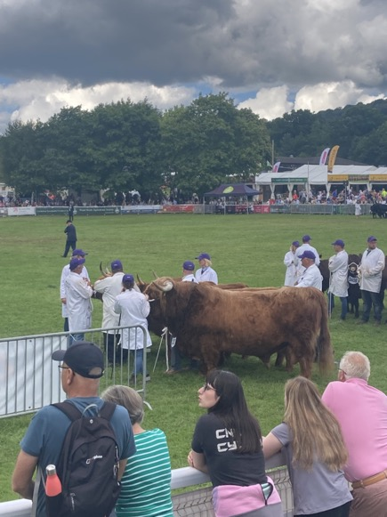

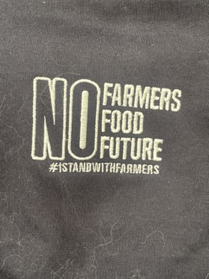
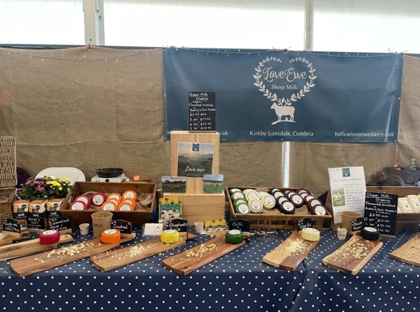
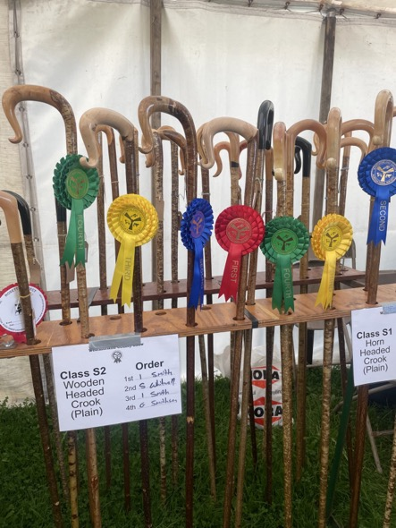
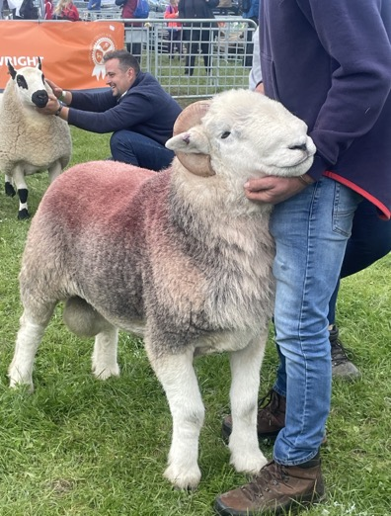
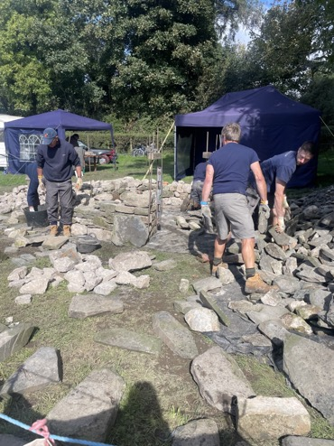
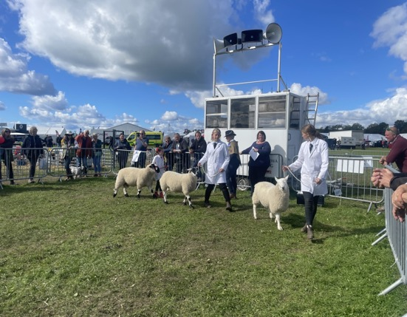
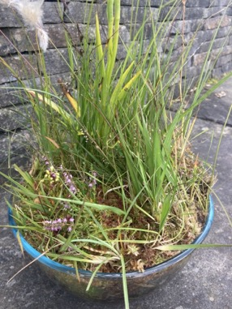

Slide 14
Thank you for Listening
Time for the panel and the audience

