Slide 1
Managing succession in multi-generational family farming businesses
ORFC 2025

Slide 2
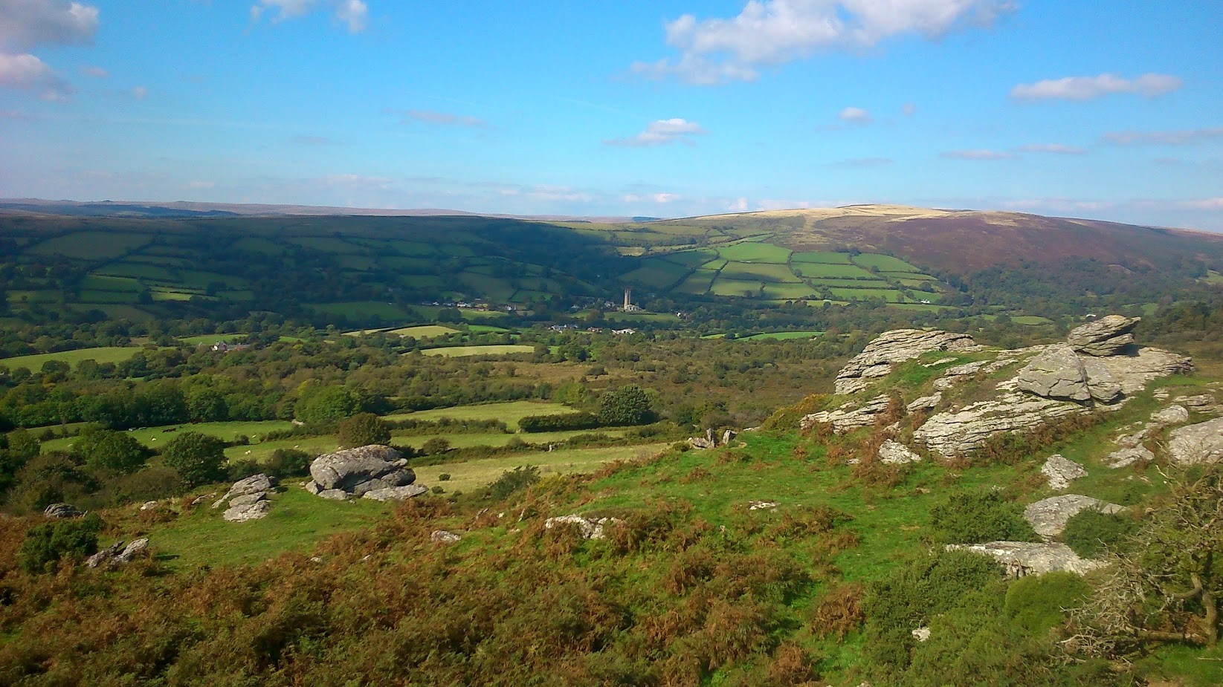

Farm Family Succession Planning
Matt Lobley (m.lobley@exeter.ac.uk)

Slide 3
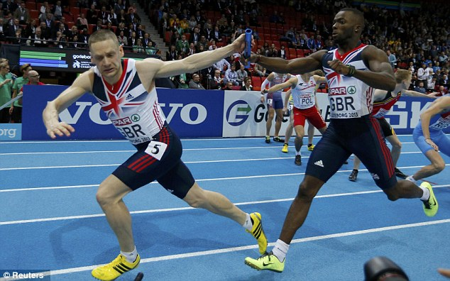
Passing the baton

Slide 4
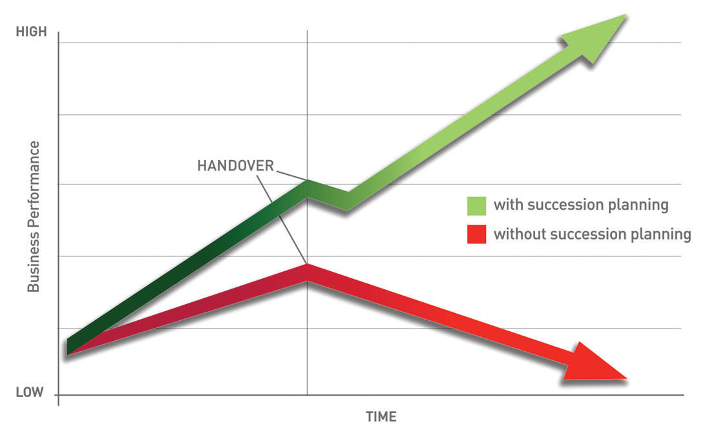

Slide 5

Getting it wrong

Slide 6
Some definitions
Succession: The inter-generational transfer of managerial control
Inheritance: The inter-generational transfer of ownership land and farming assets

Slide 7
Tough Decisions - Risks and Benefits
Loss of the business
Alienation of next generation
Failure to prepare the next generation
Older generation ‘trapped’ on the farm
Protect the business
Protect family assets
Allows successor(s) and older generation to plan
Remove uncertainty
Keep people happy & motivated

Slide 8
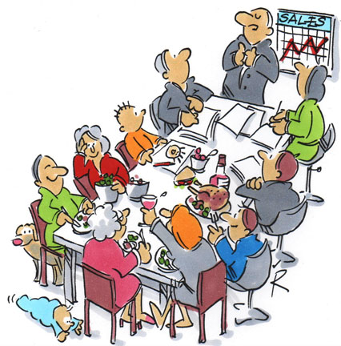
Conversation confusion
Timing
Location
Role
Vocabulary
Conflict

Slide 9
Start at the beginning:
Family, Ownership, Business
Family
Ownership
Business

Slide 10

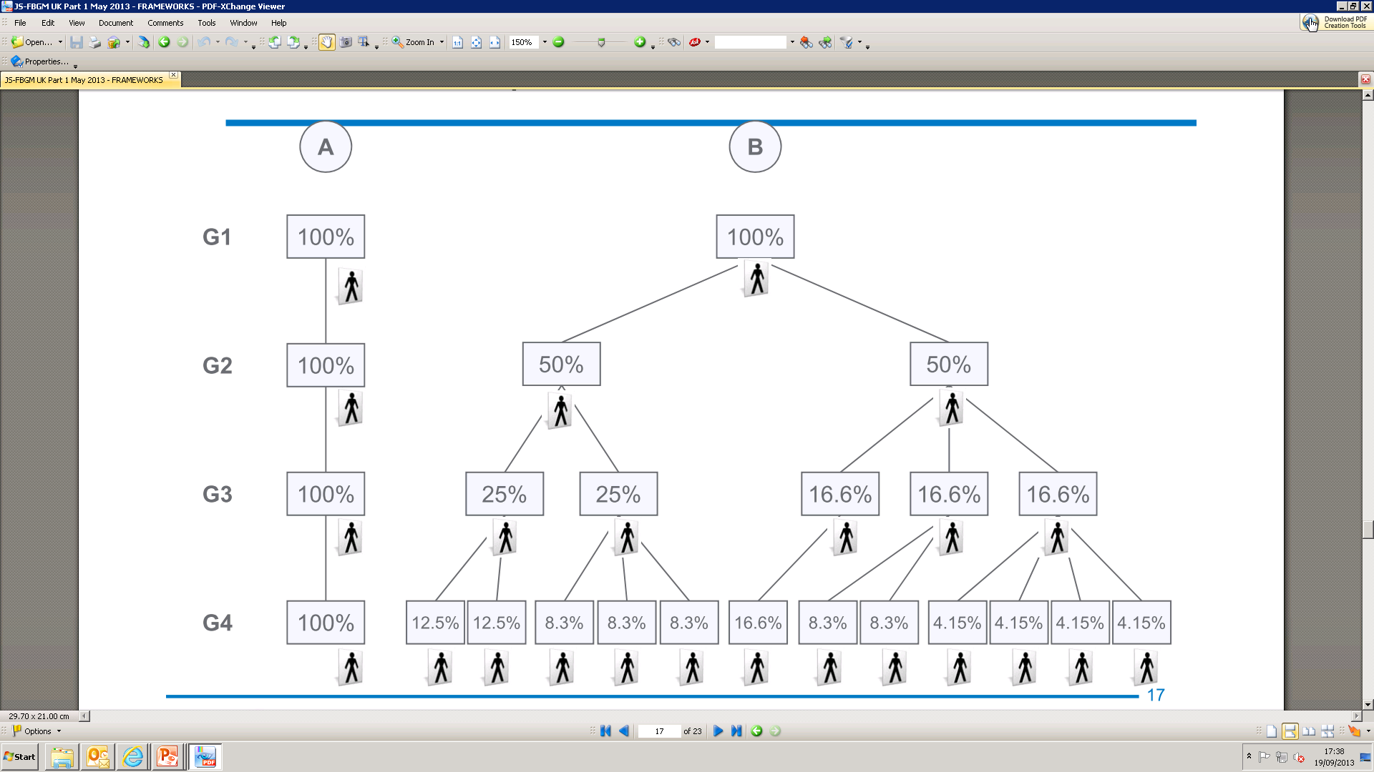
Equal or fair?
A
B

Slide 11
Planning Succession
Identify the individual business roles
Delegate enterprise responsibility/decision making authority
Establish accountability
Business meetings
  Regularly scheduled
  Not on a holiday
  Take minutes
  Hire a facilitator when needed
Develop a family business constitution – the goals and values of the business, it’s aims, rules of behaviour …

Slide 12
Timing
Succession is a process not an event.
It’s never too soon to start planning.
Don’t be overtaken by events ….

Slide 13
Next steps
Succession doesn’t just happen. Don’t put it off.
Plan for succession; Plan for retirement; Involve the children & family members.
Keep communicating with each other.
There will be difficult conversations (eg equal or fair).
Seek professional assistance.
Prepare your successor for success: delegate managerial responsibility.

