Slide 1
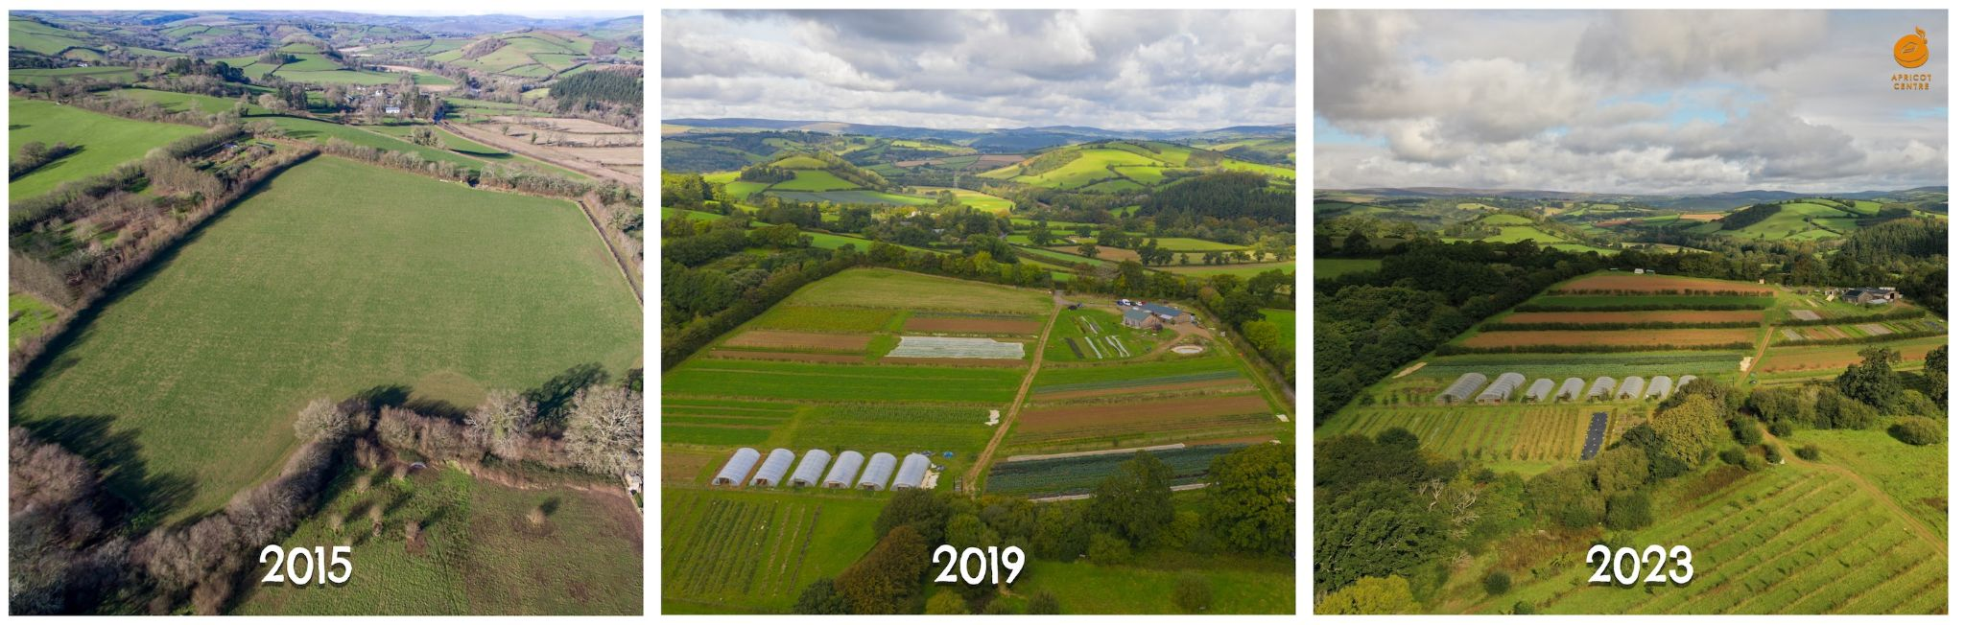

Rachel Phillips
People & Regenerative Agriculture Systems
Examples at Huxhams Cross Farm

Slide 2
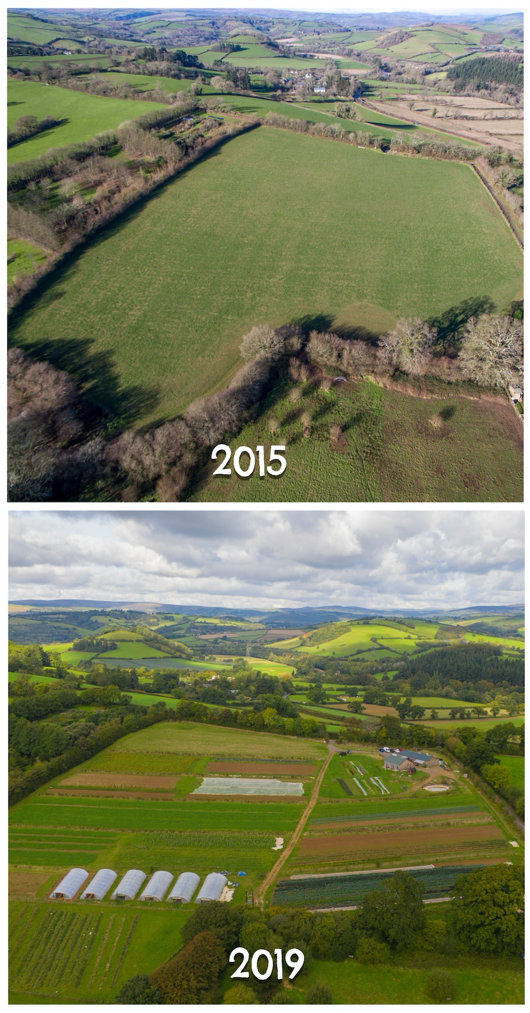
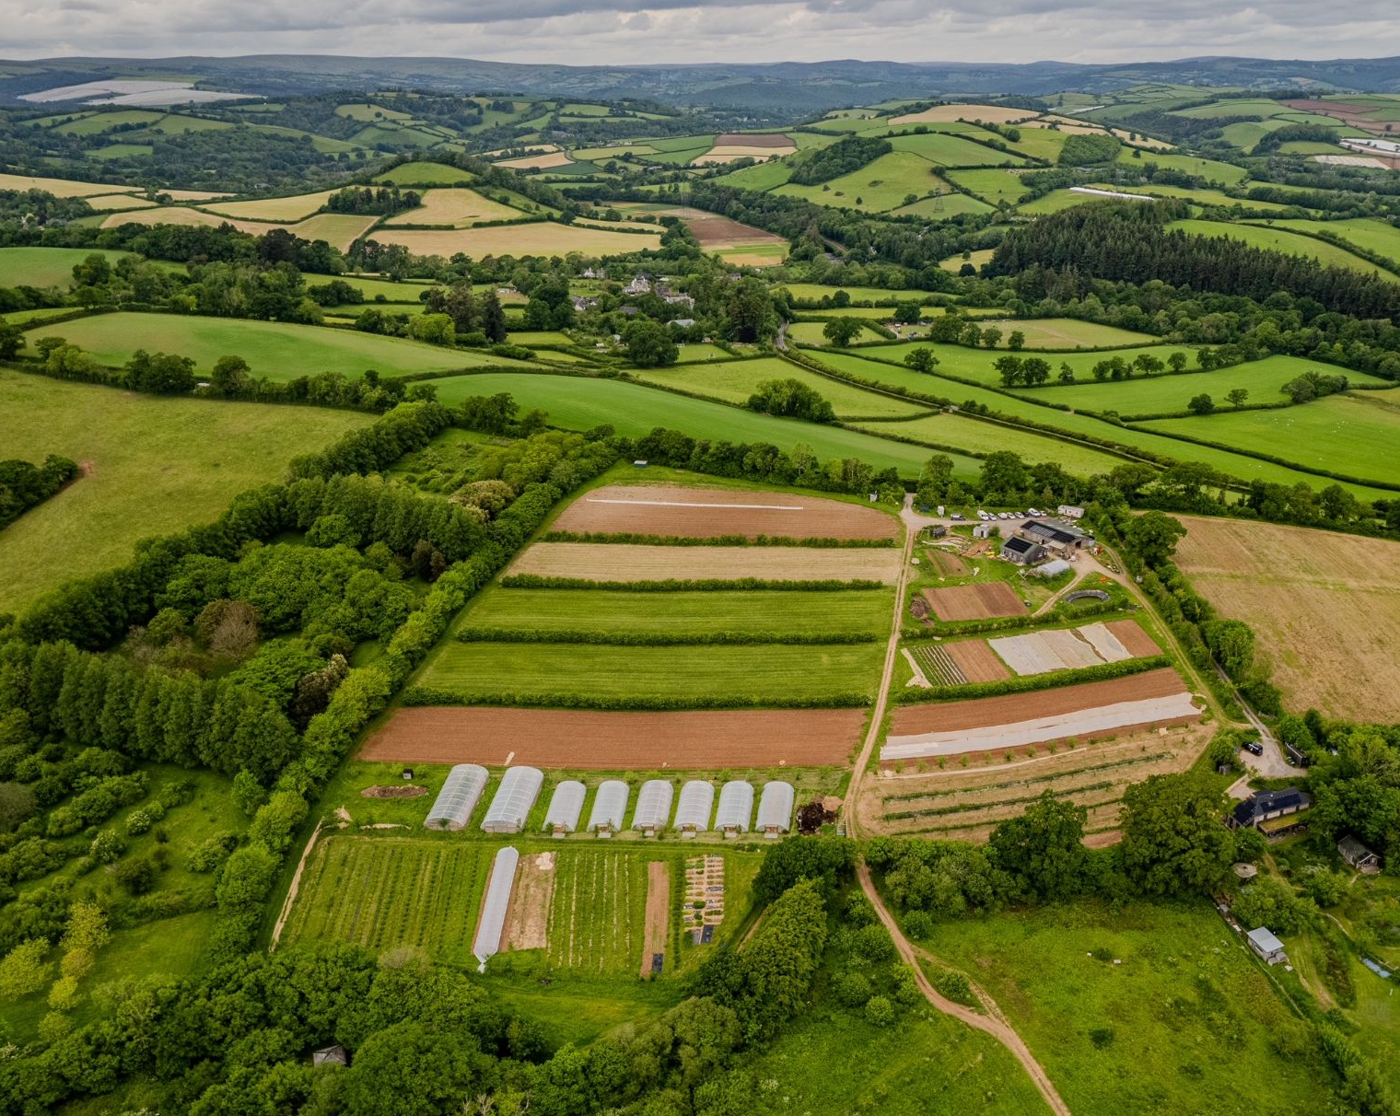
Evolution of the farm
2024
Notes:
The Apricot Centre is located at Huxhams Cross Farm, which was acquired by the Biodynamic Land Trust in 2015. Huxhams Cross Farm, near Totnes South Devon, is a small 13-hectare farm- soon to be 100 hectares.
The Biodynamic Land Trust aims to secure farms for sustainable food production for farmers and communities. The Apricot Centre is the first tenant at Huxhams Cross Farm and operates as sustainable or regenerative farmers, focusing on growing vegetables, fruit, flowers, eggs, and grain. Additionally, the farm serves as a wellbeing service for children and families.
One of the primary objectives of this partnership was for The Apricot Centre to assess and demonstrate the outcomes and impacts of their farming practices on the farm. This includes measuring carbon sequestration, climate change resilience, biodiversity, food production, economic figures, and social impact over a 5-year period.

Slide 3
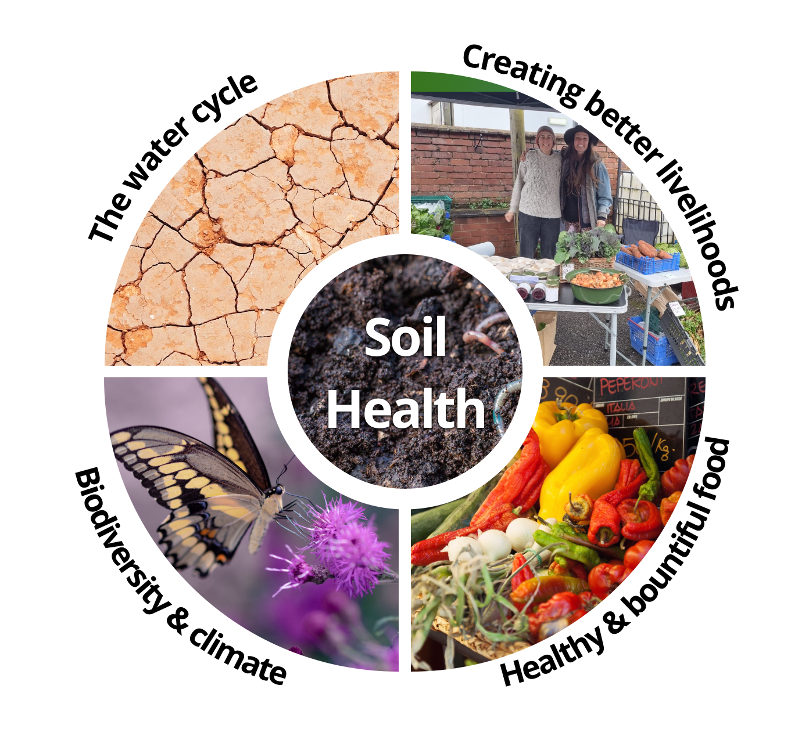
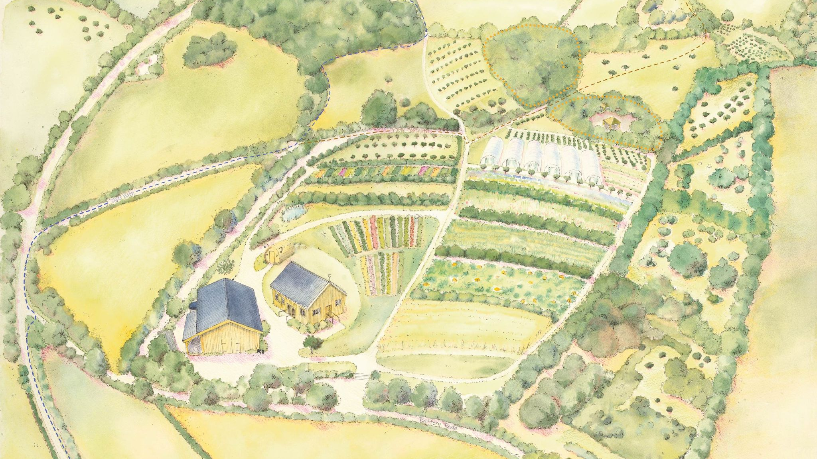
Healing the Soil

Slide 4
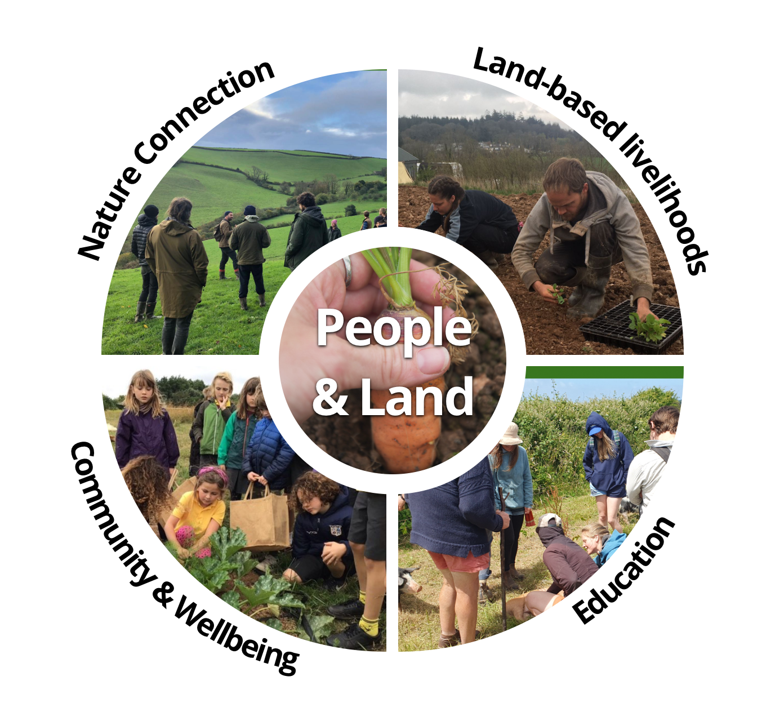
Connecting People & the Land

Slide 5
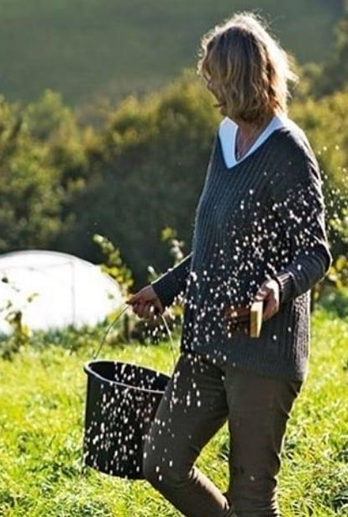
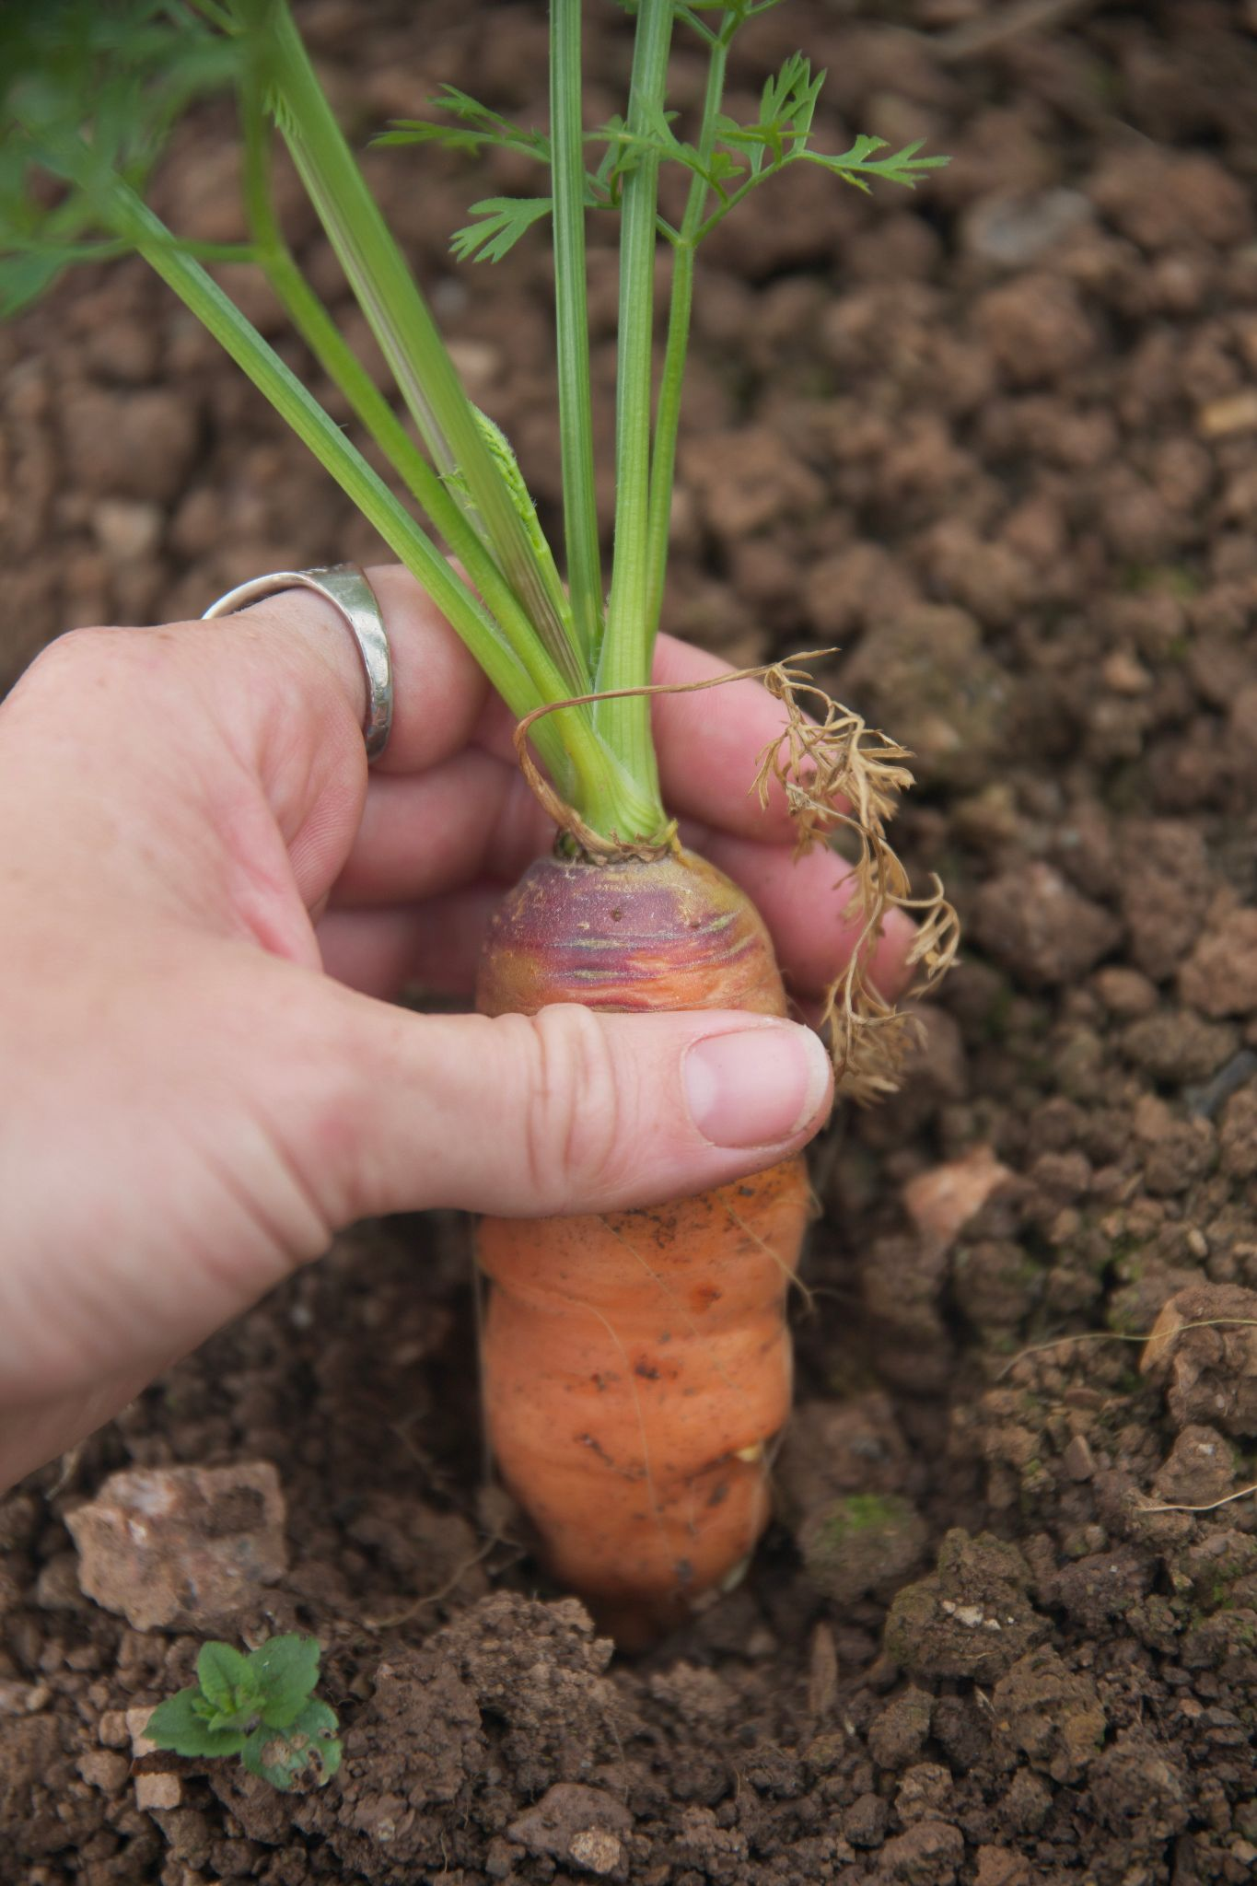
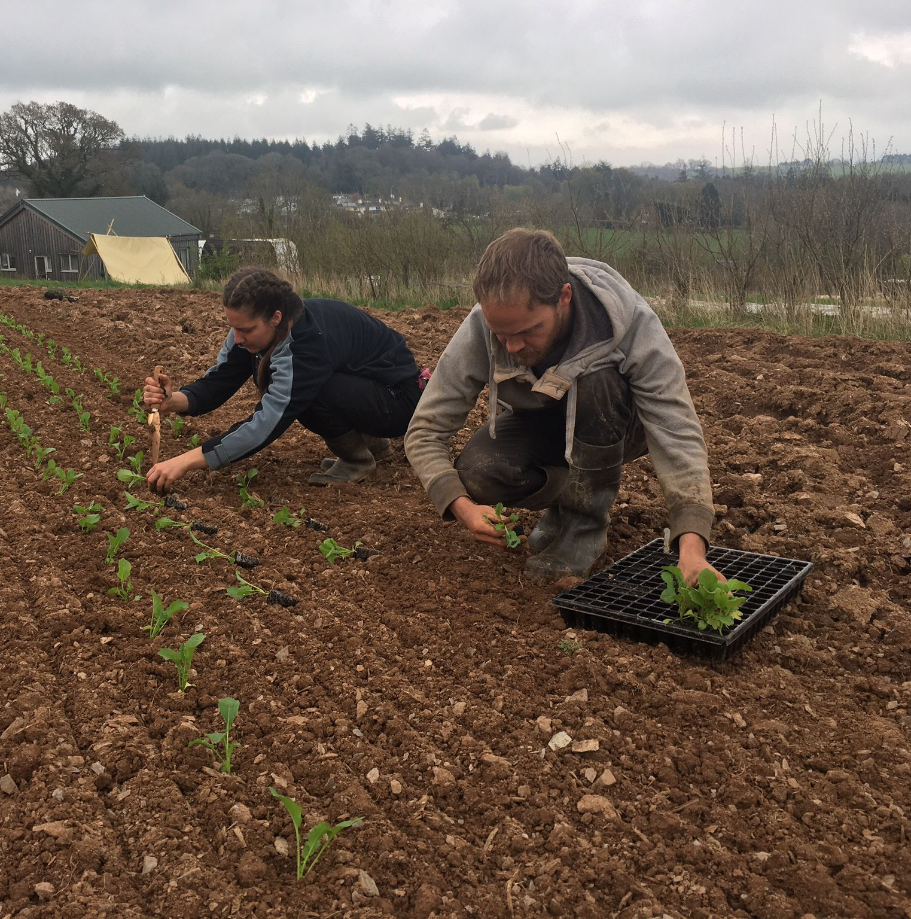
Working on the Land

Slide 6
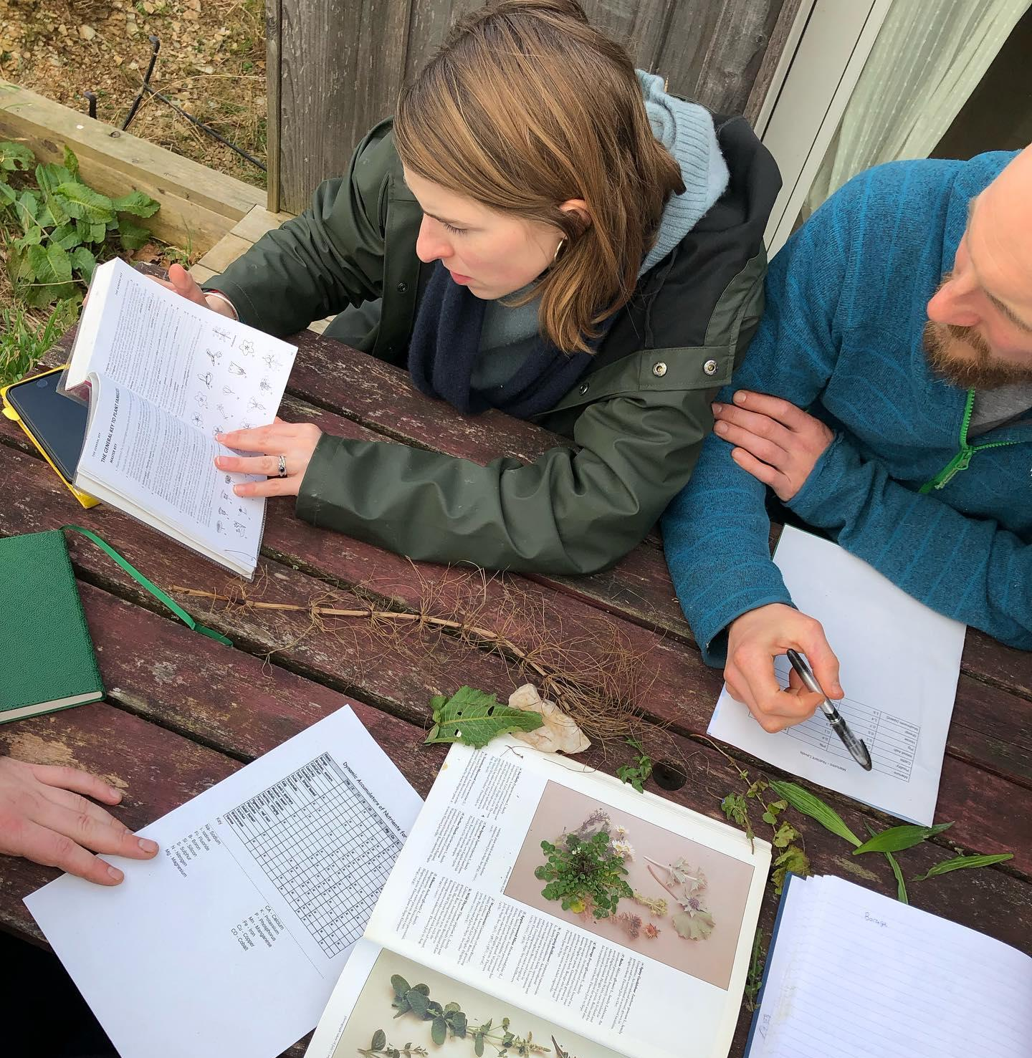
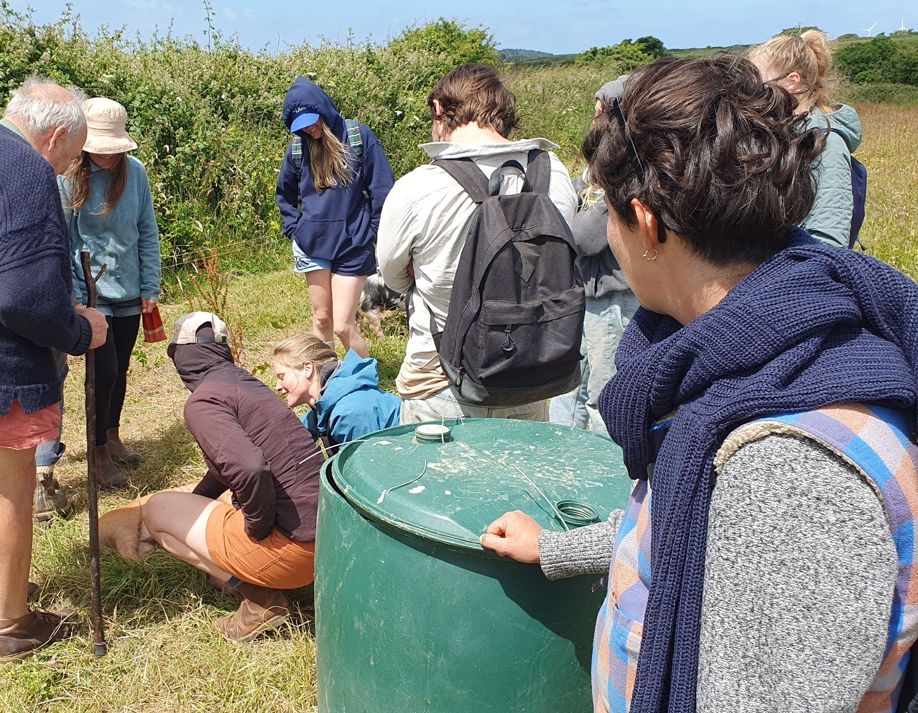
Education on the Land

Slide 7
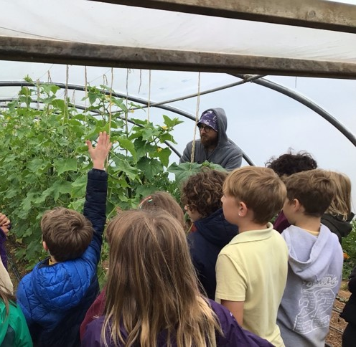
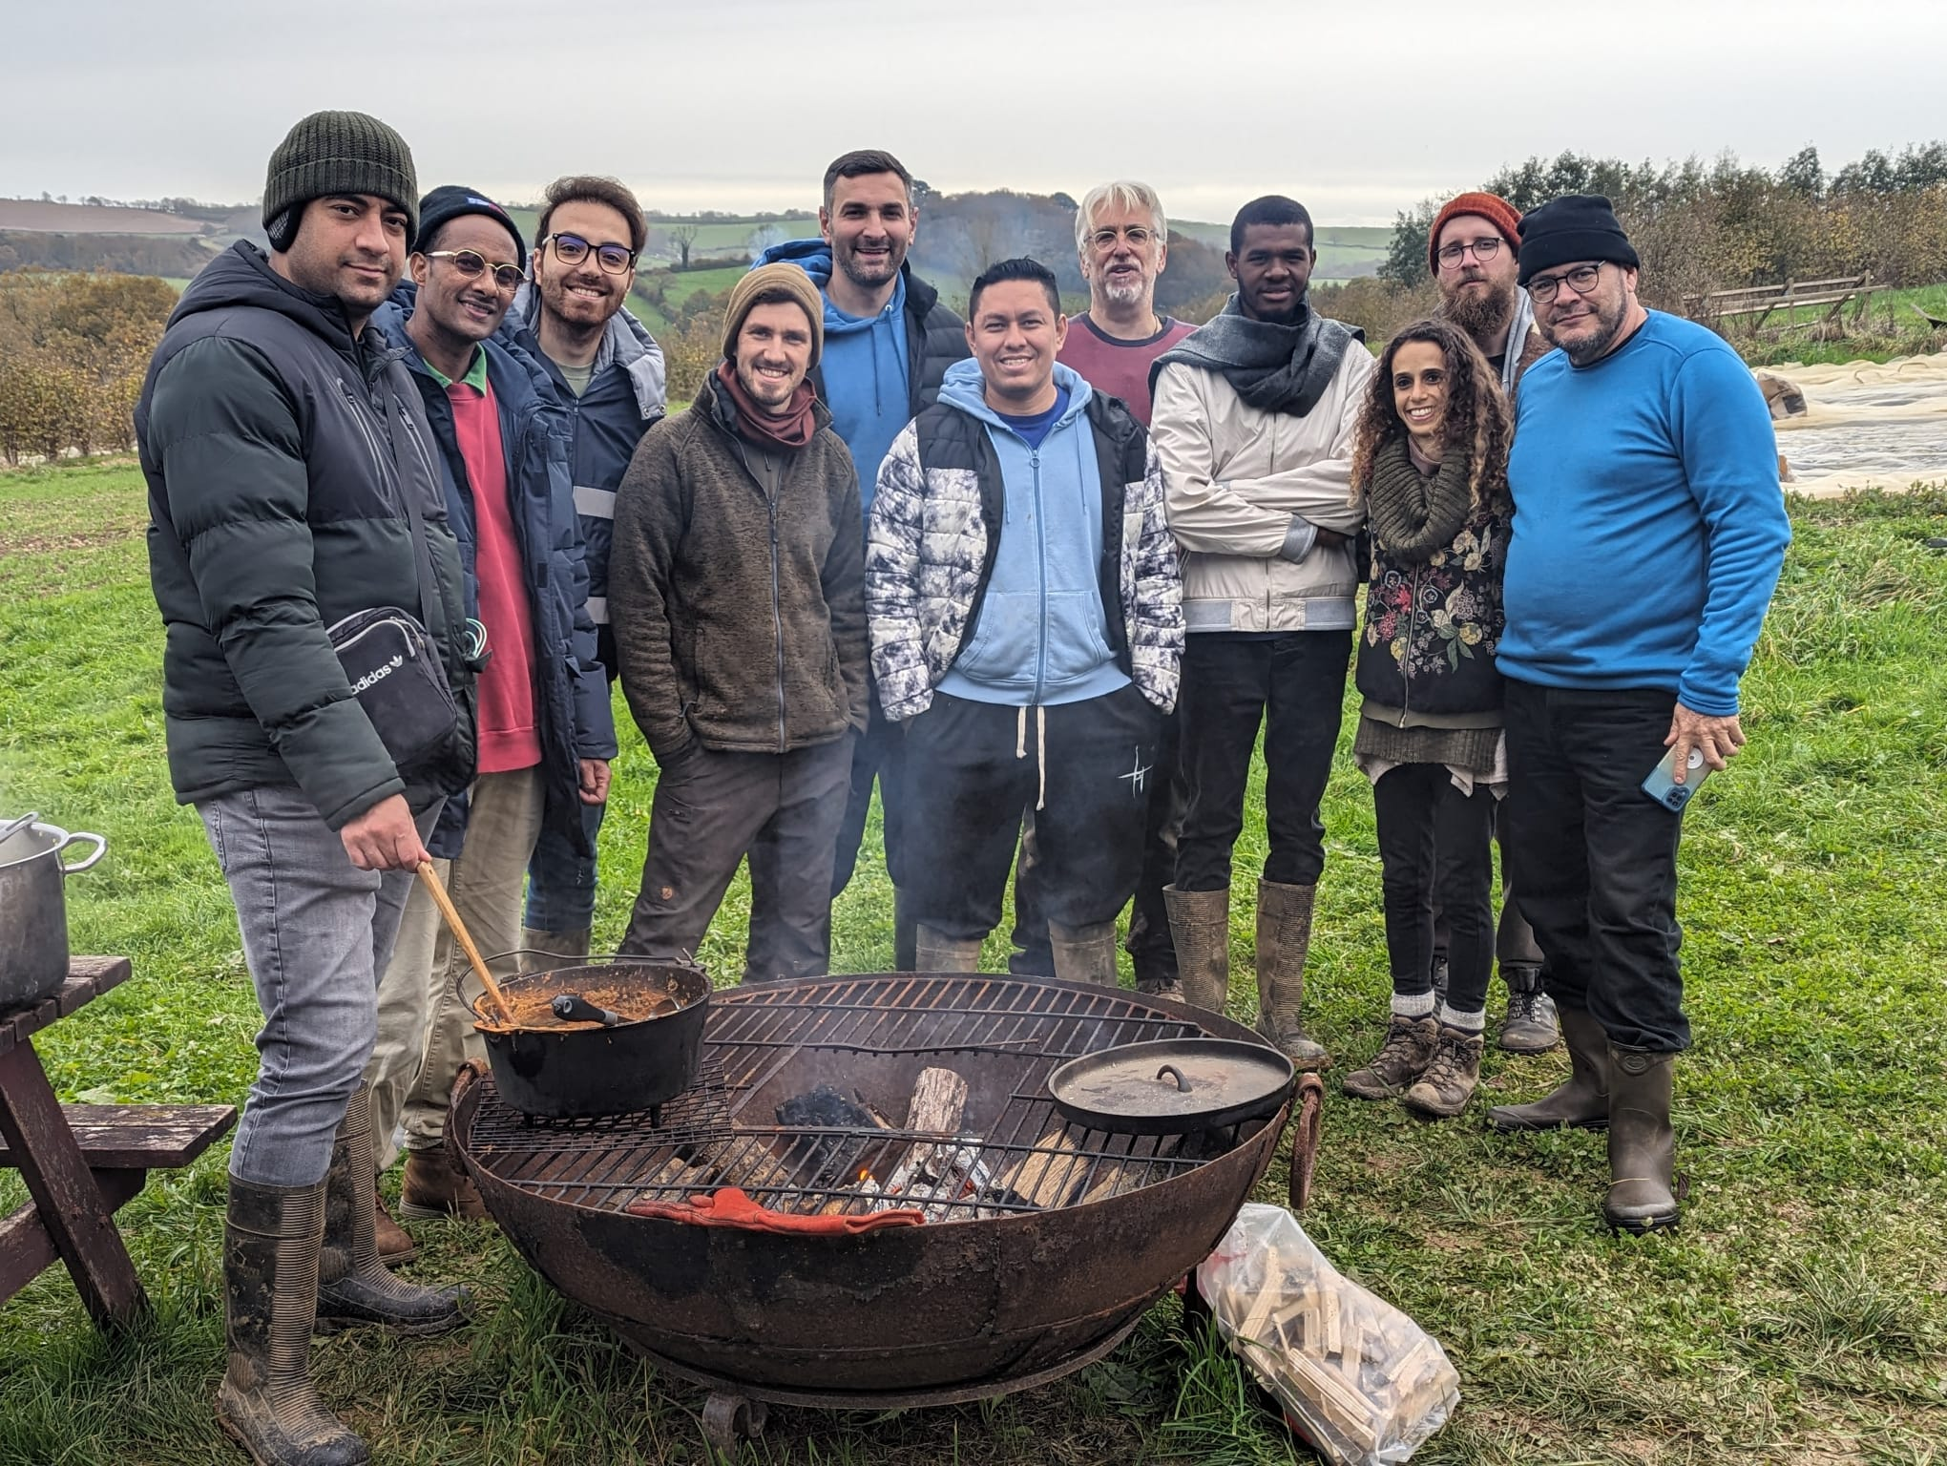
Well-being

Slide 8
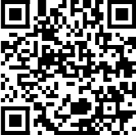
Rachel Phillips
rachelphillips@apricotcentre.co.uk
www.apricotcentre.co.uk

