Slide 1

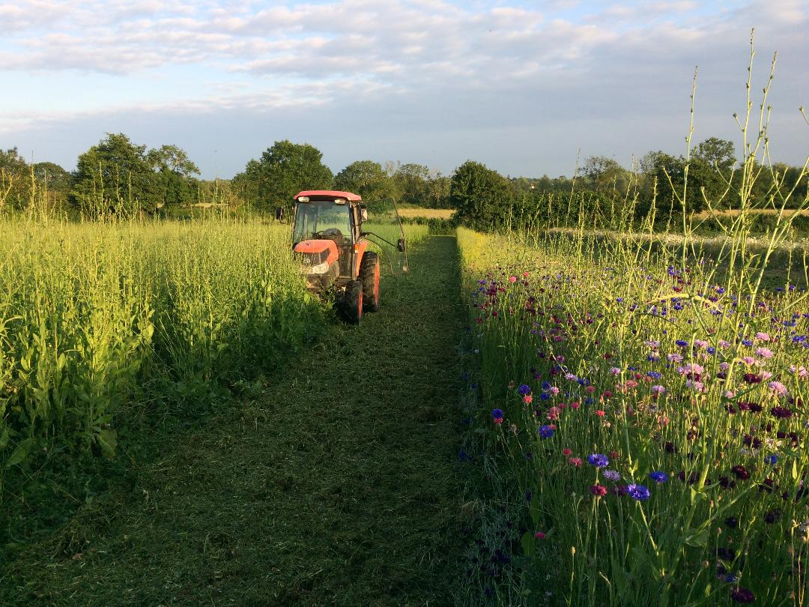


The role of tillage- it’s not the plough it’s the how
Oxford Real Farming Conference 2025

Slide 2
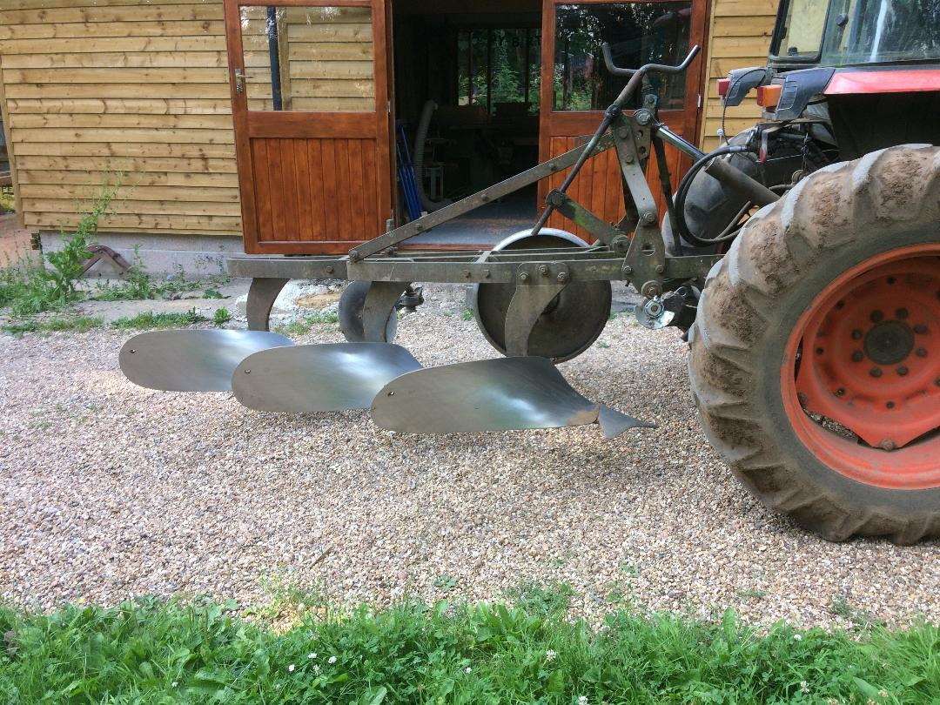

Vegetables and tillage? The positive plough
Expedient way to deal with cover crops
Weed control
Aeration
Manage crop debris
Use of plough needs to be done with care and consideration for soil life.
Shallow. Timeliness. With growing roots. Planted/sown rapidly. Keeping soils covered.

Slide 3
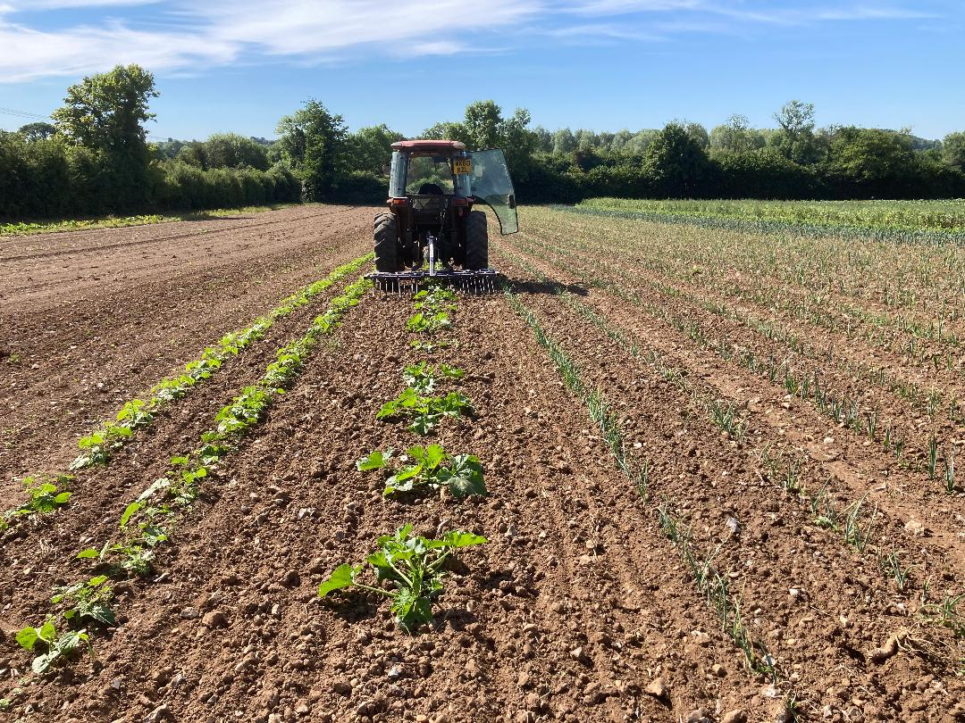
Vegetables and tillage- the negative plough
Total inversion
Damage to soil life
Damage to soil structure
Loss of nutrients
Inappropriate and badly timed ploughing can have negative effects that may last a long time, deeper it goes the greater the damage.

Slide 4
Field rotation-Hardwick
Stockfree rotation
Year 1+2 Red clover/Lucerne, chicory, w clover + wild flowers Cut and mulched. Ramial or woodchip compost applied @50 cube/ha
Year 3 Potato Followed by o/w green manure, clover/vetch sown by mid Sept, Cereal rye for later sowing.
Year 4 Brassicas. Winter/spring cropping. Under-sow cover crop late summer.
Year 5 Allium. Onion+leek. Autumn sown cover crop
Leek u/s cereal rye/oats, autumn.
Year 6 Carrot after leek. Parsnip after onion.U.S Green,manure
Year 7 Sweet corn. Squash. Both u/s red clover/Lucerne.

Slide 5
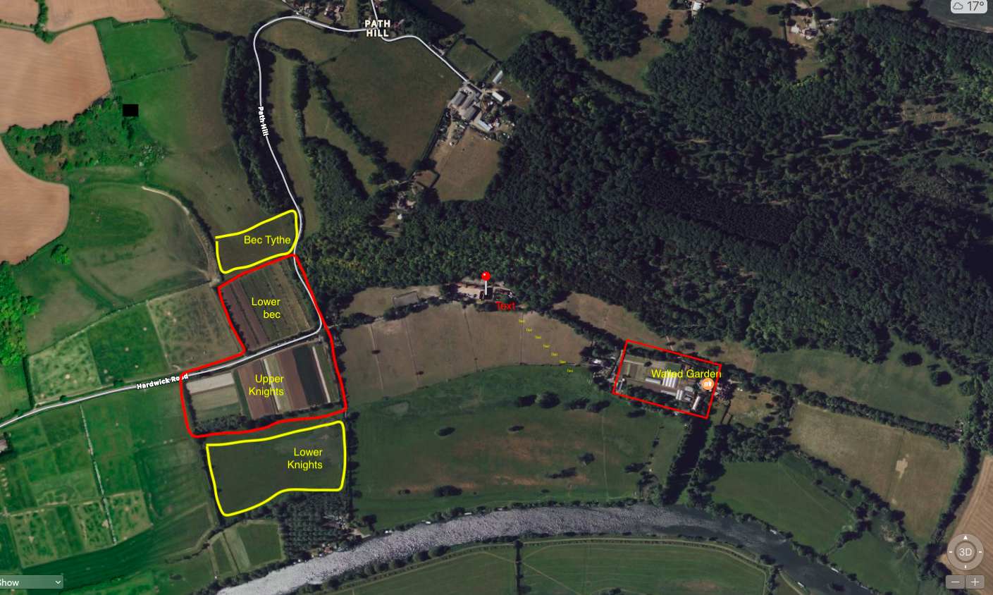
AGRICARBON CARBON STUDY 2022

Slide 6
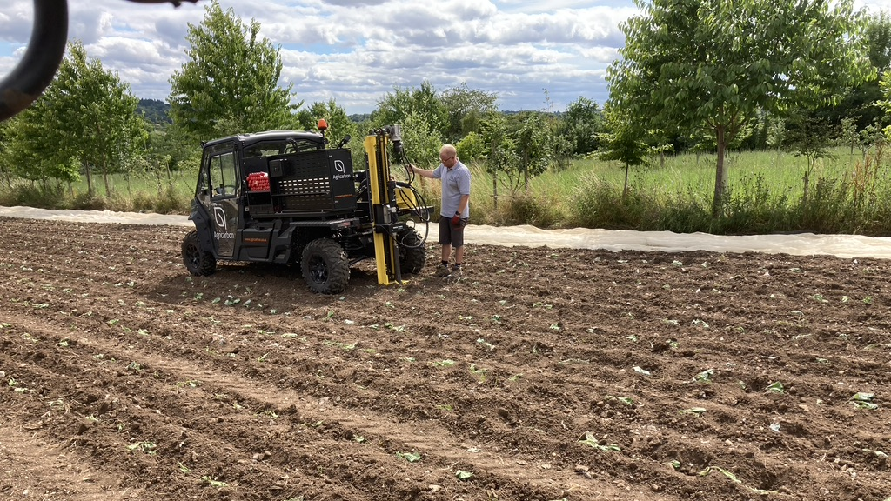
Cores to 1m deep

Slide 7
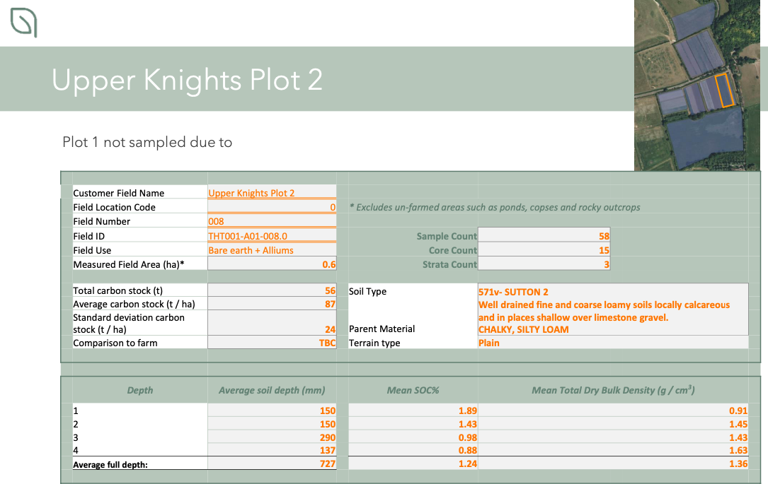

Slide 8
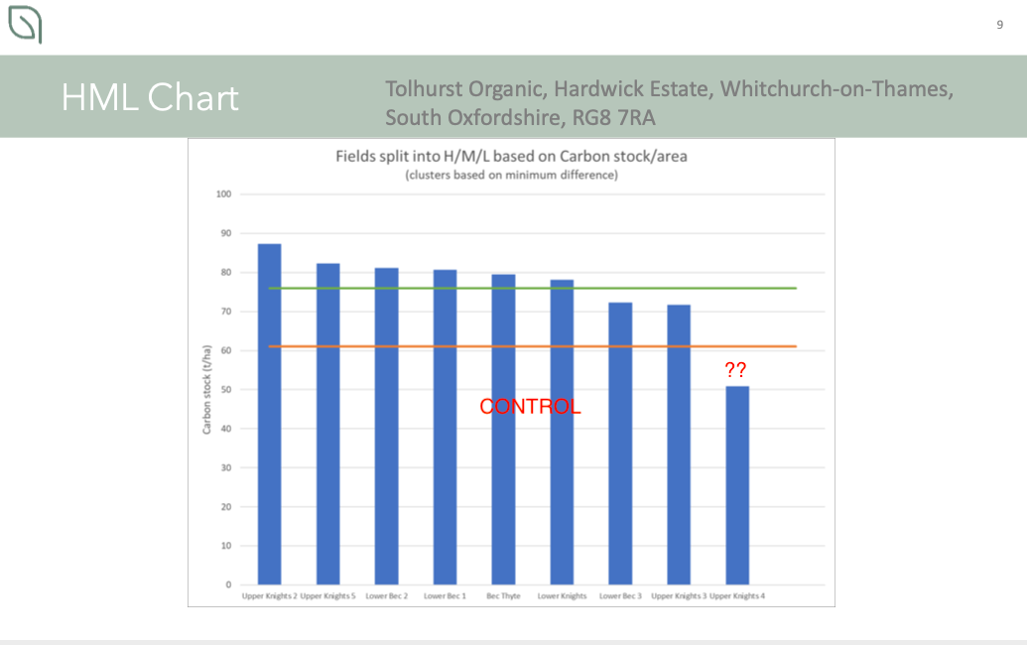

Slide 9
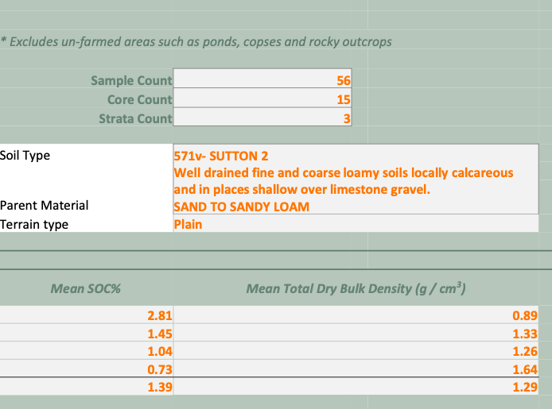

Soil Bulk Density optimum clay soil <1.10g/m3 >1.47g/m3 Soil Organic Carbon x 1.72 = Organic matter
CONTROL Permanent pasture
VEGETABLE FIELD PLOTS
Plot 4 Year 1 Rotation 32 month mixed ley

Slide 10
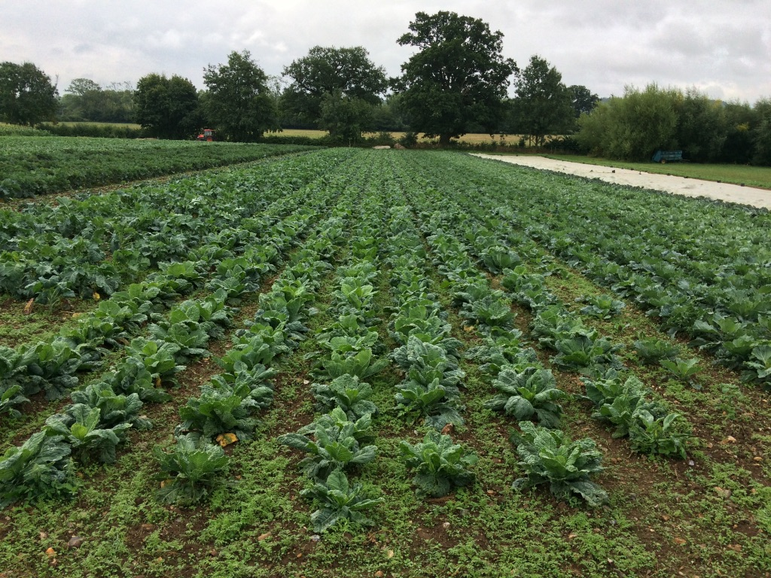
Carbon 80 tonnes = 12.5 oak trees/ha

Slide 11
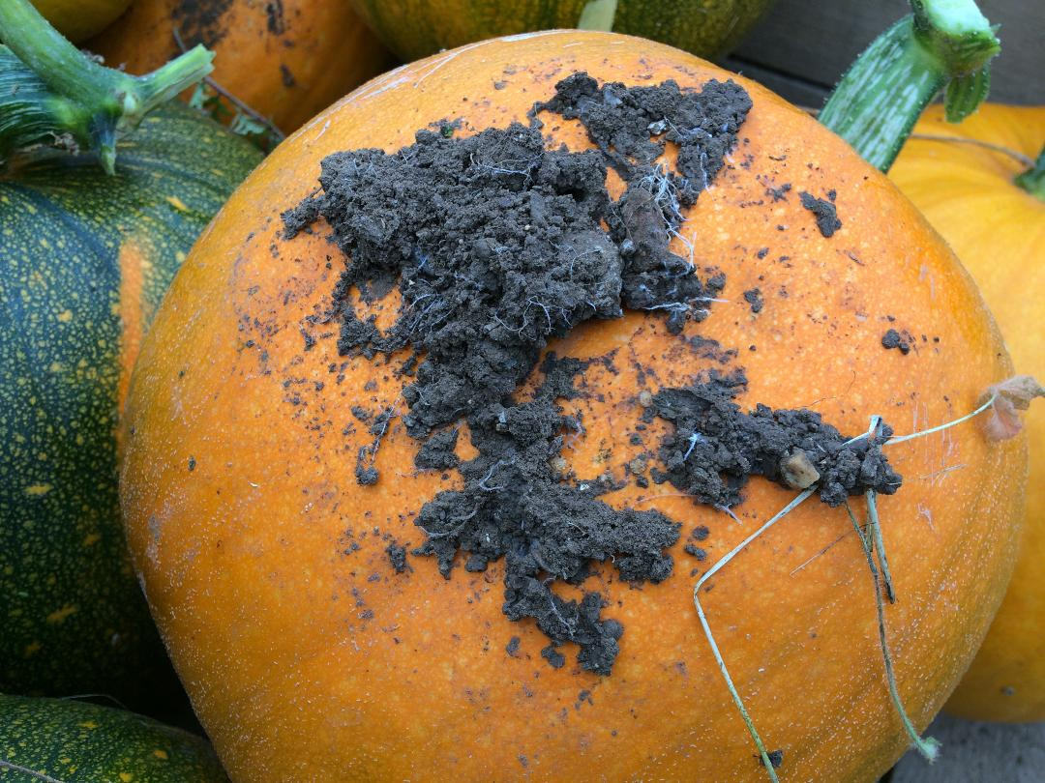
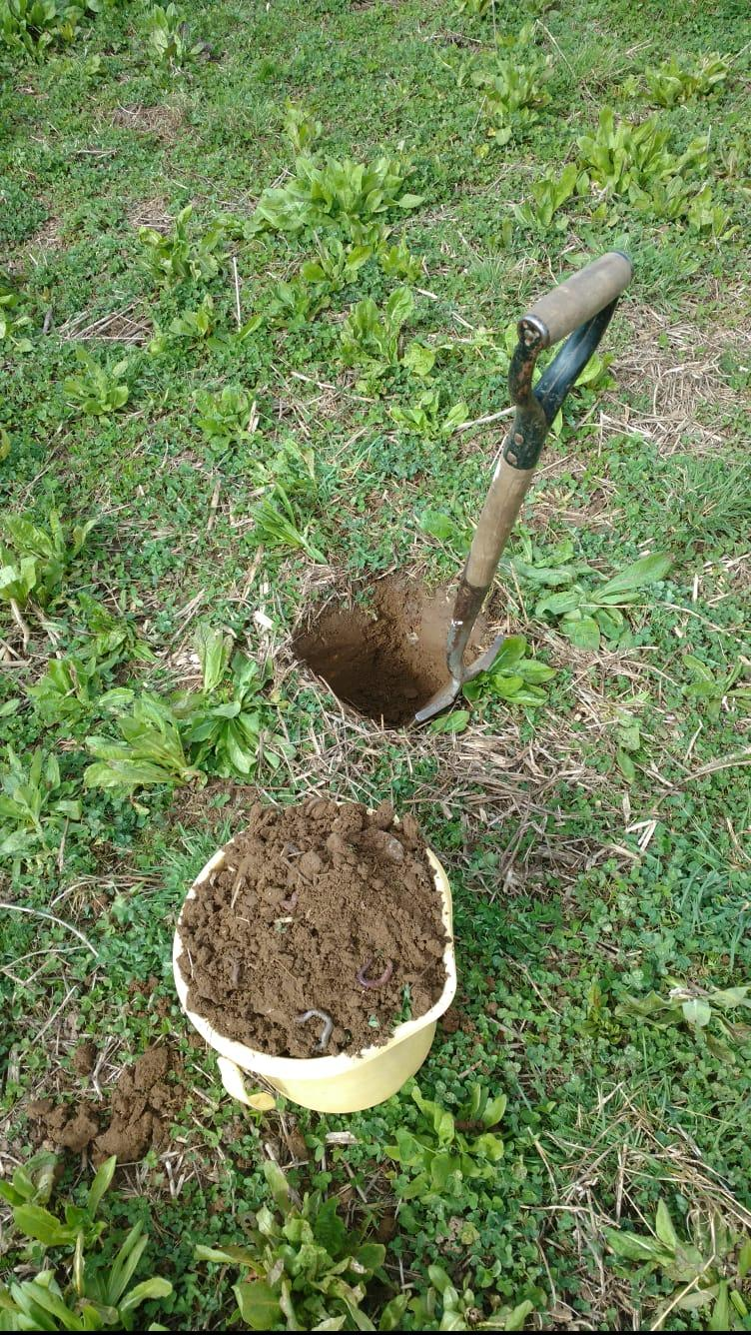
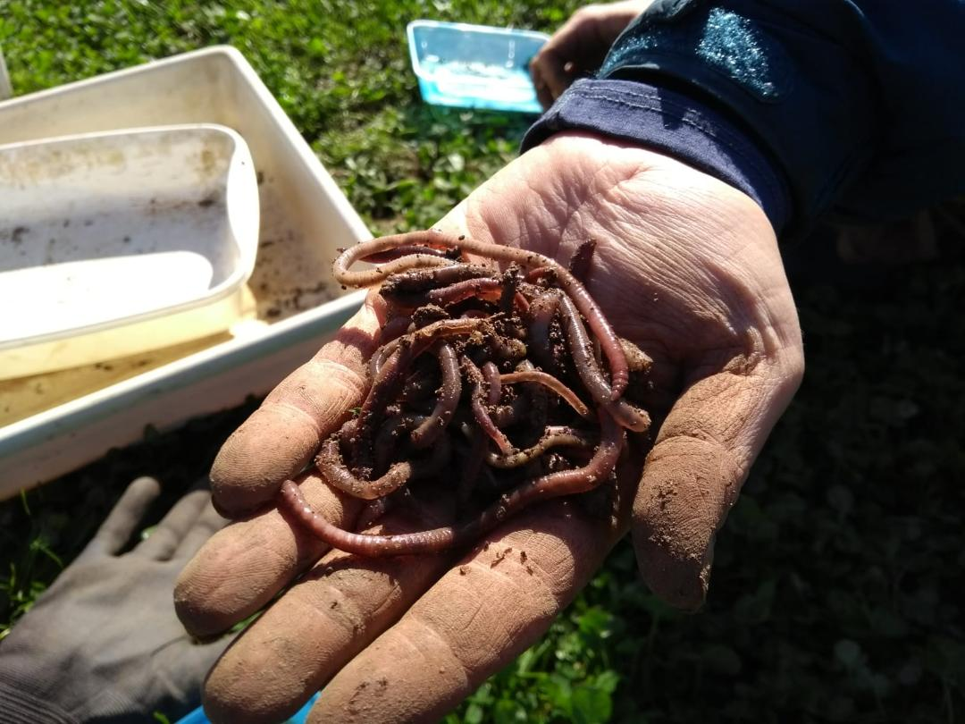
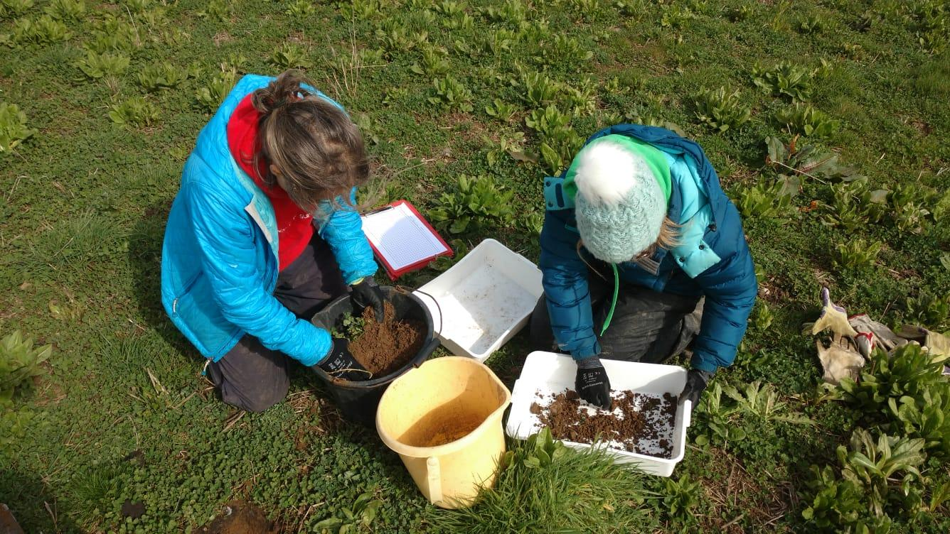
EARTHWORM POPULATIONS
1500/SQ M= 15 MILLION/HA APPROX 7-10 TONNES

