Slide 1
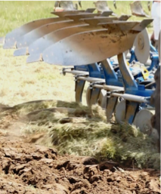
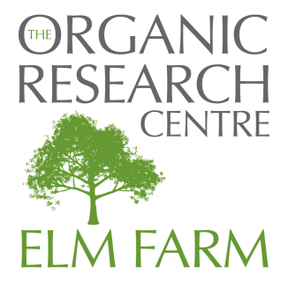
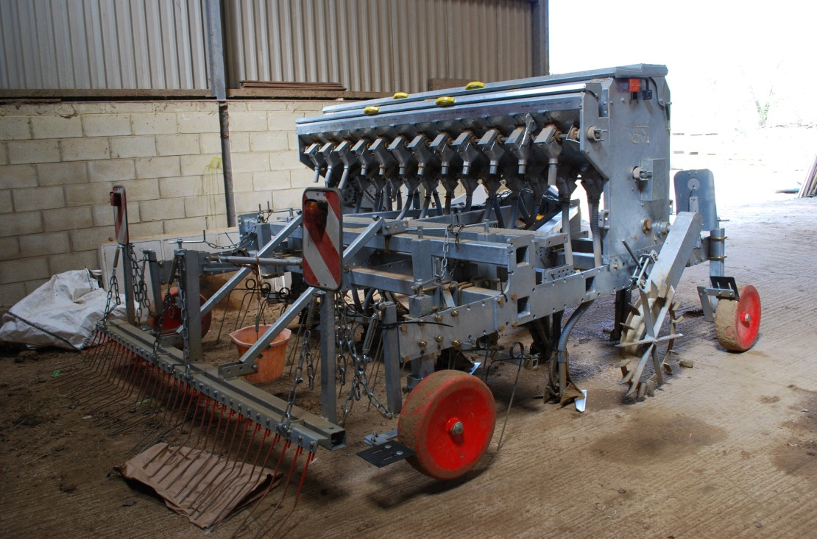
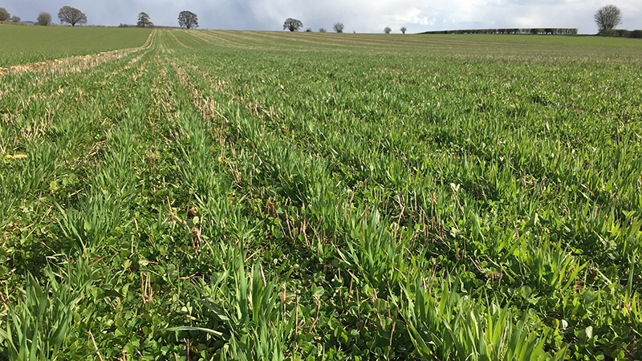
Mark Measures Iain Tolhurst Dominic Amos Richard Gantlett
The Role of Tillage: science and best practice
Notes:
Unsubstantiated claims that ”no till the holly grail of organic farming”? Misunderstanding of soil fertility and impact of tillage.
Soil erosion, soil compaction, loss of organic matter, damage to soil life and excessive fuel use are possible consequences of bad cultivation practices.
In reality only about 7% arable land in UK is no-till. Organic and agroecological farming does not need to be slaves to No-Till, which conventional farmers are adopting because of poor systems, fueled by agrochemical sales.
What is best practice?

Slide 2
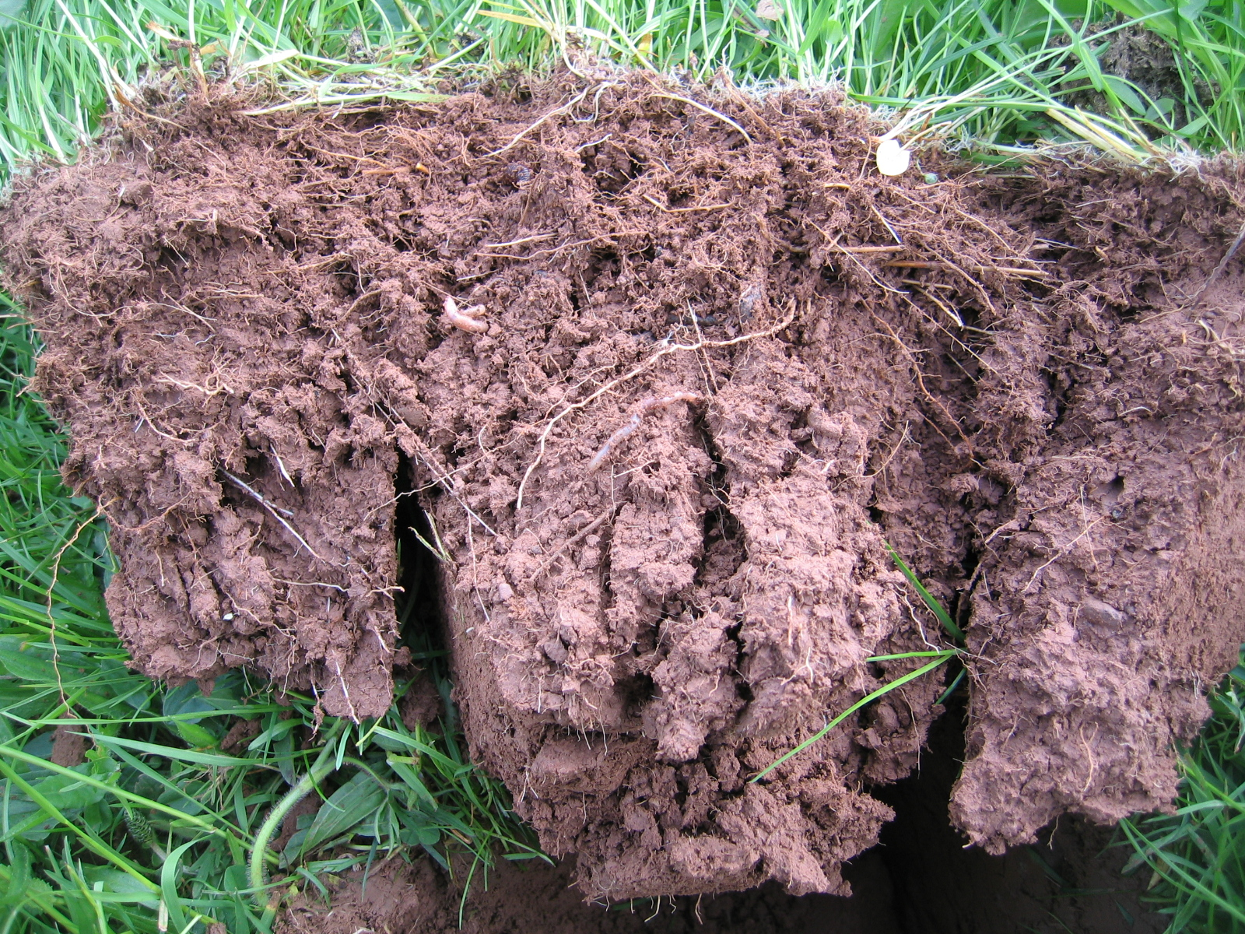
Soil fertility
Cultivation
Aeration, oxygenation
Soil biology stimulation – bacteria, fungi etc.
Using carbon as energy source
SOM breakdown and mineralisation
Nutrient mobilization e.g. N, P +
Humus formation – stable SOM
Notes:
Decomposition of “active” SOM, successive recycling, humification, formation of more stable humus – which is responsible for the physical benefits of SOM

Slide 3
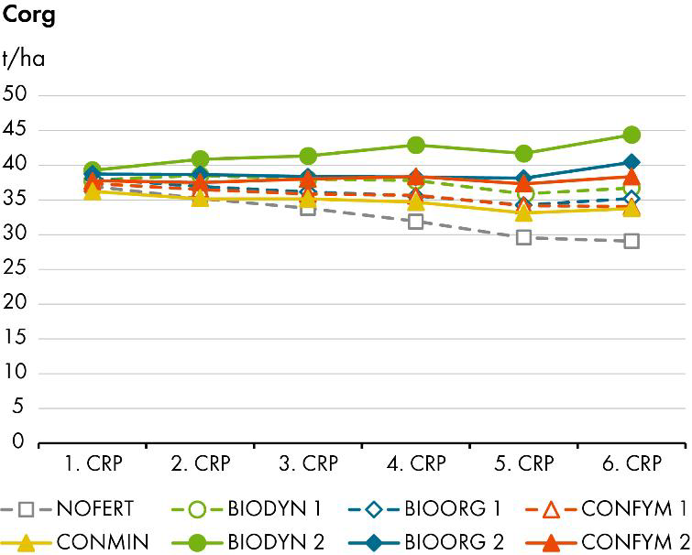
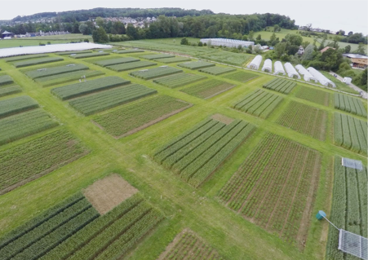
Soil carbon Results from long term trials FiBL DOC systems trial 42 years
All system at 0.7 LU, CONMIN and NOFERT loose SOC
Mixed farming with 1.4 LU can sustain SOC contents
Increased SOC contents in BIODYN presumably due to input quality
Notes:
“The role of tillage in climate mitigation is widely overstated”
The potential to continually increase SOM levels is limited and does not increase exponentially. It is influenced by soil type and the starting point. Need to consider the full soil profile.
Organic farming already includes diverse leys, green manures and often livestock manures and prohibits pesticides – so does it need to focus on no-till?
1 and 2 refers to the stocking rate/FYM use

Slide 4
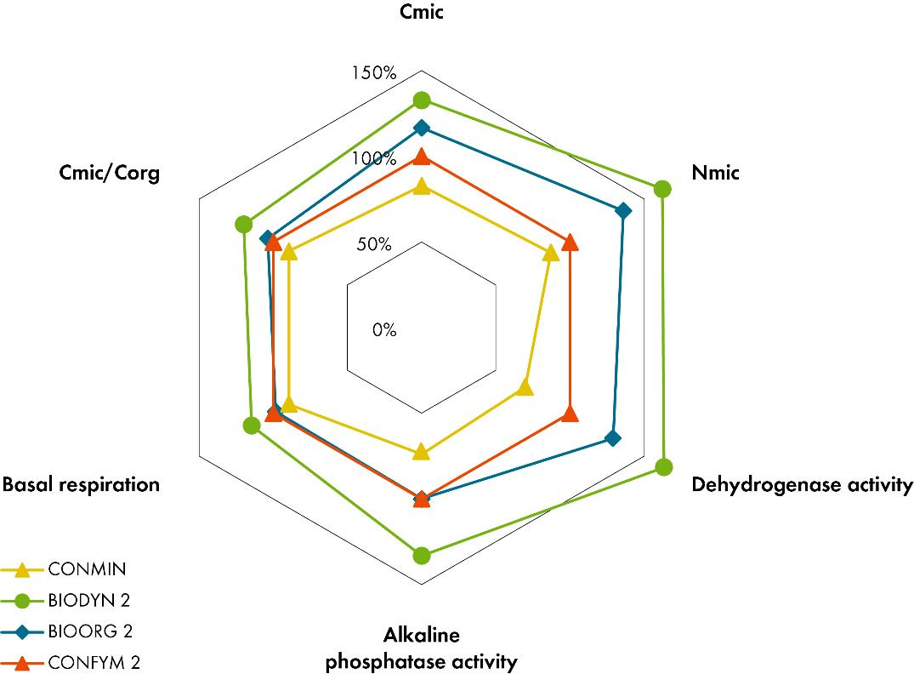
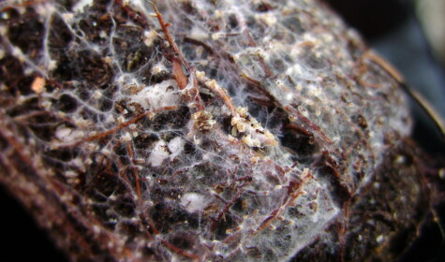
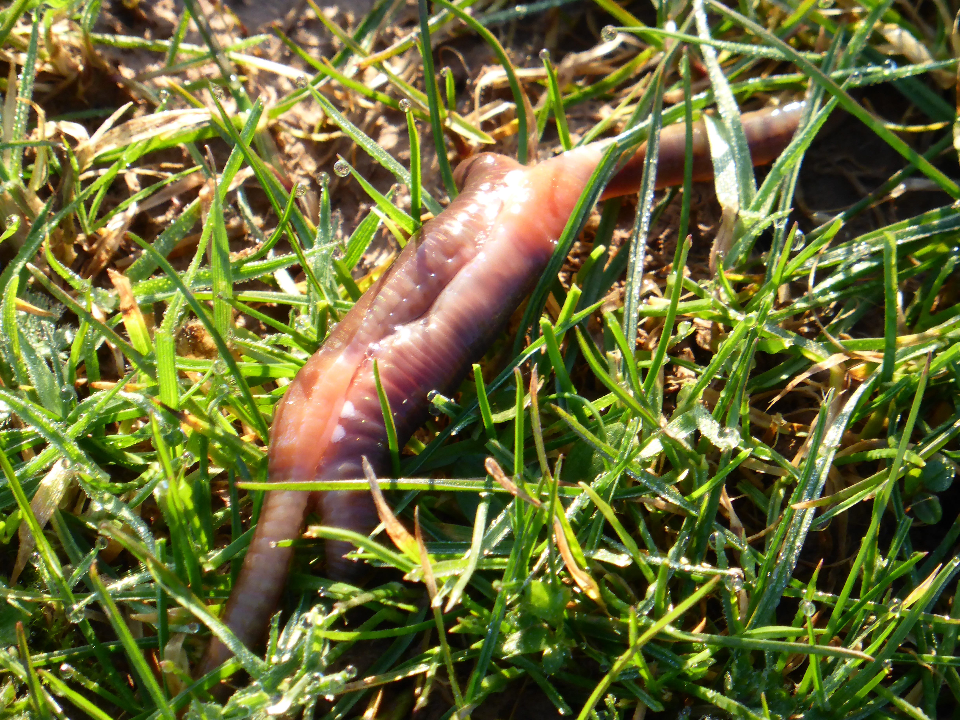
Soil biological quality Results from long term trials FiBL DOC systems trial 42 years
Picard
https://commons.wikimedia.org/wiki/File:Mycorhizes-01.jpg
Krause et al. (2022): Agronomy for Sustainable Development
Notes:
Mycorrhiza: drought, disease, nutrient transfer, soil structure
Some effect of ploughing on mycorrhiza population but not diversity
Spores are the source of mycelium each year
Multiple factors affecting biology activity

Slide 5
References
Alskaf, K. et al 2019 The uptake of different tillage practices in England https://www.researchgate.net/publication/335069898_The_uptake_of_different_tillage_practices_in_England
FAO Organic mater decomposition and the soil food web Chapter 2 https://www.fao.org/4/a0100e/a0100e05.htm#:~:text=As%20they%20break%20down%20the,release%20process%20is%20called%20mineralization.
Haddaway, N. R. et al, 2016 ‘How does tillage intensity affect soil organic carbon? A systematic review protocol’, Environmental Evidence, 5 (1), https://doi.org/10.1186/s13750-016-0052-0
Powlson, D. S. et al, 2014, ‘Limited potential of no-till agriculture for climate change mitigation’, Nature Climate Change, 4, https://www.nature.com/articles/nclimate2292
Whitmore, A. P. et al, ‘Technologies for increasing carbon storage in soil to mitigate climate change’ http://nora.nerc.ac.uk/id/eprint/513034/1/technologies_carbon_SUM_Whitmore_et_al.pdf
Fliessbach, A. et al FiBL DOK Trial 42 years of organic and conventional cropping systems https://www.fibl.org/fileadmin/documents/shop/1783-powerpoint-dok-en.pdf
https://www.fibl.org/fileadmin/documents/shop/1741-dok-dossier-en.pdf
Piexoto, D.S. et al, 2020 Occasional tillage in no-tillage systems: A global meta-analysis https://www.researchgate.net/publication/343013519_Occasional_tillage_in_no-tillage_systems_A_global_meta-analysis
Young, R. 2023 More things in heaven and earth: Mycorrhizal fungi, ploughing, no-till and glyphosate https://sustainablefoodtrust.org/news-views/more-things-in-heaven-and-earth-mycorrhizal-fungi-ploughing-no-till-and-glyphosate/
Yound, R. 2023 Speed the plough or the direct drill and sprayer https://sustainablefoodtrust.org/news-views/speed-the-plough-or-the-direct-drill-and-sprayer/
Sale, V. et al 2015, Impact of conservation tillage and organic farming on the diversity of arbuscular mycorrhizal fungi https://www.sciencedirect.com/science/article/abs/pii/S0038071715000504

