Slide 1


Don’t lose your N!
Using carbon-rich material to save nitrogen

Slide 2
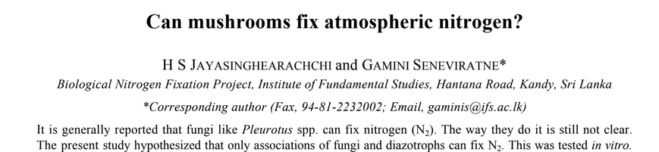
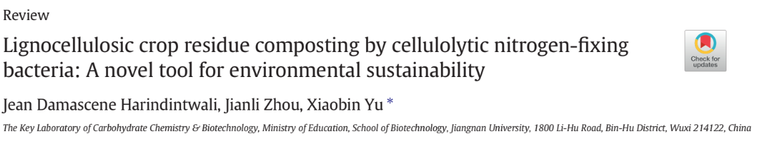

Slide 3
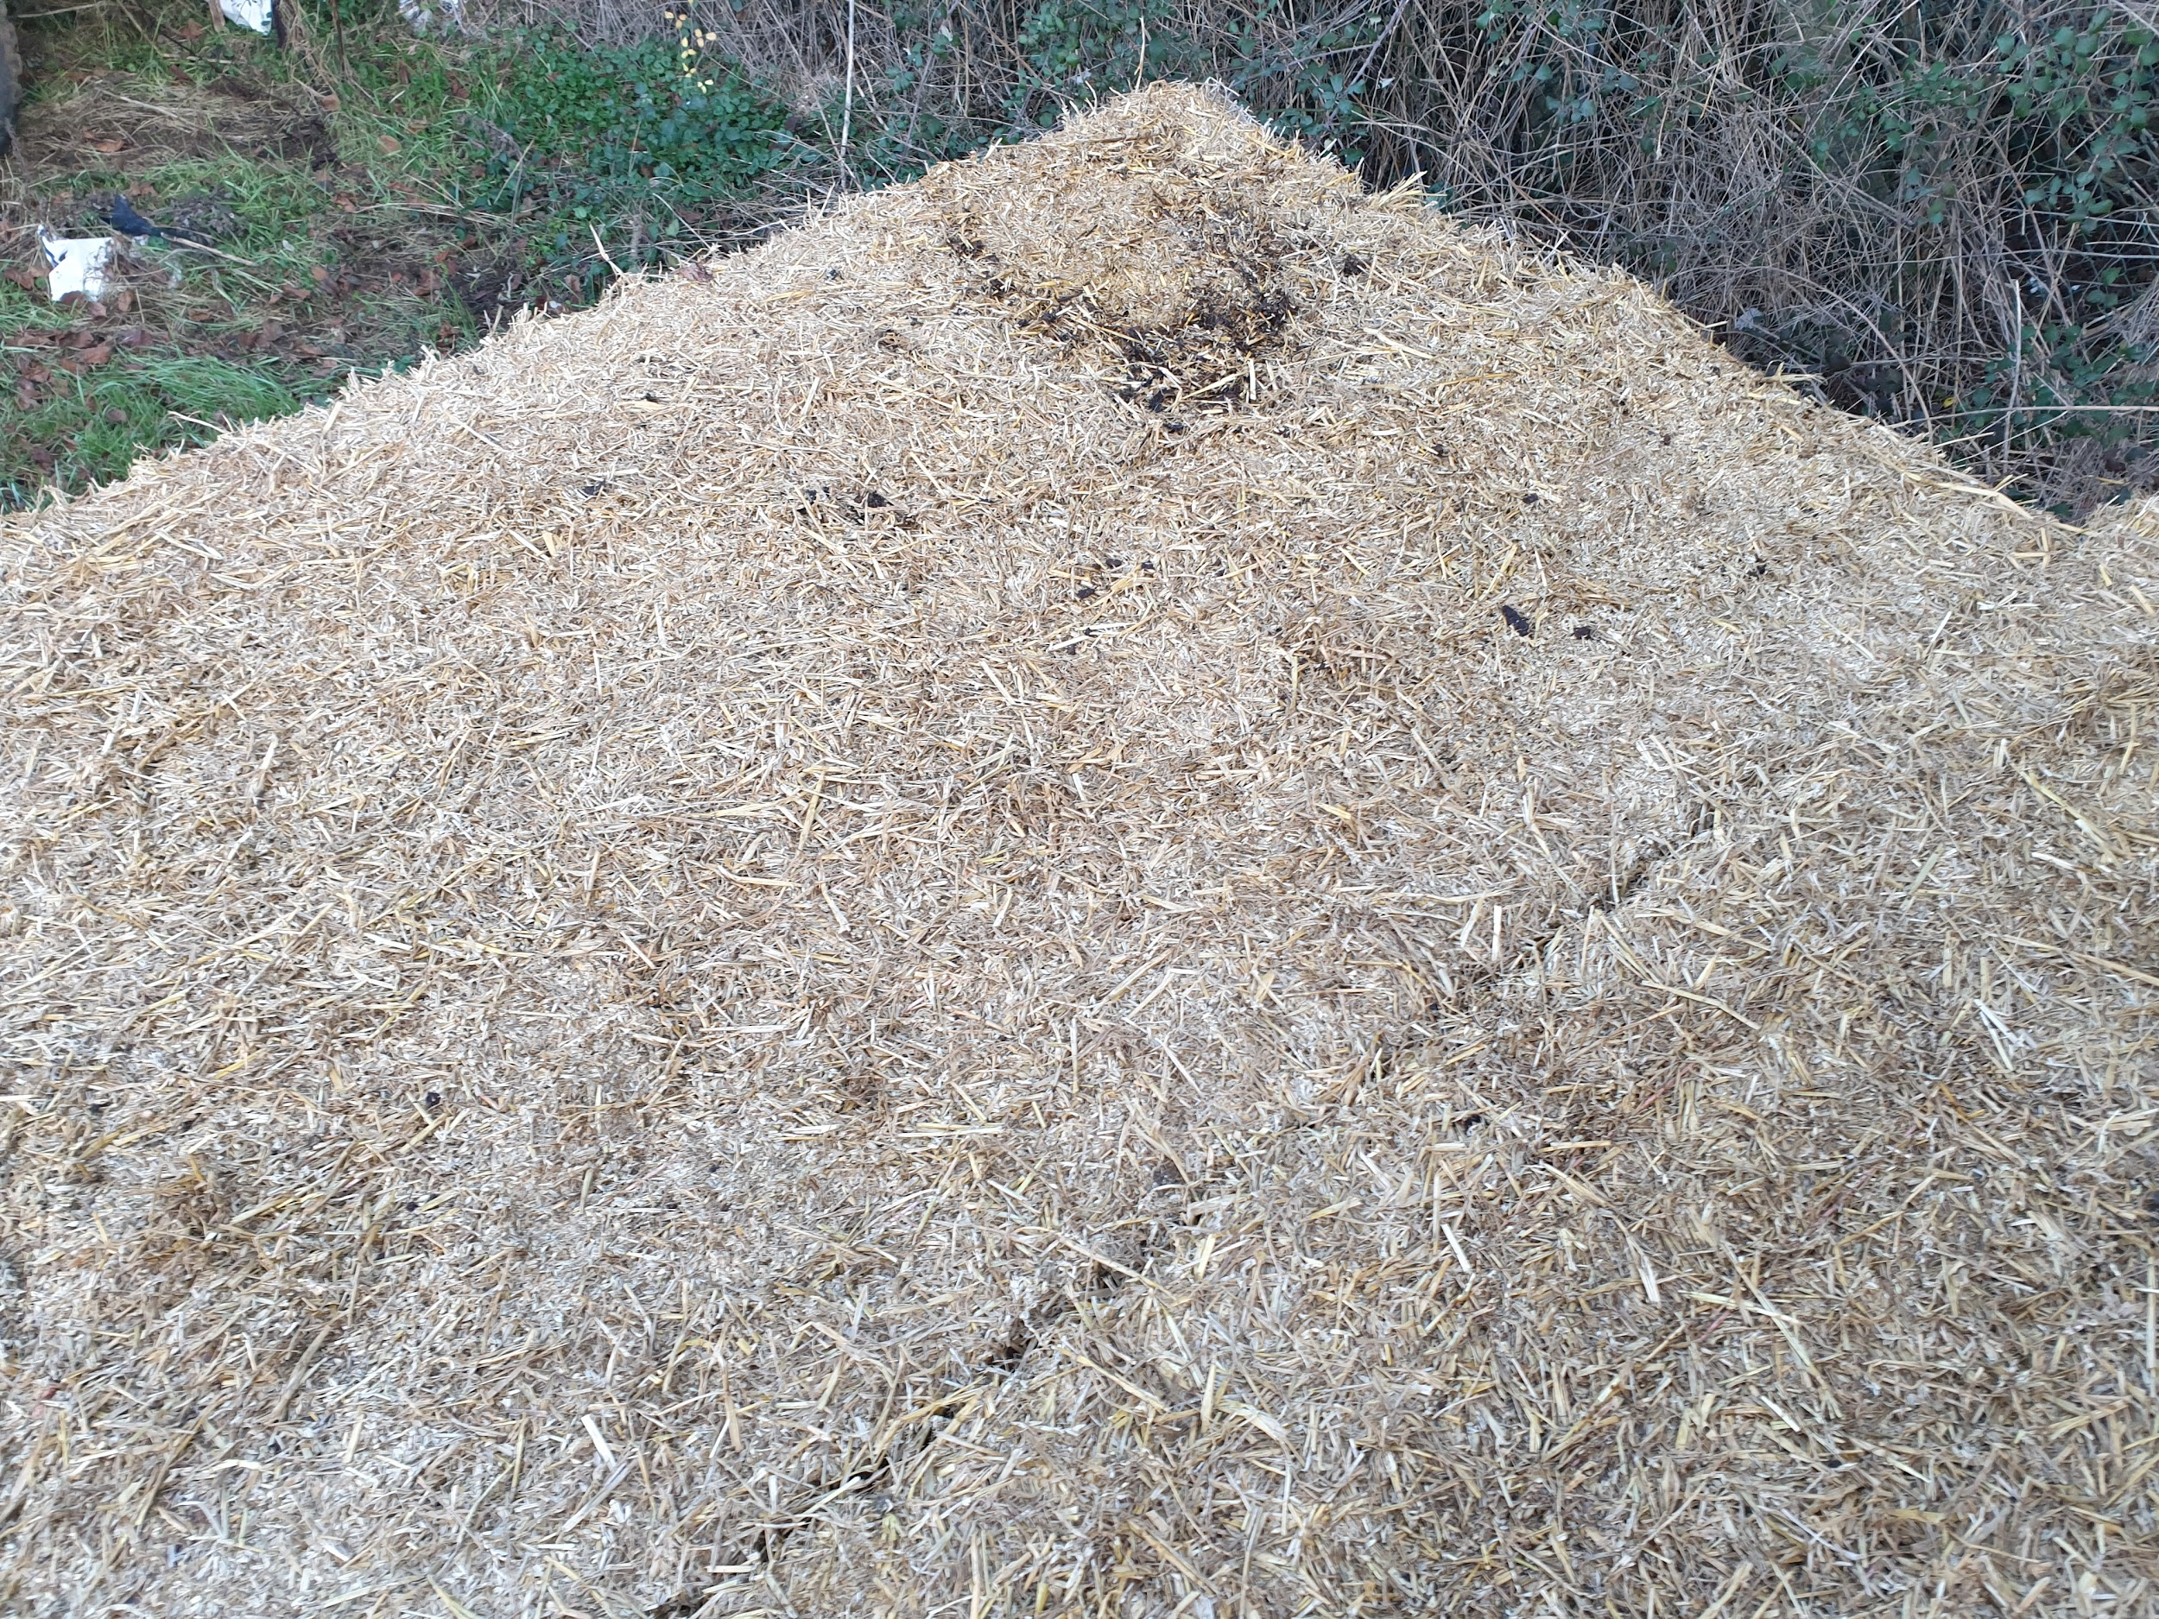
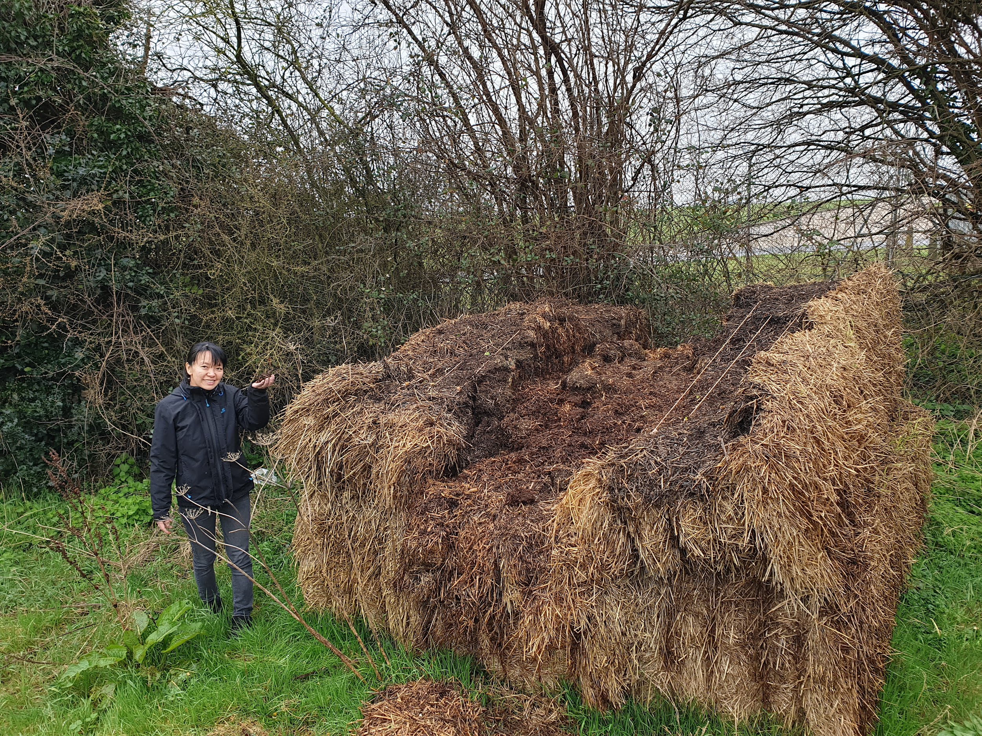
Free
nitrogen!!!

Slide 4
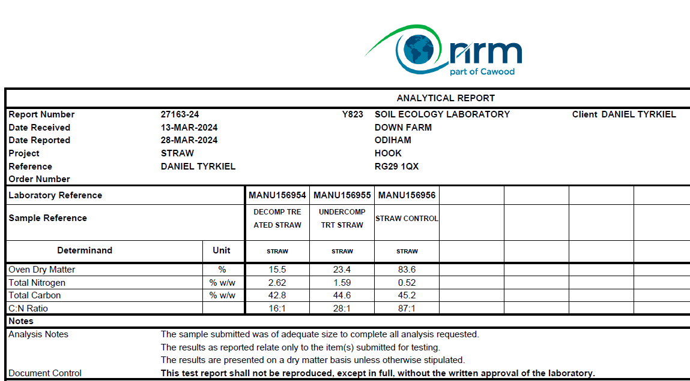

Slide 5
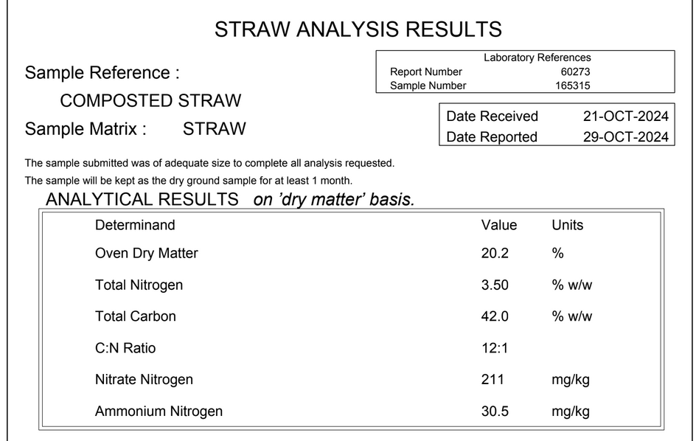

Slide 6
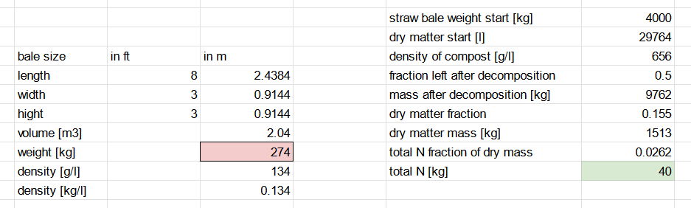
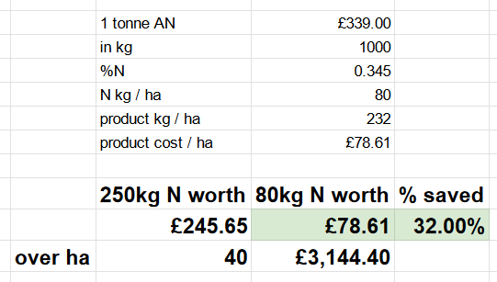

Slide 7
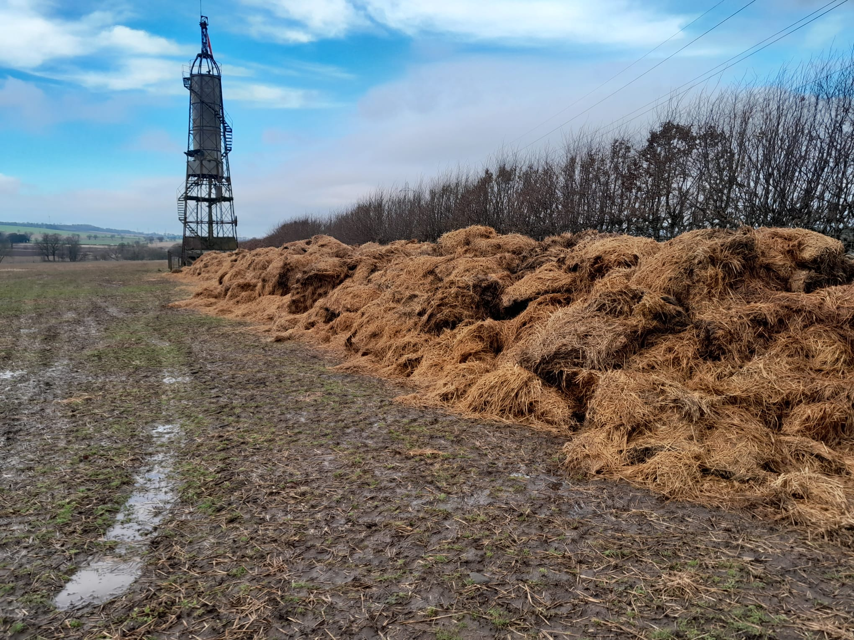

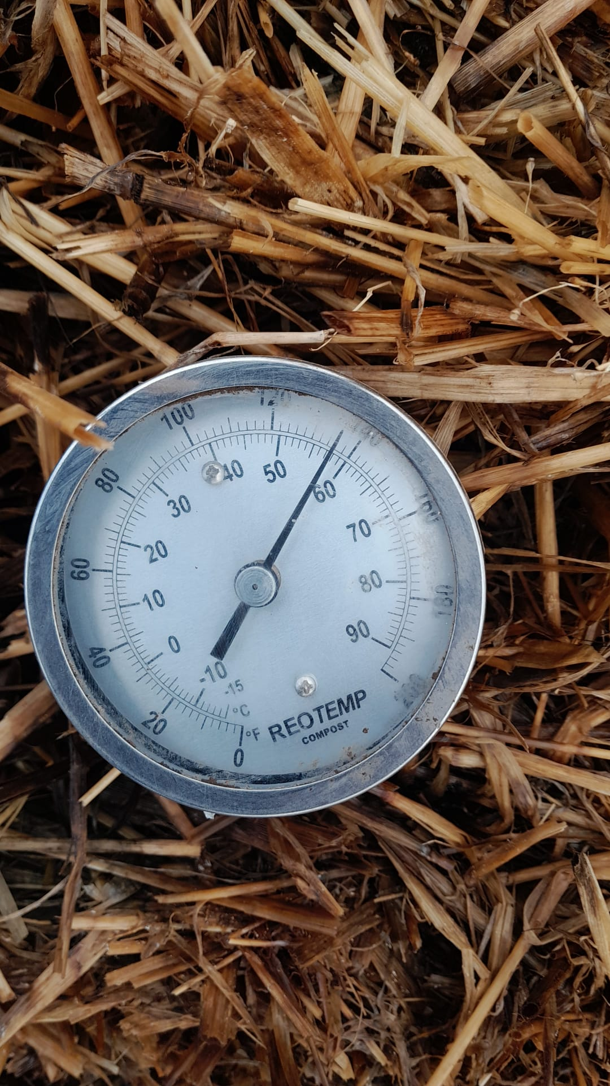

Slide 8
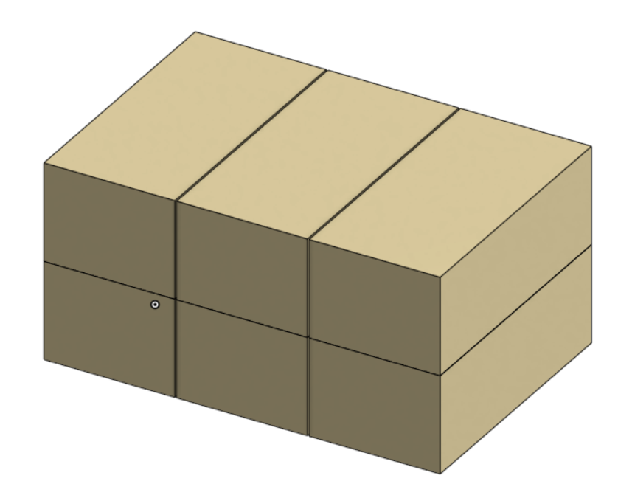
8x4x3 ft Hessian bales - 270 kg each.
3x2 stack used in
our experiment

Slide 9
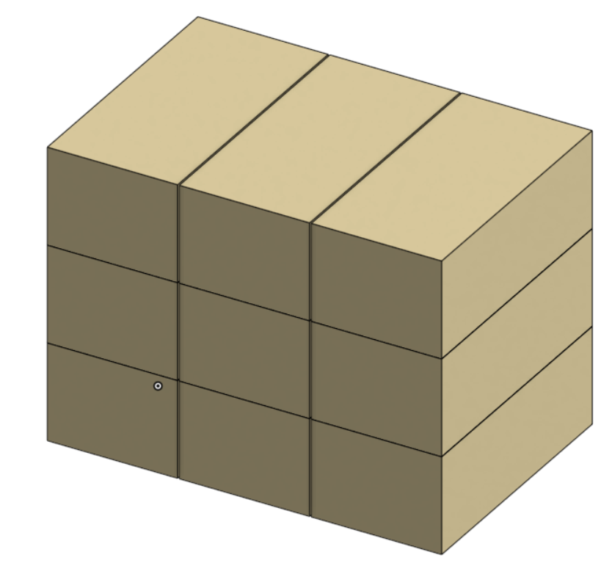
Recommended:
3x3 stack or windrow

Slide 10
Thank you!
Daniel Tyrkiel
Soil Ecology Laboratory
daniel@soilecologylab.co.uk
www.soilecologylab.co.uk
07926268349

