Slide 1
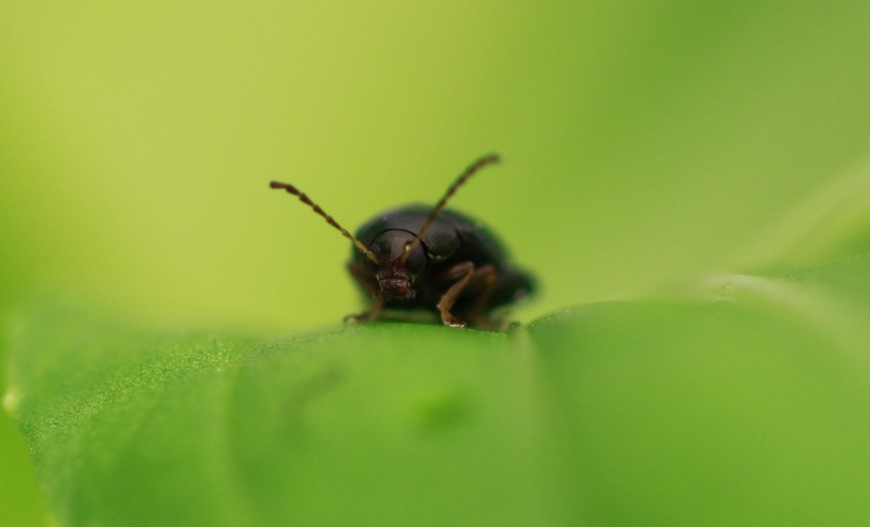



Do we see synergism in IPM and are we using the science of IPM?
Prof. Tom Pope
9th January 2025

Slide 2

The ‘concept’ of IPM
Many definitions (perhaps too many) but the concept of IPM is well established:
A holistic ‘approach’ or ‘strategy’ to combat plant pests and diseases using all available methods, while minimizing applications of chemical pesticides
Stenberg, 2017

Slide 3
The ‘science’ of IPM
The science of IPM is much less well established but may be defined as:
The systematic study of the compatibility and optimization of simultaneously implemented actions associated with at least two pest management elements of the IPM pyramid
Stenberg, 2017

Slide 4
Are we getting the most out of IPM?
Most IPM research focuses on individual plant protection methods
Comparatively little research has considered how plant protection methods can be integrated
In practice, this means that approaches to pest management are simply combined and not integrated

Slide 5
Are we getting the most out of IPM?
Combining or integrating (hopefully) IPM methods is currently often left to farmers and growers
Good examples of where farmer led research is working and use of IPM programmes is being promoted (SFI – CIPM1)
However:
It is often hard to translate results from one system to another
There is a lack of underpinning knowledge of how methods may work and how they interact
Creates perception that IPM is complicated or unreliable

Slide 6
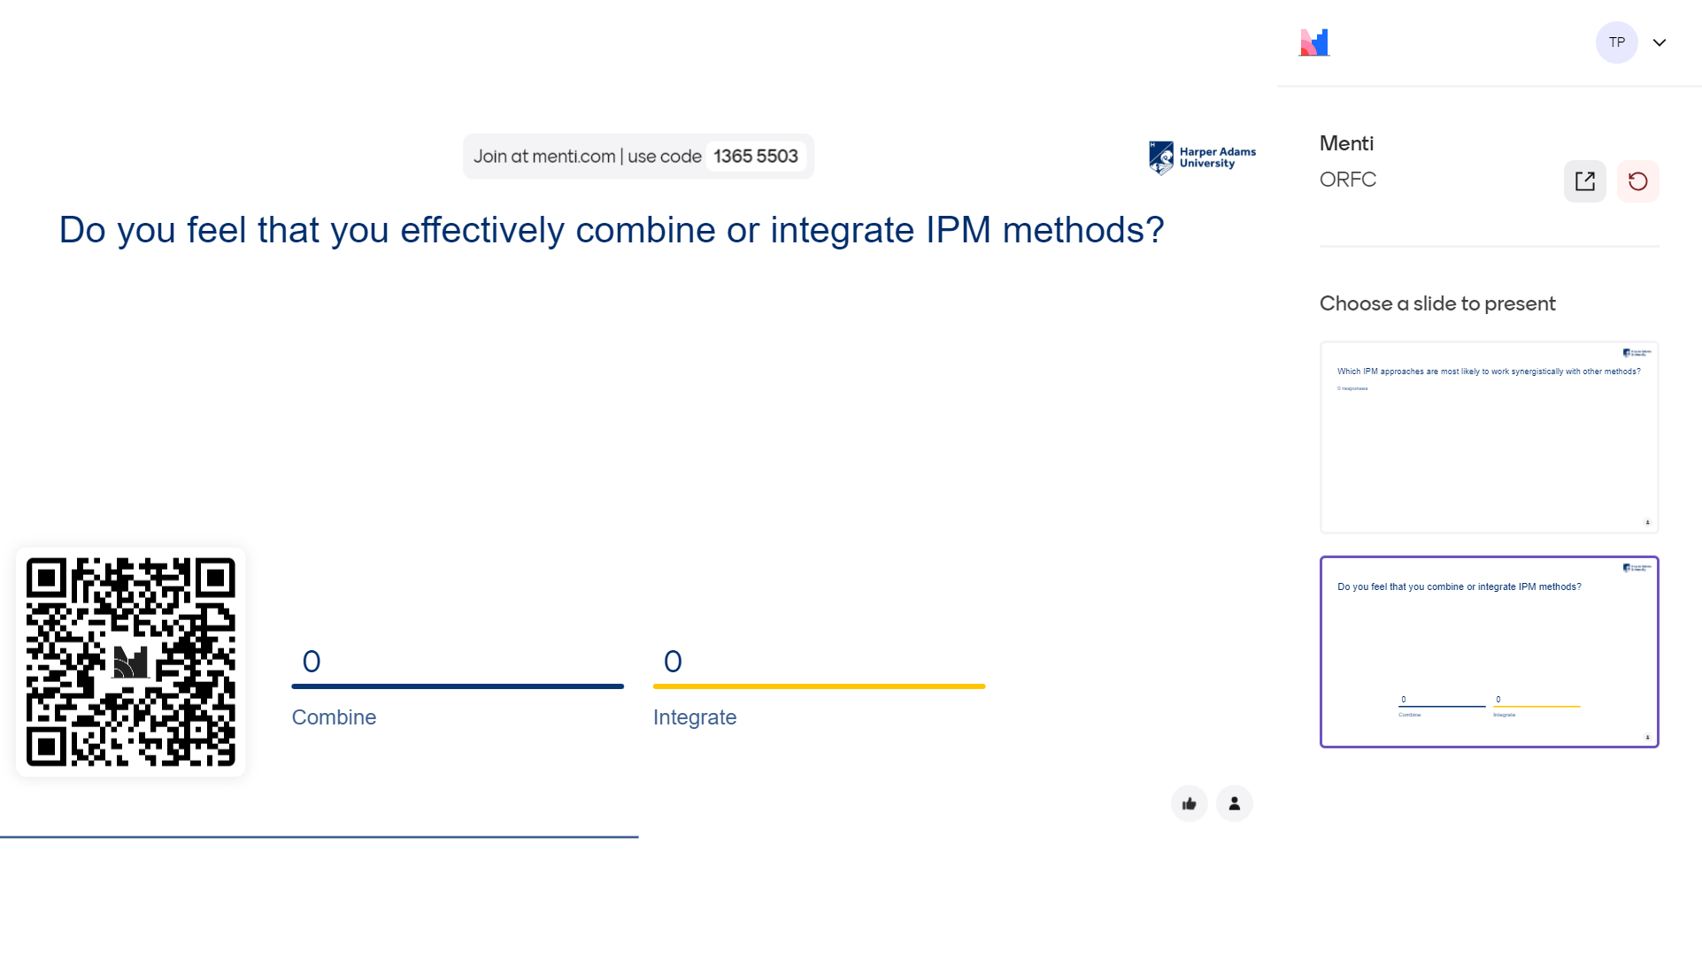

Slide 7
How do pest management elements interact?
Pest management methods may interact with each other in different ways:
Synergistic effects – combined effect of two or more methods greater than the sum of the effects seen when methods used individually
Additive effects - combined effect of two or more methods the same as the sum of the effects seen when methods used individually
Antagonistic effects - combined effect of two or more methods less than the sum of the effects seen when methods used individually

Slide 8
How do we check for synergy?
Various approaches have been taken but no one approach has been widely adopted
Despite this, pharmacology regularly test for interactions between medical treatments – the Checkerboard approach
Can we apply the Checkerboard approach to IPM?

Slide 9
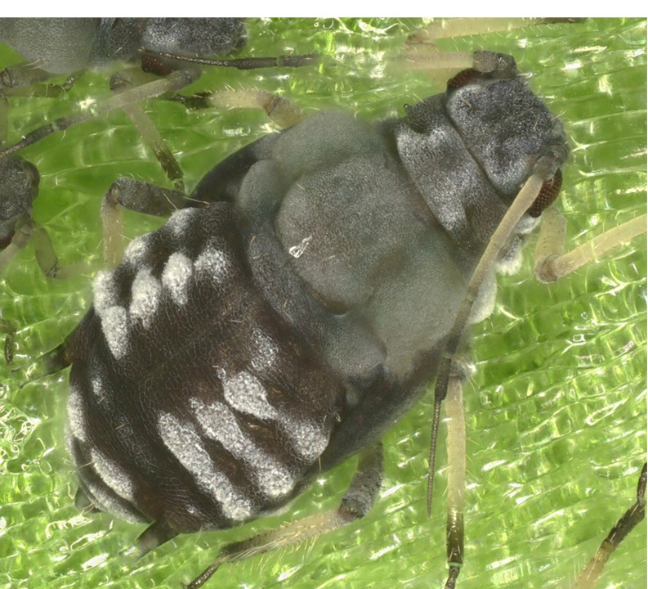
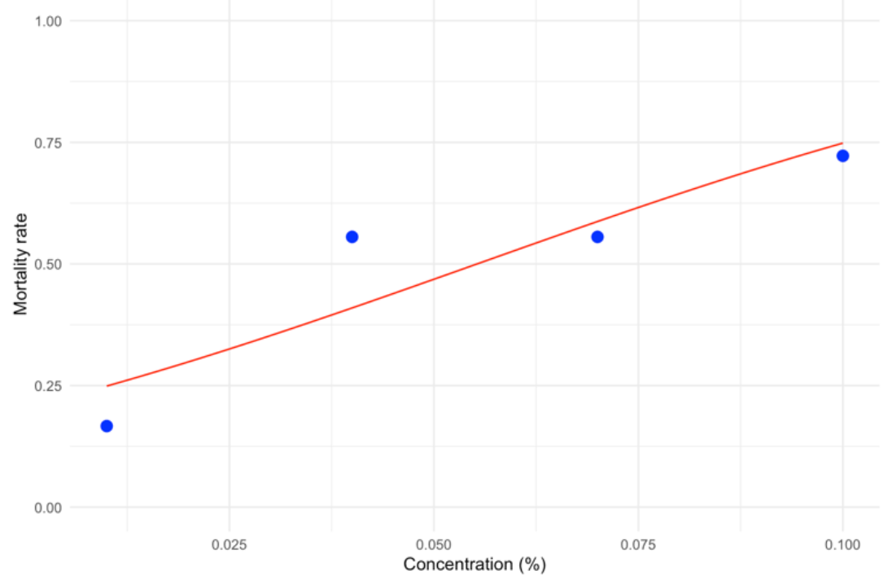
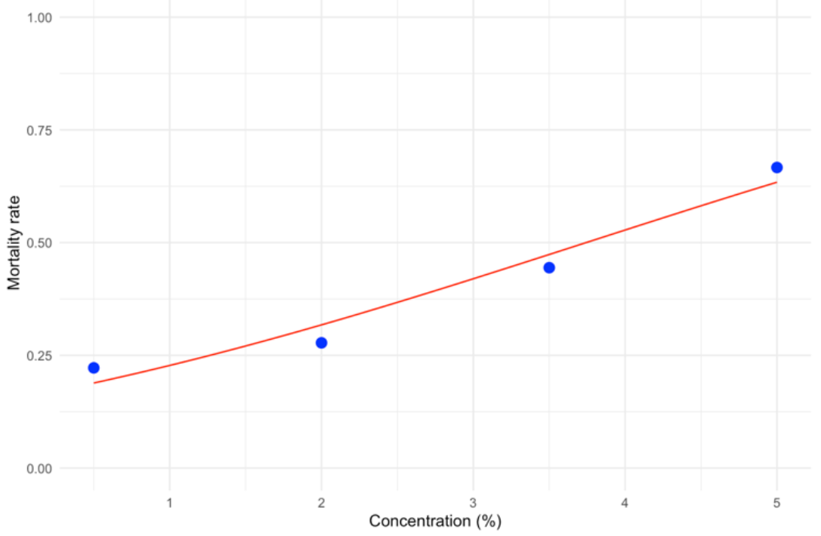
Combining biopesticides
Use of biopesticides is most similar to pharmacology where interactions between medical treatments are assessed
Step 1 – determine efficacy of individual biopesticides
Pyrethrum
Oleic acid

Slide 10
Combining biopesticides
Checkerboard approach tested multiple concentrations of each biopesticide applied as 67 treatment combinations!
Record difference between observed and expected mortality
Where expected mortality is based on efficacy of biopesticides used individually

Slide 11
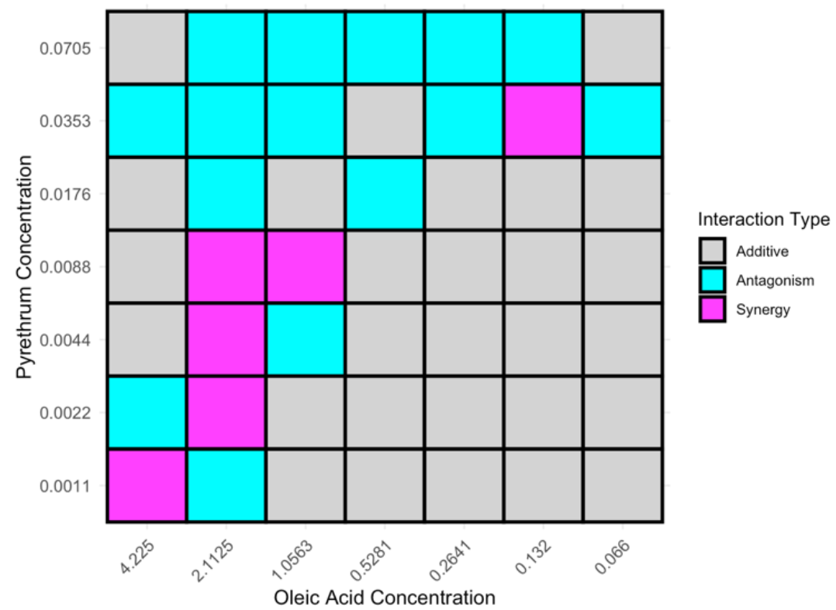
Combining biopesticides
Differences of observed and expected mortality with synergy and antagonism been deviations of > 0.1 or > -0.1, respectively.

Slide 12
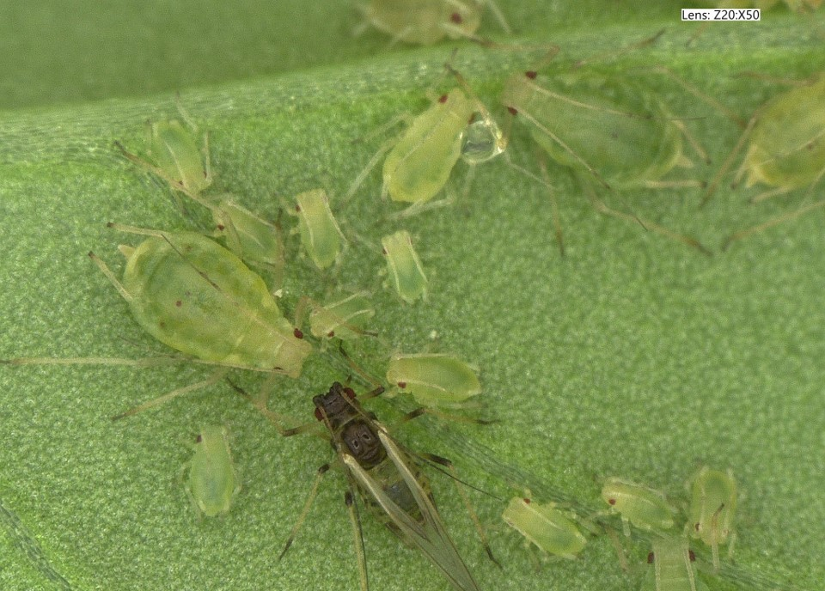
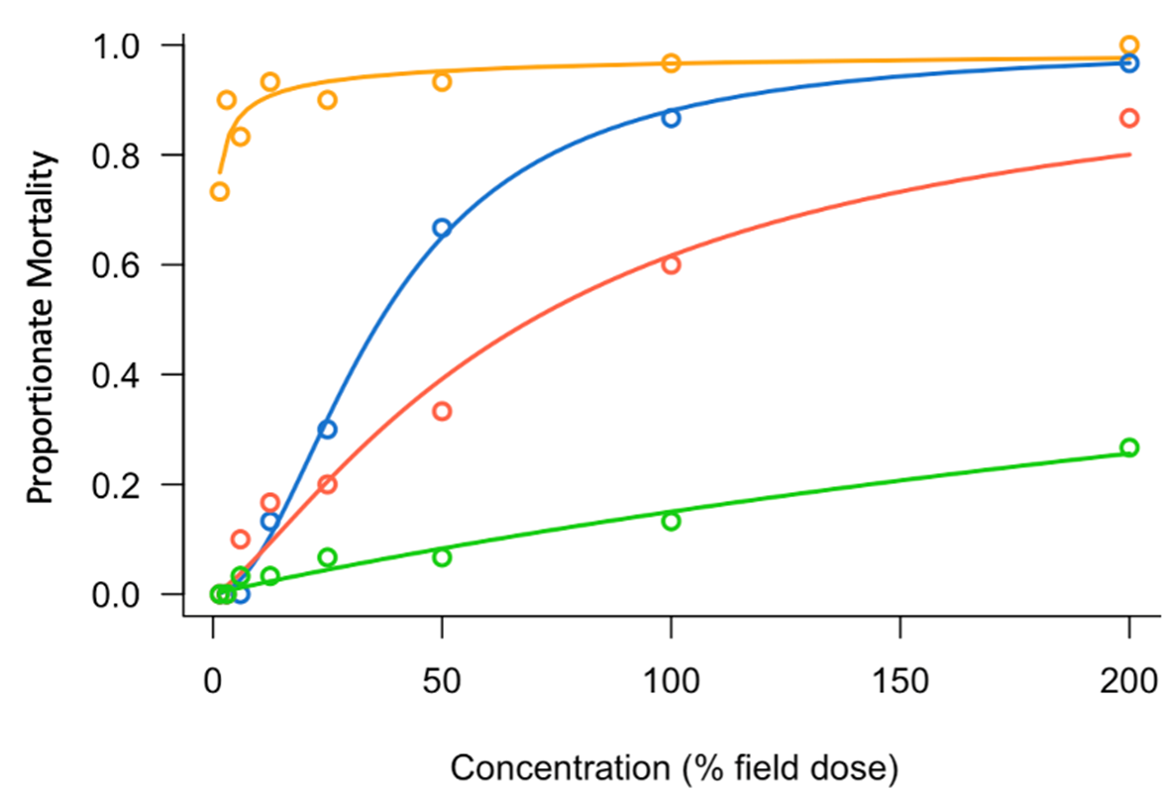
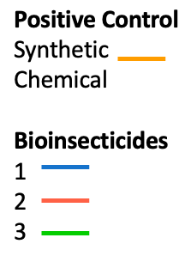
Frequency of application and concentration
Similar approach, first, record efficacy of different concentrations of a biopesticide applied as a single application:

Slide 13
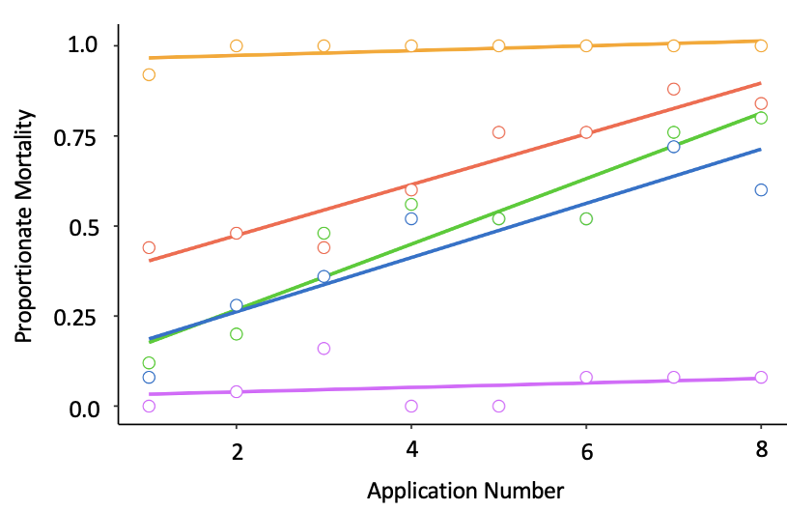
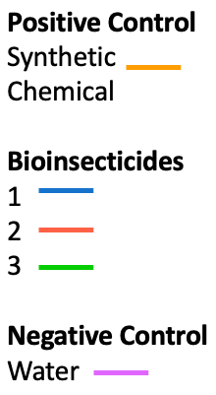
Frequency of application and concentration
Second, record efficacy of repeated applications of a single concentration of a biopesticide:

Slide 14
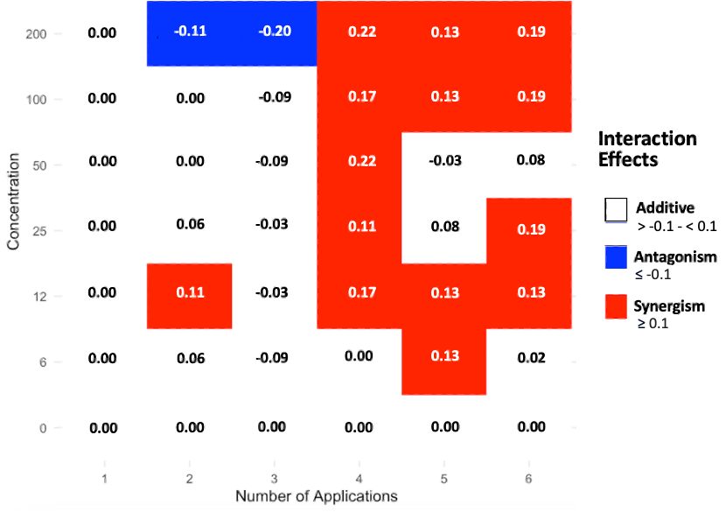
Frequency of application and concentration
Checkerboard approach where both concentration and application number is varied:

Slide 15
What about other aspects of IPM?
Checkerboard approach works best where we vary a frequency or concentration
Further modifications required to address other aspects of IPM e.g. variety selection, biological control, landscape effects, rotations
Can we test for synergy in a cost-effective way?
Is it enough to see synergy if we don’t understand the mechanism?

Slide 16
Conclusions
It is 52 years since the terms Integrated Pest Management and IPM were coined
Much progress has been made and effective IPM programmes developed
Science of IPM is practiced by many farmers and growers but studied by relatively few researchers
Identifying synergism and the mechanisms by which crop protection tools work and interact will unlock the full potential of IPM

Slide 17
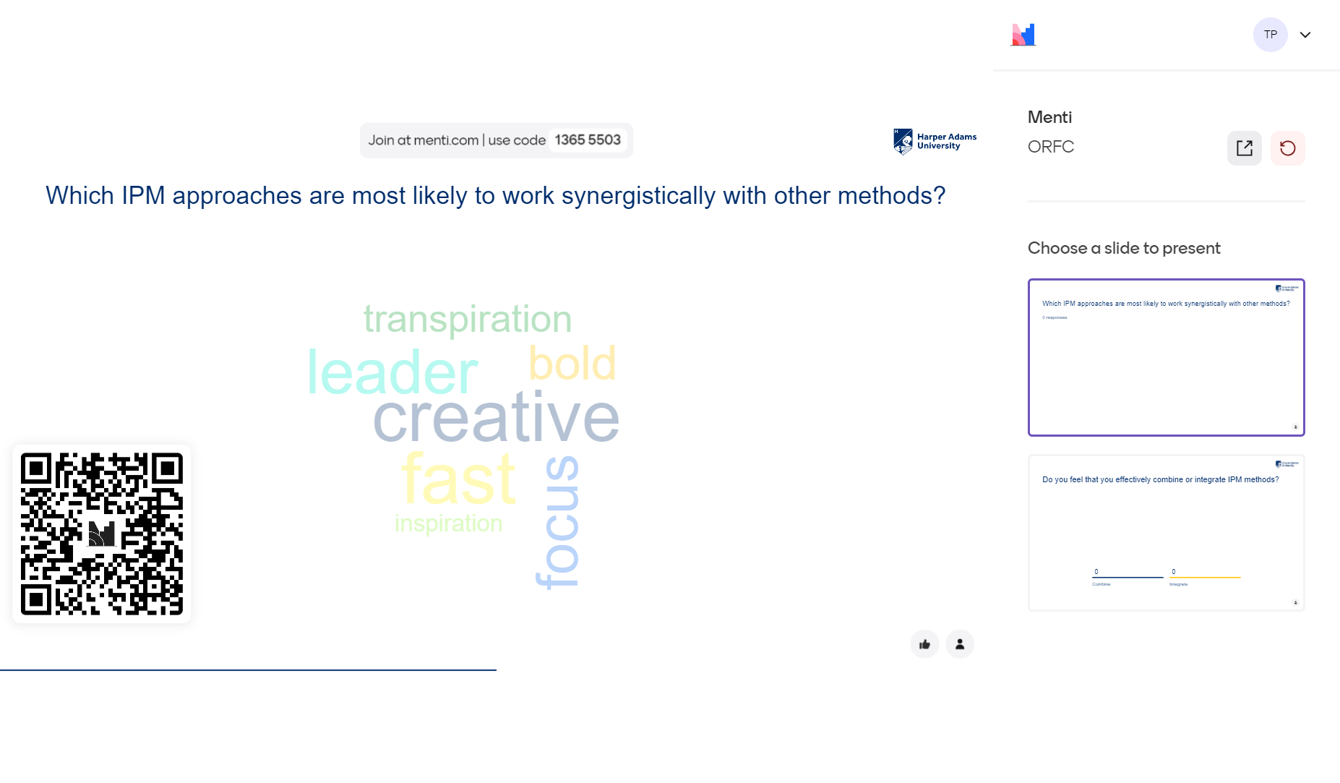

Slide 18

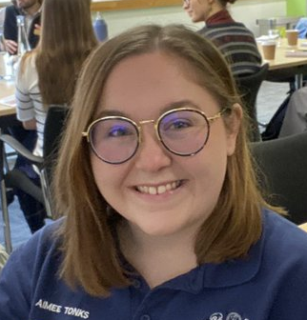



Acknowledgements
Dr Joe Roberts
Aimee Tonks
Elvis Veras Garcia

